Slide 1
Fund Balance
Discussion and Analysis
Notes:
Hello, I am Rebecca Clawson, the Finance Specialist for the Charter School Office at LSSU. I am going to be presenting a short summary of Fund Balance as part of a series of short videos produced for our Academy Boards. The PowerPoint presentation will be available on our website if you would like to view it or print and follow along. The website is: www.lssu.edu/charter

Slide 2
Introduction
Fund Balance Presentation in the Governmental Funds:
On the Income Statement - Fund Balance is comprised of the Excess (Deficiency) of Revenues Over Expenditures for the Fiscal Year combined with the Beginning Balance of Fund Balance
On the Balance Sheet – Fund Balance is presented below the Liabilities section
Required to be presented for each Governmental Fund used
Modified by GASB Pronouncement #54:
Implemented for periods ending after June 15, 2011
Changes classification of Fund Balance categories
Presented based on most restricted to least restricted
5 categories of Fund Balance
Notes:
Fund Balance in its most simple definition is the difference between Assets and Liabilities on the Balance sheet and is comprised of any existing Fund Balance at the beginning of the reporting period coupled with the net change in the Income Statement for the reporting period. Essentially it is what is leftover after the Fund’s Assets have been used to satisfy the Fund’s Liabilities.
Sometimes it is difficult to give a definitive answer as to how Fund Balance should be interpreted, because different users of the Financial Statements have different needs. For example a financial institution that is considering lending funds to an Academy will interpret Fund Balance differently than a parent at the School Board meeting.
Given these differences in interpretation, there are some fundamentals to consider when trying to analyze Fund Balance. One such fundamental is that Fund Balance is only reported in the Governmental Funds, not for any Proprietary Type funds or for the Academy as a whole.
The best way to envision Fund Balance is in terms of the Fund it is associated with; for example: a Special Revenue Fund exists to account for a specific revenue source and the use of those revenues, so the remainder after the liabilities have been satisfied would be a Fund Balance with certain limitations imposed upon it.
Since June 15 of 2011 the Governmental Accounting Standards Board has required implementation of GASB Pronouncement #54. This pronouncement reclassified Fund Balance designations from Reserved & Unreserved into 5 new categories. These new categories are presented on the Balance Sheet in a hierarchy from most to least restricted.
More on the individual types of classifications later in the presentation

Slide 3
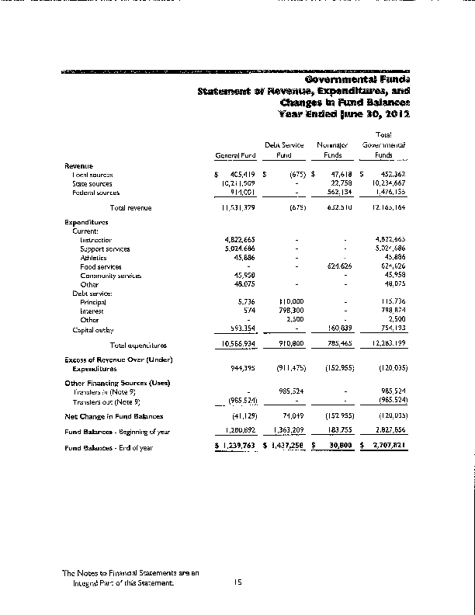
Income Statement – Fund Balance
Revenues – Expenditures = Change in Fund Balance
The “bottom line” for the Fiscal Year
The Change gets added to the Fund Balance at the Beginning of the Fiscal Year
The total will carry over to the Balance Sheet
Notes:
This is an example from an Annual Audit of a Combined Statement of Revenue, Expenditures and Changes in Fund Balance, also known as an Income Statement
It shows all the Revenues and Expenditures for each Governmental Fund that the Academy operates on one statement with a combined Governmental Total column
As I stated earlier, essentially Fund Balance is the residual amount left after the Fund’s Assets have been used to satisfy the Fund’s Liabilities, which is why the Net Change from this statement is added to the Beginning Fund Balance for the reporting period
In the example it is represented in the orange circled area
The Beginning Fund Balance for the period is shown below the Net Change, which is combined with the Beginning Fund Balance, that combined figure is what the ending Fund Balance for the reporting period would be
The Ending Fund Balance is carried over to the Balance Sheet for the reporting period

Slide 4
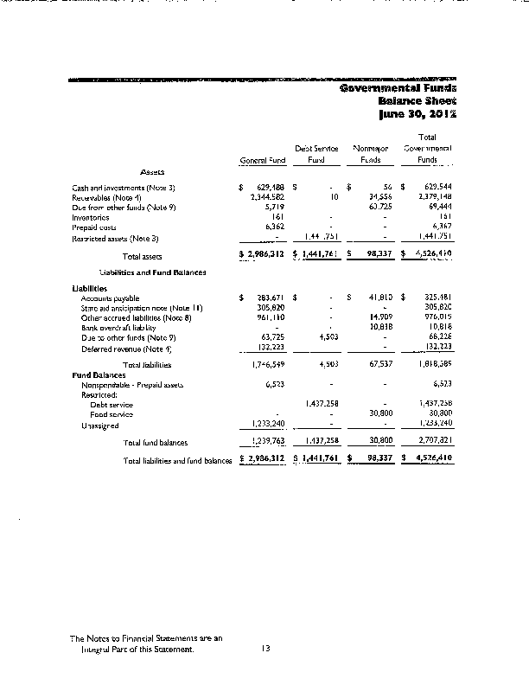
Balance Sheet – Fund Balance
Assets = Liabilities + Fund Balance
Total Fund Balance must match the Ending Fund Balance from the Income Statement
GASB 54 introduces 5 new categories of Fund Balance
Notes:
This is an example from an Annual Audit of the Combined Governmental Balance Sheets
It shows all the Assets, Liabilities and Fund Balances for each Governmental Fund that the Academy operates
Earlier I mentioned that Fund Balance is the difference between Assets and Liabilities, which is represented by the equation: Assets = Liabilities + Fund Balance
The Total Fund Balance for each Fund presented must match the Ending Fund Balance from the Statement of Revenues, Expenditures and Changes in Fund Balance
You can see Fund Balance is in the orange circled area in the example
Some of the new categories of Fund Balance introduced in GASB 54 are shown in the example
The next few slides will discuss each of the new designations of Fund Balance

Slide 5
5 Categories of Fund Balance
Non-Spendable
Restricted
Committed
Assigned
Unassigned
Similar to previous classification of “Reserved”
Similar to previous classifications of “Unreserved - Designated” and “Unreserved - Undesignated
Notes:
Prior to June 15, 2011 Fund Balance was designated into two types: Reserved and Unreserved, with Unreserved having two categories of: Designated & Undesignated
After June 15, 2011 GASB Pronouncement #54 requires 5 designations instead of just 2
These new designations are presented in descending order from most restricted to least restricted
The first 3 are: Non-Spendable, Restricted and Committed – they are most similar to the old classification of Reserved, these are the most restricted types of Fund Balance
The last 2: are Assigned and Unassigned – they are most similar to the previous classifications of Unreserved – Designated and Unreserved-Undesignated, these are the least restricted types of Fund Balance

Slide 6
Non-Spendable
Amounts that cannot be spent because:
  They are not in spendable form
  Legally or contractually required to remain intact
“Not in spendable form” means:
  Not expected to be converted into cash
    Example: Inventory or Prepaid Items
Notes:
Non-Spendable is the category of Fund Balance that is the most restricted because these amounts are not in spendable form meaning that they are not expected to be converted into cash – something like Inventory
Or that they are legally required to remain intact - like a corpus or the principal of a permanent fund for example

Slide 7
Restricted
Amounts constrained to being used for a specific purpose by:
  External parties
  Imposed by law through constitutional provisions or enabling legislation
    Example: Bonded Capital Projects, Debt Service Funds
Notes:
Restricted Fund Balance is segregated based on a specific purpose either: by external parties or imposed by law
The definition of Restricted Fund Balance is the same as the definition used in the GASB #34 for Restricted Net Assets
An example would be principal payment in a Debt Service Fund for a Bond indenture

Slide 8
Committed
Amounts segregated based on the School itself
  Pursuant to constraints imposed by formal action of the Government’s highest level of decision making
      The School Board passes a resolution
  Resolution to Commit a portion of Fund Balance must occur prior to Year End
Notes:
Committed Fund Balance are amounts designated for a specific purpose based on action of the Academy itself, in other words, formal action taken by the School Board such as a resolution
A resolution to designate resources as Committed Fund Balance must occur prior to the end of the Fiscal Year, however, the dollar amount may be decided upon at a later date
The same formal action is required to change the amount or remove the designation

Slide 9
Assigned
All remaining positive amounts in the Governmental Funds other than the General Fund
In the General Fund: amounts intended to be used for a specific purpose
  Intent is expressed by Governing body (School Board)
    Not the same as segregated by resolution = Committed
Notes:
For all governmental funds except the General Fund, Assigned Fund Balance is any residual amount not classified as Non-Spendable, Restricted or Committed
Assigned Fund Balance for any fund except the General Fund must be positive
For the General Fund Assigned Fund Balance is an amount that the Academy itself or an official of the Academy with the authority to assign amounts, has intended for a specific purpose
Intent is not the same a Commit because no formal resolution is required for intent
Any fund with Assigned Fund Balance cannot result in a Deficit Unassigned Fund Balance

Slide 10
Unassigned
The residual classification for the General Fund
  Anything that has not been classified as:
    Non-Spendable, Restricted, Committed or Assigned within the General Fund
The General Fund should be the only fund that reports positive Unassigned Fund Balance
  Deficit Fund Balance is always reported as Unassigned in the Governmental Funds
Notes:
The least restrictive Fund Balance designation is Unassigned
Within the General Fund Unassigned is a catchall for any amounts that are not already segregated for Non-Spendable, Restricted, Committed or Assigned
The General Fund should be the only fund with a positive Unassigned Fund Balance
Any other fund that reports an Unassigned Fund Balance would report it as a Deficit

Slide 11
Classifying Amounts as Fund Balance
Classification should represent the nature of the net resources in the Governmental Fund
A Government should have policies determining use of Restricted or Unrestricted funds:
  Policy determines if committed or Assigned funds have been spent when expenditure is incurred
  The Michigan School Business Officials organization recommends a School maintain a Fund Balance of 15% of General Fund expenditures
Disclosures in the Audited Financial Statements are required
Notes:
When it comes to deciding on the classification between the 5 different types of Fund Balance it is usually safe to assume the classification should represent the nature of the designation
For example: in a Debt Service Fund the payment of principal on an outstanding bond would need to be segregated based on the fact that there are resources that would need to be used to satisfy the payment, so a Restricted Fund Balance would be appropriate for that transaction
Not all Academy Governmental Funds will have every type of Fund Balance designation
Each Academy should review their policy regarding which type of funds are used first
If no policy has been adopted then the default usage would begin with Committed, then Assigned and then Unassigned Fund Balance
One of the most common questions regarding Fund Balance that I have had is “How much should we have?” This is a great question but there are so many different answers. The short answer is to make sure that in the event there was a loss of revenue, there should be enough to meet the liabilities of the Academy until another funding source can be obtained. Another really good resource I found is from the Michigan School Business Officials, who recommend that Schools maintain a Fund Balance of 15% of the General Fund expenditures. Also, try to remember it takes time to build up a Fund Balance, and a new School may not have such a large Fund Balance but over time could accumulate a comfortable amount. A School can also consult with their external Auditor to obtain a recommendation, and perhaps adopt a policy regarding a minimum Fund Balance
Certain disclosures are required in the Notes of the Audited Financial Statements of each Academy, such as the policy regarding expenditures as Committed, Assigned or Unassigned, a minimum Fund Balance requirement and a description of the Authority required to designate amounts for Committed Fund Balance. Your external Auditor will be able to assist with the required Note Disclosures

Slide 12
Example of Fund Balance Classifications
 |  | Food | Capital
 | General | Service | Projects
Fund Balances: | Fund | Fund | Fund | Total
Non Spendable | 20,144 | - | - | 20,144
Restricted - Capital Project | - | - | 100,000 | 100,000
Committed | - | 5,028 | - | 5,028
Assigned | 16,872 | - | - | 16,872
Unassigned | 1,046,570 | - | - | 1,046,570
Total Fund Balances: | 1,083,586 | 5,028 | 100,000 | 1,188,614
Notes:
This is an example of what the different types of Fund Balances in the Governmental Funds may look like
Note the descending order from most to least restricted beginning with Non-Spendable and ending with Unassigned
Again, not all Governmental Funds will have all 5 types of Fund Balances

Slide 13
Resources
www.GASB.org
Michigan Public School Accounting Manual
  Can be found electronically on the State of Michigan’s Department of Education website
External Auditors
Rebecca Clawson, CPA – Charter School Finance Specialist at LSSU
  (906) 635-2279 or rclawson@lssu.edu
Notes:
There are so many great resources available including the Governmental Accounting Standards Board (GASB.org), the Michigan Public School Accounting Manual and your External Auditors. These are all excellent sources of information. I can’t recommend your external auditors enough as a very helpful source of knowledge and experience
If you don’t understand something or need some clarification on a subject please contact me directly at 906-635-2279 or my email rclawson@lssu.edu, I would be happy to provide any assistance I can. Thanks for your participation and have a great day!

