Slide 1

INDUSTRIAL ADVISORY BOARD
November 5, 2010 | University Center - Gaylord
School of Engineering & Technology

Slide 2
Today’s Agenda
8:30-9 am Welcome!
9-9:10 am Meeting called to order
9:10-9:20 am Action Item Review/Minutes Approval
9:20-9:45 am Chair’s Report: Fred Berg
9:45-10:30 am Recruitment Subcommittee Report:
Chris Conklin
10:30-10:45 am Break
10:45-Noon School/PDC Updates: Ron DeLap
Noon-1 pm Lunch /Tour of Facility
1-1:30 pm Program Updates: Ron DeLap
1:30-2 pm Senior Projects: Ron DeLap
2 pm Closing Remarks
Next meeting: April 29 at LSSU Sault Ste. Marie Campus

Slide 3
Chair’s Report
State of the industry
  Auto Industry production is starting to pick-up
  Schedules are being revised, 2010 third and fourth Quarters are positive
  Opel,GM, looking at increase Engineering personnel, 300 Electrical Engineers
  Nexteer, reports to hire over 100 Engineers
  Recent report in Electronic Design: (October 2010)
    2010 Design Engineering Salary Survey: How Much Financial Bounce in the rebound?
      2500 engineers representing a cross-section of industries, job functions, and company sizes.
      Employers are being tightfisted with base salaries for engineers, because they believe they can be. Like housing, engineering is a buyer’s market.
      It’s also important to note that engineering is still a well-paying profession. Across the U.S., survey respondents report an average total compensation in 2010 of $103,680—a slight increase over last year’s $102,443, but still below the 2008 average of $106,271.
      Engineers had better be at least somewhat happy about their work, since they now put in an average of more than 55 hours a week on the job.

Slide 4
Chair’s Report
State of the industry
  Recent report in Electronic Design:
  an overwhelming 84% of engineers are bullish on engineering as a career path for young people to pursue. For the right young person, engineering can be a great profession. The puzzles and challenges bring forward fresh thinking on a daily basis.
  One of the reasons engineers remain enthusiastic about their profession is the satisfaction they get from the challenge of designing and delivering new products that can benefit society. More than half of those surveyed (58%) still find themselves sufficiently challenged intellectually by the projects they work on.
  nearly a third of those responding this year said their company plans to increase the number of engineering jobs next year.
  The majority of OEMs (55%) continue to engage in outsourcing. The type of engineering work being contracted out includes manufacturing and assembly (57%), design (50%), software development (49%), and R&D (26%).

Slide 5
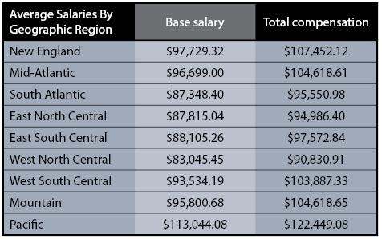
Chair’s Report
State of the industry
  Recent report in Electronic Design:

Slide 6
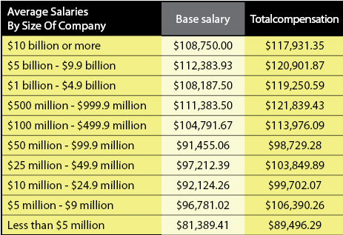
Chair’s Report
State of the industry
  Recent report in Electronic Design:

Slide 7
IAB Role Statement
The Industrial Advisory Board (IAB) is comprised of professional men and women in engineering positions who actively participate in the development of and the promotion of Lake Superior State University engineering and engineer technology programs, faculty members and students.
IAB members guide, nurture and assure that the School of Engineering and Mathematics produces engineers with skills that will not only fulfill today’s industrial needs, but will foresee the requirements of tomorrow in a global economy. IAB members provide “real time” interface with both faculty members and students bringing today’s industrial technology to LSSU “today”.
IAB members are expected to:
Evaluate and critique engineering programs by providing professional experience and direction.
Be able to provide technical support such as, teaching materials, information on equipment, donate equipment, funding.
Promote LSSU engineering curriculum to young people by participating in regional recruitment seminars and invite students for industrial tours.
Attend IAB meeting.
Support the senior project program with ideas or equipment and/or materials.
Encourage professional development of the faculty by providing summer employment and sponsoring sabbaticals.
Provide assistance with job placement for students both full-time and summer internships.
Participate on subcommittees.
Vote during IAB meetings on issues relative to the Role Statement.

Slide 8
Chair Election Spring 2011
Nomination Process:
Any existing IAB members are eligible
Self nominations are acceptable
If you are nominating another member please be sure that they are willing to participate
All nominations will be accepted and presented at the spring IAB meeting
Any Questions you can contact the existing IAB offices.
The Nominations Are:
_________________
_________________
_________________

Slide 9
Officer Responsibilities & Term Limits

Slide 10
Chairman’s Responsibilities & Term Limits
It is the Chairman’s responsibility to oversee all of the activities of the IAB including
coordinating committees.
As the need arises, the Chairman shall appoint committee chairpersons.
The Chairman is an ex-officio member of all committees and is eventually responsible for the completion of all committee business. He/She shall keep in touch with all committee chairs, facilitate the completion of their task, and if necessary, remove inactive committee chairs/members and appoint successors.
The Chairman is directly responsible for the IAB meetings.
Meeting Responsibilities include:
Establish meeting dates, locations and times (coordinate with Dean of Engineering)
Arrange meeting facility
Finalizing meeting agendas
Presiding over meeting

Slide 11
Recruitment Committee
Report
Chris Conklin

Slide 12
Fall 2010 MACRAO Events
November 5, 2010 LSSU IAB Meeting
11/5/2010
LSSU IAB 11-05-2010 Meeting
12

Slide 13
Over the Summer
11/5/2010
LSSU IAB 11-05-2010 Meeting
13
MACRAO calendar updated.
Recruiting/Press Kit Updated for MACRAO Events by Jeanne Shibley.
Recruiting information sent to the IAB MACRAO volunteers by Jeanne Shibley.
Many THANKS to Jeanne for her support in this effort.

Slide 14
IAB MACRAO Participation
11/5/2010
LSSU IAB 11-052010 Meeting
14
LSSU Admissions office and the IAB are working very well together.
We participated in and supported the 2010 Fall MACRAO events.

Slide 15
IAB MACRAO Participants
Fall 2010
11/5/2010
LSSU IAB 11-05-2010 Meeting
15
Bob Andersen
George Bielis (Chicago area)
Fred Berg
Nathan Callaghan
Chris Conklin
Jim Gibbs
Ralph Larsen
Don Stephanic

Slide 16
Highlights
11/5/2010
LSSU IAB 11-05-2010 Meeting
16
MACRAO events continue to be well organized and many students are now being bussed to these events by their schools.
MACRAO events remain regionally focused.
Highlight Sheets are a popular handout.
Summer Camps are a high interest area.
Rubik’s Cube Robot video is a popular eye-catcher.

Slide 17
Lowlights
MACRAO events not as well attended as in the past.
Less interest in the Recruiting/Press Kit.
Meeting fewer potential Engineering and Technology students at MACRAO events.
LSSU is still a major unknown in the field of engineering and technology.
11/5/2010
LSSU IAB 11-05-2010 Meeting
17

Slide 18
Thoughts/Sharing
11/5/2010
LSSU IAB 11-05-2010 Meeting
18
Less interest in the Recruiting/Press Kit this year. Need a different format or different approach?
Are MACRAO events the best use of our time in attracting engineering and technology students to LSSU?
Article in Detroit News on Monday, October 24th produced a bit of concern. LSSU is rated lowest in the state with respect to graduation rates. See table in next slide…

Slide 19
Michigan Graduation Rates
…from the Detroit News, October 24, 2010
Institution | Enroll | Ave GPA | Ave ACT | Retention Rate | Grad Rate
LSSU | 2,644 | 3.18 | 21.6 | 69% | 26%
Wayne State University | 31,505 | 3.19 | 20.4 | 76% | 32%
Saginaw Valley State University | 10,656 | 3.2 | 21.5 | 71% | 38%
Eastern Michigan University | 23,503 | 2.96 | 20.44 | 72% | 40%
Oakland University | 19,053 | 3.3 | 22.4 | 74% | 41%
Ferris State University | 14,381 | 3.21 | 21.1 | 68% | 44%
UofM Flint | 8,138 | 3.23 | 22.07 | 72% | 45%
Northern Michigan University | 9,273 | 3.12 | 22.9 | 73% | 46%
UofM Dearborn | 8,885 | 3.54 | 24.15 | 78% | 49%
11/5/2010
LSSU IAB 11-05-2010 Meeting
19

Slide 20
…in closing
11/5/2010
LSSU IAB 11-05-2010 Meeting
9
We all enjoy supporting these events, it is a rewarding experience to be able to provide information that may be used in a student’s decision making process for their educational and career choices.
The Spring 2011 MACRAO events are coming up after the beginning of the new year, I will again post an email soliciting your support.

Slide 21
THANK YOU
11/5/2010
LSSU IAB 11-05-2010 Meeting
21
A special THANK YOU to all of the IAB membership that supported the Fall 2010 MACRAO events. Your support is greatly appreciated and I hope that we can continue to support future events.
IAB participation in MACRAO events is a very UNIQUE and POSITIVE INFLUENCE on student choice.

Slide 22
Take a Break!

Slide 23
Lake Superior State University Updates
Dr Ron DeLap
Dean, College of Engineering, Technology and Economic Development

Slide 24
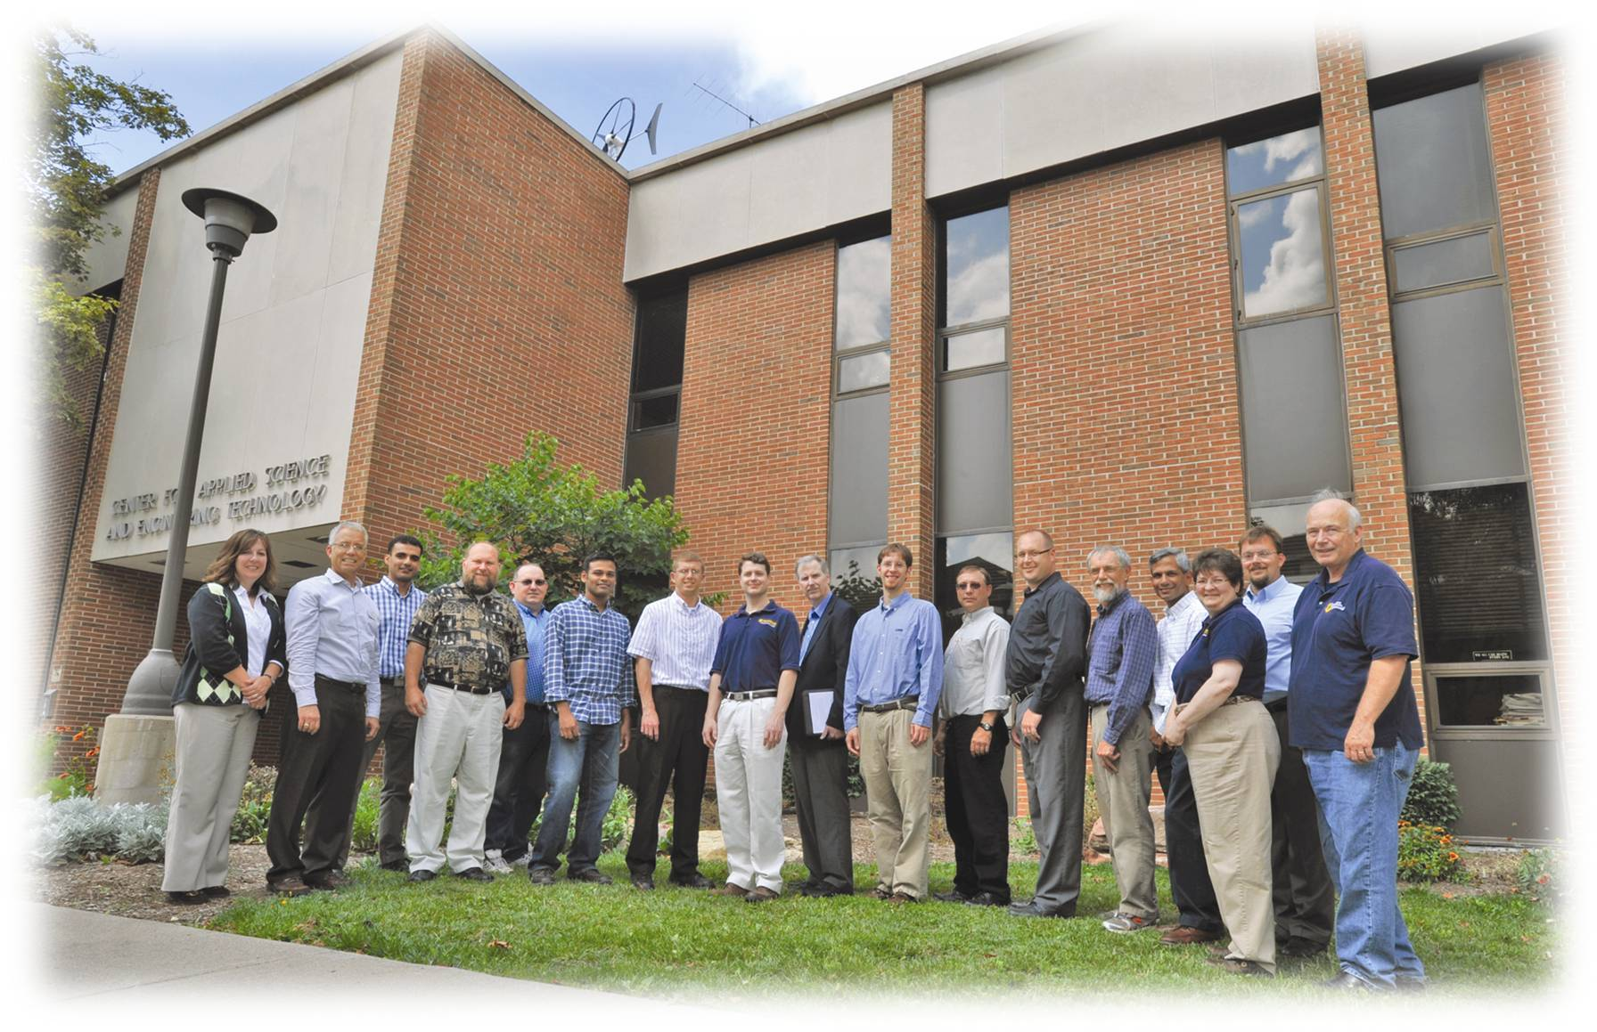
School/PDC Updates
10:45-Noon

Slide 25
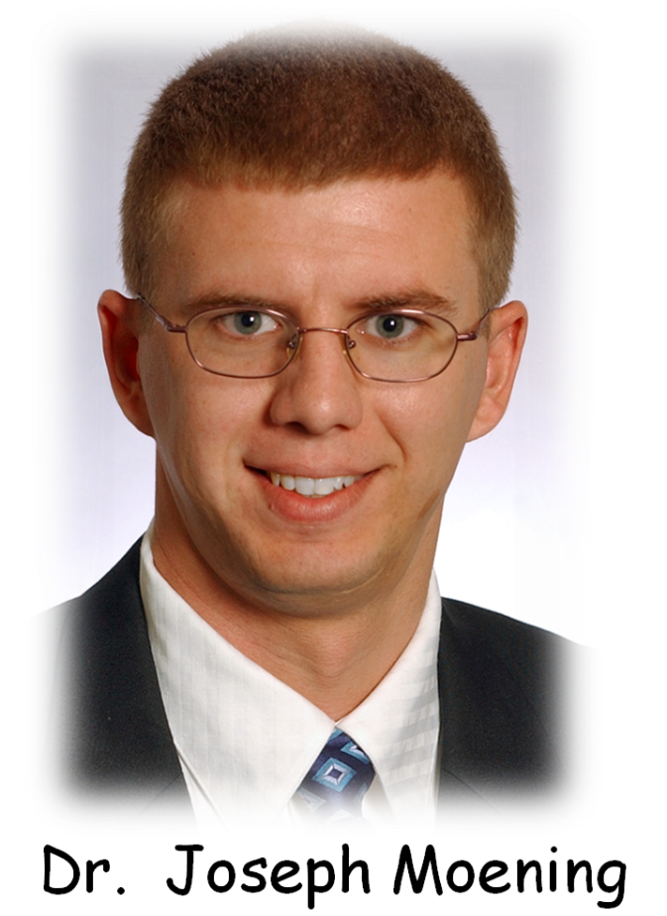
School of Engineering & Technology
Hired: Joseph P. (Joe) Moening
Ph.D. – University of Cincinnati “the Rockets!”
Dissertation was related to solar cells
Familiar with the U.P.
Fits in well with our “family”

Slide 26
School of Engineering & Technology
Enrollment numbers – UP.
Enrollment distribution – spreading
Significant gains in Grand Rapids
Significant gains in out of state recruitment
Trends are all looking positive for Engineering
Freshmen students are initially VERY PLEASED with the Lake State experience
63 of 65 “Very sure” they made the right choice.

Slide 27
Enrollment
Fall 2005: 240 Students
Fall 2006: 194 Students
Fall 2007: 176 Students
Fall 2008: 175 Students
Fall 2009: 172 Students
Fall 2010: 185 Students
  Highest in four years and reverses > 5 year slide
  Freshmen enrollment highest in > 6 years

Slide 28
Enrollment By The Numbers
Fresh*
Soph
Junior
Senior*
Total
2007
42
29
36
70
177
2008
47
26
23
79
175
2009
34
38
23
76
171
2010
64
34
31
56
185
* Includes 5 and 6 year seniors, and transfers
What does this mean?
Maybe a lot!
Maybe not much!
Notes:
28
2007 Freshman class was

Slide 29
School of Engineering & Technology
Plans of your new Dean:
Recruiting, Recruiting, Recruiting!!!
Alternative Energy Minor
Co-op’s and Internships
Fundraising
Business/Engineering Partnerships – Challenge!
Two KEY GOALS!
Keep our freshmen happy, and challenged (retain our gains).
Graduate seniors that are well prepared, and happy, on time (our future recruiters).

Slide 30
School of Engineering & Technology
Plans of your new Dean:
Recruiting, Recruiting, Recruiting!!!!
Continue working hard to recruit and retain quality students
Your Dean has been on the road significantly this term!
Midland
Mt. Pleasant
Grand Rapids
Kalamazoo
Alpena
Cheboygan
Gaylord
Plans: Evaluate current methods
Keep what’s best, lose the rest
Pursue new recruiting methods
Targeted recruiting
Student input
Constant Contact
Be relevant, be personal

Slide 31
School of Engineering & Technology
Plans of your new Dean:
Re-evaluate our areas of emphasis
3 areas is about right for our school size.
Currently: Robotics, Digital, Automotive, General.
Considering: Add Power, put Automotive on hold.
20MW Solar recently added in Sault, Canada
25MW from Hydro
~200MW from Wind in Sault, Canada (126 Turbines)

Slide 32
School of Engineering & Technology
Plans of your new Dean:
Increase number of students in Co-op and
Intern positions
    Not much done here yet
    Looking for companies to partner with

Slide 33
School of Engineering & Technology
Plans of your new Dean:
Increase Fundraising Efforts
    Targeted calling campaigns possible
    Looking to develop middle to large donor contributions
    Will be attending multiple training sessions on how to pursue
    First opportunity……..

Slide 34
School of Engineering & Technology
Plans of your new Dean:
Open a new center for entrepreneurship
    Interdisciplinary, with Business School
    Encourage actual creation of student businesses
    Space identified, pursuing funding ($50-60K needed)
    Planting seeds with students now - two entrepreneurial competitions
    Business Challenge Grant Matching
    Looking to develop sources for matching funds

Slide 35
School of Engineering & Technology
Some Troubling Developments:
Capital plans from Lansing
Publication of 6 year graduation trends in Free Press, Tribune
Personal conversations with others

Slide 36
School of Engineering & Technology
Governor Snyder’s White Paper on Education Savings
The state needs to reverse recent trends of under-investing in colleges, universities and community colleges. Michigan spent decades building a world-class system of higher education. The system is arguably the most important asset the state has to help develop the concentration of talent Michigan needs to be successful in the knowledge-based economy. Michigan’s research universities are among the few enterprises in the state that attract talent – students, faculty, and researchers – from around the world. Significant opportunities exist in emerging fields like life-sciences research, bio medicine, information technology, and renewable energy. The state needs to create the business-friendly environment, offer the quality of life, and provide the talent pipeline to sustain and expand these industries and others as Michigan rebuilds.

Slide 37
School of Engineering & Technology
Governor Snyder’s White Paper on Education Savings
Higher Education – Continued recruitment of highly talented students and faculty, concentrated research and development, and an efficient system to transfer technology from the classroom to industry will serve as a critical conduit to sustaining Michigan’s new economic model. There must also be increased coordination between community colleges and universities to facilitate course credit transfers, opportunity learning, private sector collaboration, and early course offerings for high school students.

Slide 38
School of Engineering & Technology
Governor Snyder’s White Paper on Education Savings
Proposals Potential Annual Savings
Budgeting
Value For Money Budgeting TBD
Services
Require Competitive Bidding for
Non-instructional services in Public Schools $200 - $500 million
Intensified School Consolidation and Service Sharing $300 million
Personnel
Tightened Pension Eligibility & 401k Style Retirement Plans $87 million
Pooling of School District Healthcare Costs $156 - $223 million
Total Potential Savings $743 - $1.11 Billion

Slide 39
Michigan business executives call for universities to share services
Published: Sunday, August 22, 2010.
The Saginaw News
An influential group of Michigan executives — a group that includes Dow Chemical Co. Chief Financial Officer William H. Weideman and Dow Corning Corp. Executive J. Donald Sheets — wants Michigan to become a “Top Ten” state for job and economic growth.
To do so, the Detroit-based Business Leaders for Michigan is calling for a change in the state’s approach to higher education to help achieve that goal.
They say the state’s higher education system is inefficient and costly. If the state’s 15 public universities and 28 community colleges are going to remain separate, and not adopt a one-system approach as Ohio recently has done, then they need to work more closely together to lighten the burden on taxpayers.

Slide 40
School of Engineering & Technology
What the IAB can do to help the Engineering Program:
Identify and lobby people of influence in Lansing
Continue to aggressively recruit potential students
$upport the Product Development Center
$upport our scholarship programs and our Entrepreneurial Center
Support Senior Projects
Hire and promote our graduates
Know what is special about our engineering program! Visit our web site.
We Are Unique, and We Produce GREAT Engineers.

Slide 41
Lunch & Facility Tour
Noon – 1:00 p.m.

Slide 42
Program Updates
1-1:30
New/ Existing Course Updates,
ABET Visit from October

Slide 43
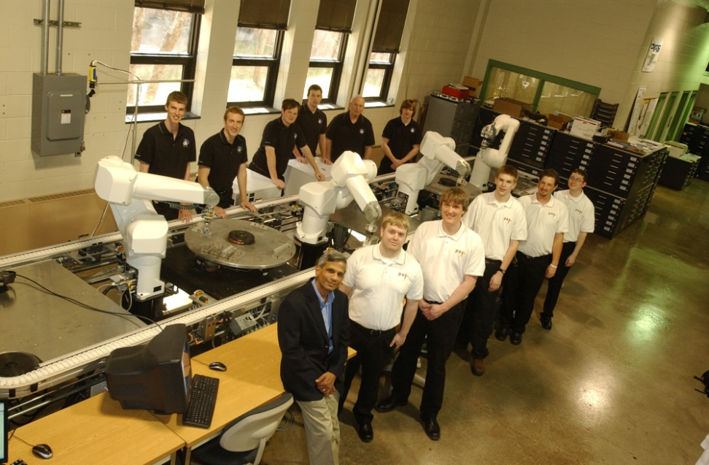
LSSU Robotics Center
100% Placement of Robotics Option 2009-2010 Graduates
Senior Project Robotics Lab Upgrade Valued at $750,000 (with ~$40,000 LSSU Investment)

Slide 44
LSSU Robotics Center
Summer Camps
Highest # of Sessions Offered in 2010
  2 Women in Technology Programs
  4 Robotics Camps
  1 ATA Robotics Camp
Many Compliments from Parents and Participants

Slide 45
What’s new in… Electrical Engineering
and
Electrical Engineering Technology?
● EET minor
● EGEE280
Notes:
45

Slide 46
Electrical and Computer Engineering
─ EET Minor ─
EGEE-125 Digital Fundamentals (3,2)
EGET-110 Applied Electricity (3,2)
EGET-175 Applied Electronics (3,2)
EGET-310 Elect Manuf Processes (3,3)
EGNR-140 Lin Alg and Num Meth (1,3)
MATH-131 College Trigonometry (3,0)

Slide 47
Electrical and Computer Engineering
─ EGEE 280 ─
Intro to Signal Processing
  Purpose?
  Level?
  Practical Considerations

Slide 48
What’s new in… Mechanical Engineering
and
Manufacturing Engineering Tech?
● ABET visit for MfgET program
● Curricula
● Clubs: ASME, SAE
Notes:
48

Slide 49
● ABET visit for MfgET program
▫ Will definitely reaccredit – no interim visit likely
▫ No major findings (“weaknesses” or “deficiencies”) – only a few lower-level findings (“concerns”): ○ some older equipment & texts, ○ continuous improvement practices (not convincingly demonstrated)
▫ One finding contested by us
○ the continuous improvement concern ○ we were able to document this very well in our written “due process” response
▫ Positive Verbal Feedback that…
○ PDC impressive ○ senior projects impressive & ambitious ○ atmosphere student-centered
Notes:
49

Slide 50
● Curricula
▫ CNC course updated
○ Now for MEs as well as Manufacturing
(an elective for MEs, required for MfgET)
○ New emphasis on simulation before cutting
○ Reduce by 1-credit (4 to 3) – but more lab time!
▫ Quality Control course updated
○ Now for MEs as well as Manufacturing
(an elective for MEs, required for MfgET)
○ Also has a distance-ed audience
(Engineering Mgmt students in Escanaba)
○ Emphasis on Statistical Process Control
○ Reduce by 1-credit (4 to 3)
Notes:
50

Slide 51
● Clubs
▫ ASME
○ Planning to participate in regional competition
– collecting energy from rainwater
○ Dr. Janjua advising
▫ SAE
○ Attended mini-Baja competition in Menominee, WI in October – middle of the pack performance – 2 vehicles in the race
○ Plans to attend February competition in Houghton
○ Prof. Duesing advising
Notes:
51

Slide 52
Senior Projects
Dr. Ron DeLap
1:30 – 2 p.m.

Slide 53
Senior Projects
Last Year’s Results
This Year’s Projects, IAB Projects

Slide 54


Senior Projects
Last Year’s Results
Teams AIR and PAS
The purpose of this project was to design and implement a robotic flow line to replace the existing L-line located in room 125 of the CASET building at Lake Superior State University.
The sponsor of this project was LSSU

Slide 55

Senior Projects
Last Year’s Results
Team FIRE
The purpose of this project was to examine, improve, and test the scale prototype coupler developed by the 2008-2009 senior projects team ICE for “O” scale model railroads.
The sponsor of this project was LSSU.

Slide 56
Senior Projects
Last Year’s Results
Team DRIVE
The purpose of this project was to design and develop a coupling device for use in noise, vibrations and harshness testing of drivetrains between a dynamometer motor and vehicle driveline.
The project was sponsored by American Axle and Manufacturing (AAM).

Slide 57

Senior Projects
Last Year’s Results
Team II
The purpose of this project was to design and build a fully automated work cell for two Rofin laser etching machines.
The project was sponsored by Precision Edge, which coordinated design requirements and specifications.

Slide 58

Senior Projects
Last Year’s Results
Team MTD
The purpose of this project was to improve the prototype design of a past senior project, and to build 3 prototypes of the newly designed system.
The project was sponsored by Dr. Chandran, who is affiliated with the Cardiovascular Research Institute of New Mexico.

Slide 59
PREVIOUS YEAR’S PROJECTS
Grading

Slide 60
CURRENT PROJECTS
2010-11 Senior Year Projects
Industry Sponsored Projects (4)
Vermilion Foundation Sponsored Project (1)
THIS YEAR’S GOAL:
  Graded Final Presentations by First Week in April.

Slide 61

Customer: 3M
Faculty Advisor: Dr. Paul Weber
Goal: Implement a solar power system
using proprietary 3M materials
Budget: ~ $12K
Outcome: Classified

Slide 62
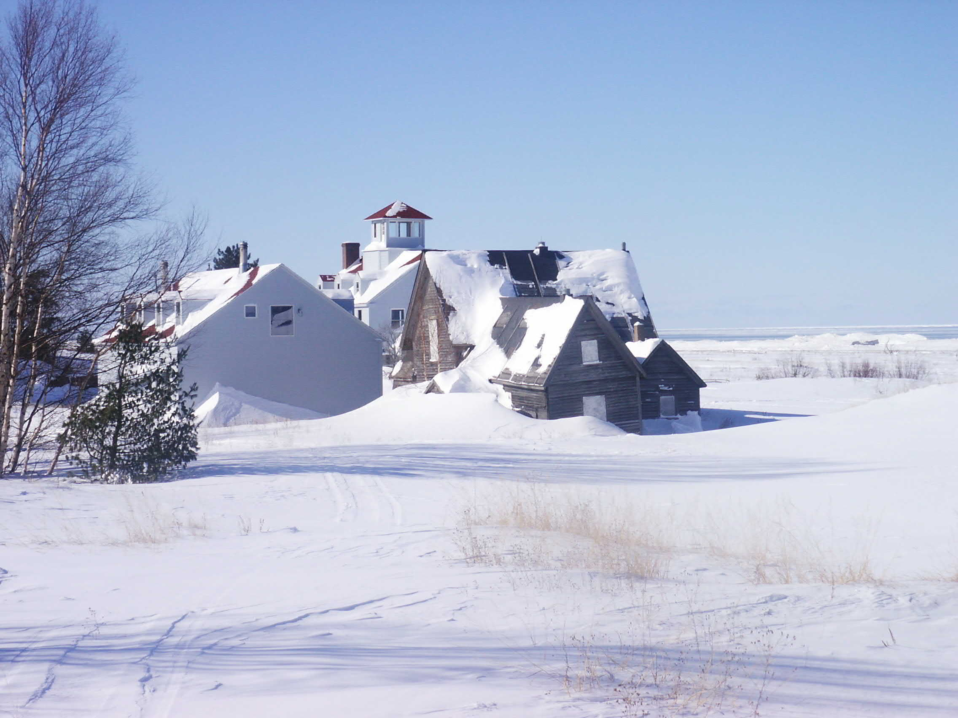


Vermilion Innovation Providers of Energy Research Solutions
Goals:
Install weather station
Establish communication link
Research energy sustainability for site
Propose future plan of action
Present research at conference
Members:
Eric Hoxie (EE)
Jameson Mattice (EE)
Brad Ekin (EE)
Ben Martin (ME)
John Preczewski (EE)
Budget: $6000
Faculty Advisor: Dr. Andrew Jones
Industrial Customer: Mr. Charles Dawley

Slide 63
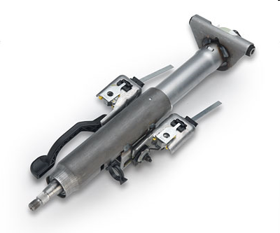
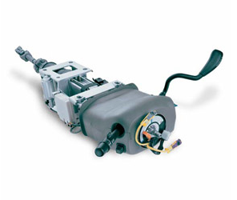
Team Steering Innovations
OneTouch
Steering Column
(Our Project)
Manual lever
operated column
Power operated
(pushbutton) column
Customer: Nexteer Automotive
Industrial Customer: Fred Berg
Faculty Advisor: David McDonald
Goal: Optimize Nexteer’s Prototype
Budget: $10K
Outcome: Functioning Prototype in Buick LeSabre
Thanks Fred!

Slide 64



Team Robotic Simulation Services
Sponsor: EOS
The team is assigned a task to create a set of fully functional virtual demonstrations for EOS that can be used to exhibit the Virtual Commissioning Solutions of Dassault and Siemens to potential customers.
EOS has provided the required software and hardware to the team to successfully complete the project.
Notes:
-Say Hi
-Welcome Faculty
-Thank Professor Devaprasad
-Special thank you to Brent and JP
64

Slide 65

Team ProtoTech
Customer: LSSU Prototype Development Center
Members: 2 MfgET, 1 ME, 1 EE
Advisor: Dr. Hildebrand
Team Prototech serves as an adjunct to LSSU's Product Development Center, tasked with the design, prototyping, testing, and optimization of new products proposed by industry and entrepreneurs. It will complete a series of new product development projects during the academic year, beginning with an innovative instrumentation project with applications in veterinary medicine (now largely complete) and following that with a hand-held power tool application.
Notes:
65

Slide 66
REQUEST FOR IAB FEEDBACK
Final Presentations
Held same day as Spring IAB Meeting
(April 29, 2011)
IAB Feedback on the quality of the projects
IAB Feedback valued by SPFB & ABET
Please Consider and submit projects
for 2011-12

Slide 67

2010 Fall IAB Meeting
Notes:
67

Slide 68
Topics
Stats
Skate Fenders – Frank McClelland
Marble Arms

Slide 69
Product Development Center
  November 2007 Activities Started
  Web Based Tracking System In Place
  Over 240 clients
  97 Project Numbers
  Over 48 Projects Completed
  At Least 11 Active Projects
  5 Proposals Awaiting Reply
  Over 7950 Student Hours

Slide 70
Skate Fenders
Frank McClelland

Slide 71
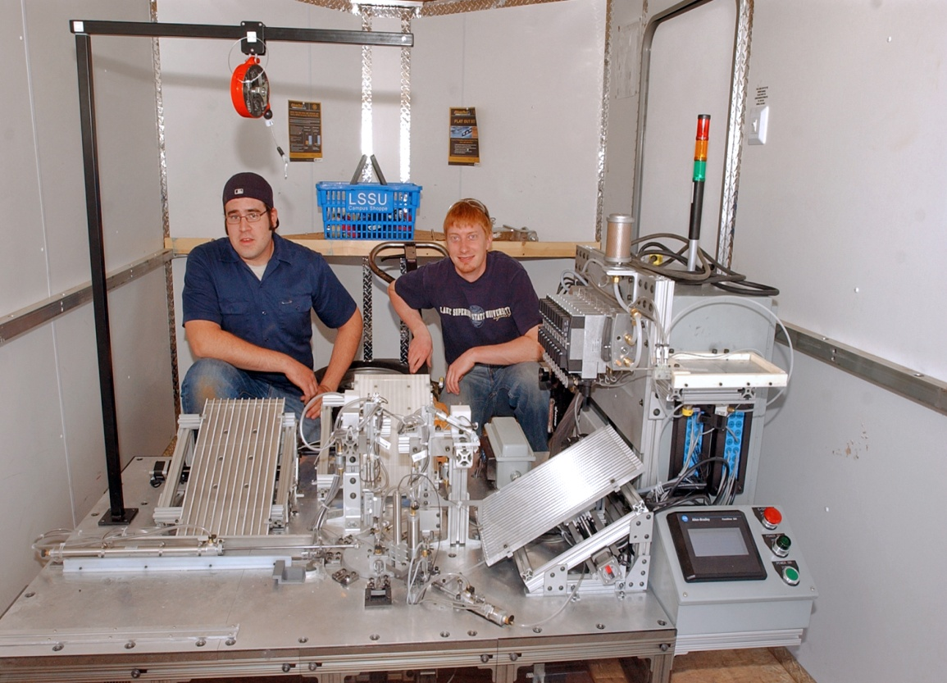
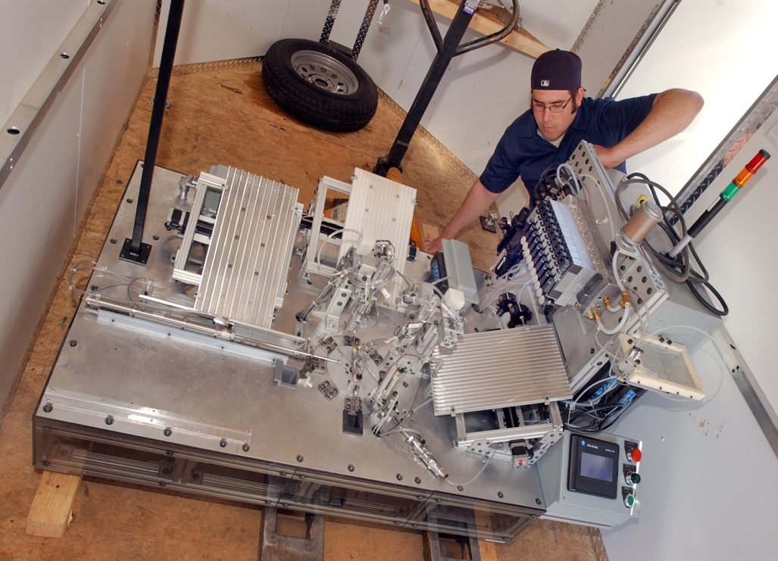
Marble
Arms
MIIE/MUCI Grant
Local Funding (Gladstone)
Additional Projects

Slide 72
? ? QUESTIONS ? ?

Slide 73
Concluding thoughts……
Jim Collins, “Good to Great”

Slide 75
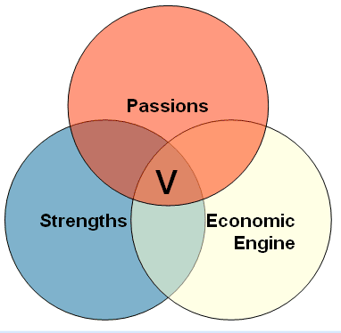

Slide 76
Breakthrough
Buildup
Level 5
Leadership
First Who,
Then What
Confront the
Brutal Facts
Hedgehog
Concept
Culture of
Discipline
Technology
Accelerators
Disiplined People
Disiplined Thought
Disiplined Action

Slide 77
Lake Superior State University
We are UNIQUE!
We have a GREAT Engineering Program!
We Produce GREAT Engineers!
Spread the word!

