Slide 1

LSSU Industrial Advisory Board
APRIL 27, 2012

Slide 2
Welcome!
Nathan Callaghan

Slide 3
Secretary’s Report
Steve Kars
Minutes
Action Items from November 2011 meeting

Slide 4
Chairman’s Report
Nathan Callaghan
Secretary Election
Role Statement
Scholarship Status

Slide 5
Secretary Election
Need the membership to vote for a Secretary
to serve for the next two years.

Slide 6

IAB Secretary Responsibilities and Term Limits
It is the responsibility of the secretary to maintain all of the IAB’s records. The records are to include:
    Newsletter
    Newsletter Supplements
    Press Releases
    Publicity
    Phone lists
    E-mail lists
    Meeting minutes
    Historical information
A copy of all records shall be housed at the Engineering office (CASET 202, on campus at LSSU) with production assistance from the LSSU School of Engineering and Technology secretary and administrative assistant.
If the Chairman is unable to run a meeting, the secretary will officiate the meeting.

Slide 7
IAB Officer Responsibilities and Term Limits
TERM LIMITS
The term of each office shall be two calendar years.
The terms of Chairman and Secretary shall expire on alternate years.
No more than 2 consecutive terms are allowed.
There is no limit to the number of non-consecutive terms.
Election shall be by a majority of the members present at the spring meeting.
The term shall pass to the successors at the end of the spring meeting.
Communication of all necessary information is the responsibility of the exiting officer.
Comments:
The smooth operation of this small organization will depend on communication.
Forms of correspondence:
  Phone
  Fax
  E-mail
  Letters
To facilitate hand-offs, a format should be consented upon for electronic applications
(e.g. IBM/DOS).

Slide 8
Nomination Process
Any existing IAB members are eligible
Self nominations are acceptable
If you are nominating another member please be sure that they are willing to participate
All nominations will be accepted and presented at the spring IAB meeting
Any Questions: you can contact the existing IAB officers.
The Nominees Are:
___Steve Kars______
_________________
_________________

Slide 9
IAB Role Statement Review
The Industrial Advisory Board (IAB) is comprised of professional men and women in engineering positions who actively participate in the development of and the promotion of Lake Superior State University engineering and engineer technology programs, faculty members and students.
IAB members guide, nurture and assure that the School of Engineering and Technology produces engineers with skills that will not only fulfill today’s industrial needs, but will foresee the requirements of tomorrow in a global economy. IAB members provide “real time” interface with both faculty members and students bringing today’s industrial technology to LSSU “today”.

Slide 10
IAB Role Statement Review
IAB members are expected to:
Evaluate and critique engineering programs by providing professional experience and direction.
Be able to provide technical support such as, teaching materials, information on equipment, donate equipment, funding.
Promote LSSU engineering curriculum to young people by participating in regional recruitment seminars and invite students for industrial tours.
Attend IAB meeting.
Support the senior project program with ideas or equipment and/or materials.
Encourage professional development of the faculty by providing summer employment and sponsoring sabbaticals.
Provide assistance with job placement for students both full-time and summer internships.
Participate on subcommittees.
Vote during IAB meetings on issues relative to the Role Statement.

Slide 11
Scholarship Status
Nathan Callaghan

Slide 12
Scholarship Updates
Freshmen Only (3)
Charles Snyder Memorial Scholarship (Any combination of $500 or more), nonrenewable
Available for 2012: $2500 (up to 5 @ $500)
LSSU Robotics Scholarships (up to $1,500), renewable
Available for 2012: $10500 ($6000 for new: 4 @ $1500)

Slide 13
Scholarship Updates (cont.)
Huizenga Engineering Scholarships (up to $1,000), nonrenewable
Available for 2012: $2000 (2 @ $1000)
Freshman or Returning Student (2)
Lawrence Roy Jacobson and Dorothy M. Bell Engineering Scholarship ($1,000), nonrenewable
Available for 2012: 1 @ $800

Slide 14
Scholarship Updates (cont.)
Andersen Family Engineering Scholarship (up to $1,200), nonrenewable
Available for 2012: 1 @ $1200
Returning Student Only (5)
Floyd & Joyce Starks Memorial Scholarship (up to $1,200), nonrenewable
Available for 2012: 2 @ $1200

Slide 15
Scholarship Updates (cont.)
Sven V. Heikkinen Engineering Scholarship ($500), nonrenewable
Available for 2012: 1 @ $500
Precision Edge Surgical Products Company Engineering Scholarship ($2000), nonrenewable
Available for 2012: 2 @ $2000

Slide 16
Scholarship Updates (cont.)
ADD Software LLC Scholarship ($500), nonrenewable
Available for 2012: 3 @ $500
John and Jan Madl Manufacturing Engineering Technology Award ($500), nonrenewable
Available for 2012: 2 @ $500

Slide 17
Committee Reports
Spring 2012 MACRAO & FIRST Robotics Events
Chris Conklin

Slide 18
Over the Winter
MACRAO calendar updated.
Query sent to IAB membership for Spring 2012 MACRAO event volunteers.
Recruiting Cards sent to the IAB MACRAO volunteers.
Fall 2011 IAB Meeting query as to creating a similar recruiting card for Summer Camps, decision was to stay with current generic brochure.
Query sent to IAB membership and former students to staff FIRST Robotics event in Ypsilanti.
Awareness to Admissions concerning participation in Delta College Transfer Fair.

Slide 19
IAB MACRAO Participation
LSSU Admissions office and the IAB continue working very well together.
We participated in and supported the 2012 Spring MACRAO events.
Recruiting cards with MS Tags continue to be well received.

Slide 20
IAB MACRAO Participants
Spring 2012
Diane Haig
Brian Theriault
Ralph Larsen
Chris Conklin

Slide 21
MACRAO Comments
Charlevoix HS: good turnout, 8 students with engineering interest.
Marian HS: no real engineering interest.
Gaylord HS: 4 students with some engineering interest.
Mid Michigan CC: 1 student with some engineering interest. (Gladwin, Clare, Harrison, Beaverton, Houghton Lake High Schools)
Business, Physical Therapy, and Nursing dominate as interests.

Slide 22
Highlights
MACRAO events continue to be well organized and many students are now being bussed to these events by their schools.
MACRAO events remain regionally focused.
Recruiting cards with MS Tags well accepted.

Slide 23
Lowlights
More students undecided at these events.
Meeting fewer potential Engineering and Technology students at MACRAO events.
Social interaction with students is changing.
LSSU is still a major unknown in the field of engineering and technology.

Slide 24
FIRST Robotics Event Participation
Event held April 13/14, 2012 in Ypsilanti, MI.
Andrew Moran and Kyle Finlan, LSSU Alumni from Nexteer volunteered to staff the recruiting table and help support Jay Jessen from Admissions.
LSSU staff Jim Devaprasad volunteered to support the event.
Feedback from Andrew and Kyle is that they felt the experience was positive and they enjoyed meeting and talking about LSSU.

Slide 25
Thoughts/Sharing
Are MACRAO events the best use of our time in attracting engineering and technology students to LSSU? Still the BIG question.
Admissions would like something representative of Engineering and Technology to place on the recruiting table during MACRAO events. Any thoughts?

Slide 26
…in closing
We all enjoy supporting these events, it is a rewarding experience to be able to provide information that may be used in a student’s decision making process for their educational and career choices.

Slide 27
THANK YOU
A special THANK YOU to Jeanne Shibley for her support in the Recruiting effort.
A special THANK YOU to all of the IAB membership that supported the Spring 2012 MACRAO events. Your support is greatly appreciated.
IAB participation in MACRAO events is a very UNIQUE and POSITIVE INFLUENCE on student choice.

Slide 28
…at the end of the day…
This is my last meeting with the IAB…
…am going to an inactive status after today.
Thank you to all of the membership for your support in the recruiting activities.
Thank you all for your friendship and support over the years, this has been one of the most rewarding activities of my life.

Slide 29
Lake Superior State University Updates
School Updates:
  School of Engineering & Technology
  Dr. David Finley, PE
  PDC
  Eric Becks
  ABET Employers Survey
  Dr. Robert Hildebrand
  Mission, Goals & Objectives
  Dr. David Baumann

Slide 30
Vision for
College of Business, Engineering, & Economic Development
David R. Finley, Ph.D., P.E.

Slide 31
The Path to Collaboration, Synergism, & Student Growth
(Enrollment Growth, Earnings Growth…)
David R. Finley, Ph.D., P.E.

Slide 32
Questions
Why are we here?
Who am I (and why that even matters)?
What is LSSU doing w.r.t. economic dev?
How can we work together?

Slide 33
Why are we here?
Craft a best path forward for the new College of Business, Engineering, and Econ Dev
Provide input to build an even better School of Engineering & Technology moving forward
Discuss the South Hall Renovation Project

Slide 34

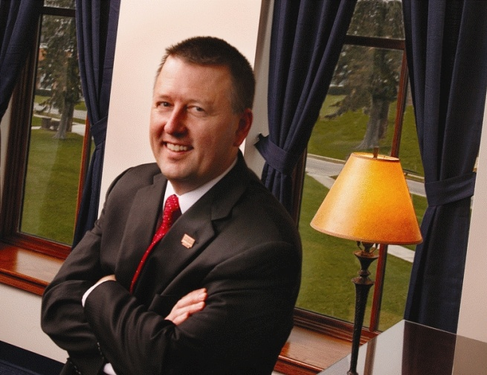
Who am I?
B.S. & M.S. at University of Michigan
Environmental Scientist, ASTI
Ph.D. in Chemical Engineering (Wayne State)
Faculty & Chair, Chemical Engineering at Trine U.
Dean, Engineering & Technology
VP for Academic Affairs (Interim Dean, Business)

Slide 35
Who I am, and
why it matters
My roots are here in Michigan
I helped take Trine U. from surviving to thriving
I am committed to growing this region
It is imperative to start now (taking next steps)

Slide 36
Hot, Flat, and Crowded-Friedman
German economy wavers
Yemen president to quit amid unrest
Moody’s may lower grade again
Occupy protesters target Black Friday shopping
Retailers opening season early
Portugal strike spreads as credit rating junked
Fed to test bank stress capacity again
Durable goods orders fell for 2nd month
        select headlines in The Journal Gazette, Nov. 24-26, 2011

Slide 37
Grand Challenges—NAE
Energy
  lessen oil dependence with safe, renewable sources
Environment
  global warming, clean water, livable mega-cities
Health
  better medicines & rehabilitation, health informatics
Infrastructure/Security
  roads, rail, air, power grid, Internet, thwart terrorism
Learning/Computation
  personalized learning, virtual reality, reverse engineer

Slide 38
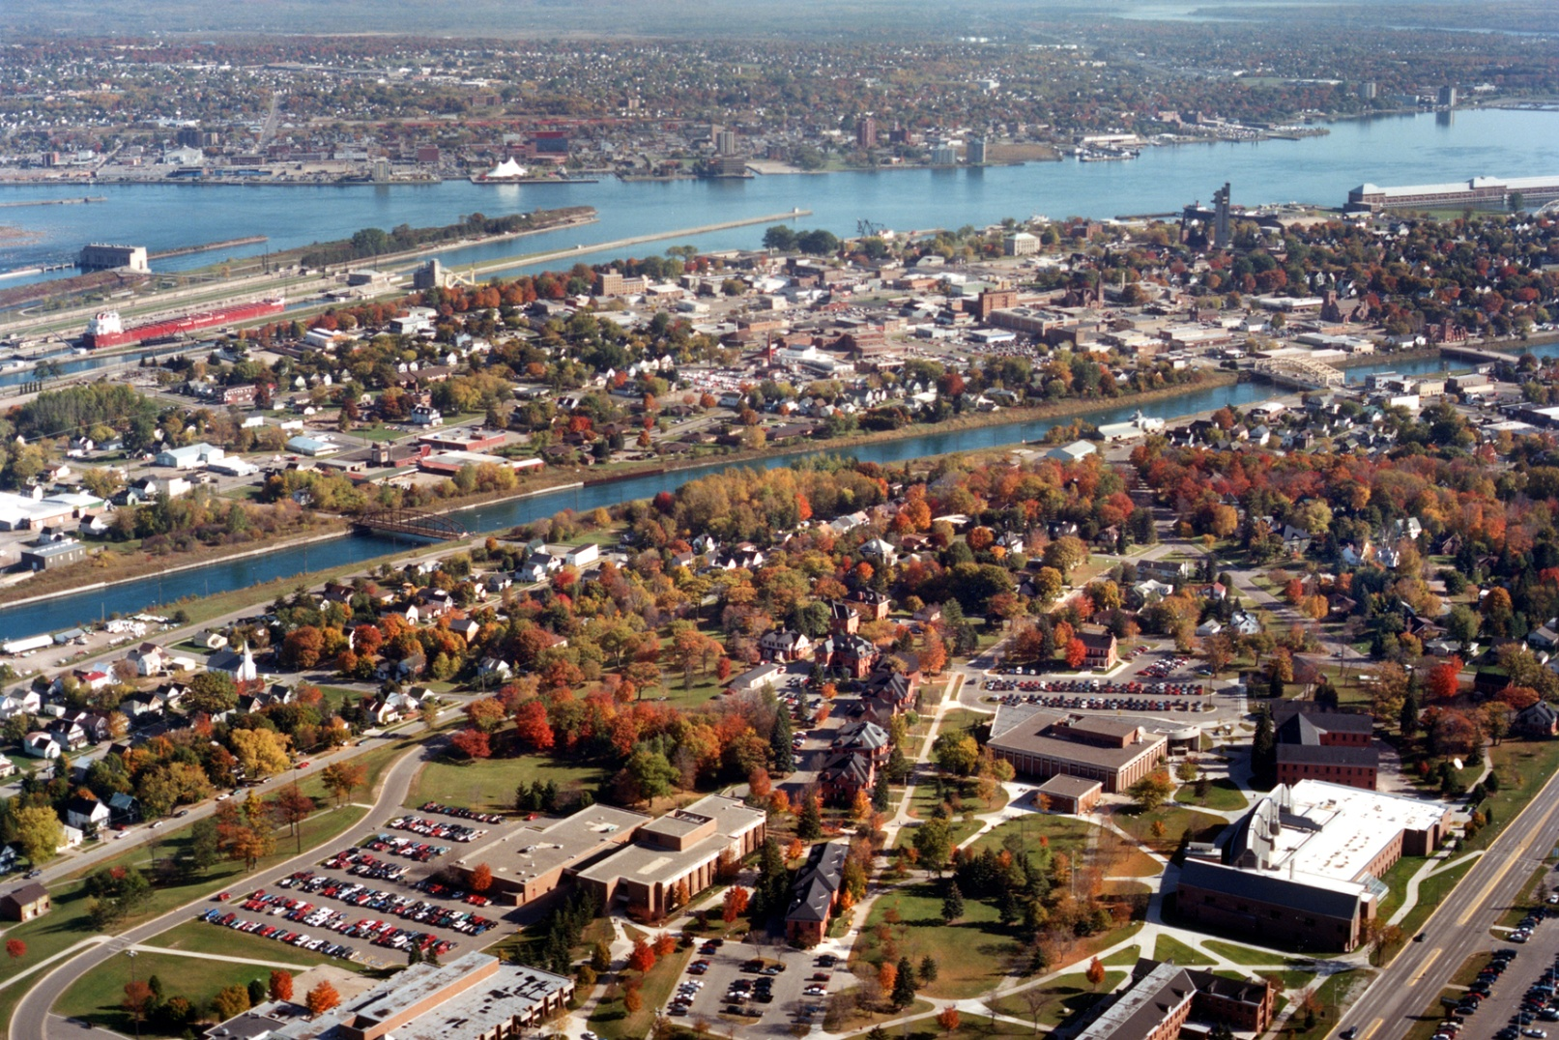
What are we doing at LSSU?

Slide 39
Typical University
Who?
Skills
Skills
Analyst,
Management,
Etc.
Students/
Faculty
Design,
Development,
Testing, etc.
Business
Education
Engineering
Education
GAP

Slide 40
Why this approach won’t work…
Engineering constraints are now financial and societal, not just technologically-based. Business constraints are complex.
Need continued modifications to undergraduate curricula (Wulf, others)
Our society wants graduates who can create jobs through entrepreneurship!!

Slide 41
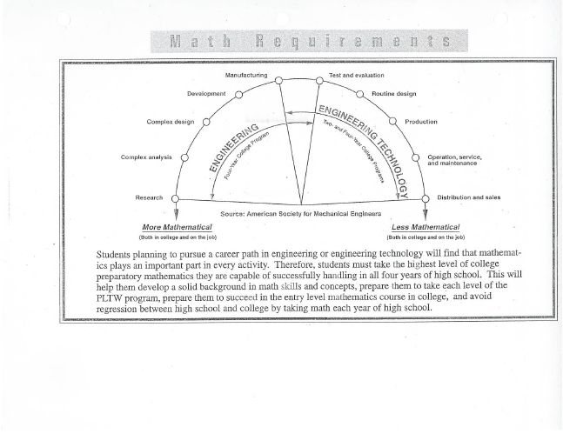

Slide 42
Another continuum…
Engineering
  Complex Analysis, Complex Design, Development
Industrial Engineering/Operations Management
Engineering Economics/Quantitative Analysis
Business
  Finance, Accounting, Management, Marketing

Slide 43
Entrepreneurial Umbrella
School of Engineering and Technology
School of Business
Major/
Minor/
Design Projects
Applied Research
Center
Venture Capital/
Incubator
  Flexible Curriculum
  Teamwork-Oriented
  Interdisciplinary
  Ethics
In collaboration with:
  Center for Entrepreneurial Excellence
  Small Business Development Ctr
  Mechatronics
  Hybrid Vehicles
  CAD/CAM
  Power Generation
  Robotics
Adapted from:
Developing an Entrepreneurial Framework at Tri-State University
David R. Finley, Thomas J. Enneking, Dolores M. Tichenor; 2004

Slide 44
Factors Impeding Collaboration
Organizational
Strategy
Management
Commitment
Business
Organization
Structure
Engineering
Risk of Change
LSSU
Product
Dev Ctr
Employee
Attitude
Teamwork
Legacy
Systems
Business &
Engineering
Frameworks
Adapted from:
Integrating Business Process Reengineering with Information Systems Development: Issues and Implications, 2003

Slide 45




*New* College of Business, Engineering, and Economic Dev.
  School of Business
  School of Engineering & Tech (Robotics Lab)
  Product Development Center
  Strongly linked to SmartZone (SSMart)

Slide 46
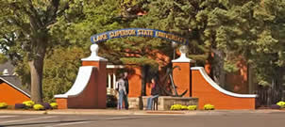
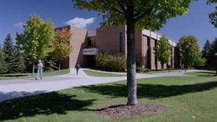
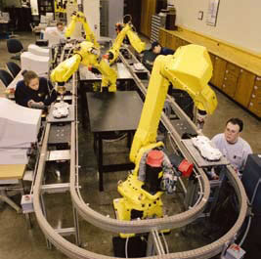
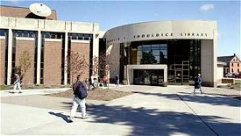
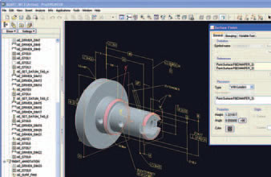
*New* College of Business, Engineering, and Economic Dev.

Slide 47
Business, Engineering, & Econ Dev.
(A Merger…)
Trust…
Different cultures… (ex. selling)
Semantics (same words mean different things)…
Trust!!!

Slide 48
Hot, Flat, and Crowded (part II)
The country—read LSSU—needs to focus on critical (mission-driven) initiatives, use technologies wisely, revive true innovation, and collaborate aggressively to assure success.
Prudent organizations seek opportunities to constrain costs and enhance effectiveness.
Those that are especially well-led will do even more...
  seize the moment to make positive, long-term changes

Slide 49
Dream/Plan
Use students and faculty to nurture technology and commercial enterprises
Learn the process of bringing product from conception to design to manufacture to market (RD² = R&D + deployment)
“Practice” entrepreneurship skills
Could this be part of a new School of Business facility?

Slide 50
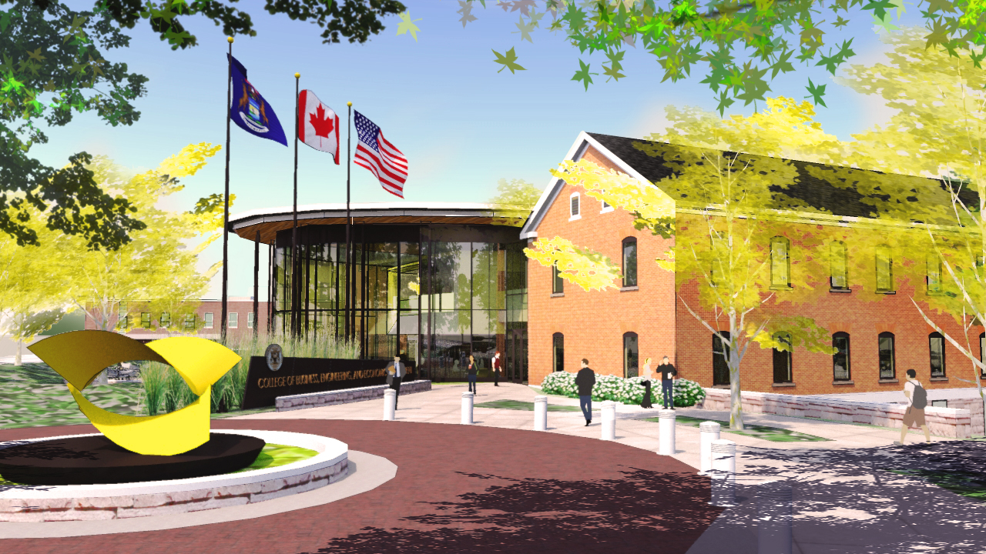
South Hall Renovation Project

Slide 51
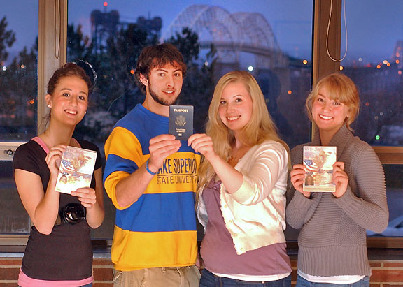
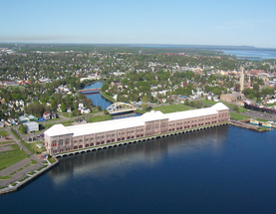
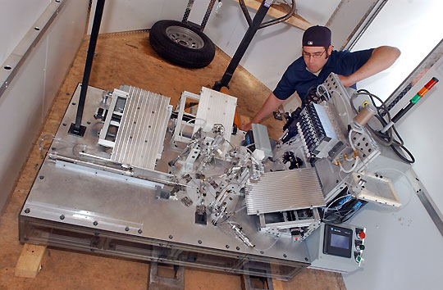
Assets

Slide 52
How to grow Sault Ste. Marie,
the Eastern UP, and Michigan?
21st Century Talent
Entrepreneurship (foster)
Infrastructure
Competitive Business Climate
Quality of Life
On Target… with Economic Development
Image source: Office.com

Slide 53
How We Can Work Together
Support the newly-formed College alignment
Help us reach others interested in LSSU SET
Inform curricular decisions
Recruit Students
Donate Equipment and $$$
Provide Internships/Hire Graduates
Call to Action--Urgency
Contact me personally:
  906-635-2207, dfinley@lssu.edu

Slide 55
How Would You Lead…?
Constant, Gentle (Moderate) Pressure
Idea-Generator
Implementer—Love Seeing a Plan Come Together
Listener—OK with being challenged
“In The Trenches”/Team Player
Highest Ethical Standards
Advocate of Diversity
Engineer/Scientist/Intra-preneur/Leader
Enjoy Friendraising/Fundraising

Slide 56
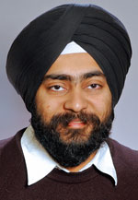
Jaskirat Sodhi, Ph.D.
Assistant Professor
Mechanical Engineering
School of Engineering & Technology
Expertise/Interests: Non-Linear Mechanics, Finite Element Analysis, and Shape Memory Polymers
Phone: (906) 635-2132
Office: CASET 127
E-mail: jsodhi@lssu.edu

Slide 57
Discussion Topics
Pending ABET visit (complete surveys)
Reorganization w/in SET? (spread too thinly)
Host IAB student feedback session in fall?
Host mock interviews for students?
How to grow enrollment?
New programs/Program deletions?
***

Slide 58
Product Development Center
Significant grant support initially
Push to become self-sustaining
Strengths
  Circuit boards (design, imbedded programming)
  Rapid prototyping
  Machining (metals)
  Plastics
  CAD Modeling, Finite Element Analysis (FEA)
  Tensile Testing (Tension, Compression)

Slide 59

New Focus
Existing Business
Vetted Referrals
Welcome Projects

Slide 60
Questions?

Slide 61
Employers Survey
Please help us comply with our ABET criteria and complete an Evaluation of Educational Preparation of Employees survey. We have been collecting materials during the 2011-12 academic year for the CE, EE and ME programs. EAC of ABET will visit during Fall 2012.
When complete, please turn them in to Jeanne.
Thank you!

Slide 62
Mission, Goals & Objectives
Dr. David Baumann

Slide 63
Forecast
What are Mission, Goals, Objectives?
Mission Statement
Goals
Educational Objectives (for CE, EE, ME)
Outcome Objectives (for CE, EE, ME)

Slide 64
Mission, Goals, Objectives
Mission Statement
↓
  Goals (7)
  ↓
  Educational Objectives (3)
  ↓
  Outcome Objectives (4)

Slide 65
Mission Statement (Part 1 of 2)
The School of Engineering and Technology provides a learning experience that produces highly capable engineers and technologists. The primary endeavor is to offer a rigorous, high-quality undergraduate education that is relevant to the future careers and lives of its students. The School also actively contributes to regional economic growth by providing engineering solutions through partnerships with business and industry. The School recognizes that faculty, staff, and students are essential in the realization of this mission and it seeks to provide a working environment that supports and values these individuals.

Slide 66
Mission Statement (Part 2 of 2)
The School utilizes a personal approach to education that is supportive of students. It incorporates and develops skills in communication, design, mathematics, science, and technology relevant to the students’ degrees. The programs develop and integrate students’ professional and technical skills so that they can confidently enter, continue, and succeed in the life-long learning process in their chosen careers.

Slide 67
Goals (1-2 of 7)
A. Deliver an undergraduate education that is current and provides knowledge and skills to be successful in professional careers or graduate school.
B. Provide programs that focus on the applications of fundamental technical principles of engineering, technology, mathematics, science, and computing to benefit society.

Slide 68
Goals (3-4 of 7)
C. Provide courses, including capstone experiences, which incorporate and develop skills in communication, design, ethics, teamwork, and technology relevant to the students’ degrees.
D. Provide an education and opportunities for students with diverse abilities to enhance their personal and professional growth.

Slide 69
Goals (5-6 of 7)
E. Engage in assessment and continuous improvement activities through ongoing external and internal reviews.
F. Enable faculty, staff, and students to apply engineering solutions that support regional economic growth and develop intellectual property through professional development of these individuals.

Slide 70
Goals (7 of 7)
G. Maintain the School’s viability, productivity, and effectiveness by supporting enrollment, retention, and regional economic growth initiatives.

Slide 71
Educational Objectives (1 of 3)
I. Experienced graduates of the Computer, Electrical and Mechanical Engineering programs will have successfully applied engineering knowledge and skills to solve problems in their professions.

Slide 72
Educational Objectives (2 of 3)
II. Experienced graduates of the Computer, Electrical, and Mechanical Engineering programs will have successfully demonstrated application of design principles subject to technical, practical, ethical, and other societal constraints.

Slide 73
Educational Objectives (3 of 3)
III. Experienced graduates of the Computer, Electrical, and Mechanical Engineering programs will have set professional goals, experienced professional growth, and engaged in ongoing professional development and learning activities. Through life-long learning, they will have the ability to adapt in a constantly changing world and will be capable self-learners.

Slide 74
Outcome Objectives (1 of 4)
1. Employability. Graduates will have received an engineering education that is respected by relevant engineering and manufacturing organizations, companies, societies, and educational institutions. Graduates will have the ability to seek employment in a variety of engineering or engineering technology positions or enter a related graduate school.

Slide 75
Outcome Objectives (2 of 4)
2. Societal Awareness. Graduates will have knowledge of contemporary issues and cultures and will recognize the impact of technological decisions within both global and societal contexts.

Slide 76
Outcome Objectives (3 of 4)
3. Professionalism. Graduates will be able to utilize basic sciences, mathematics, and engineering sciences to design systems, components, or processes that meet desired outcomes and design constraints. They will have the ability to interact in all aspects of the design process from product inception to completion. Graduates will be able to use software to design and analyze products and systems. They will have the ability to act professionally and ethically as individuals and as members of multi-disciplinary teams. They will be able to clearly communicate their ideas in both written and oral forms as typically expected within the engineering discipline. They will have the ability to generate various forms of documentation necessary for product design and production.

Slide 77
Outcome Objectives (4 of 4) - CE
4. Fundamental Technical Skills. Each graduate of the Computer Engineering program will possess fundamental technical skills in mathematics, science, software, and engineering, as well as the ability to apply these skills and use modern engineering tools to solve engineering problems through the analysis, design, and implementation of digital systems and through the development of computer algorithms. The fundamental technical skills will include those in the areas of complex variables, linear algebra, discrete mathematics, calculus, differential equations, statistics, chemistry, physics, C/C++ programming, data structures and algorithms, computer networks, discrete structures, numerical methods, electronic devices, signals and systems, analog circuits, digital circuits and systems, digital signal processing, microprocessors, assembly language programming, and control systems.

Slide 78
Outcome Objectives (4 of 4) - EE
4. Fundamental Technical Skills. Each graduate of the Electrical Engineering program will possess fundamental technical skills in mathematics, science, software, and engineering, as well as the ability to apply these skills and use modern engineering tools to solve engineering problems through the analysis, design, and implementation of electrical systems. The fundamental technical skills will include those in the areas of complex variables, linear algebra, calculus, differential equations, statistics, chemistry, physics, computer programming, numerical methods, electromagnetics, electronic devices and circuits, signals and systems, analog circuits, digital circuits, microprocessors, assembly language programming, and control systems.

Slide 79
Outcome Objectives (4 of 4) - ME
4. Fundamental Technical Skills. Students of the Mechanical Engineering program at graduation will have foundational skills in technical areas including basic and advanced mathematics, science, software, and engineering, as well as applied skills involving industrially-relevant problems, laboratory experiences, computer-based experiences, and applied research. The graduate will use these skills and modern engineering tools to conduct experiments and to identify, analyze, and solve engineering problems. Such skills are to be obtained in areas including, but not limited to: linear algebra, calculus, differential equations, complex variables, statistics, computer programming, numerical methods, chemistry, physics, manufacturing processes, drafting and solid modeling, dimensioning and tolerancing, statics, strength of materials, dynamics, thermodynamics, fluid mechanics, heat transfer, material science, machine design, electronics, analog circuit analysis, automatic controls.

Slide 80
Senior Projects
Jim Devaprasad
Recent Senior Projects History
Current 2011-2012 Projects
Presentations and Demonstrations
Request for 2012-2013 Projects
Also Information on Summer Camps
See brochures for schedule and demonstration locations.
Presentations will all take place in CASET 212. Events begin on the half hour.

Slide 81
10-YEAR SENIOR PROJECTS HISTORY
IAB Connection

Slide 82
CURRENT PROJECTS
2011-12 Senior Year Projects
Industry Sponsored Projects (3)
LSSU Sponsored Projects (2)

Slide 83

CURRENT PROJECTS
Concentrated Photovoltaic Module
Company…......3M, Maplewood, MN
Contact……….Tim Hebrink
Advisor……….Paul Weber
Team……........ 2 ME, 1 EE
Budget ……….$8,500
Description:
Updated photovoltaic system using 3M Brand Cool Mirror Film. Same power produced with fewer solar panels in a light weight and cost effective configuration. Uses articulated mirror panels to focus sunlight on solar panels.
Status: To be completed within 1 week

Slide 84

CURRENT PROJECTS
Virtual Maintenance Planning for Commercial Ships
Company…....… EOS, Rochester, MI
Contact………... Brent Kemmer
Advisor……..…. Jim Devaprasad
Team…….......… 3 ME
Budget ………… Support through several software licenses
Description:
Innovative methodology to efficiently plan the maintenance, repair and overhaul operations of large vessels. Process involves 4-phases – scan, model, simulate, and validate. Research subject was the Valley Camp Museum Ship.
Status: Completed

Slide 85
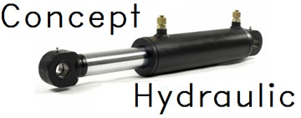
CURRENT PROJECTS
Hydraulic Hose Reel Kit
Company…....… Superior Fabrication, Kincheloe, MI
Contact………... Ian Moore
Advisor……..…. Robert Hildebrand
Team…….......… 3 ME
Budget ………… $4,000
Description:
Design and prototype build of hose reel kit for forklifts. Kit is universal to handle two or four hoses as well as right or left-handed mounting. Design included FEA and fluid dynamics analysis to verify functionality.
Status: Completed

Slide 86

CURRENT PROJECTS
Automated Robotics Workcell
Company…....… LSSU Engineering
Contact………... Jim Devaprasad
Advisor……..…. Jeff King
Team…….......… 1 CE, 2 EE, 2 ME
Budget ………… $6,000 (project material worth - $62,000)
Description:
Design and build robotics workcell with machine vision to automatically vend pharmaceutical and candy products. Workcell also can draw portrait of a person using vision system. The workcell was built using AMT donated platform. Also, update of machine vision system in the robotics lab.
Status: To be completed in one week

Slide 87

CURRENT PROJECTS
Mini-Baja Race Vehicle
Company…....… LSSU Engineering
Contact………... Paul Duesing
Advisor……..…. Jon Coullard
Team…….......… 2 ME, 1 MET
Budget ………… $6,000
Description:
Updating of LSSU Mini-Baja vehicle by redesign and building the final drive CV hub, correcting the front steering geometry, reducing weight, and improving ergonomics. Vehicle is tested, documented for SAE, and ready for race in Wisconsin on June 7-10, 2012.
Status: Completed

Slide 88
PRESENTATIONS AND DEMONSTRATIONS
Schedule
Presentations
  1:00, 1:30, 2:00, 2:30, and 3:00 in CAS212
Demonstrations
  1:30, 2:00, 2:30, 3:00, and 3:30 in CAS
LSSU Engineering Faculty solicits, values, and utilizes IAB evaluations of the presentations

Slide 89
PRESENTATIONS AND DEMONSTRATIONS
IAB Evaluations
Evaluation forms
Provides “external evaluation” (ABET)
Guidelines:
  Look for ownership, professionalism
  Technical competence via questions
  Target audience is “grandmother”!
Turn in at Video Camera – Please don’t leave with the students!

Slide 90
REQUEST FOR 2012-2013 PROJECTS
Course Status
~18 Students Expected For EGNR491 (Fall 2012)
• Mostly ME and MET students (~4-5 ECE)
Looking for 5 Projects
A Few Projects in Consideration
Invitation from IAB to Submit Projects

Slide 91
REQUEST FOR 2012-2013 PROJECTS
Sponsor’s Commitment
Project Fee: $2500 + 5% of Budget
($3500 maximum)
Provide Industrial Contact
Responsibilities
  Sponsor to provide funding and special supplies
  LSSU to provide facilities and faculty advisor
  Students to design, construct, and manufacture
  (or research and prototype)
  Sponsor owns product

Slide 92
REQUEST FOR 2012-2013 PROJECTS
Project Selection Criteria
Match Between Students and Projects
Match Between LSSU Resources and Projects
Project Scope and Timeframe
Clarity in Project Definition and Outcomes
Evidence of Engineering and Financial Support

Slide 93
REQUEST FOR 2012-2013 PROJECTS
Submission of Proposals
Send by August 1, 2012, to
Jim Devaprasad
Project Proposal Form Available
Please Submit Proposals!!!!

Slide 94
Summer Camps
2 Women in Technology Camps
3 Robotics Camps
Robotics Camp for ATA
One of our best recruitment tools!
  Typical Participant Profile
    Average GPA - 3.9
    Average ACT Score - 24
    Average # of Extra-Curricular Activities – 5
IAB Sponsorship Encouraged

Slide 95
Closing
Remarks
Next Meeting: proposed IAB host location – Gaylord
Lunch: Anchor Room – Meet our outstanding & notable seniors

