Slide 1
LSSU Industrial Advisory Board
Spring Meeting
APRIL 29, 2011

Slide 2
Welcome!
Fred Berg

Slide 3
AGENDA
8:00 – 8:30 am Informal Discussion – All Welcome
8:30 – 8:40 am Meeting Call to Order – Fred Berg INFORMATION
8:40 – 8:55 am Secretary Report – Nathan Callaghan ACTION
Approve Minutes / Action Items from November Meeting
8:55 – 9:15 am Chairman Report – Fred Berg ACTION
Chairman Election
New IAB Candidate
Committee Reports
9:15 – 9:30 am Subcommittees Report FEEDBACK
Recruiting / MACRO Events: Chris Conklin
Lake Superior State University Updates
9:30 – 11:30 am School Updates – Ron Delap FEEDBACK
Program Updates – David Baumann & Robert Hildebrand
Senior Projects
11:30 – 11:45am 2010 / 2011 Senior Project Evaluations INFORMATION
Evaluation Form Overview
11:45 – 11:55 am 2011 / 2012 Senior Project Proposals ACTION
Discussion
11:55 – 12:00 pm Closing Remarks / Next Meeting – November 4, 2011
IAB Host Location: Gaylord, MI (proposed) ACTION
12:00 – 1:00 pm Lunch – Walker Cisler Center, Anchor Room
1:00 – 5:00 pm Senior Project Presentations – CAS 212 ACTION

Slide 4
IAB Members: What’s New
Nathan Callaghan has been awarded four Patents
Bob Anderson is participating as a industrial advisor for Senior Projects
Chris Conklin participated in a meet LSSU night held in Midland Michigan in February
Darryl Dinel, started a new job as Senior Automation Engineer, Mechanical and Industrial Engineering Nike-WHQ, email: darryl.dinel@nike.com, Cell: 404-226-7341
Charlie Litzner retiring from Cloverland Electric Cooperative this May

Slide 5
2011 Engineering Salary Outlook Ref: Engineering Salary.com
Electrical Engineer Salary
Electrical engineers hold about 319,100 jobs, making this the second largest branch of the U.S. engineering community (behind software engineering).
Most electrical engineers are employed by manufacturers of electrical/electronic components and computer/office equ ipment, industrial machinery, and professional, medical and scientific instruments.
California, Texas, Maryland, New York, Georgia and New Jersey employ nearly 40% of all electrical engineers nationwide.
Mechanical Engineer Salary
Mechanical engineers hold about 251,900 jobs. More than 2 out of 5 are in manufacturing, primarily in machinery, transportation equipment, electrical equipment, instruments and fabricated metal products industries.

Slide 6
2011 Engineering Salary Outlook
Electrical Engineer Salaries
Electrical engineer salary range for the middle 50% is between $62,420 and $104,180. Median annual electrical engineer salary in the industries employing the largest numbers are:
Computer and office equipment: $73,790 Measuring and control devices: $76,910 Search and navigation equipment: $78,140 Electronic peripherals, components and accessories: $76,820 Engineering service firms: $71,650 Federal Government $74,850 RF Engineering: $87,230
Advanced electrical engineering degrees are in high demand by both Fortune 500s and start-ups. The highest electrical engineer salaries for experienced engineers are concentrated on the east and west coasts, and average nearly 7% higher than the rest of the United States.
Electrical Engineering Employment Outlook
Electrical engineer job opportunities should be favorable into 2015. The number of electrical engineer job openings resulting from employment growth, and the need to replace electrical engineers who transfer to other occupations, are promoted, or leave the labor force is expected to be in rough balance - because of the sharply reduced supply of recent electrical engineering new graduates (which has declined annually since 2003).

Slide 7
2011 Engineering Salary Outlook
Mechanical Engineer Salaries
Mechanical engineer salary range for the middle 50% is between $55,680 and $89,910. Median annual mechanical engineer salary in the industries employing the largest numbers are:
Federal government: $68,770 Engineering and architectural services: $69,150 Motor vehicles and equipment: $72,190 Construction and related machinery: $67,380 Manufacturing: $71,930
Mechanical Engineering Employment Outlook
Mechanical engineer employment is projected to grow about as fast as the average for all non-engineering occupations though 2015. Employment of mechanical engineers in manufacturing should increase more rapidly as the demand for improved machinery and machine tools grows and industrial machinery and processes become increasingly complex. Also, emerging technologies in IT, biotechnology, and nanotechnology will continue to create new mechanical engineer job opportunities.
Employment in mechanical engineering for business and engineering services firms is expected to grow slightly faster than average - as companies increasingly outsource mechanical engineering functions. In addition to job openings from growth, many mechanical engineer openings should result from the need to replace workers who transfer to other occupations or leave the labor force.

Slide 8
Secretary’s Report
Nathan Callaghan
Review minutes and action items from November 2010 meeting

Slide 9
Chairman’s Report
Fred Berg

Slide 10
IAB Role Statement Review
Need the membership to either approve existing version of Role Statement or update it.

Slide 11
IAB Role Statement Review:
The Industrial Advisory Board (IAB) is comprised of professional men and women in engineering positions who actively participate in the development of and the promotion of Lake Superior State University engineering and engineer technology programs, faculty members and students.
IAB members guide, nurture and assure that the School of Engineering and Technology produces engineers with skills that will not only fulfill today’s industrial needs, but will foresee the requirements of tomorrow in a global economy. IAB members provide “real time” interface with both faculty members and students bringing today’s industrial technology to LSSU “today”.

Slide 12
IAB Role Statement Review
IAB members are expected to:
Evaluate and critique engineering programs by providing professional experience and direction.
Be able to provide technical support such as, teaching materials, information on equipment, donate equipment, funding.
Promote LSSU engineering curriculum to young people by participating in regional recruitment seminars and invite students for industrial tours.
Attend IAB meeting.
Support the senior project program with ideas or equipment and/or materials.
Encourage professional development of the faculty by providing summer employment and sponsoring sabbaticals.
Provide assistance with job placement for students both full-time and summer internships.
Participate on subcommittees.
Vote during IAB meetings on issues relative to the Role Statement.
Approve or Update?

Slide 13
Chairman Election
Need the membership to vote for a Chairman to serve as the IAB Chair for the next two years

Slide 14
IAB Chairperson Responsibilities and Term Limits
It is the Chairman’s responsibility to oversee all of the activities of the IAB including coordinating committees.
As the need arises, the Chairman shall appoint committee chairpersons.
The Chairman is an ex-officio member of all committees and is eventually responsible for the completion of all committee business. He/She shall keep in touch with all committee chairs, facilitate the completion of their task, and if necessary, remove inactive committee chairs/members and appoint successors.
The Chairman is directly responsible for the IAB meetings.
Meeting Responsibilities include:
Establish meeting dates, locations and times (coordinate with Dean of Engineering)
Arrange meeting facility
Finalizing meeting agendas
Presiding over meeting

Slide 15
IAB Chairperson Responsibilities and Term Limits
TERM LIMITS
The term of each office shall be two calendar years.
The terms of Chairman and Secretary shall expire on alternate years.
No more than 2 consecutive terms are allowed.
There is no limit to the number of non-consecutive terms.
Election shall be by a majority of the members present at the spring meeting.
The term shall pass to the successors at the end of the spring meeting.
Communication of all necessary information is the responsibility of the exiting officer.
Comments:
The smooth operation of this small organization will depend on communication.
Forms of correspondence:
Phone
Fax
E-mail
Letters
To facilitate hand-offs, a format should be consented upon for electronic applications (e.g. IBM/DOS).

Slide 16
Nomination Process
Any existing IAB members are eligible
Self nominations are acceptable
If you are nominating another member please be sure that they are willing to participate
All nominations will be accepted and presented at the spring IAB meeting
Any Questions: you can contact the existing IAB offices.
Congratulations go to
Nathan who was elected chair and to
Steven who was elected secretary!
The Nominees Are:
Nathan Callaghan
Steven Kars
_________________
_________________

Slide 17
Today’s Visitors
Adil Shafi President, Advenovation Inc.
John Tillotson Fellow Engineer, Honeywell
Trevor Swenson Infrastructure Engineer, Research in Motion

Slide 18
New IAB Candidate
Adil Shafi
Need the membership to either approve or disapprove
Send back for further review

Slide 19
NEW CANDIDATE TO THE IAB
Name Adil Shafi
Company ADVENOVATION, Inc.
Address 7517 Radcliffe, Brighton, MI 48114
Email : Website adil@advenovation.com, www.advenovation.com
Phone Home (810) 844 – 0996, Work (734) 516 – 6761
Title President
Professional Member Robot Industries Association (RIA)
Automated Imaging Association (AIA)
Motion Control Association (MCA)
Work Experience 22+ Years in Industrial Automation, Robotics and Vision Innovation
List some professional volunteer activities or affiliations
1. Editorial Committee Robot Industries Association
2. Education Committee Robot Industries Association
3. Served on Board of Directors Automated Imaging Association
4. Served on Planning Committee International Robots and Vision Shows
5. Served on Planning Committee Automate 2011 Show, Vision Guidance Workshops
List some non work related / community volunteer activities or affiliations
1. Primary non-work activity Time with family (wife and two children)
2. Member of Parishes Our Lady of Good Counsel, St. Mary Magdalen
3. Physical Activities Walking, Swimming, Downhill Skiing, Golf, Squash

Slide 20
Knowledge of Michigan Tech and experience / interaction over 30 years
Earned BSEE, BSCS, MSCS Degrees, College of Engineering, College of Sciences & Arts, School of Business, School of Technology, 10+ Clubs and Organizations (Blue Key, Omicron Delta Kappa, IEEE, ACS, Model United Nations, International Club, Lode Newspaper, Michigan Tech Student Foundation, Ski Club, Cricket Club, Squash Club), Michigan Tech Fund, accounting models, International (student and admin levels), Treasurer of Alumni Association, Alumni Email, Graduate School, Council of Graduate Schools, Boards / Committees (College of Sciences and Arts Co Chair, College of Engineering MEEM Department, Computer Science, Enterprise Development, Email Development, Information Technology, Portals, Michigan Tech Fund, Entrepreneur Alumni, Graduate School / CGS), personal relationships in many parts of the university, Departments (MEEM, Computer Science, Electrical Engineering, Humanities, Physics, Math, KRC, Information Technology, Summer Youth Program, Youth Expo), interaction with Enterprises and Senior Design, Alumni Chapters (US and overseas), Administration (Office of President, Governement Affairs, Corporate and Alumni Advancement, Advanced Technology Development Center, Admissions, International Advancement, Career Center, Alumni Office, Reseach (Ray Decker, Sung Lee, David Reed), familiarity with Advancement Officers), LDFA.
Knowledge of educational institutions and / or interaction and relationships
Lake Superior State University (Visits, Software Donation), MIT (UPOP Program for undergraduates, Agelab, Mars Lab, Volpe Center, CSAIL), Stanford (Gates Center), Purdue (RVL Robot Vision Lab), Carnegie Mellon (Robotics Institute), Cornell University, University of California Berkeley, University of Michigan, Northwestern University (Rehabilitation Institute of Chicago and Small Motor Performance Program), Fraunhofer Institute in Germany (Bin Picking, Efforts with IFR: International Federation of Robotics), University of Tokyo (INK Lab), Waseda University (Sugano Lab), Indian Institutes of Technology (15), Birla Institute of Technology, Benares Hindu University in India, Beijing University in China, National Chung Hsing University in Taiwan, UPM Saudi Arabia, METU Turkey, University of Hawaii, Pinckney High School (Competition Judging), Virginia Tech, Kent State University (Computer Science), Georgia Tech (Robotics), Mott Community College, University of Chicago (Illinois), Bay Noc College Escanaba, Oakland University, Northern Illinois University, Washtenaw Community College, Southwest Research Institute, University of Windsor.

Slide 21
Nomination approved: Welcome Adil!

Slide 22
Knowledge, relationships and interaction at State and Federal Levels
Letters of support from Governor of Michigan and President of MEDC. Knowledge of UPEDA, LDFA, Michigan Congressional Delegation (Offices of Senator Levin and Senator Stabenow, Congressman Stupak and their local representatives in the UP / Houghton), House Armed Services Committee, Senate Armed Services Committee, TARDEC, TACOM, NSF, NIST, Department of Transportation, Volpe Center and Agelab at MIT, USAID and Commerce Department procedures and practices. Companies operating in defense + mobile military robotics and next generation innovation. Working with National Institute of Standards (NIST) in group charged with writing next generation of vision performance evaluation standards.
Personal Experiences and Traits
TRAVEL : About 40 countries and 50 US states, DC and Puerto Rico, Understanding and familiarity with key regions in the USA (MIT/Harvard, Manhattan (business, diplomatic, cultural, tourist), Silicon Valley (companies, events, venues, history, players, MTU alumni base), Chicago (industrial, medical), Detroit (automotive), Texas (military, medical, computer Compaq, Dell), Upper Peninsula (MTU, LSSU, NMU, Bay College key innovation companies), Seattle/Vancouver (Microsoft, Chinese and Korean business development, MSRS initiative), Canadian innovation, Southern German automation which leads in Europe, manufacturing in Italy (automotive, consumer), Spain (automotive), France (automotive) and key companies, Scandinavian trends in Finland, Sweden, Denmark, Norway. Languages (Fluent English, Fluent Hindi / Urdu and travel passable Chinese, Japanese, French, German, Spanish).
INNOVATION : Wrote program to solve any Rubik's cube, 1983 Library of Congress Copyright, world leading Bin Picking innovation in recent years : #1 ranking in the world above all other universities and companies for 3+ years, presently preparing to apply for Guinness World Record for highest average score in computer game Bubble Breaker.
EDUCATION : Taught precalculus at Michigan Tech. Personal experience in developing training courses and delivering them for more than 20 years.

Slide 23
Committee Reports
Recruiting / MACRAO Events
Chris Conklin

Slide 24
IAB Admissions Support
LSSU Admissions and the IAB continue to work very well together.
Participation in and support for the 2011 Spring MACRAO events and Admitted Students Receptions across the state.

Slide 25
IAB MACRAO Participants Spring 2011
Diane Haig: 03/07/11: Marion HS
Bob Andersen: 03/15/11: Romeo Engineering and Technology Center
Brian Theriault: 03/16/11: Gaylord HS
Ralph Larsen: 03/17/11: Charlevoix HS
Chris Conklin: 04/15/11: Mid Michigan Community College

Slide 26
IAB Admitted Students Reception Participants Spring 2011
Chris Conklin: 02/28/11: Midland
Lynnette Eding: 03/03/11: Grand Rapids
Both receptions were very well attended by admitted students
and parents.

Slide 27
Highlights
MACRAO events continue to be well organized and many students are now being bussed to these events by their schools.
MACRAO events remain regionally focused.
Highlight Sheets are a popular handout.
Summer Camps are a high interest area.
March 2011 MACRAO events attended had strong engineering and technology interests.

Slide 28
Lowlights
Laptop less of a tool, no interest.
Little to no interest in the Recruiting/Press Kit.
Fewer potential Engineering and Technology students at MACRAO events.
LSSU is still a major unknown in the field of engineering and technology.
April 2011 MACRAO event attended had no engineering or technology queries or interest.

Slide 29
Thoughts/Sharing
Loss of interest in the Recruiting/Press Kit this year. Need a different format or different approach?
Loss of interest in laptop PC presentations. Need a different format or different approach?

Slide 30
…in closing
We all enjoy supporting these events, it is a rewarding experience to be able to provide information that may be used in a student’s decision making process for their educational and career choices.
The Fall 2011 MACRAO events are not yet scheduled. During the summer as this calendar is firmed up and posted, I will again send an email soliciting your support.

Slide 31
THANK YOU
A special THANK YOU to all of the IAB membership who supported the Spring 2011 MACRAO events and Admitted Student Receptions. Your support is greatly appreciated and I hope that we can continue to support future events.
IAB participation in MACRAO events and Admitted Student Receptions is a very UNIQUE and POSITIVE INFLUENCE on student choice.

Slide 32
Lake Superior State University Updates
College of Engineering, Technology & Economic Development
School of Engineering & Technology
Programs:
Mechanical Engineering & Manufacturing Engineering Technology and ABET Visit
Computer & Electrical Engineering

Slide 33
College of Engineering, Technology & Economic Development
Eric Becks & David Leach
Product Development Center
SSMart Zone
Laker Technologies, Inc.

Slide 35
PDC Overview
PDC Activites
SSMartSM, Inc. – SmartZoneSM
Laker Technologies, L3C
Request for Projects

Slide 36
PDC Activities
Marble Arms Automation
Skate Fenders
Medical
Veterinary
Other
Administer SSMart

Slide 37
SSMart, Inc. Sault Ste. Marie advanced resources and technologies
Administered by PDC under contract
Breeder Building Designed
Construction Soon
AUTOMATE Show
Seeking Startups

Slide 38
Laker Technologies, L3C
Low-profit Limited Liability Company
Board from
Engineering
Business
Computer Science
Turn-key Web/Marketing Services
Server Equipment Grant Request
Outlet for New Products

Slide 39
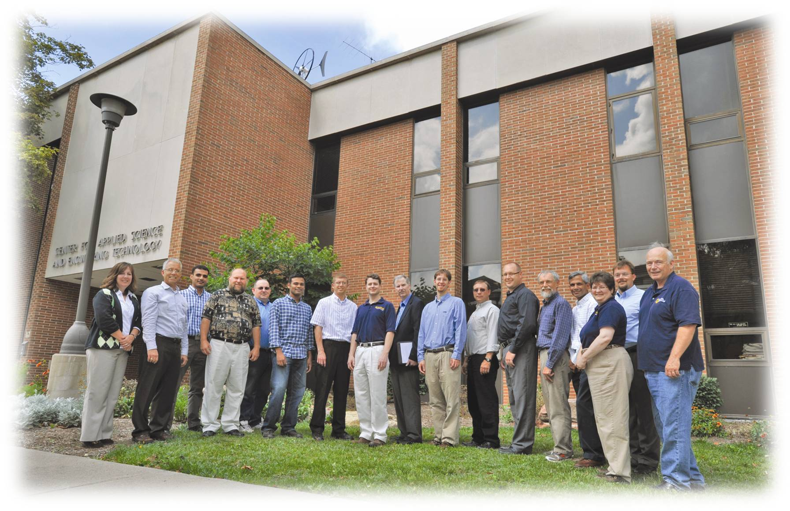
School Updates Ron DeLap

Slide 40
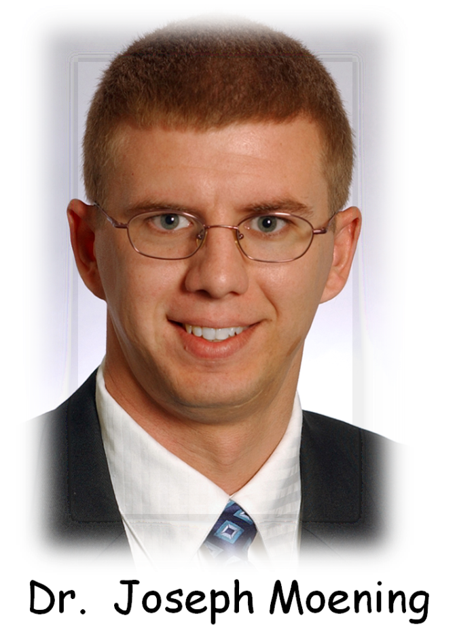
Hired: Joseph P. (Joe) Moening
Ph.D. – University of Toledo “the Rockets!”
Dissertation was related to solar cells
Familiar with the U.P.
Fits in well with our “family”

Slide 41
School of Engineering & Technology
PROMOTIONS! Dr. Robert Hildebrand, from Assistant to Associate Professor Dr. Andrew Jones, from Assistant to Associate Professor CONGRATS!

Slide 42
Sabbatical! David McDonald, Awarded 1-year sabbatical! CONGRATS!
School of Engineering & Technology

Slide 43
School of Engineering & Technology
Clubs
▫ ASME
○ Competed in H2Go competition at Grand Valley First Place!!
▫ SAE
○ A year of rebuilding. Competition should resume next year.
▫ SWE
○ Great community PR – Girl scout events.
▫ IEEE
○ Another positive year; FRC 1596 Instigators made state finals.

Slide 44
School of Engineering & Technology
From Fall report: Enrollment numbers – UP.
Enrollment distribution – spreading
Significant gains in Grand Rapids
Significant gains in out of state recruitment
Trends are all looking positive for Engineering

Slide 45
School of Engineering & Technology
Since Fall Report (187 students):
Left Engineering - 17
Graduated – 3
Additional Gains - 10
Primary reasons for leaving:
Difficulty with coursework.
Lost interest in engineering

Slide 46
Enrollment
School of Engineering & Technology
Fall Spring Delta
06: 194 Students 07: 174 10%
07: 176 Students 08: 161 8.5%
08: 175 Students 09: 165 5.7%
09: 172 Students 10: 165 4.1%
10: 187 Students 11: 177 5.3%
Fall 11: ??
32 “new students” signed up for orientation at present – need more!

Slide 47
Enrollment
School of Engineering & Technology
Fall 10: 187 Students
Spring 11: 177 Students
RETENTION – 17 students left at the break
Retention rate = 91% overall
Freshman retention rate = 87%
These are phenomenal numbers!

Slide 48
Graduation - Jobs
School of Engineering & Technology
One of our best years ever!
25 Grads, 70+ job offers.
Salaries moving up.
VERY POSITIVE Employer and Alumni Feedback

Slide 49
School of Engineering & Technology
Plans of your new Dean:
Recruiting, Recruiting, Recruiting!!! – Check.
Alternative Energy Minor – In progress
Co-op’s and Internships – In slow progress
Fundraising – Has not progressed
Business/Engineering Partnerships – some progress
Two KEY GOALS!
Keep our freshmen happy, and challenged (retain our gains). Check
Graduate seniors that are well prepared, and happy, on time (our future recruiters) This seems to be the case this year!! Why?

Slide 50
School of Engineering & Technology
Recruiting, Recruiting, Recruiting!!!!
Plans: Evaluate current methods
Keep what’s best, lose the rest
Pursue new recruiting methods
Targeted recruiting
Student input
Constant Contact
Be relevant, be personal

Slide 51
School of Engineering & Technology
Ongoing and new plans:
Open a new center for entrepreneurship (Eric’s talk)
Continuing to work on this
Sault Smart Zone is on board
Open an Engineering House
9 students to start
Currently have 3 upper class signed up
18 Freshmen apps

Slide 52
School of Engineering & Technology
What the IAB can do to help the Engineering Program:
Identify and lobby people of influence in Lansing
Continue to aggressively recruit potential students
$upport the Product Development Center
$upport our scholarship programs and our Entrepreneurial Center
Support Senior Projects
Hire and promote our graduates
Know what is special about our engineering program! Visit our web site.
We Are Unique, and We Produce GREAT Engineers.

Slide 53
Program Updates
LSSU Robotics Center Ron DeLap
Mechanical Engineering & Manufacturing Engineering Technology and ABET Visit
Robert Hildebrand
Computer & Electrical Engineering David Baumann

Slide 54
No major initiatives this year, but Jim has been very active. - RIA – board - Automate Conference, Chicago - Multiple Papers - National level Webinars - EOS Senior Project Summer Camps – hundreds of apps for 64 slots. Wow!
School of Engineering & Technology
LSSU Robotics Center

Slide 55
School of Engineering & Technology
Mechanical Engineering/ Manufacturing Engineering Technology
Only minor ME curriculum changes (prerequisites, etc.)
Only small lab equipment acquisitions (e.g., camera integral to microscope)
Started ME curriculum comparison (Note David B’s data). (benchmarking other Schools) -- updates at fall meeting
Contemplating a Thermodynamics/Fluid Lab course (1 credit)

Slide 56
School of Engineering & Technology
ABET visit for MfgET program
▫ Will definitely reaccredit – no interim visit likely
▫ No major findings (“weaknesses” or “deficiencies”) – only a few lower-level findings (“concerns”): ○ some older equipment & texts, ○ continuous improvement practices (not convincingly demonstrated)
BUT!
Post inspection, one concern became a weakness!
We have vigorously contested this.

Slide 57
Survey
Please help us comply with our ABET criteria and complete an Evaluation of Educational Preparation of Employees survey. We are collecting materials during the 2011-12 academic year for the CE, EE and ME programs. EAC of ABET will visit during Fall 2012.
Thank you!
The Survey can be found on the IAB web page under “resources”.

Slide 58
Electrical & Computer Engineering FORECAST
David Baumann
EE Curricular Comparison (FYI)
CE Curricular Comparison (FYI)
Sustainable Energy Option (FYI)
Ideas for Lab Changes (IAB input)
Ideas for EE Curricular Changes (IAB input)
Ideas for CE Curricular Changes (IAB input)

Slide 59
Electrical and Computer Engineering EE Curricular Comparison
Compared EE Core Courses with:
Lawrence Technological University
Michigan State University
Michigan Technological University
Rose-Hulman University
Saginaw Valley State University
University of Michigan
University of Toledo
University of Wisconsin – Platteville
Western Michigan University

Slide 60
Electrical and Computer Engineering EE Curricular Comparison
Major Findings
We are one of only three institutions to have a Numerical Methods course.
We are one of only two institutions to have two Control Systems courses and the only one to have two Control Systems labs.
We are the only institution to have a Probability and Statistics lab.
We have 13 lab credits compared to an average of 5.7 lab credits. Lawrence Tech is the closest to us with 10 lab credits.

Slide 61
Electrical and Computer Engineering CE Curricular Comparison
Compared CE Core Courses with:
Lawrence Technological University
Michigan State University
Michigan Technological University
Rose-Hulman University
University of Michigan
University of Toledo
Western Michigan University

Slide 62
Electrical and Computer Engineering CE Curricular Comparisons
Major Findings
We are one of only three institutions to have a Numerical Methods course.
We are one of only three institutions to have a DSP course and the only institution with a DSP lab.
We are the only institution to have a Probability and Statistics lab.
We are one of only three institutions to have a Computer Networks course.
(continued)

Slide 63
Electrical and Computer Engineering CE Curricular Comparison
Major Findings (continued)
We are one of only two institutions not to have a Computer Organization/Architecture course.
We are one of only three institutions not to have an Operating Systems course.
We have 13 lab credits compared to an average of 5.8 lab credits. Lawrence Tech is the closest to us with 9 lab credits.

Slide 64
Electrical and Computer Engineering Sustainable Energy Option
Growth in General Power Field
New emphasis on “Smart Grid”
Many engineers in field nearing retirement
Demand for power continues to grow
Growth in Sustainable/Renewable Energy
Wind
Photovoltaic Solar
Hydrogen Fuel
Thermal Solar

Slide 65
Electrical and Computer Engineering Sustainable Energy Option
National Model (Result of NSF Grant)
Electric Drive Course
Power Electronics Course
Electrical Power Transmission Course
Sustainable/Renewable Energy Course
Additional LSSU Course
Electrical Vehicle Systems

Slide 66
Electrical and Computer Engineering Ideas for Reducing Labs
Killing of Labs
EGEE-280 Intro to Signal Process (3,3) → (3,0) or (4,0)
EGEE-425 DSP (2,2) → (3,0)
More Killing of Labs
EGNR-346 Prob and Stats Lab (0,2) → Eliminate
EGRS-461 Design of Control Systems (3,3) → (4,0)
Removal of Labs from Curricula
EGNR-340 Adv Num Meth (0,2) → Out of CE, EE Cores

Slide 67
Electrical and Computer Engineering Ideas for EE Curriculum
Changes to EE Core
EGEM-220 Statics (3,0) replaced by EGEM-220 Statics (3,0) or EGEM-377 Thermodynamics (3,0)
Kill EGEE-375 Electronic Devices (modify and change to EGEE-475 so we can offer four course options)
Vehicle Systems Option {Cancel-have not had any students}
Electrical/Mechanical Option {Cancel-few students if any}
(continued)

Slide 68
Electrical and Computer Engineering Ideas for EE Curriculum
Robotics and Automation Option (14 credits)
EGRS-365 PLCs (2,3) {NEW}
EGRS-385 Robotics Engineering (3,3)
EGRS-430 Sys Integration and Machine Vision (3,3)
EGRS-435 Automated Manufacturing Systems (2,3)
Digital Systems Option (14 credits)
EGEE-320 Digital Design (3,3)
EGEE-355 Microcontroller Systems (3,3)
EGRS-425 Digital Signal Processing (3,0)
Technical Elective {NEW}

Slide 69
Electrical and Computer Engineering Ideas for EE Curriculum
Sustainable Energy Option (13 credits)
EGEE-311 Power Distrib and Trans (3,0) {New}
EGEE-361 Energy Sys and Sustainability (2,2) {Newish}
EGEE-362 Electric Vehicle Systems (2,3 ) {Newish}
EGEE-475 Power Electronics (3,3) {Altered EGEE-375}

Slide 70
Electrical and Computer Engineering Ideas for CE Curriculum
Changes to CE Core
CSCI-201 Data Structures and Algorithms (3,0) or CSCI-221 Computer Networks (2,2)
replaced by
CSCI-201 Data Structures and Algorithms (3,0) or CSCI-315 Computer Org and Architecture (3,0) or CSCI-334 Operating Systems Concepts (3,0)
(continued)

Slide 71
Electrical and Computer Engineering Ideas for CE Curriculum
Robotics and Automation Option (11 credits)
EGRS-385 Robotics Engineering (3,3)
EGRS-430 Sys Integration and Machine Vision (3,3)
EGRS-435 Automated Manufacturing Systems (2,3)
Control Systems Option (11 credits)
EGEE-320 Digital Design (3,3)
EGEE-355 Microcontroller Systems (3,3)
EGRS-425 Digital Signal Processing (3,0)

Slide 72
Electrical and Computer Engineering Ideas for CE Curriculum
Sustainable Energy Option (9-10 credits)
EGEE-361 Energy Systems and Sustainability (2,2)
EGEE-362 Electric Vehicle Systems (2,3)
One course from:
EGEE-311 Power Distribution and Trans (3,0)
EGEE-330 Electro-Mechanical Systems (3,3)
EGEE-475 Power Electronics (3,3)

Slide 73
Senior Projects
Ron DeLap
2010-11 Senior Project Evaluations Form Overview
2011-12 Senior Project Proposals Discussion
See brochures for schedule and demonstration locations.
Brochure available on IAB web page under “Spring 2011 meeting”.
Presentations will all take place in CASET 212. Events begin on the half hour.

Slide 74
CURRENT PROJECTS 2010-11 Senior Year Projects
Industry Sponsored Projects (4)
Vermilion Foundation Sponsored Project (1)
THIS YEAR’S GOAL:
Graded Final Presentations by First Week in April.
Did not happen, but…..

Slide 75
Team Innovative Solar Solutions
Customer: 3M
FA: Dr. Paul Weber
Goal: Implement a solar power system using proprietary 3M materials
Budget: ~ $12K
Outcome: Proof of concept for new solar material
Status: Complete, some final testing in progress

Slide 76
Vermilion Innovation Providers of Energy Research Solutions
Goals:
Install weather station
Establish communication link
Research energy sustainability for site
Propose future plan of action
Present research at conference
Status: Complete
Members:
Eric Hoxie (EE)
Jameson Mattice (EE)
Brad Ekin (EE)
Ben Martin (ME)
John Preczewski (EE)
Dr. Andrew Jones (FA)
Mr. Charles Dawley (IC)
Budget: $6000

Slide 77
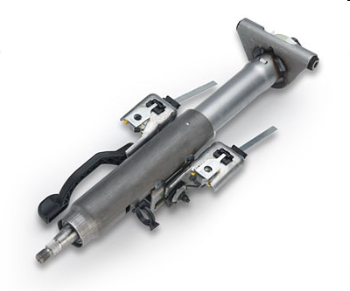
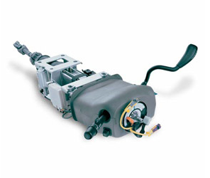
Team Steering Innovations
Steering Column
Adjustment Button (Our Project)
Power operated (pushbutton) column
Manual lever
operated column
Customer: Nexteer Automotive
IC: Fred Berg
FA: David McDonald
Goal: Optimize Nexteer’s Prototype
Budget: $10K
Outcome: Functioning Prototype in Buick LeSabre
Status: Complete
Thanks Fred!

Slide 78
Team Robotic
Simulation Services
Sponsor: EOS
The team is assigned a task to create a set of fully functional virtual demonstrations for EOS that can be used to exhibit the Virtual Commissioning Solutions of Dassault and Siemens to potential customers.
EOS has provided the required software and hardware to the team to successfully complete the project.
Status: Complete
Notes:
-Say Hi
-Welcome Faculty
-Thank Professor Devaprasad
-Special thank you to Brent and JP

Slide 79
Team ProtoTech
Customer: LSSU Prototype Development Center
Members: 2 MfgET, 1 ME, 1 EE
Advisor: Dr.Hildebrand
Team Prototech served as an adjunct to LSSU's Product Development Center, tasked with the design, prototyping, testing, and optimization of new products proposed by industry and entrepreneurs. It completed a series of new product development projects during the academic year, beginning with an innovative instrumentation project with applications in veterinary medicine (now largely complete) and followed that with a hand-held power tool application.
STATUS: Complete

Slide 80
Lake Superior State University
We are UNIQUE!
We have a GREAT Engineering Program!
We Produce GREAT Engineers!
Spread the word!

Slide 82
Closing
Remarks
Next Meeting: proposed IAB host location – Gaylord
Lunch: Anchor Room – Meet our outstanding & notable seniors
Senior project presentations & demonstrations begin at 1 p.m.

