Slide 1

Understanding the Three-Legged Stool
Maintaining Balance: Authorizer, Board and Academy Leadership
2017/2018 Webinar Series
Presenter: Angela Irwin
President
AirWin Educational Services, LLC
Notes:
Welcome, introductions
“Housekeeping” – webinar details
Webinar series: First of five being brought to you by your authorizer, LSSU – all will be recorded for access on LSSU’s website at: https://www.lssu.edu/charter-schools/

Slide 2
UNDERSTANDING THE THREE LEGGED STOOL
MAINTAINING BALANCE: AUTHORIZER, BOARD AND ACADEMY LEADERSHIP
A three-legged stool is always stable, regardless of its placement on an uneven surface. Keeping the top parallel to the floor and comfortable to sit on, however, requires careful steps to achieve balance among each of the three legs.
NACSA Issue Brief – Authorizing Matters
Steadying the Three-Legged Stool: Authorizers, Charter Schools, and Educational Service Providers
October 2006
Notes:
Older excerpt but still relevant!

Slide 3
UNDERSTANDING THE THREE LEGGED STOOL
MAINTAINING BALANCE: AUTHORIZER, BOARD AND ACADEMY LEADERSHIP
To achieve balance, we must first understand who is responsible and what we are balancing . . .

Slide 4

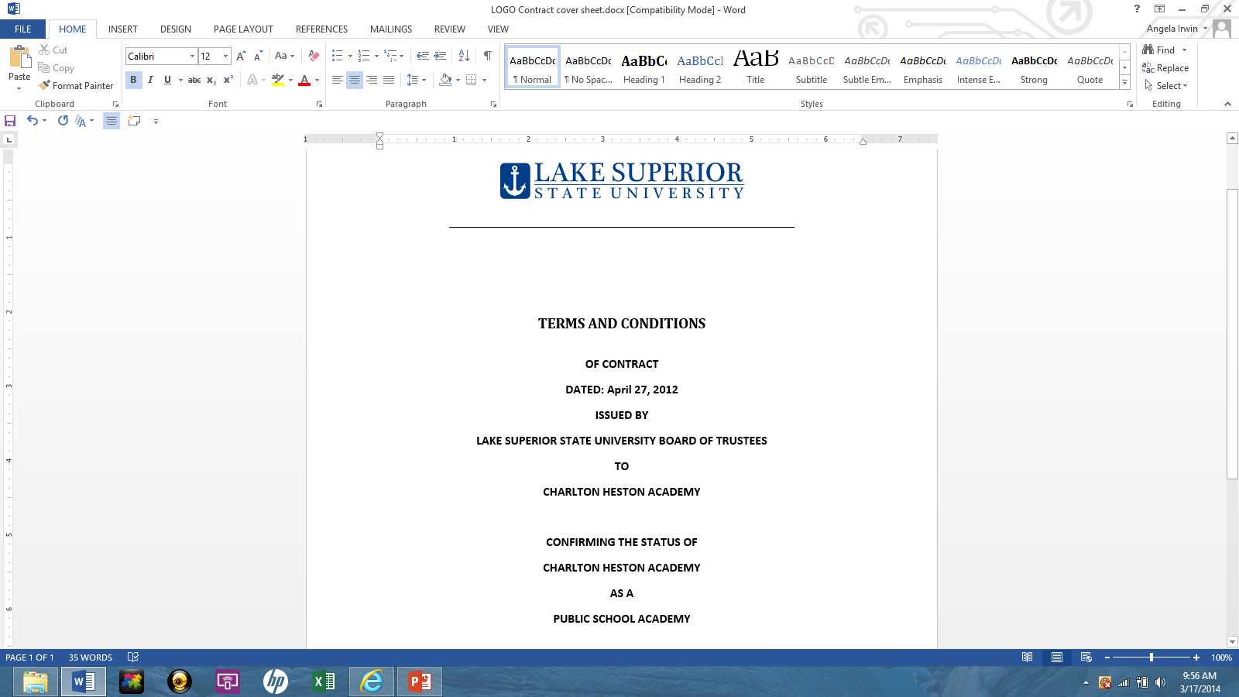
UNDERSTANDING THE THREE LEGGED STOOL
MAINTAINING BALANCE: AUTHORIZER, BOARD AND ACADEMY LEADERSHIP
WHO?
WHAT?
=
=
THROUGH . . .
Board
Authorizer
PERFORMANCE
Leadership

Slide 5
UNDERSTANDING THE THREE LEGGED STOOL
MAINTAINING BALANCE: AUTHORIZER, BOARD AND ACADEMY LEADERSHIP
Academic
Fiscal
Operational
PERFORMANCE
Board
Leadership
Authorizer
Notes:
Operational is the “catch-all” for the functional role of the “leader”

Slide 6
UNDERSTANDING THE THREE LEGGED STOOL
MAINTAINING BALANCE: AUTHORIZER, BOARD AND ACADEMY LEADERSHIP
How Do We Achieve Performance Balance?

Slide 7
UNDERSTANDING THE THREE LEGGED STOOL
MAINTAINING BALANCE: AUTHORIZER, BOARD AND ACADEMY LEADERSHIP
THREE PRIMARY WAYS . . .
Understanding . . .
  The role of each party relative to the charter performance contract
Performing . . .
  To the expectations delineated through the charter performance contract
Respecting . . .
  The relationship of each party relative to the charter performance contract

Slide 8
UNDERSTANDING THE THREE LEGGED STOOL
MAINTAINING BALANCE: AUTHORIZER, BOARD AND ACADEMY LEADERSHIP
Authorizer
Board
Leadership
Issues charter performance contract to board
Signs charter performance contract with authorizer
Negotiates agreement with board that considers charter performance contract requirements/goals
Oversees board compliance to charter performance contract
Understands all aspects of charter performance contract
Administers, procedurally, business and operational functions in alignment with charter performance contract and agreement with board
Reauthorizes/renews charter performance contract
Meets/exceeds goals and requirements pursuant to charter performance contract, law and policy
Through operational and business functions, expected to meet/exceed all academy goals
Administers performance assessments on academics, finances and operations
Establishes systems and processes to monitor, effectively, academy’s performance
Provides clear, accurate and timely information in support of board’s monitoring systems/processes
Appoints and re-appoints board members
Ensures quality board candidates for authorizer consideration
Works in cooperation with board in identifying board candidates for board consideration
Expects transparent, respectful relationships with board and leadership
Fosters a transparent, no surprise approach with authorizer
Establishes transparent, trusting, communicative relationship with board
Notes:
Illustrating how each leg supports the performance seat . . . Designed to emphasize commonalities in role(s) not division(s) between roles . . .
Re-enforce commonalities after each connection . . .

Slide 9
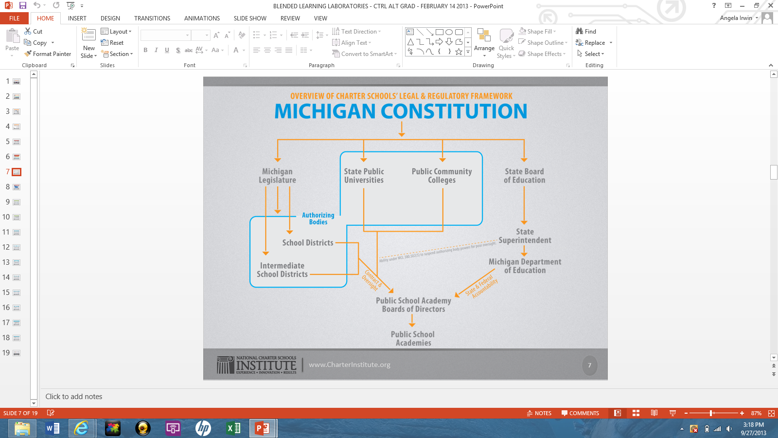
UNDERSTANDING THE THREE LEGGED STOOL
MAINTAINING BALANCE: AUTHORIZER, BOARD AND ACADEMY LEADERSHIP
Source: Central Michigan University
Governor John Engler Center for Charter Schools
Notes:
Remember to tie back to roles slide, prior . . .

Slide 10
UNDERSTANDING THE THREE LEGGED STOOL
MAINTAINING BALANCE: AUTHORIZER, BOARD AND ACADEMY LEADERSHIP
What happens when stool is not balanced? Performance is compromised . . .
Board
Leadership
PERFORMANCE
Authorizer
Not understanding and/or respecting roles, performance expectations and/or accountability

Slide 11
UNDERSTANDING THE THREE LEGGED STOOL
MAINTAINING BALANCE: AUTHORIZER, BOARD AND ACADEMY LEADERSHIP
School flounders
Reactive versus proactive culture
Lack of clear policies or lack of understanding of policies that exist
Lengthy, unstructured board meetings
Quick, ineffective meetings
Inability to meet due to quorum issues
Board instability
Finance concerns
Compliance reporting concerns (i.e. timing)
High turnover in staff and/or leadership
Notes:
Be sure to emphasize consistency/patterns in these behaviors – not an exhaustive list!
A board meeting should last as long as it takes for the board to engage in meaningful deliberations and decision-making that support the academic, fiscal and operational performance of the school over which it is governing – materials in advance/review materials, bringing “wise questions” forward . . . (refer to AI wise-questions template) – more prepared a board is for the meeting, the more efficient the meetings become – one more tip/note: bring committee need discussion into this

Slide 12
UNDERSTANDING THE THREE LEGGED STOOL
MAINTAINING BALANCE: AUTHORIZER, BOARD AND ACADEMY LEADERSHIP
The Balance: Remaining Steady
Understand the charter performance contract and what is expected of each of the three legs relative to it
Increase understanding of roles, responsibilities and expectations of each stool leg
Begin developing systems/processes and policies that keep all stakeholders informed of progress
Regularly work toward achieving charter performance contract goals and establish systems and processes that keep all stakeholders informed of progress
Assume role in relationship building
PERFORMANCE
Board
Authorizer
Leadership

Slide 13
UNDERSTANDING THE THREE LEGGED STOOL
MAINTAINING BALANCE: AUTHORIZER, BOARD AND ACADEMY LEADERSHIP
QUESTIONS & ANSWERS

Slide 14

Angela L. Irwin, President
4521 Henry Drive
Beaverton, MI 48612
Telephone: (O): 989-435-9922; (C): 989-239-7555
Email: angela@airwinllc.com
Thank You!
Notes:
In Slide Show mode, click the arrow to enter the PowerPoint Getting Started Center.

