Slide 1
Building an Effective Board Team: Extending Greatness through the Role of the Officer
Board Webinar Series
February 7, 2018
Presenter: Angela Irwin
President
AirWin Educational Services, LLC
Notes:
Recap last two presentations – three-legged stool and communications . . .(October and December, respectively)
Welcome and housekeeping (webinar guidance, including recording)
Acknowledge LSSU

Slide 2
Building an Effective Board Team: Extending Greatness through the Role of the Officer
“The Board of Directors is the highest level of leadership” (BoardSource)

Slide 3
Building an Effective Board Team: Extending Greatness through the Role of the Officer
Building an Effective Board Team Begins with Intentional Recruiting and Orientating

Slide 4
Building an Effective Board Team: Extending Greatness through the Role of the Officer
Board Recruitment and Orientation Process
BOARD RECRUITMENT
Step 1 | Step 2 | Step 3 | Step 4
Profile Existing Members | Address Future Needs | Recruit Based on Needs | Ensure Positive Board Candidate Experience
Review full board composition (including board terms, as established by authorizer) | Consistent with established strategic plan, identify future board/academy needs | Identify gaps between existing qualities and future needs | Establish a board candidate onboarding process
Identify professional and personal qualities each member brings to the board | From profile exercise above, determine which qualities may satisfy future needs | Recruit members based on identified gaps | Follow process from initial conversation with candidate through board candidate decision and/or swearing-in
Notes:
Note: May have policy on board orientation – Policy Number 0142.4)
Once team is in place, then effectiveness . . .

Slide 5
Building an Effective Board Team: Extending Greatness through the Role of the Officer
Board Recruitment and Orientation Process
BOARD ORIENTATION
Step 1 | Step 2 | Step 3 | Step 4
Ensure Board Member Commitment | Share ALL Relevant Information with Board Member | Review Structural Roles and Relationships with Board Member | Identify/Determine Professional Development Needs
Establish/review and/or sign “letter of agreement” | Review all critical documents with member, including charter contract, charter law, board policy, school improvement plan | Review board role relative to MDE, authorizer, ESP, etc. | Identify, with new member, areas of PD need(s)
Be clear about time commitment | Provide member with all contact information for member colleagues, ESP and staff | Review board role relative to board meeting preparation | Work with authorizer to determine fulfillment of need(s)
Notes:
Note: May have policy on board orientation – Policy Number 0142.4)
Once team is in place, then effectiveness . . .

Slide 6
Building an Effective Board Team: Extending Greatness through the Role of the Officer
Board Member
Statement of Agreement
Name:
Dates of Board Term:
As a board member of {NAME OF ACADEMY}, I pledge my service, as follows:
I am fiscally responsible, with all other board members, for this academy. It is my duty to know what our budget is and to take an active role in planning the budget.
I am legally responsible to this academy. I am responsible to know and approve all policies and programs and to govern over their implementation.
I am morally responsible for the health and well-being of this academy. As a member of the board, I have pledged myself to carry out the academy’s mission of {MISSION OF ACADEMY}. I am fully committed and dedicated to this mission.
I will attend all board meetings and be prepared to engage in meaningful dialogue and policy deliberations at all public meetings.
I will commit to ensuring that the children attending the academy are receiving a quality education by assisting in the implementation of systems, processes and practices that offer assurances to the board as a whole that children are learning.
I will serve as an ambassador for the academy, actively engaging in board recruitment efforts and strategies.
I will commit to the short and long-term planning of the academy through strategic work and efforts.
Signed: {NEW BOARD MEMBER}
Date:
Notes:
Note: Board Ethics Policy – Policy Number: 0144.2

Slide 7
Building an Effective Board Team: Extending Greatness through the Role of the Officer
LSSU B0ARD APPOINTMENT PROCESS
Academy Board | Field Officer | Charter Office | LSSU Board
1. Nominate
member
 | 2. Receive nomination form signed by Bd Pres
 | 3. Receive application signed
 | 4. Receive resume
 | 5. Receive I.D.*** (birth certificate, passport, or
 | enhanced drivers license)
 | 6. U.S. verification form signed***
 | 7. Interview/Orientation with member
 | 8. Once all the above received - send to CSO
 | please send above items as ONE pkg
 |  | 9. Request Background check
 | ***ID and verification form required with first | 10. Request approval by
 | appt | LSSU Board
 | Note -Only items 2 & 3 required for reappointments
 |  |  | 11. Approve appoint-
 |  |  | ment of Member
 |  | 12. Notify Field Officer
 |  | Board President & new member
 |  | 13. Send Oath to
 |  | Member, Field Officer &
14. Sworn in |  | Board President
and oath of office
form signed |  | 16. Enter all info in
 | 15. Receive oath & Send to CSO | Epicenter
Notes:
Note: Board Ethics Policy – Policy Number: 0144.2

Slide 8
Building an Effective Board Team: Extending Greatness through the Role of the Officer
Effective Board Teams . . .
Govern for results
Ask wise questions
Develop capacity to govern well
Evaluate performance
Understand their role(s) as leaders and board officer role(s) as leaders
Conduct themselves ethically
Engage in future planning
Notes:
Note: Board Ethics Policy – Policy Number: 0144.2

Slide 9
Building an Effective Board Team: Extending Greatness through the Role of the Officer
Inputs
(Academy Resources)
Outputs
(Delivery on Resources)
OUTCOMES
GOVERNING FOR RESULTS
Impacts/changes based on effectiveness of inputs and outputs

Slide 10
Building an Effective Board Team: Extending Greatness through the Role of the Officer
ASKING WISE QUESTIONS
Begins with a comprehensive review of board meeting materials – being prepared!
Academics:
Is the board receiving the principal(s) reports in advance? (Hint: Encourage the reports be provided as part of the board packet and use the meeting to ask questions about the report(s).)
What outcomes-based questions are necessary pursuant to review of principals’ report(s)?
Is the Board asking questions about desired outcomes for reported inputs (i.e. if the school is planning a field trip to the African-American Museum, what does the school hope to achieve/accomplish from that trip? What is the “return on investment” proposition?)
Is the Board ensuring that the school is on track for meeting its contracted academic goals?
If academic deficiencies, is management addressing how those deficiencies are being satisfied? Are there financial implications? What is the Board’s role in ensuring academic and financial strategies are aligned?
Are there any academic elements that require the attention of the authorizer?
Review Guidance:
Ensure that the agenda/materials offer an academic reporting format that tracks progress toward goals
Ensure that academic achievement and growth is being discussed at every board meeting
If necessary, ensure that specific strategies are being addressed/implemented to improve proficiency and growth
Ensure academic reports include both formative and summative approaches to impact improvements (If board does not understand formative and summative assessments, ask.)
Establish protocols for communicating with the authorizer

Slide 11
Building an Effective Board Team: Extending Greatness through the Role of the Officer
DEVELOPING CAPACITY TO GOVERN WELL (HOW)
Conferences
External Professional Development
Internal Professional Development
Committees

Slide 12
Building an Effective Board Team: Extending Greatness through the Role of the Officer
EVALUATING PERFORMANCE
Interpersonal Skills
Leadership and Management
Climate and Culture
Fiscal Integrity
Charter Contract Compliance
Student Achievement and Growth
BOARD

Slide 13
Building an Effective Board Team: Extending Greatness through the Role of the Officer
EVALUATING PERFORMANCE
Relationships
Climate and Culture
Academy Leadership
Fiscal Integrity
Charter Contract Compliance
Student Achievement and Growth
MANAGEMENT

Slide 14
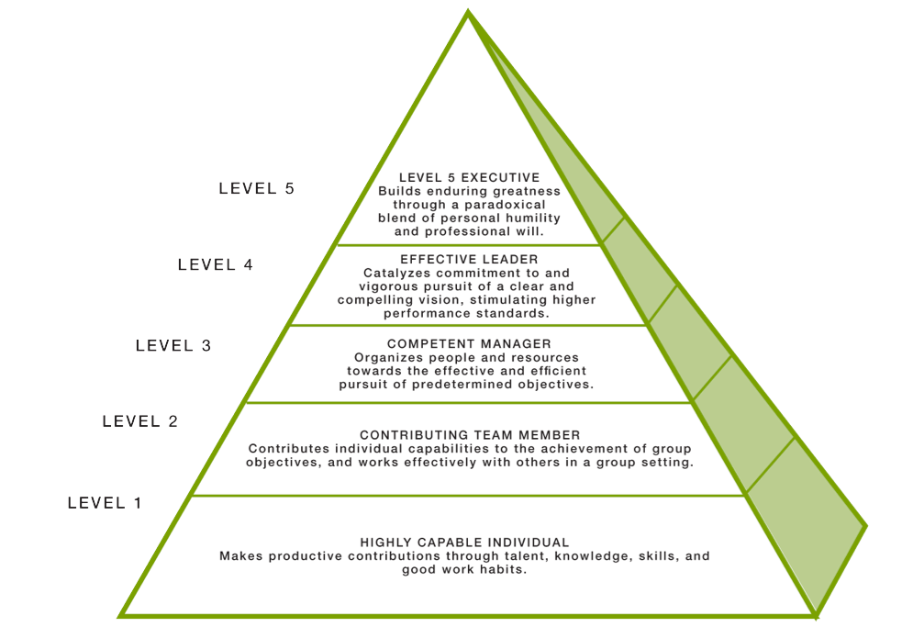
Building an Effective Board Team: Extending Greatness through the Role of the Officer
UNDERSTANDING ROLE(S) AS LEADERS
Ambitious to the cause, the movement, the mission, the work
Makes sure the right decisions happens for the “greatness” of the organization
Good to Great and the Social Sectors: A Monograph to Accompany Good to Great:
Jim Collins, 2005
Notes:
As Jim Collins would tell us . . . Leadership boards are “ambitious to the case, the movement, the mission, the work – makes all decisions for the greatness of the organization (level 5 leadership)

Slide 15
Building an Effective Board Team: Extending Greatness through the Role of the Officer
Ethical Conduct
Attend all regularly scheduled Board meetings and stay informed on issues
Make policy decisions only after full discussion at public board meeting
Render all decisions based on available facts and independent judgment
Encourage free expression of opinion by all Board members and seek systematic communications among the Board and students, staff, and all elements of the community
Work with other Board members to establish effective policies and delegate authority for the administration of the Academy
Communicate effectively
Keep informed on relevant educational issues
Avoid conflicts of interest and refrain from using board positions for personal or partisan gain
Take no private action that may compromise the board or administration and respect the confidentiality of information that is privileged
Remember that the first and greatest concern must be for the educational welfare of the students
Source: Extracted from the National Charter Schools Institute Board Policy 0144.2 – Board Member Ethics
Notes:
As Jim Collins would tell us . . . Leadership boards are “ambitious to the case, the movement, the mission, the work – makes all decisions for the greatness of the organization (level 5 leadership)

Slide 16
Building an Effective Board Team: Extending Greatness through the Role of the Officer
ENGAGING IN FUTURE PLANNING
Strategic Plan
Mission
Meld
Matrix
Manu-facture
Measure
Strategic Planning:
Mission
Existing documents containing goals
Strengths, Weaknesses, Opportunities and Threats
Choice template
Measuring effectiveness of plan/goals
Notes:
As Jim Collins would tell us . . . Leadership boards are “ambitious to the case, the movement, the mission, the work – makes all decisions for the greatness of the organization (level 5 leadership)

Slide 17
Building an Effective Board Team: Extending Greatness through the Role of the Officer
Officers and Leadership
Notes:
All officers should serve as an extension of the effective team . . .

Slide 18
Building an Effective Board Team: Extending Greatness through the Role of the Officer
Board Offices Defined
Bylaws
Policy
Board-developed job descriptions
Notes:
Practical definitions found in Bylaws; policy; job descriptions

Slide 19
Building an Effective Board Team: Extending Greatness through the Role of the Officer
Board President
Practical | Leadership
Preside at meetings | Oversees board affairs; acts as the representative of the board as a whole
Speaks to the media and the community | Represents the Academy in the community
Assists in the development of agendas for meetings | Ensures the effective actions of the board in governing and supporting the Academy
Recommends committee development to board | Ensures committee leadership and stays connected with leadership to ensure work is carried out
Establishes search and selection committees, as necessary (for school leadership and/or management) | Initiates board discussions on evaluating school leadership and/or management
Ensures preparation of all pre-meeting materials, committee functions and recruitment and orientation of new board members | Ensures all board matters are handled properly

Slide 20
Building an Effective Board Team: Extending Greatness through the Role of the Officer
Board Vice President
Practical | Leadership
Acts as president in his/her absence | Ability and willingness to assist president in achieving his/her leadership role
Accepts responsibility in/with certain board functions | Ability to lead in the areas of board membership, media, facility(ies), personnel, etc.
Vital part of board officer team | Vital part of board LEADERSHIP team

Slide 21
Building an Effective Board Team: Extending Greatness through the Role of the Officer
Board Secretary
Practical | Leadership
Ensures accurate minutes of meetings are taken and approved | Recruits a “recording secretary” for board consideration, as appropriate and necessary
Ensures all records are maintained as required by law and made available when requested by authorized persons and all corporate records are filed and up-to-date | Understands the laws and expectations relative to corporate/public records
Ensures up-to-date copies of bylaws are available at all meetings | Understands bylaws to the extent that he/she can answer board functioning questions
Ensures proper notification of meetings is given, as specified in the bylaws | Takes leadership role in following Open Meetings Act
Manages general correspondence of board (except for correspondence addressed to others) | Ensures full understanding and transparency of all board correspondence
Functions as signing officer for certain docs | Ensures full understanding of everything that he/she signs

Slide 22
Building an Effective Board Team: Extending Greatness through the Role of the Officer
Board Treasurer
Practical | Leadership
Manages the board's review of, and actions related to, the board's financial responsibilities | Develops and/or implements financial procedures and systems (directly with business manager and/or bookkeeper)
Ensures that appropriate financial reports are made available to the board | Ensures consistent and clear financial reporting of key financial events, trends, concerns and OVERALL ASSESSMENT OF FISCAL HEALTH
Prepares agendas for meetings, including a year-long calendar of issues | Chairs the finance committee
Reviews independent auditor options and recommends an auditor (in conjunction with the finance and/or audit committees) | Meets with the auditor, annually, in conjunction with finance and/or audit committee(s)
Disburse funds, as directed | Ensures, through the finance committee, sound management and maximization of cash and investments

Slide 23
Building an Effective Board Team: Extending Greatness through the Role of the Officer
Board’s Election of Officers
Annual organizational meeting
When you prepare for your organizational meeting/election of officers, are you:
Thinking in advance of officer positions?
Relying on “job descriptions” to help in your discernment?
Electing board officers that can help advance the board’s strategic function?
Electing board officers based upon practical function or leadership skills or both?

Slide 24
Building an Effective Board Team: Extending Greatness through the Role of the Officer
In Summary
Effective boardsmanship begins with an effective recruiting and orientation process
Effective board teams govern as leaders
Effective board teams identify officers that have the highest potential for transcending board’s leadership role

Slide 25
Thank You!
Notes:
In Slide Show mode, click the arrow to enter the PowerPoint Getting Started Center.

