Slide 1

How Well Are You Managing your
Management Agreement?
2018/2019 Webinar ESP Series
Presenter: Angela Irwin
President
AirWin Educational Services, LLC
Notes:
Welcome, introductions
Webinar series: ESP-focused: management agreement (tonight), evaluations (January), selecting management (February)
Thank LSSU for bringing this series to all of you . . . (indicate who is on the webinar from LSSU)
“Housekeeping” – recorded for future use; posted on website
Discuss this session . . .

Slide 2
How Well Are You Managing your
Management Agreement?
“The Board of Directors
is the highest level
of leadership”
(BoardSource)
Notes:
This slide is especially important tonight as we discuss the relationship between management and board – it might not always feel, in the context of the relationship, that you are the highest level of leadership – you are and the enabling legislation supports that . . .

Slide 3
How Well Are You Managing your
Management Agreement?
Relevant Clarification and Definitions
Section 380.502 of The Revised School Code
Sec. 502(1): A public school academy shall be organized and administered under the direction of a board of directors in accordance with this part and with bylaws adopted by the board of directors . . .
(To) Organize: To form a coherent unity or functioning whole
(To) Administer: To manage or supervise the execution, use or conduct of
(To) Govern: Exercise continuous sovereign authority over – to control and direct the making and administration of policy in (Merriam-Webster).
Notes:
One of the opening provisions of the current legislation
Highlighted two key works – organize and administer
Organize – you have a key role to play in ensuring that the school over which you are governing is unified and functioning - rules, regulations, law, policy, etc .
Administer – delegate this responsibility to a third-party provider or a skilled school leader (depending on your structure)
Sovereign: Regardless of how you are structured, you still have the responsibility to exercise the (preeminent) authority that has been granted to you by legislation . . .

Slide 4
How Well Are You Managing your
Management Agreement?
Inputs
(Academy Resources)
Outputs
(Delivery on Resources)
OUTCOMES
Impacts/changes based on effectiveness of inputs and outputs
Notes:
Governing is not concerned, consistently, with inputs; concerned slightly with outputs and concerned significantly about outcomes . .

Slide 5
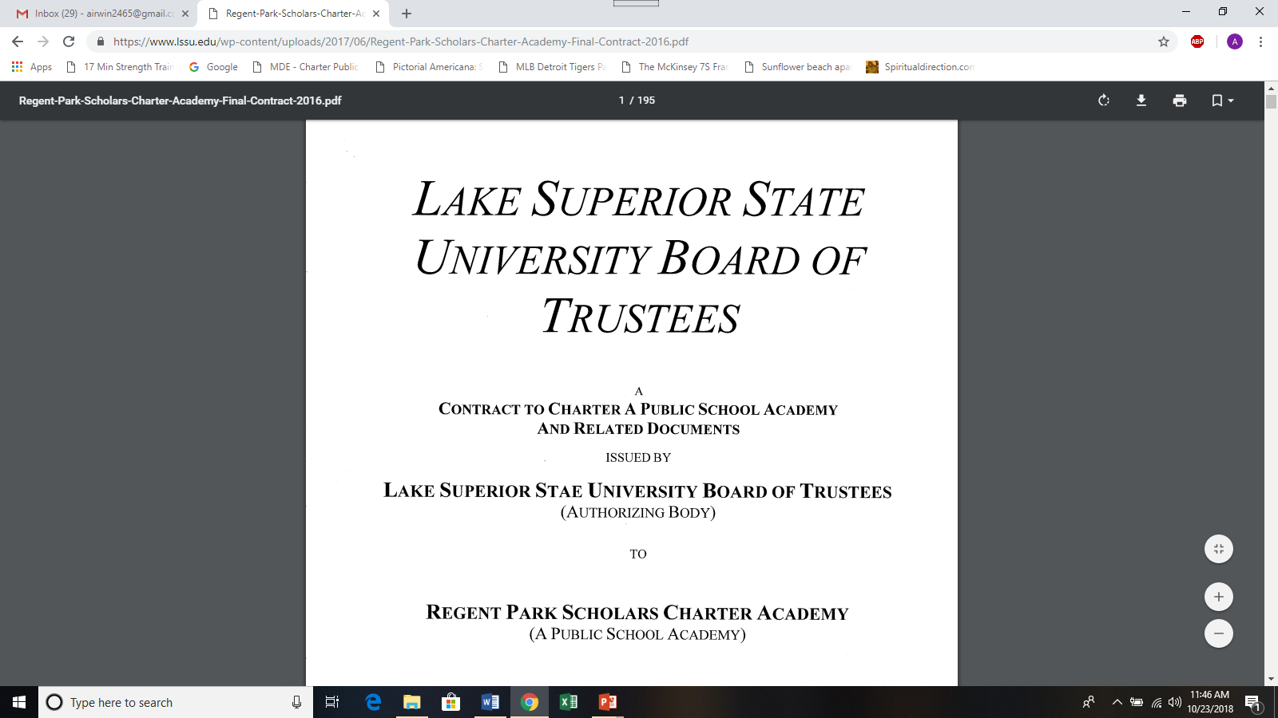
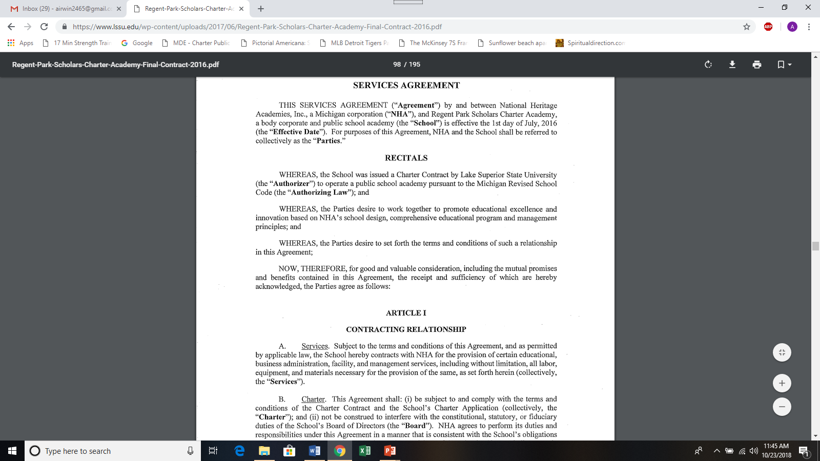
How Well Are You Managing your
Management Agreement?

Slide 6
How Well Are You Managing your
Management Agreement?
ALIGNMENT

Slide 7
How Well Are You Managing your
Management Agreement?
Governance Document Hierarchy
Michigan Constitution
Enabling Legislation
Charter Performance Contract
By laws
Policy
Laws governing non-profit entities
Management Agreement

Slide 8

How Well Are You Managing your
Management Agreement?

Slide 9
How Well Are You Managing your
Management Agreement?
The Role of the Supervisor
An overseer whose main responsibility is to ENSURE that a group of subordinates produce in a timely, quality, cost-productive and safe manner, within the parameters of the JOB for which he/she/they were hired.

Slide 10
How Well Are You Managing your
Management Agreement?
How Does a Board Best Satisfy this Supervisory Role?
1. Understand the job to be performed
2. Understand and/or establish the (board’s) expectations relative to the job to be performed
3. Understand and/or establish the agreed-upon results to be achieved through effective job performance

Slide 11
How Well Are You Managing your
Management Agreement?
Understand the Job to be Performed
What did you hire management to do?
Does what you hired management to do and the job outlined in the agreement align?
Is the board asking for clarification on delineated services (if they are not clear or the board does not understand)?
Are services to be performed, clear, concise and measurable?

Slide 12
How Well Are You Managing your
Management Agreement?
Understand and/or Establish the Expectations Relative to the Job to be Performed
Does the agreement identify performance expectations?
Do those performance expectations align with the charter performance contract?
Are those expectations identified, by service?
Does the agreement address the Board’s expectations on the actions and behaviors by which those services will be conducted?
Has the board and management documented all expectations?

Slide 13
How Well Are You Managing your
Management Agreement?
Understand and/or Establish Agreed Upon Results
  By service, mutually agree upon desired results/outcomes
  Be certain desired results/outcomes are clear, concise and measurable
  Attach documented performance results to service/management agreement
  Use the performance results to guide board meeting discussion
Notes:
For example, agreements might include:
Student recruitment and enrollment
Student assessments
Instructional materials
Employment of personnel
School business admin
Accounting
Food services
Facilities admin and maintenance
Student behavior management and discipline

Slide 14
How Well Are You Managing your
Management Agreement?
From these practices, you then formally evaluate management through a well-defined, well-constructed evaluation process.
Notes:
For example, agreements might include:
Student recruitment and enrollment
Student assessments
Instructional materials
Employment of personnel
School business admin
Accounting
Food services
Facilities admin and maintenance
Student behavior management and discipline

Slide 15
How Well Are You Managing your
Management Agreement?
Summary
Get acquainted with your management agreement
Use board meetings to discuss services and corresponding outcomes/results
Evaluate management, formally
Notes:
For example, agreements might include:
Student recruitment and enrollment
Student assessments
Instructional materials
Employment of personnel
School business admin
Accounting
Food services
Facilities admin and maintenance
Student behavior management and discipline

Slide 16
Thank You!
Notes:
In Slide Show mode, click the arrow to enter the PowerPoint Getting Started Center.

