Slide 1

How Well is Management Performing: Evaluating your ESP
2018/2019 Webinar ESP Series
Presenter: Angela Irwin
President
AirWin Educational Services, LLC
Notes:
Welcome, introductions
Webinar series: ESP-focused: management agreement (tonight), evaluations (January), selecting management (February)
Thank LSSU for bringing this series to all of you . . . (indicate who is on the webinar from LSSU)
“Housekeeping” – recorded for future use; posted on website
Discuss this session . . .
First few slides will serve as a review of November 7th session

Slide 2
REVIEW
Notes:
In Slide Show mode, click the arrow to enter the PowerPoint Getting Started Center.

Slide 3
How Well is Management Performing: Evaluating your ESP
“The Board of Directors
is the highest level
of leadership”
(BoardSource)
Notes:
Use the first few slides to reacquaint us with this series by reminding all of you of what we discussed in October during our Managing your Management Agreement discussion
I will continue to open up our sessions with this slide, which, as I indicated during our last session is critically important when we are discussing the board/esp relationship

Slide 4
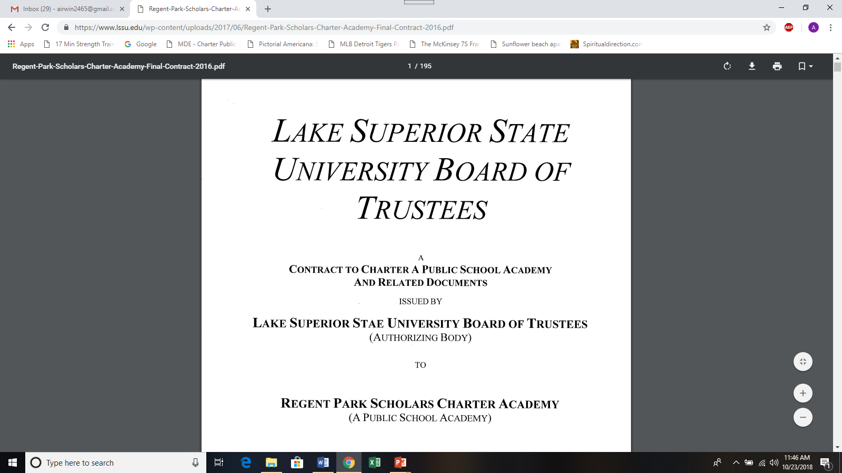
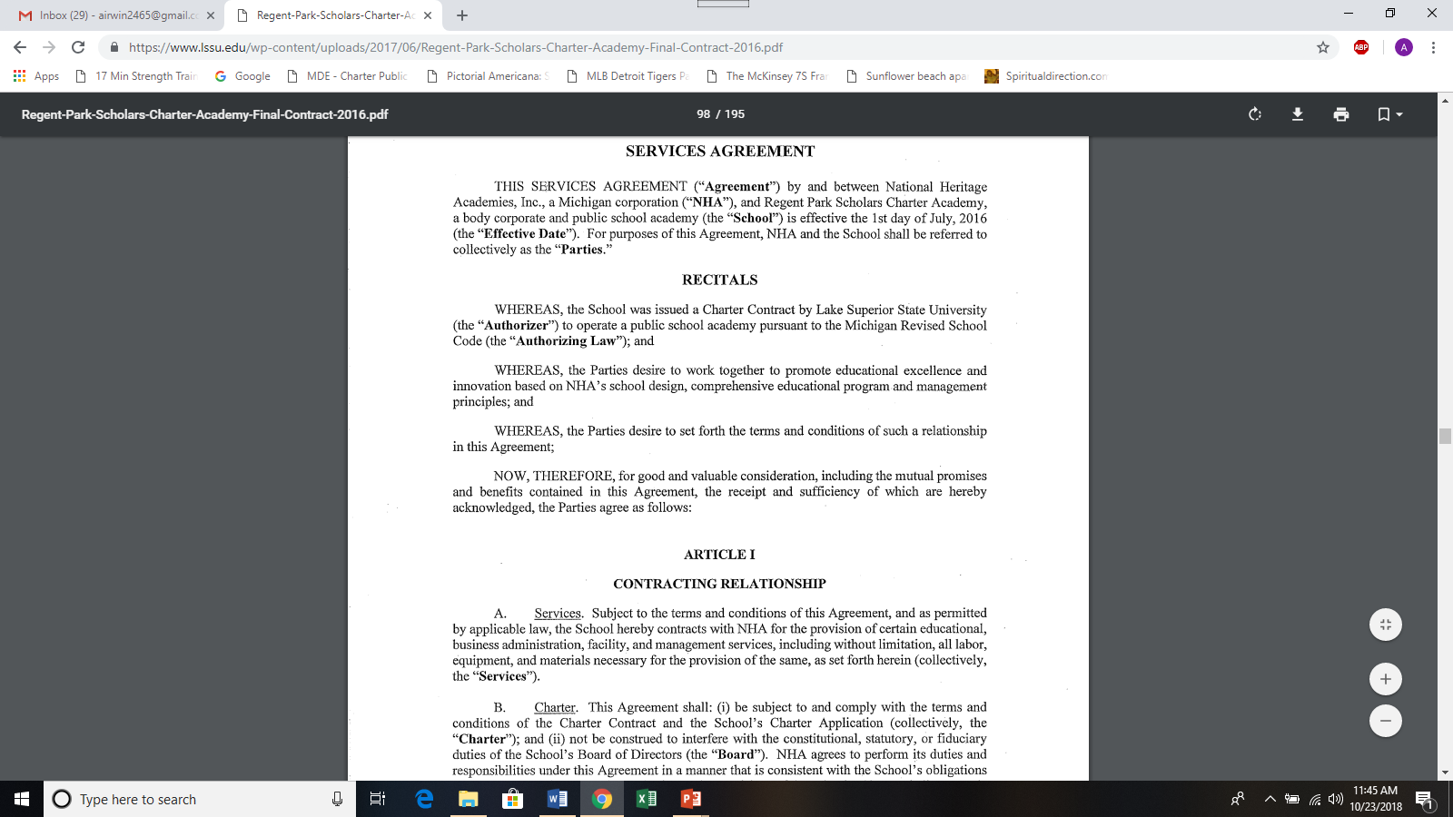
How Well is Management Performing: Evaluating your ESP
ALIGNMENT

Slide 5

How Well is Management Performing: Evaluating your ESP

Slide 6
How Well is Management Performing: Evaluating your ESP
The Role of the Supervisor
An overseer whose main responsibility is to ENSURE that a group of subordinates produce/perform in a timely, quality, cost-productive and safe manner, within the parameters of the JOB for which he/she/they were hired.

Slide 7
EVALUATING YOUR ESP
Notes:
In Slide Show mode, click the arrow to enter the PowerPoint Getting Started Center.

Slide 8
How Well is Management Performing: Evaluating your ESP
What did you hire management to do?
Impact educational environment (teaching and learning)
Safeguard taxpayer’s dollars (in cooperation with Board)
Preserve conducive (learning) climate/culture
Effectively “operate” the school
Notes:
Discussed this in November in terms of getting acquainted with your agreement . . . tonight’s discussion is about understanding the agreement so you can evaluate management fairly and accordingly (i.e. according to the services they are to provide or the “job” they are to perform).

Slide 9
How Well is Management Performing: Evaluating your ESP
How do you Know if management is performing . . . .
Two Typical Ways:
Monthly (assurance) reporting
Formal evaluation(s)
Notes:
Last webinar we discussed how to effectuate your supervisory role . . . Tonight we are going to discuss how best to answer this question . . .

Slide 10
MONTHLY REPORTING
Notes:
In Slide Show mode, click the arrow to enter the PowerPoint Getting Started Center.

Slide 11
How Well is Management Performing: Evaluating your ESP
(Sample) Key Performance Indicators
Educational Environment | Finances | Climate/Culture | Operations
Student growth and proficiency | Fund allocation | Chronic absenteeism | Technology services
Cohort data | Fund balance | Student/staff parent engagement | Food services
Subgroup data | Budget | Suspension/expulsions | Maintenance services
College prep data/information | Audit | Social-emotional skills | Teacher effectiveness
Mission-specific data | Transparency | Special education | School leadership effectiveness
Subject data |  | Respect for diversity | Marketing/enrollment
At-risk program data |  | School participation | Exterior services
Climate and culture |  | Physical safety | Compliance reporting
Student mobility/attrition |  | Physical environment
Leadership mobility/attrition |  | Academic environment
Facility safety and security |  | Wellness
 |  | Relationships
Notes:
Last webinar we discussed how to effectuate your supervisory role . . . Tonight we are going to discuss how best to answer this question . . .

Slide 12
How Well is Management Performing: Evaluating your ESP
(Sample) Key Performance Indicators: Educational Environment
Educational Environment | Expectations (Desired Outcomes)
Student growth and proficiency
Cohort data
Subgroup data
College prep data/information
Mission-specific data
Subject data
At-risk program data
Climate and culture
Student mobility/attrition
Leadership mobility/attrition
Facility safety and security
Notes:
Last webinar we discussed how to effectuate your supervisory role . . . Tonight we are going to discuss how best to answer this question . . .

Slide 13
How Well is Management Performing: Evaluating your ESP
(Sample) Key Performance Indicators: Finances
Finances | Expectations (Desired Outcomes)
Fund allocation
Fund balance
Budget
Audit
Transparency
Notes:
Last webinar we discussed how to effectuate your supervisory role . . . Tonight we are going to discuss how best to answer this question . . .

Slide 14
How Well is Management Performing: Evaluating your ESP
(Sample) Key Performance Indicators: Climate/Culture
Climate/Culture | Expectations (Desired Outcomes)
Chronic absenteeism
Student/staff parent engagement
Suspension/expulsions
Social-emotional skills
Special education
Respect for diversity
School participation
Physical safety
Physical environment
Academic environment
Wellness
Relationships
Notes:
Last webinar we discussed how to effectuate your supervisory role . . . Tonight we are going to discuss how best to answer this question . . .

Slide 15
How Well is Management Performing: Evaluating your ESP
(Sample) Key Performance Indicators: Operations
Operations | Expectations (Desired Outcomes)
Technology and services
Food services
Maintenance services
Teacher effectiveness
School leadership effectiveness
Marketing/enrollment
Exterior services
Fiscal integrity
Compliance reporting
Notes:
Last webinar we discussed how to effectuate your supervisory role . . . Tonight we are going to discuss how best to answer this question . . .

Slide 16
How Well is Management Performing: Evaluating your ESP
Inputs
(Academy Resources)
Outputs
(Delivery on Resources)
OUTCOMES
Impacts/changes based on effectiveness of inputs and outputs
Notes:
All reporting topics should be aligned with the expectations and measurements outlined in the formal management agreement . . .

Slide 17
FORMAL EVALUATION
Notes:
In Slide Show mode, click the arrow to enter the PowerPoint Getting Started Center.

Slide 18
How Well is Management Performing: Evaluating your ESP
FAIR AND TRANSPARENT
Documented evaluation process, formally adopted by Board
Action plan that outlines evaluation timing expectations
Agreed-upon evaluation instrument with well-defined criterial (based on monthly reporting tool)
Agreed upon rubric
Action plan identifying areas of improvement
Notes:
All reporting topics should be aligned with the expectations and measurements outlined in the formal management agreement . . .

Slide 19
How Well is Management Performing: Evaluating your ESP
SCHOOL LEADER EVALUATIONS
PA 170 & 173
LSSU is currently working with MDE and the Michigan Council of Authorizers to establish a best practices reference document that will help schools ensure they are in compliance with the revised school code, specifically subsection 380.1249b.
Notes:
All reporting topics should be aligned with the expectations and measurements outlined in the formal management agreement . . .

Slide 20

How Well is Management Performing: Evaluating your ESP
PERFORMANCE
PERFORMANCE
Board
Board
Authorizer
ESP
Authorizer
ESP
Not understanding and/or respecting roles, performance expectations and/or accountability
Notes:
All reporting topics should be aligned with the expectations and measurements outlined in the formal management agreement . . .

Slide 21
Thank You!
Notes:
In Slide Show mode, click the arrow to enter the PowerPoint Getting Started Center.

