Slide 1

Assessing School Services: Best Practices for Making Services Transitions
2018/2019 Webinar ESP Series
Presenter: Angela Irwin
President
AirWin Educational Services, LLC
Notes:
Welcome, introductions
Webinar series: ESP-focused: management agreement (tonight), evaluations (January), selecting management (February)
Thank LSSU for bringing this series to all of you . . . (indicate who is on the webinar from LSSU)
“Housekeeping” – recorded for future use; posted on website
Discuss this session . . .
First few slides will serve as a review of November 7th session

Slide 2
Assessing School Services:
Best Practices for Making Services Transitions
Session Clarification!
Notes:
Use the first few slides to reacquaint us with this series by reminding all of you of what we discussed in October during our Managing your Management Agreement discussion
I will continue to open up our sessions with this slide, which, as I indicated during our last session is critically important when we are discussing the board/esp relationship

Slide 3
Assessing School Services:
Best Practices for Making Services Transitions
“The Board of Directors
is the highest level
of leadership”
(BoardSource)
Notes:
Use the first few slides to reacquaint us with this series by reminding all of you of what we discussed in October during our Managing your Management Agreement discussion
I will continue to open up our sessions with this slide, which, as I indicated during our last session is critically important when we are discussing the board/esp relationship

Slide 4
Best Practices
Notes:
In Slide Show mode, click the arrow to enter the PowerPoint Getting Started Center.

Slide 5
Assessing School Services:
Best Practices for Making Services Transitions
Best Practice #1:
Understand your Contract/Agreement
Notes:
All reporting topics should be aligned with the expectations and measurements outlined in the formal management agreement . . .

Slide 6
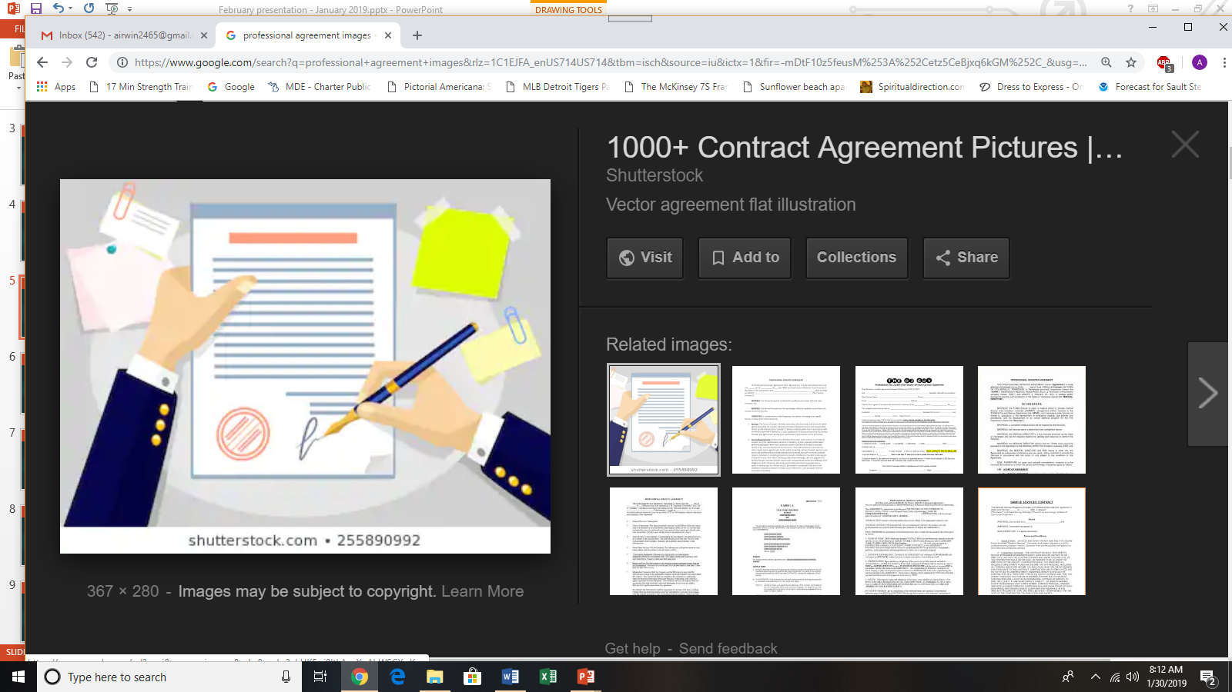
Assessing School Services:
Best Practices for Making Services Transitions
Notification Language
Services Language
Termination Language
Notes:
All reporting topics should be aligned with the expectations and measurements outlined in the formal management agreement . . .

Slide 7
Assessing School Services:
Best Practices for Making Services Transitions
Best Practice #2:
Ensure Open Communication
Notes:
All reporting topics should be aligned with the expectations and measurements outlined in the formal management agreement . . .

Slide 8
Assessing School Services:
Best Practices for Making Services Transitions
Communications Network
PRIMARY
Authorizer
School Families
Michigan Department of Education
School Staff
Legal Counsel
Vendor
Notes:
All reporting topics should be aligned with the expectations and measurements outlined in the formal management agreement . . .

Slide 9
Assessing School Services:
Best Practices for Making Services Transitions
Sample Communications Plan
Notes:
All reporting topics should be aligned with the expectations and measurements outlined in the formal management agreement . . .

Slide 10
Assessing School Services:
Best Practices for Making Services Transitions
Best Practice #3:
Perform a Needs Analysis
Notes:
All reporting topics should be aligned with the expectations and measurements outlined in the formal management agreement . . .

Slide 11
Assessing School Services:
Best Practices for Making Services Transitions
Evaluations
Performance Gaps
Requirements
Stakeholders
Process
Notes:
All reporting topics should be aligned with the expectations and measurements outlined in the formal management agreement . . .

Slide 12
Assessing School Services:
Best Practices for Making Services Transitions
Best Practice #4: Develop/Review Process
Notes:
All reporting topics should be aligned with the expectations and measurements outlined in the formal management agreement . . .

Slide 13
Assessing School Services:
Best Practices for Making Services Transitions
Project Planning
Drafting the RFP
Issuing the RFP
Reviewing Proposals and Awarding Contract
Notes:
All reporting topics should be aligned with the expectations and measurements outlined in the formal management agreement . . .

Slide 14
Assessing School Services:
Best Practices for Making Services Transitions
Best Practice #5:
Implement Process with Fidelity
Notes:
All reporting topics should be aligned with the expectations and measurements outlined in the formal management agreement . . .

Slide 15
Assessing School Services:
Best Practices for Making Services Transitions
Identify:
Requirements
Scope (of services)
Alignment with vision/mission/values
Range of vendors
Budget
Time line
Committee
Screening criteria and review process
Project Planning
Notes:
All reporting topics should be aligned with the expectations and measurements outlined in the formal management agreement . . .

Slide 16
Assessing School Services:
Best Practices for Making Services Transitions
Sections Include:
Introduction
Statement of Purpose
Background information
Scope of work/services
Budget
Agreement terms and conditions
RFP timeline, including review process
Requirements for proposals
Drafting the RFP
Notes:
All reporting topics should be aligned with the expectations and measurements outlined in the formal management agreement . . .

Slide 17
Assessing School Services:
Best Practices for Making Services Transitions
Coordinate responses and answer questions
Receive submissions
Distribute to networks
Issuing RFP
Notes:
All reporting topics should be aligned with the expectations and measurements outlined in the formal management agreement . . .

Slide 18
Assessing School Services:
Best Practices for Making Services Transitions
Review proposals
Complete interviews and reference checks
Final negotiations (note authorizer policies and/or requirements with respect to negotiating new agreements)
Notify other applicants
Select finalists
Score proposals
Notify finalist
Begin meeting(s) and negotiating contract
Reviewing Proposals and Awarding Contract
Notes:
All reporting topics should be aligned with the expectations and measurements outlined in the formal management agreement . . .

Slide 19
Concluding Thoughts
Notes:
In Slide Show mode, click the arrow to enter the PowerPoint Getting Started Center.

Slide 20
Assessing School Services:
Best Practices for Making Services Transitions
Noteworthy Items
If transitioning management services, be mindful of authorizer policies with respect to process and/or negotiated agreements
If transitioning management, be mindful of need to allow “public” to ask questions or comment on new management in public meeting
Keep authorizer engaged in process as much as authorizer desires
Ensure mutual understanding of expectations with new vendor
Notes:
All reporting topics should be aligned with the expectations and measurements outlined in the formal management agreement . . .

Slide 21
Thank You!
Notes:
In Slide Show mode, click the arrow to enter the PowerPoint Getting Started Center.

