Slide 1

Governing in a post-pandemic environment: Navigating Your Board role within a new reality
Owning your Budget During Change
Webinar #3: November 18, 2020
Notes:
NOTE:
To change the image on this slide, select the picture and delete it. Then click the Pictures icon in the placeholder to insert your own image.

Slide 2
OWNING YOUR BUDGET DURING CHANGE
Board of Directors:
To serve as the highest level of leadership by directing academic, fiscal and operational performance and holding management accountable for results within the parameters of the directing goals.
Accountable/Accountability:
Accepting complete responsibility for academic, fiscal and operational actions and being able to give a satisfactory reason for the actions and/or a satisfactory report on results/outcomes.

Slide 3

OWNING YOUR BUDGET DURING CHANGE
To demonstrate ownership of your governance role is to apply, consistently, the understanding of the director/accountability exchange to your governance practices.

Slide 4
OWNING YOUR BUDGET DURING CHANGE
How School Funding Works
Notes:
Start with timeline; determine who initiates the process based on documented guidance (i.e. ESP, School Leader, etc.); ensure a cooperative budgeting system

Slide 5

OWNING YOUR BUDGET DURING CHANGE
What Steps Should Board’s Take, Then, in Ensuring Budget Fidelity?
Notes:
Start with timeline; determine who initiates the process based on documented guidance (i.e. ESP, School Leader, etc.); ensure a cooperative budgeting system

Slide 6

OWNING YOUR BUDGET DURING CHANGE
Step 1: Review Your Budgeting Process
Notes:
Start with timeline; determine who initiates the process based on documented guidance (i.e. ESP, School Leader, etc.); ensure a cooperative budgeting system

Slide 7
OWNING YOUR BUDGET DURING CHANGE
Step 2: Understand All Budget Components
Revenues | Expenditures | Excess of Revenues Over/(Under) Expenditures | Beginning and Projected Ending Fund Balance
Local Sources | Instruction | Difference between revenues and expenditures | Estimated Beginning Fund Balance of beginning of budget year
State Sources | Supporting Services |  | Projected Ending Fund balance of end of budget year
Federal Sources
Other Sources
TOTAL REVENUES | TOTAL EXPENDITURES
Notes:
“A budget helps bridge the gap that can exist between a district’s stated goals and resource allocation . . .”

Slide 8

OWNING YOUR BUDGET DURING CHANGE
Step 3: Ensure Key Programs/Strategies are Adequately Funded
This Photo by Unknown Author is licensed under CC BY

Slide 9

OWNING YOUR BUDGET DURING CHANGE
Step 4: Ensure Board is Receiving Adequate Financial Information

Slide 10
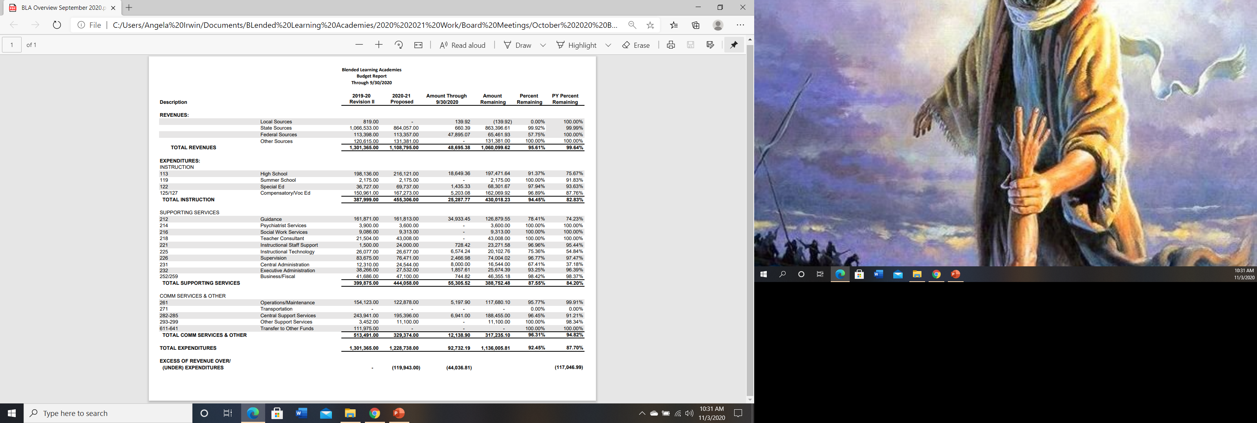
OWNING YOUR BUDGET DURING CHANGE
Step 5: Track Budget to Actual(s) Over Fiscal Year

Slide 11

OWNING YOUR BUDGET DURING CHANGE
“A budget is only a tool. It will take you wherever you wish, but it will not replace you as the driver.”

Slide 12

OWNING YOUR BUDGET DURING CHANGE
THANK YOU FOR PARTICIPATING
Angela L. Irwin
4521 Henry Drive
Beaverton, MI 48612
989-239-7555
Email: angela@airwinllc.com

