Slide 1
Governing in a post-pandemic environment: Navigating Your Board role within a new reality
Owning Board Culture During Change
Webinar #3: February 3, 2021
Notes:
NOTE:
To change the image on this slide, select the picture and delete it. Then click the Pictures icon in the placeholder to insert your own image.

Slide 2
OWNING BOARD CULTURE DURING CHANGE
“Board culture has a significant influence on the way your board carries out its work and shapes your board performance.” BoardSource: https://boardsource.org/fundamental-topics-of-nonprofit-board-service/culture-dyna

Slide 3
OWNING BOARD CULTURE DURING CHANGE
Board Culture Defined
Set of traditions and habits established over time that guide behavior – written and unwritten rules that influence relationships between board members

Slide 4
OWNING BOARD CULTURE DURING CHANGE
Four Models of Boards
Inquisitive: Boards that place a premium on “the exchange of ideas and the exploration of alternatives”
Decisive: These boards place a great deal of importance on “measurable results, driving a focused agenda and outcome-oriented decisions.”
Collaborative: These boards “value consensus and having a greater purpose.”
Disciplined: Boards that “emphasize consistency and managing risks and prioritize planning and adherence to protocols.””
Source: How to Create a Healthy Board Culture
Diligent Insights
May 2019
Rick Hoel
Notes:
“The question that needs to be asked, regularly, is how your board’s blend is working for you. These four models help boards determine, from their own results, when it may be necessary to place more emphasis on one or more of these governing types.”

Slide 5
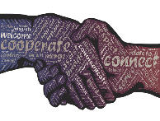
OWNING BOARD CULTURE DURING CHANGE
Characteristics of a Strong Board Culture
A healthy and respectful partnership between and among all stakeholders (i.e. board, leadership and authorizer)
Trust and candor between board members
Thoughtful and productive resolution of issues or disagreements
A willingness to address poor board behavior that is negatively impacting the board

Slide 6
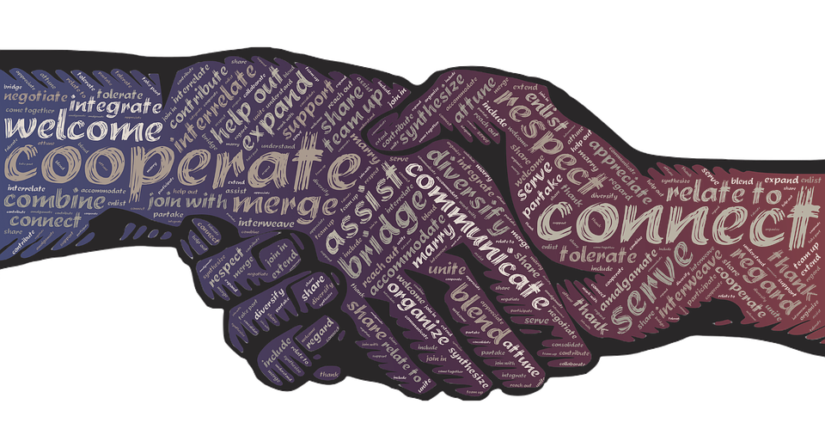
OWNING BOARD CULTURE DURING CHANGE
CULTIVATE HEALTHY AND RESPECTFUL RELATIONSHIPS
Clear expectations
Open and honest communication
Understand/respect roles of all parties involved in work
Knowledge of role/work
Board language

Slide 7
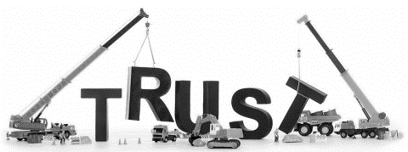
OWNING BOARD CULTURE DURING CHANGE
BUILD TRUST AND CANDOR
Consistency in governance/decision-making
Transparency
Ensure “safe” environment
Share information
Maintain confidentiality

Slide 8
OWNING BOARD CULTURE DURING CHANGE
RESOLVE ISSUES THOUGHTFULLY AND PRODUCTIVELY
“One of the frequent criticisms of boards has been a preference for ‘getting along’ at the expense of perhaps necessary conflicts that challenge complacent thinking.”
Source: How to Create a Healthy Board Culture
Diligent Insights
May 2019
Rick Hoel
Board leadership
Diversity in board
Committing to the vision
Governing to the mission
Listen, listen, listen
Consider all perspectives

Slide 9
OWNING BOARD CULTURE DURING CHANGE
ADDRESS POOR BEHAVIOR
“Bad gets worse when you avoid it”
Expectations regarding conduct
Delegate conversation to one board member
“Praise in public, punish in private”
Seek to understand
Reach mutual agreement on solution

Slide 10
OWNING BOARD CULTURE DURING CHANGE
NOW WHAT?
Identify your culture, considering the four models
Determine if your current makeup supports your culture
Determine if you are operating within the parameters of your desired culture
Discuss committee functions within the parameters of your desired culture
Assess/re-evaluate your board recruitment efforts
Review board self-evaluations to add cultural component

Slide 11
OWNING BOARD CULTURE DURING CHANGE
THANK YOU FOR PARTICIPATING
Angela L. Irwin 4521 Henry Drive Beaverton, MI 48612 989-239-7555 Email: angela@airwinllc.com

