Slide 1
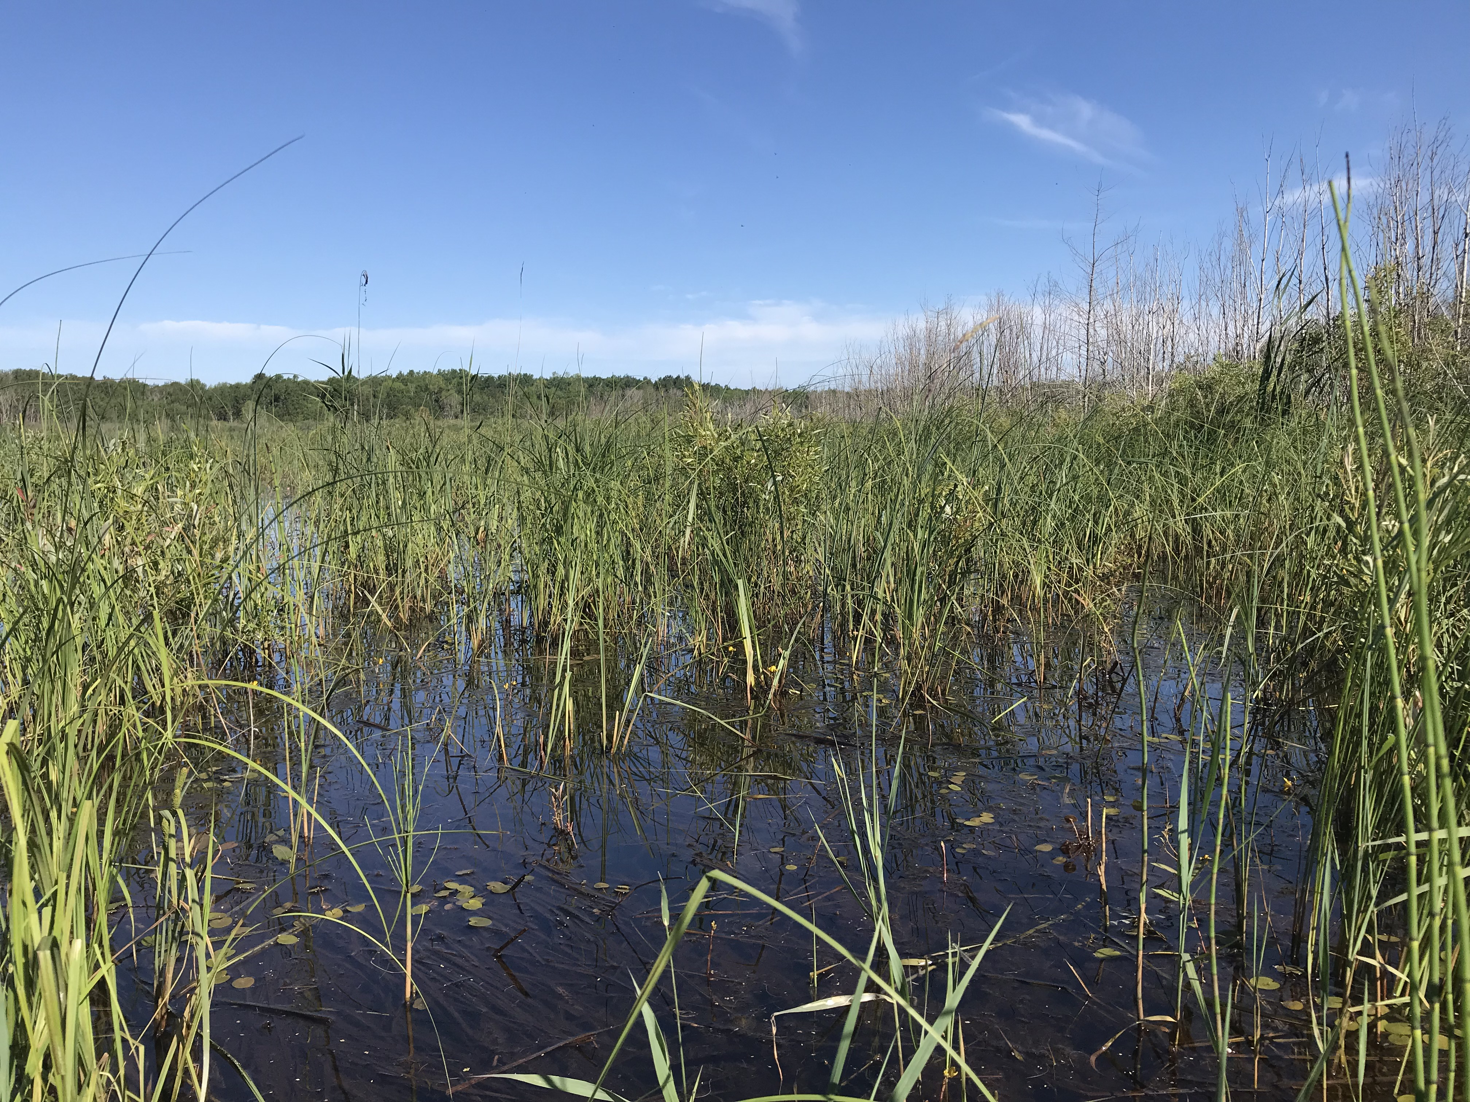
Stewardship
What does it mean?

Slide 2
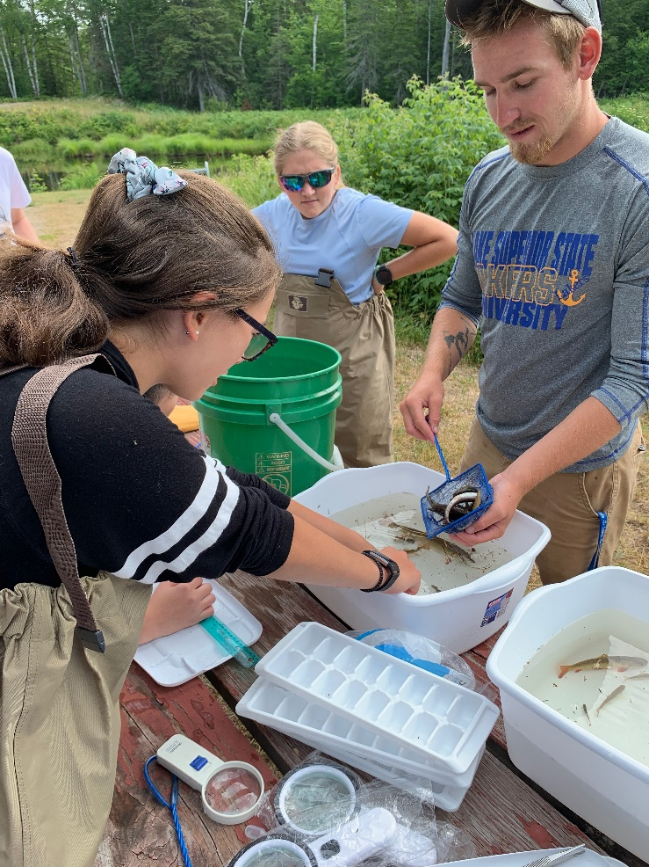
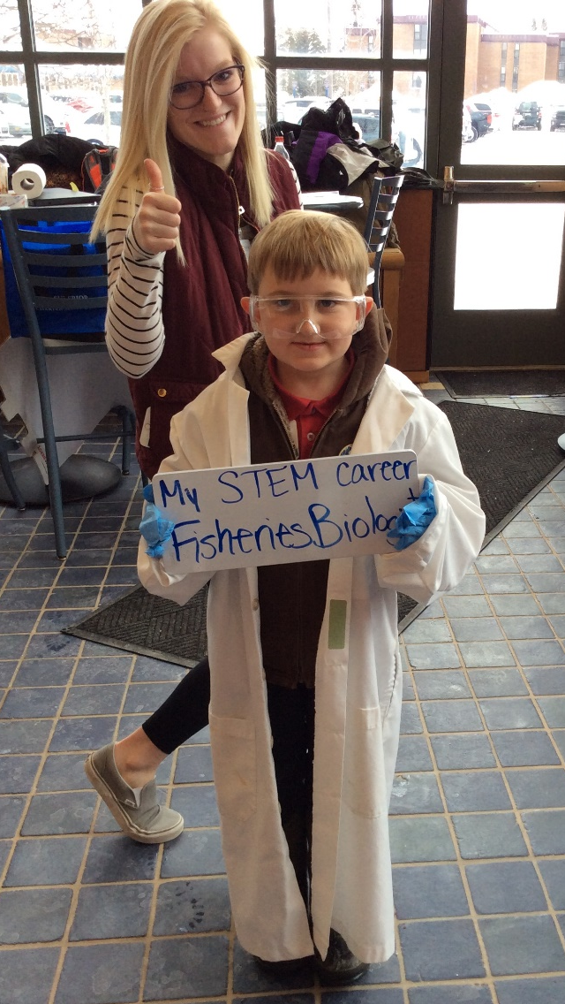
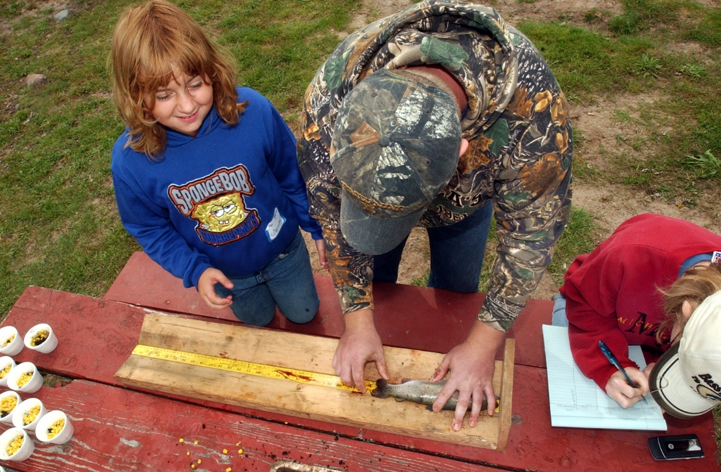
You cannot get through a single day without having an impact on the world around you. What you do makes a difference and you have to decide what kind of a difference you want to make.
—Jane Goodall

Slide 3
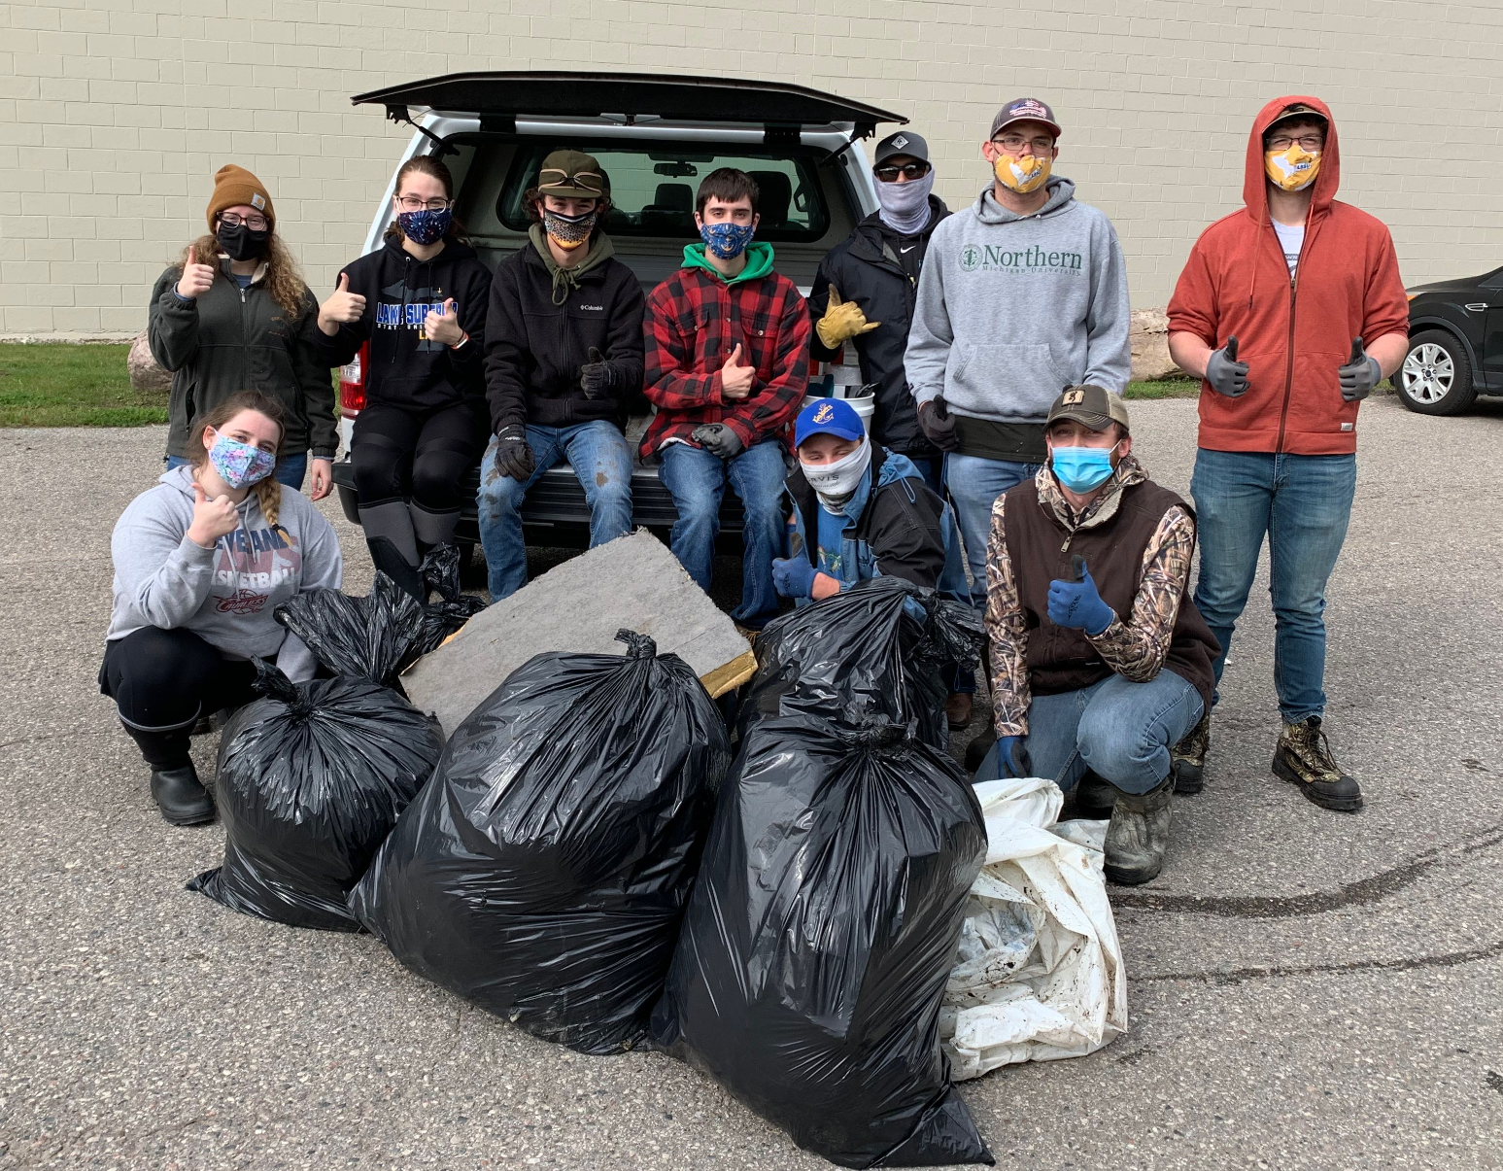
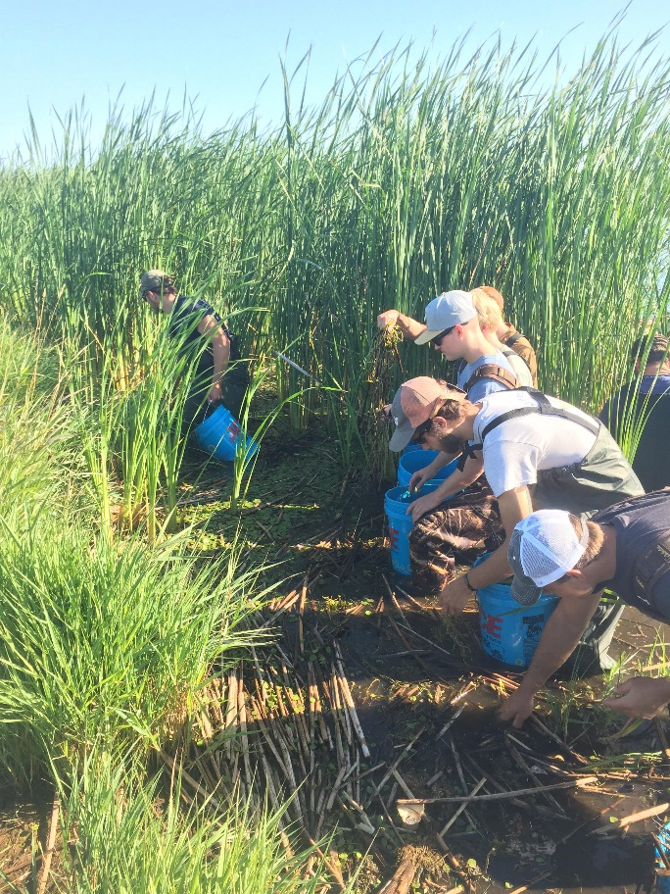
Environmental Stewardship:
A sense of caring about, connection to, and responsibility
for the well-being of our natural and human communities.
Advocacy for the natural world and each other.
Humans are responsible for the world and should take care of it.
Anishinaabe culture:
  Kinship with nature; we don’t live on this planet alone.
  We are all connected—earth, air, water, animals, plants—and equally important.

Slide 4
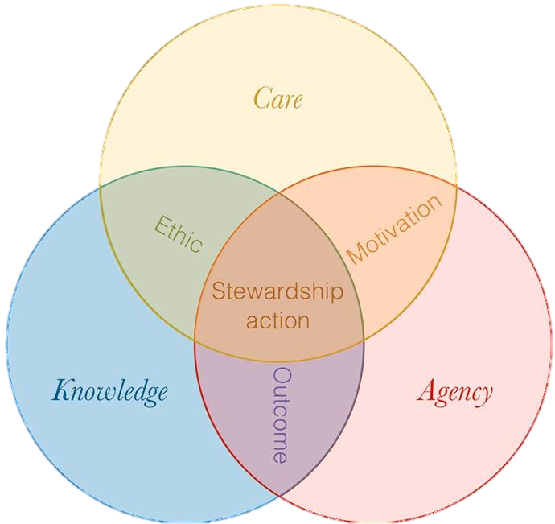
Three Parts to Environmental Stewardship:
Knowledge: information and understanding
Care: attachment and responsibility
Agency: ability to take positive action
Enqvist, Johan Peçanha, et al. “Stewardship as a Boundary Object for Sustainability Research: Linking Care, Knowledge and Agency.” Landscape and Urban Planning, Elsevier B. V., 25 July 2018, www.sciencedirect.com/science/article/pii/S0169204618305966.

Slide 5
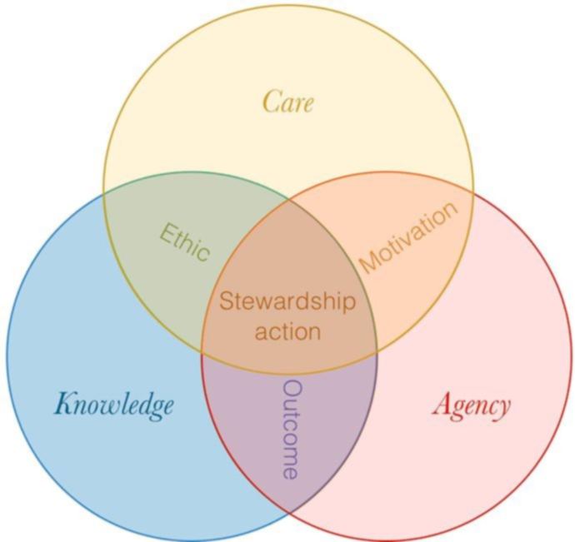
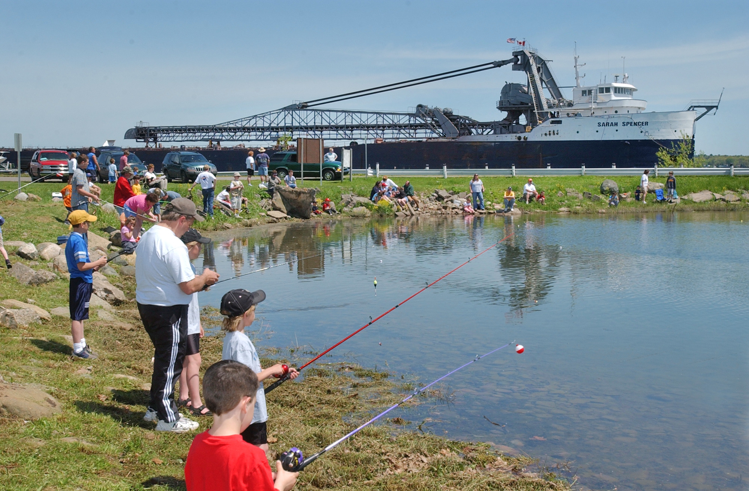
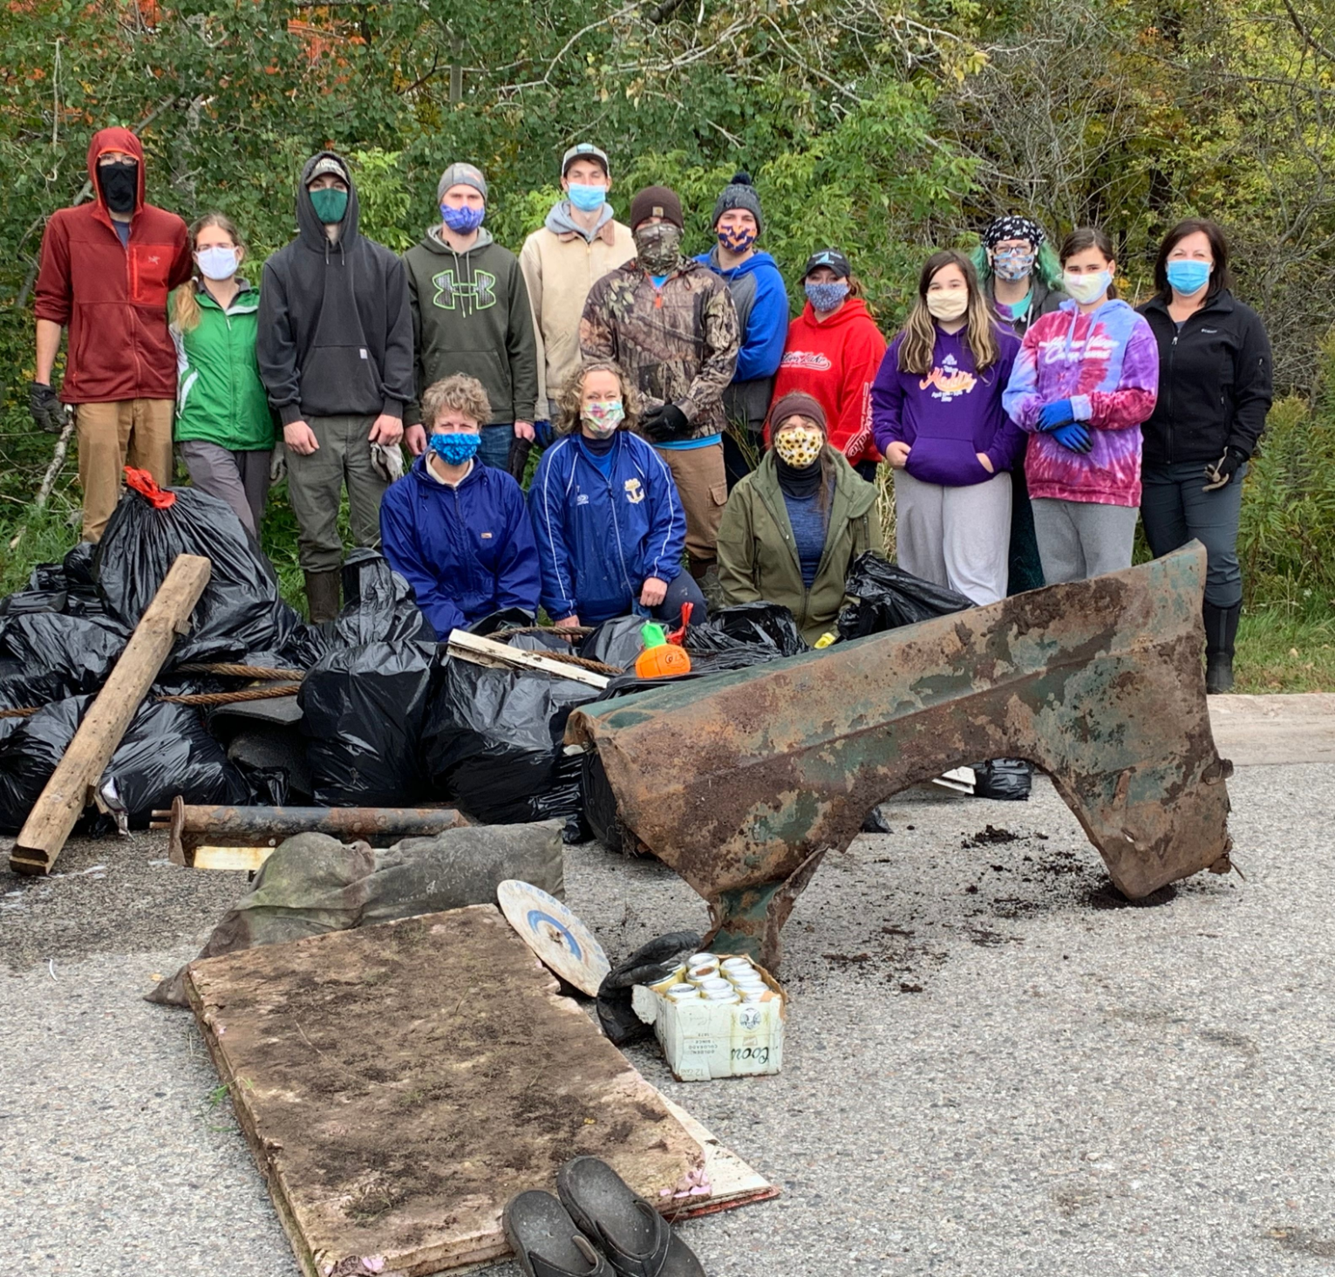
Approaches to stewardship:
Ethic i.e., moral guidelines, virtues, or principles shaping human relationship with the environment
Motivation i.e., what drives people to engage in pro-environmental or sustainable behaviors
Outcome i.e., pursuit or achievement of positive results or consequences
Action i.e., an activity, practice, or initiative intended to achieve an environmental benefit
Enqvist, Johan Peçanha, et al. “Stewardship as a Boundary Object for Sustainability Research: Linking Care, Knowledge and Agency.” Landscape and Urban Planning, Elsevier B. V., 25 July 2018, www.sciencedirect.com/science/article/pii/S0169204618305966.

Slide 6
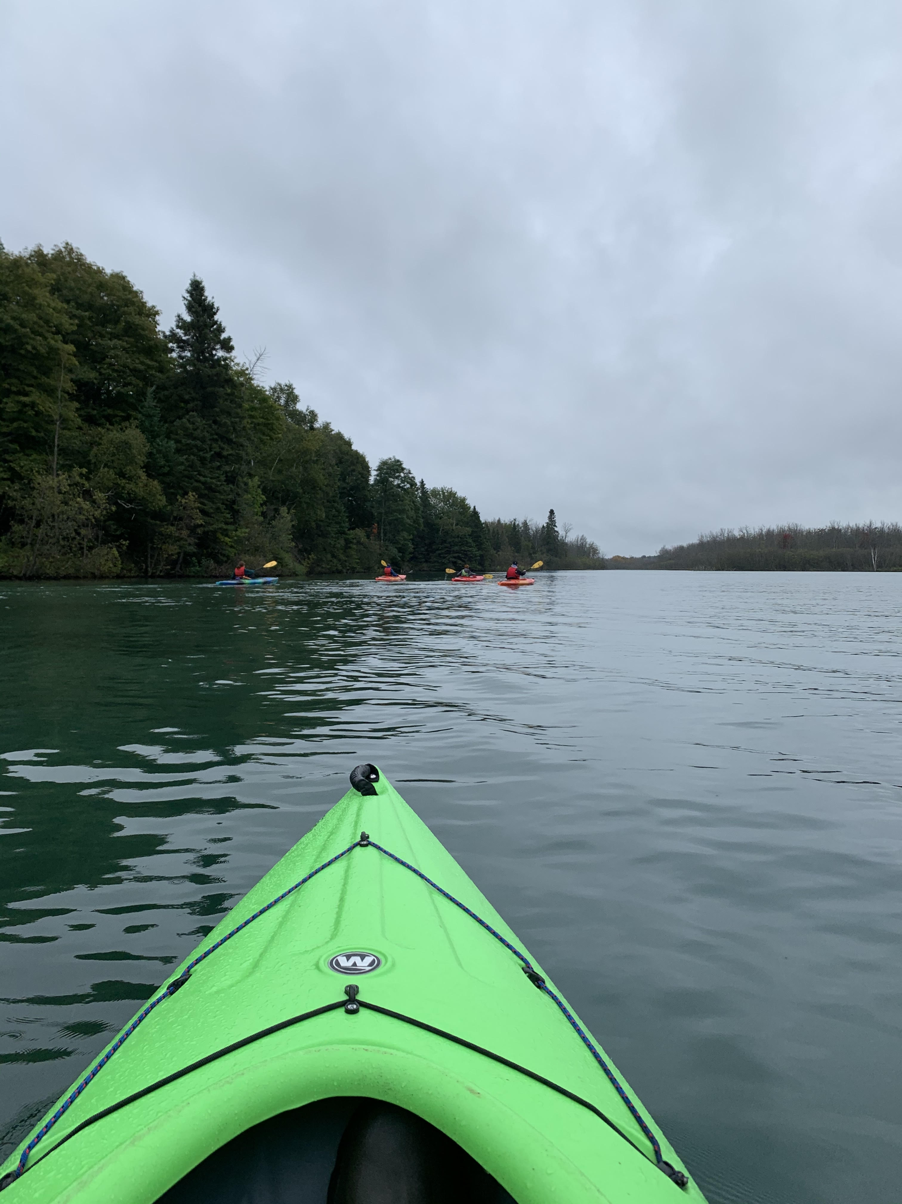
The process of stewardship:
Awareness to Advocacy and Action
Awareness (knowledge) of the natural environment
A sense of place in the natural world
Value and appreciation of this place
Actively care for this place
Inspired and empowered to improve our place and those connected to it
Result: Lifelong stewardship! A steward of(for) the environment.

Slide 7
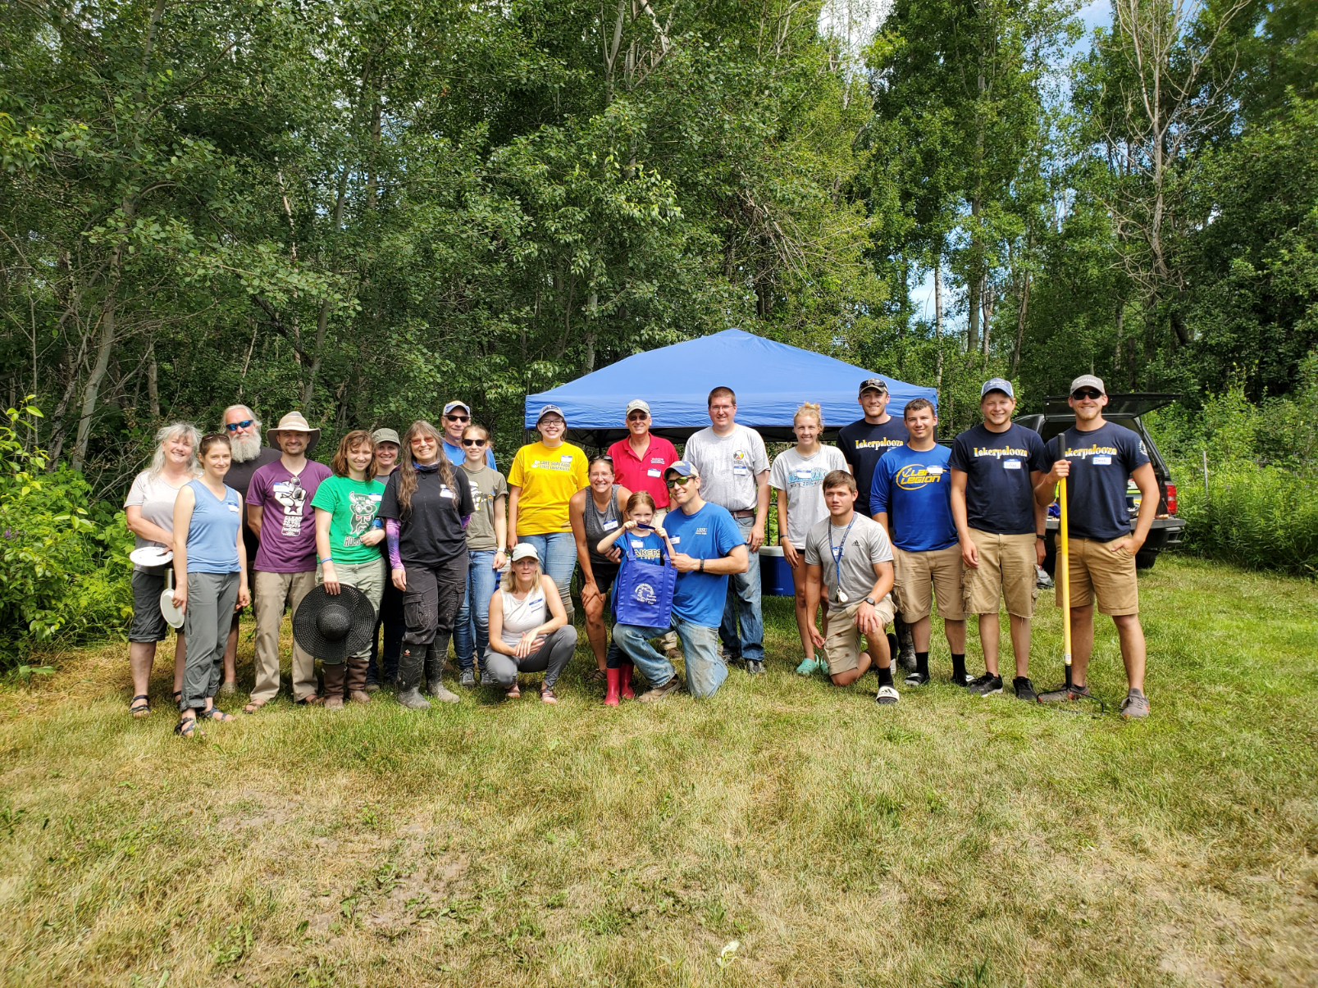
Never doubt that a small group of thoughtful, committed citizens can change the world; indeed, it is the only thing that ever has.
—Margaret Mead

Slide 8
