Slide 1
Extending Board Greatness through the Role of the Officer
On-demand Webinar: AirWin Educational Services, LLC.

Slide 2
Extending Board Greatness through the Role of the Officer
“Officers of the board oversee and direct the major aspects of the organization’s operations. Board officers, including president, vice president, secretary and treasurer, fill specific leadership roles.”
www.work.chron.com

Slide 3
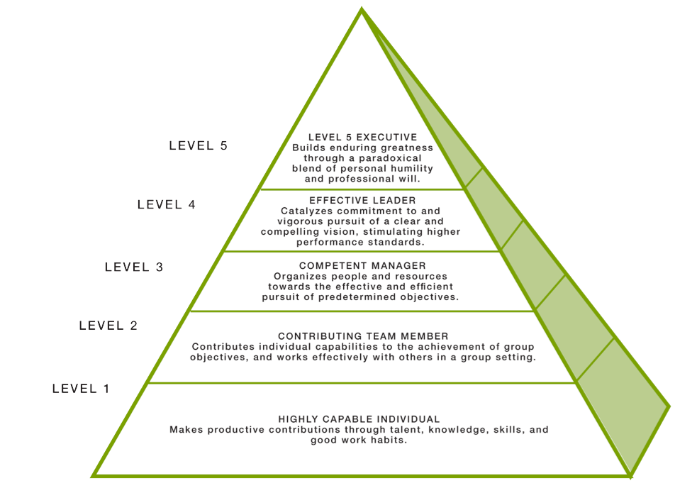
Extending Board Greatness through the Role of the Officer
UNDERSTANDING ROLE(S) AS LEADERS
Ambitious to the cause, the movement, the mission, the work
Makes sure the right decisions happens for the “greatness” of the organization
Good to Great and the Social Sectors: A Monograph to Accompany Good to Great:
Jim Collins, 2005

Slide 4
Extending Board Greatness through the Role of the Officer
Board’s Election of Officers
Annual organizational meeting
Questions to ask when considering election of officers:
Are you thinking in advance of officer positions?
Are you relying on “job descriptions” to help in your discernment?
Are you electing board officers that can help advance the board’s strategic function?
Are you electing board officers based upon practical function, leadership skills or both?

Slide 5
Extending Board Greatness through the Role of the Officer
Board President
Practical | Leadership
Preside at meetings | Oversees board affairs; acts as the representative of the board as a whole
Speaks to the media and the community | Represents the Academy in the community
Assists in the development of agendas for meetings | Ensures the effective actions of the board in governing and supporting the Academy
Recommends committee development to board | Ensures committee leadership and stays connected with leadership to ensure work is carried out
Establishes search and selection committees, as necessary (for school leadership and/or management) | Initiates board discussions on evaluating school leadership and/or management
Ensures preparation of all pre-meeting materials, committee functions and recruitment and orientation of new board members | Ensures all board matters are handled properly

Slide 6
Extending Board Greatness through the Role of the Officer
Board Vice President
Practical | Leadership
Acts as president in his/her absence | Ability and willingness to assist president in achieving his/her leadership role
Accepts responsibility in/with certain board functions | Ability to lead in the areas of board membership, media, facility(ies), personnel, etc.
Vital part of board officer team | Vital part of board LEADERSHIP team

Slide 7
Extending Board Greatness through the Role of the Officer
Board Secretary
Practical | Leadership
Ensures accurate minutes of meetings are taken and approved | Recruits a “recording secretary” for board consideration, as appropriate and necessary
Ensures all records are maintained as required by law and made available when requested by authorized persons and all corporate records are filed and up-to-date | Understands the laws and expectations relative to corporate/public records
Ensures up-to-date copies of bylaws are available at all meetings | Understands bylaws to the extent that he/she can answer board functioning questions
Ensures proper notification of meetings is given, as specified in the bylaws | Takes leadership role in following Open Meetings Act
Manages general correspondence of board (except for correspondence addressed to others) | Ensures full understanding and transparency of all board correspondence
Functions as signing officer for certain docs | Ensures full understanding of everything that he/she signs

Slide 8
Extending Board Greatness through the Role of the Officer
Board Treasurer
Practical | Leadership
Manages the board's review of, and actions related to, the board's financial responsibilities | Develops and/or implements financial procedures and systems (directly with business manager and/or bookkeeper)
Ensures that appropriate financial reports are made available to the board | Ensures consistent and clear financial reporting of key financial events, trends, concerns and OVERALL ASSESSMENT OF FISCAL HEALTH
Prepares agendas for meetings, including a year-long calendar of issues | Chairs the finance committee
Reviews independent auditor options and recommends an auditor (in conjunction with the finance and/or audit committees) | Meets with the auditor, annually, in conjunction with finance and/or audit committee(s)
Disburse funds, as directed | Ensures, through the finance committee, sound management and maximization of cash and investments

Slide 9
Extending Board Greatness through the Role of the Officer
Effective board teams identify officers that have the highest potential for transcending the boards leadership role.

Slide 10
Extending Board Greatness through the Role of the Officer
THANK YOU FOR LISTENING!
4521 Henry Drive Beaverton, MI 48612 989-239-7555 Email: angela@airwinllc.com

