Slide 1
ARP ESSER III update: LEA Plan for use of funds
January 27, 2022 OISD CHARTER SCHOOLS
Kevin Walters
Michigan Department of Education

Slide 2
Timelines for ESSER formula funds
NOTE: Section 11t application is under development and deadline to submit will be determined upon opening of application

Slide 3
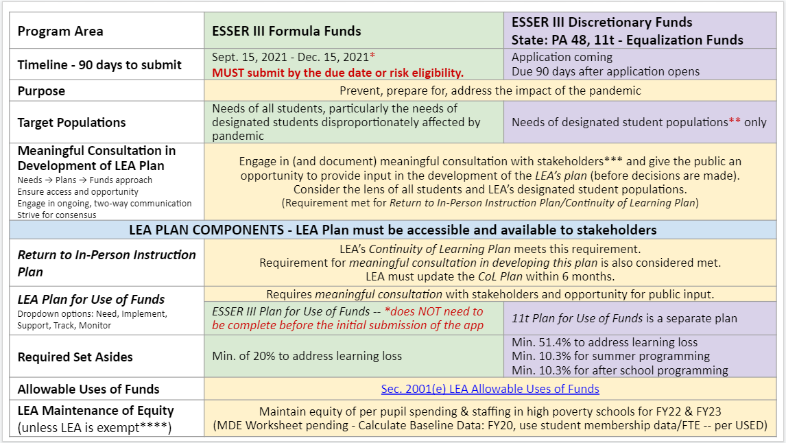
comparison of ESSER formula and section 11t funds

Slide 4
comparison of ESSER formula and section 11t funds

Slide 5
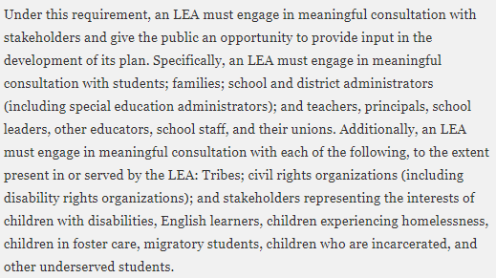
LEA Plan for Use of ARP ESSER Funds
Meaningful Consultation with Stakeholders
This requirement remains for the LEA Plan for Use of Funds. It is not considered met based on previous submissions of COVID Learning Plans to CEPI
A separate LEA Plan for Use of Funds is required specific to Section 11t funds

Slide 6
LEA Plan for use of funds Hot Topic
What qualifies as Meaningful Consultation?
The LEA will need to document supporting data that meaningful consultation was accomplished as it relates to ARP ESSER III use of funds
There are a number of local approaches to meet this: Face-to-Face, Surveys, Part of regularly scheduled stakeholder meetings, Town Hall type meetings

Slide 7
LEA Plan for use of funds Hot Topic
Making Meaningful Consultation MEANINGFUL
Simply soliciting responses to a survey or other means equates to Consultation
Using gathered information to engage in discussion in an effort to reach consensus equates to Meaningful Consultation

Slide 8
STOP
MEANINGFUL CONSULTATION: PLEASE DO NOT SPIN THIS WHEEL

Slide 9
LEA Plan for use of funds Meaningful consultation
Meaningful Consultation and Public Input
LEA Plan for Use of Funds
Approved Budget in Application
Submitted to MDE
LEA Documentation

Slide 10
Stop for Q&A
MEANINGFUL CONSULTATION: PLEASE GET TO YES!

Slide 11
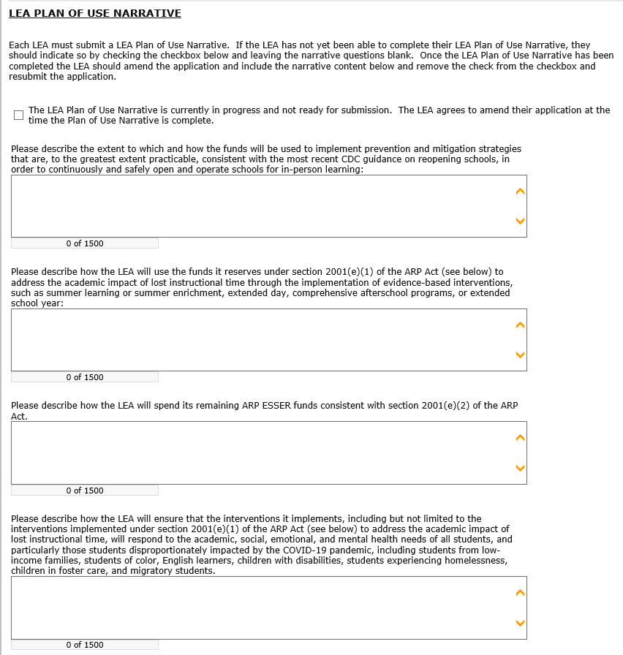
Guidance for COVID-19 Prevention in K-12 Schools | CDC ED COVID-19 Handbook, Volume 2 (PDF) ESSER.GEER_.FAQs_5.26.21 ED COVID-19 Handbook, Volume 2 (PDF)

Slide 12
DEADLINES for amended submissions and other items
If you requested more time…..
LEA Plan for Use of Funds must be submitted by February 15, 2022. The budget does not need to be complete to submit.
Why February 15……..
MDE must post any/all LEA Plan for Use of Funds for all eligible entities by March 1, 2022.
Why is LEA Plan important?
The LEA Plan for Use of Funds must be developed based on “meaningful” consultation with local stakeholders and public input BEFORE submission.
Review Process is Two-Step at MDE
LEA Plan for Use of Funds and Program Description Narratives are reviewed FIRST. When approved, they are moved to budget review. MUST BE ALIGNED to gain approval

Slide 13
Example funds to address mitigation of virus and cdc standards
1
Funds will be used to update school buildings to improve air quality throughout buildings including updating windows, roof updates, and updating indoor and exterior doors. Also, funds will be used to provide supplies for filtration systems to continuously improve air quality; the purchase of cleaning and sanitation supplies to keep classrooms and frequently occupied areas clean; the purchase of masks to allow students and staff who wish to wear masks the ability to do so or in mandated areas such as buses; and dividers/barriers for areas where distancing of greater than 3 feet is not possible.

Slide 14
Example funds to address mitigation of virus and cdc standards
1
We have returned to face-to-face learning this fall and are committed to staying face-to-face to ensure consistent and equitable learning opportunities for all students. We follow the mandates from the CDC and our local health department to safely maintain instruction in the classroom setting. Our build and the aging infrastructure is a concern. Improving air quality is a recommended mitigation strategy that requires upgrading building air handler systems to include better ventilation and air filtration. A portion of the ESSER III funds will be used to replace the heating, ventilation, and air conditioning (HVAC) system in our oldest building in the district to reduce the spread of disease and lower the risk of exposure by reducing the viral particle concentration.

Slide 15
Example funds to address 20% learning loss
To address the academic impact of lost instructional time while learning remotely from March 2020 through February 2021, the XXXXX School District will provide summer learning, summer enrichment and comprehensive after school programs. Summer school will be provided to students in the area of Reading and Mathematics for an 8-week duration. We will use software, in addition to in-person access to highly qualified teachers, to provide students with evidence-based interventions that target their learning needs. Learning needs will be determined on the review of common assessments and benchmark data with building principals and Learning Specialists. A summer enrichment program will also be offered in the district and will include extending Reading and Mathematics software licenses; Lexia and Dreambox respectively, to allow students to “power up” during the summer months and accelerate their learning. In addition, a 2-week STEM summer enrichment option will also be available to district participants. After school evidence-based programs, such as one-on-one tutoring, will be employed at all levels, in addition to after school small group tutoring options in the area of Reading and Mathematics. Funds will be allocated to staff our summer school initiative, summer enrichment and after school programs, as well as needed summer curriculum materials, software licenses and staff professional development.
2

Slide 16
Example funds to address 20% learning loss
2
Our teaching staff and administration will collaborate throughout the school year to review our current curriculum resources, pacing guides, and State and National guidelines to ensure accurate identification of the key standards of each course as well as appropriate alignment between courses within and between content areas.
This work will be significantly influenced and informed by the work that our teaching staff continuously does in identifying ‘power’ standards, alignment of curriculum, and review of best practice in teaching.
The expectation for each course will be identify approximately five key grade level targets for each course and to identify appropriate supports and ‘just in time’ learning practices to ensure all students will be able to access grade and age-appropriate learning.

Slide 17
Example funds to address use of non-learning loss funds
Maintaining the current staffing as mentioned above will help the district implement multiple CDC layered prevention strategies to protect students, teachers, staff, visitors, and other members of their households. In addition to this but more indirectly, resources that were dedicated at the beginning of the pandemic to providing internet hot spot access points, as well as a virtual alternative instruction method will be able to continue to supplement our in-person learning. This additional programming provides an opportunity for families that regardless of how many mitigation factors the district takes, still feel that at home learning is best for their child. The district is able to provide district in house teaching to those students using the Bright Space LMS platform as well as a myriad of other online software to create a similar expectation to those students that are in-person. Providing equal opportunities to online students is essential to maintaining as much physical distancing of in-person learning as possible.
3

Slide 18
Example funds to address use of non-learning loss funds
3
The district will purchase technology that will allow access to for all students to updated curriculum and research-based intervention programs. Purchase subscription for an online program that provides individualized instruction based on a screening assessment. Hire additional staff that will allow for smaller class sizes and teacher to student ratio and allow more individualized small group instruction in the K-5 classrooms.

Slide 19
Example funds to Implement interventions to address 20% learning loss
Benchmark Assessment data will be reviewed in the fall, winter and spring , to ensure that progress is being made by students. Adjustments deemed necessary by the data reviews, will be implemented without delay. iReady, the diagnostic assessment tool used for grades K-8, provides resources specific to the needs of every child and adapts to their individual changing progress. Disaggregated data will be used to identify students in particular subgroups in need of additional targeted support.
The social and emotional needs of both staff and students is a focus of our district during 2021/2022 and will remain so in the coming years. Our middle school and high schools will be staffed with highly qualified counselors. Four new social workers have been added based on anticipated additional grant funding. These positions are also assisting us with meeting the social, emotional, and academic needs of all students. Funding will also support the development of a social-emotional screening tool to be implemented as part of our ongoing MTSS work. This screening tool will provide data to help staff address needs of individual students as well as groups in need of intervention.
4

Slide 20
Example funds to Implement interventions to address 20% learning loss
4
Guidance Counselor to support the needs of students as a result of COVID-19, difficulties transitioning to remote learning, dropout prevention activities with students, Social emotional learning support advocate, Thrively social emotional learning license, Woodcock Johnson professional development, Odysseyware/Edgenuity Spanish teacher site licenses, Athlos web program for monitoring goals and progress, MS/HS Woodcock Johnson materials, hire technology/digital skills and math teacher, purchase Eureka math program, encourage family engagement through tv, media and radio. A STEM teacher will support all students through hands-on activities that will promote student engagement

Slide 21
Important link required between plan and budget
LEA Plan for Use of Funds
Approved Budget in Application
Submitted to MDE

Slide 22
STOP
LEA Plan For Use of Funds and Budget Alignment: PLEASE DO NOT SPIN THIS WHEEL

Slide 23
Stop for Q&A
LEA Plan for Use of Funds and Budget Alignment: PLEASE GET TO YES!

Slide 24
ESSER III Required 20% Set-Aside for Learning Loss
What defines Evidence Based Practices?
Evidence-based practices (EBPs) – which include activities, strategies, and interventions – are “derived from or informed by objective evidence—most commonly, educational research or metrics of school, teacher, and student performance”

Slide 25
ESSER III Required 20% Set-Aside for Learning Loss
What qualifies as Evidence Based Practice?
Leveraging Evidence-Based Practices for Local School Improvement - Office of Elementary and Secondary Education

Slide 26
Questions?
ESSER & GEER, MEGS+, Budgets, Applications
Kevin Walters
Supervisor, Grants Contracts & School Support
Office of Financial Management
517-335-0543 (office) or 810-728-5254 (cell)
MDE-CARES@michigan.gov or waltersk5@michigan.gov
CRF, Grant Accounting, FID Reporting
Christopher May
Financial Specialist, State Aid & School Finance
Office of Financial Management
517-335-1263 (office) or 517-281-3223 (cell)
MayC@michigan.gov

