Slide 1

Evaluating critical relationships
WEBINAR SERIES: 2021/2022
April 13, 2022
Presented by: Angela L. Irwin, Owner
AirWin Educational Services, LLC
Notes:
QUICK INTRODUCTION – Housekeeping: Recording, How to Participate, Jenny P., authorizer support; 30-minute sessions – “on-demand” sessions
Just your name- no details about yourself!

Slide 2
Critical Relationships = Any and all (service) contracts/agreements to which the board is a party

Slide 3
Best Practices
Understand your Contract/Agreement
Develop Review Process
Implement Process with Fidelity
Notes:
Assessment is not just about “testing.” Assessment comes in a variety of shapes and sizes – it is ongoing – this is why academic achievement/student achievement/academics, etc., should be a standard part of a board agenda – not just at the time of “formal, summative,” assessments – the process identified is, in part, a combination of formative and summative assessments -summative assessments evaluate formative learning (in some ways)

Slide 4
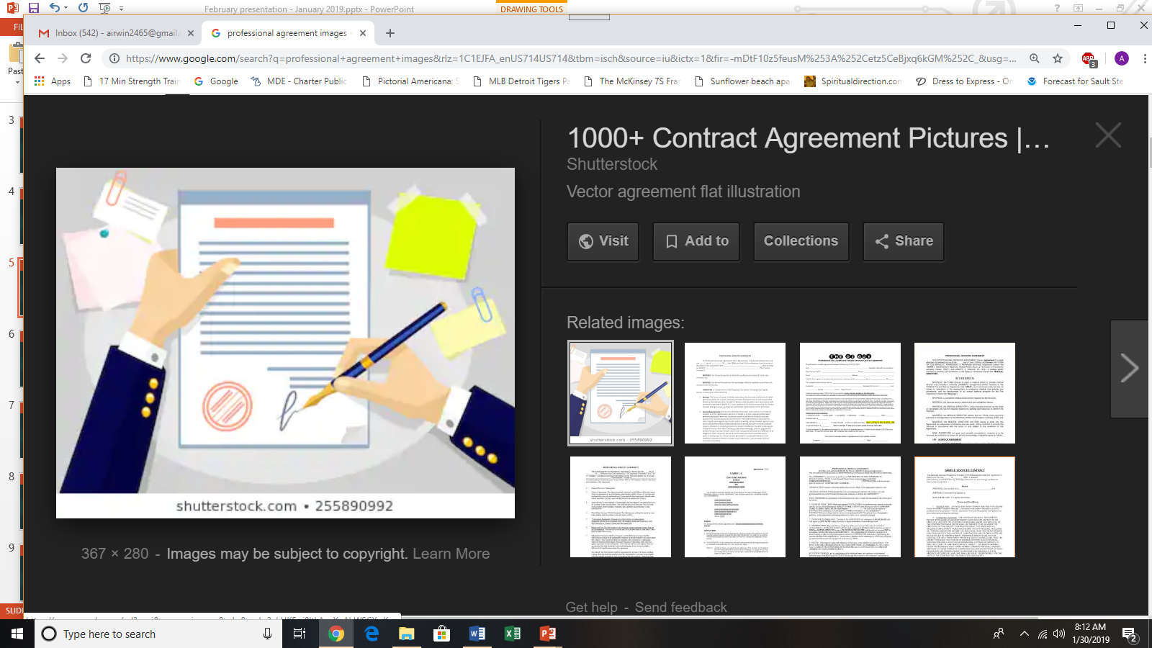

Understand Contract/Agreement
Notification Language
Services Language
Termination Language
Notes:
Charter Contract – Educational Goals . . . Number two – HOW WELL the students are doing, currently, and over time . . .

Slide 5

Develop Review Process
See Attached
Notes:
Norm Referenced – Measured against a “normed group” – typically the same age of student – nationally representative sample
Criterion Referenced: Measured against a pre-determined standard, learning goal, performance level or other criterion

Slide 6

Implement Process with Fidelity
Review evaluation content and make any necessary adjustments
Complete evaluation questionnaire, electronically and individually
Compile evaluation results
Schedule meeting to share and discuss results
During meeting (above), discuss evaluation outcomes and draft action plan for performance focus for upcoming year
Board
Notes:
How well are we doing relative to our charter contract goals? Data in comparison with the targets identified in the charter contract

Slide 7

THANK YOU!
4521 Henry Drive
Beaverton, MI 48612
Telephone: (989) 239-7555
Email: angela@airwinllc.com

