Slide 1

Assessing Your Governance Work
Webinar Series: 2022/2023
Presented by: Angela L. Irwin, Owner
AirWin Educational Services, LLC
January 17, 2023
Presented b
Notes:
The Art of Intentional Governance: Creating a Governance MODEL That Ensures the Right Focus at the Right Time . . .

Slide 2
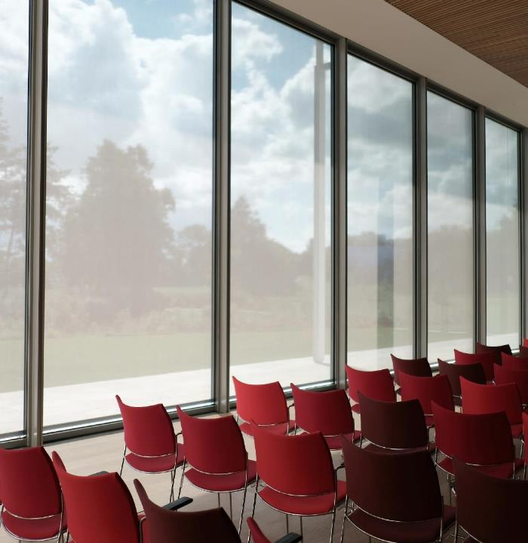
A 2022 Review . . .
Refresher on Prior Sessions
Notes:
September: What’s New in 2022? Governance Themes for year . . . ; November: What’s to be in 2023? Mid-term adjustments on any red-flag issues to ensure a strong finish to the year . . .

Slide 3

Self-Evaluation Checkpoint
Where are WE with student learning?
Where are WE with fulfilling our fiscal responsibilities?
Where are WE in our “good-faith” relationships?
Notes:
How WELL are we doing as a governing body . . . Our self-evaluation checkpoint
Red flag adjustments from November session – transfer to your effectuated governance role/work . . .

Slide 4

Inputs
(Academy Resources)
Outputs
(Delivery on Resources)
OUTCOMES
(Impact/changes
/Effectiveness)
Academy
Board
4

Slide 5

Student Learning?

Slide 6

REFLECTIVE QUESTIONS/ELEMENTS:
Do we have . . . a sufficient timeframe and format for reporting academic outcomes?
Are we . . . keeping informed about WHAT students are learning (through consistent reporting on academic achievement, programs and the impact of extra-curricular activities)?
Are we . . .spending “adequate” amounts of time discussing student learning at board meetings?
Do we have . . . a clear system of follow-up on academic reporting?
Do we . . . compare reports on academic progress with established short-and long-term goals?

Slide 7
Fiscal Responsibility?

Slide 8
REFLECTIVE QUESTIONS/ELEMENTS:
Are we . . . comfortable exercising our legal authority over the budget?
Do we . . . understand all financial reports?
Are we . . . comfortable tabling decisions until further information can be or is obtained?
Are we . . . meeting/exceeding fund balance goals?
Are we . . . ensuring key programs are adequately funded?
Are we . . . satisfied with the overall financial health of the academy?

Slide 9
Good-faith Relationships?

Slide 10
REFLECTIVE QUESTIONS/ELEMENTS:
Are we . . . compliant with the charter contract and all incorporated goals?
Do we . . . make decisions consistent with policy?
Do we . . . intentionally work toward forging relationships based on mutual trust and respect with all stakeholders?
Have we . . . established a culture that promotes collaborative dialogue between and among ALL stakeholders (including key community leaders)?
Do we . . . communicate decisions to all those stakeholders that are affected by them effectively and timely?
Do we . . . handle conflict openly and constructively?

Slide 11

FOCUS, ADJUST, EVALUATE . . .ADJUST
Consider monthly governance focus
Discuss mid-year progress – identify red-flags and adjust
Evaluate/reflect on board impact on progress/change over first half of year and adjust where and as necessary
11

Slide 12




THANK YOU
Angela Irwin, President
AirWin Educational Services, LLC.
(989) 239-7555
angela@arwinllc.com

