Slide 1

HOW TO . . .
ENSURE THE SAFETY AND WELFARE OF STUDENTS
Live Webinar – 2023/2024: February 27, 2024
Presented by: Angela Irwin, President, AirWin Educational Services, LLC
Mark Paliszewski,, recon management group
Notes:
Welcome, introductions, Jenny P., housekeeping (i.e. recorded, chatting/participating, etc.)
Prior webinars: “How To” series – How to Become an Effective Board President (September 2023); How to Engage in Legislative Advocacy (November 2023)
Tonight . . .charter school closure numbers in MI . . . NCES 755, nationally . ..

Slide 2
Five steps to ensuring the safety and welfare of students
Step 1. Assess Safety and Security
1
Step 2. Plan to Mitigate Threats
2
Step 3. Develop Emergency Management Plan
3
Step 4. Communicate Emergency Management Plan
4
Step 5. Recover
5

Slide 3
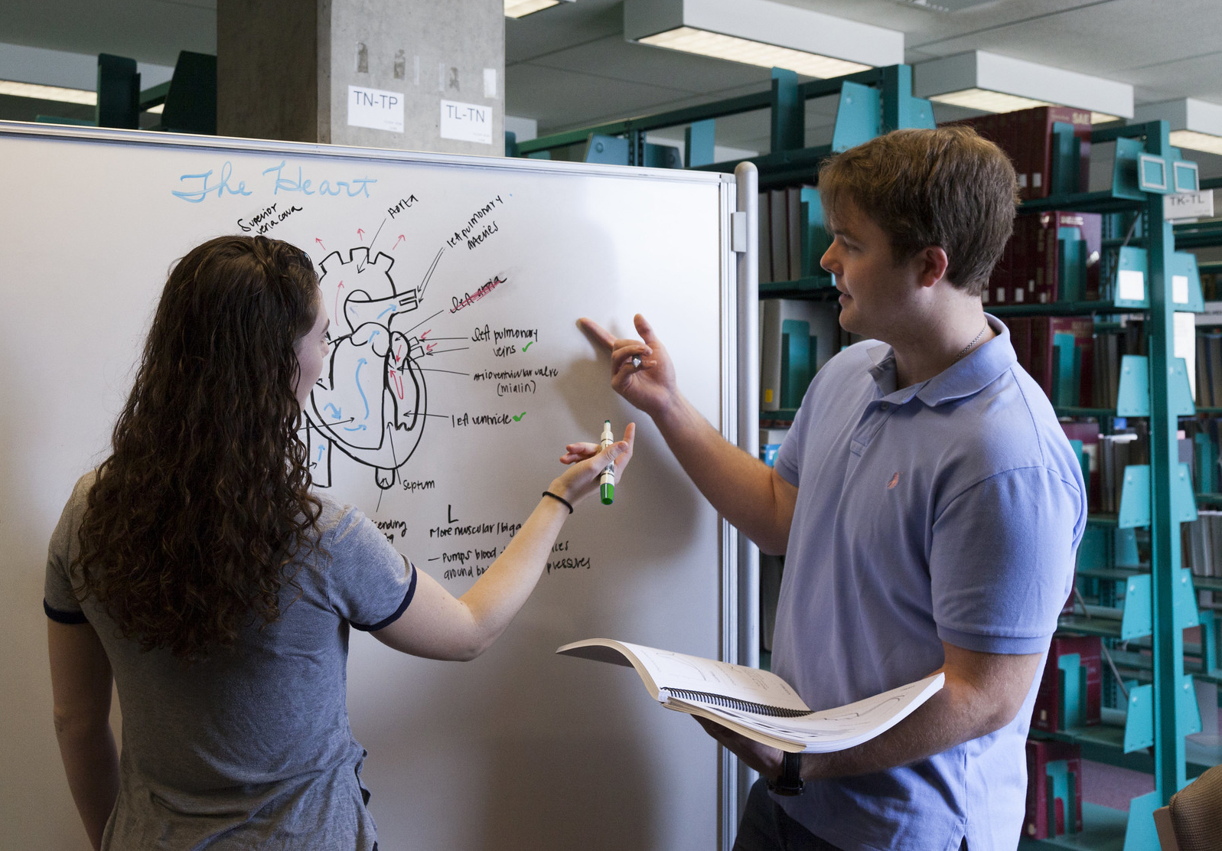
Step 1: Assess safety and security
Identify Safety and Security Measures in Place
Discuss Gaps in Measures
Develop Written Comprehensive Assessment
Notes:
Review handout – be succinct here!

Slide 4

Step 2: PLAN TO MITIGATE THREATS
Construct Team
Ensure Perimeter Control/Visitor Management
Implement Appropriate Use of Technology
Develop Anonymous Reporting System
Notes:
Understand inputs and outputs to determine effective outcomes – management: resources the Academy; delivers upon those resources – Board = impacts/changes based on effectiveness of inputs and outputs; reporting should align with contract expectations, along with management agreement services (and deliverables, if identified), board goals, etc.

Slide 5

Step 3: Develop emergency management plan
Review Comprehensive Assessment
Include Mitigation Threats/Ideas from Prior Step
Define Various Emergency Scenarios, Including Various Duties of Team Members
Ensure Consistent Policy Language
Notes:
Could have taken everything I have shared over the past 12 plus years of delivering webinars and included it here – four critical roles on which board can focus . ..

Slide 6

Step 4: COMMUNICATE EMERGENCY MANAGEMENT PLAN
Ensure School Community is Aware of Emergency Management Plan and its Content
Using Emergency Management Pan, Conduct Drills/Tabletop Exercises with Team
Ensure Team Trains Staff

Slide 7
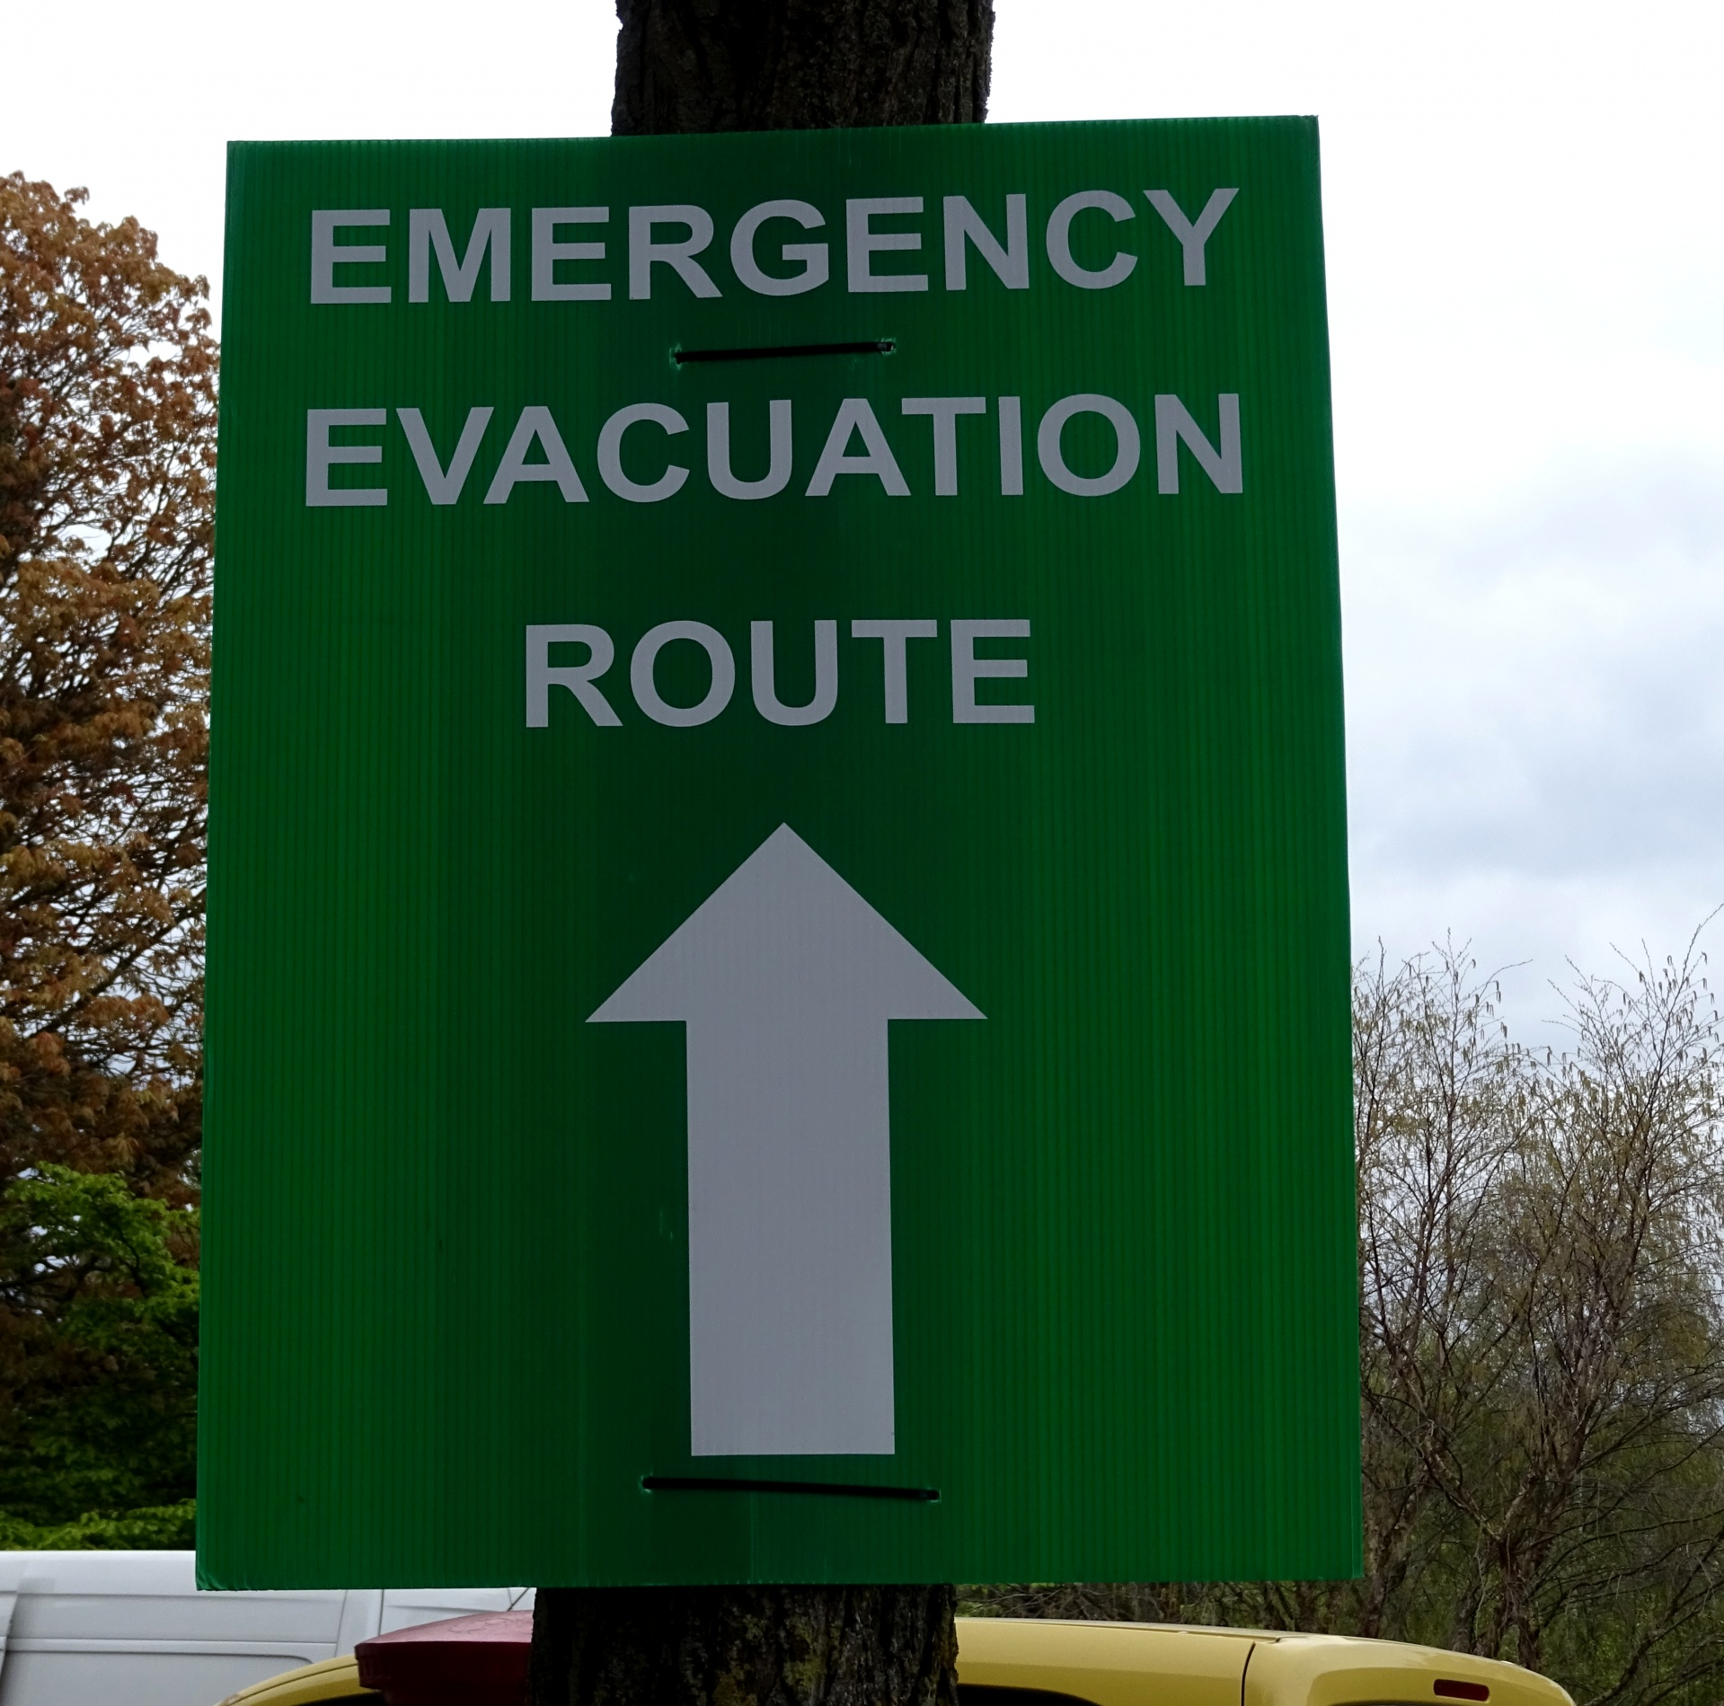
Step 5: Recover
Ensure Emergency Management Plan Provides for the Reuniting of Evacuees/Families
Through Authorized Personnel Only, Offer Statements, as Identified through the Board’s Developed and Adopted Communications’ Plan
Debrief on Process

Slide 8
THANK YOU!
Angela L. Irwin, President
Airwin educational services, llc.
4521 Henry Drive, Beaverton, MI 48612
Phone: (989) 239-7555
angela@airwinllc.com
Mark paliszewski, director
Consulting and investigative group
Recon management group
30400 Telegraph road, suite 375
Bingham farms, mi 48025
Phone: (248) 540-0160; Extension 207
mark@reconmgmt.com

