Slide 1
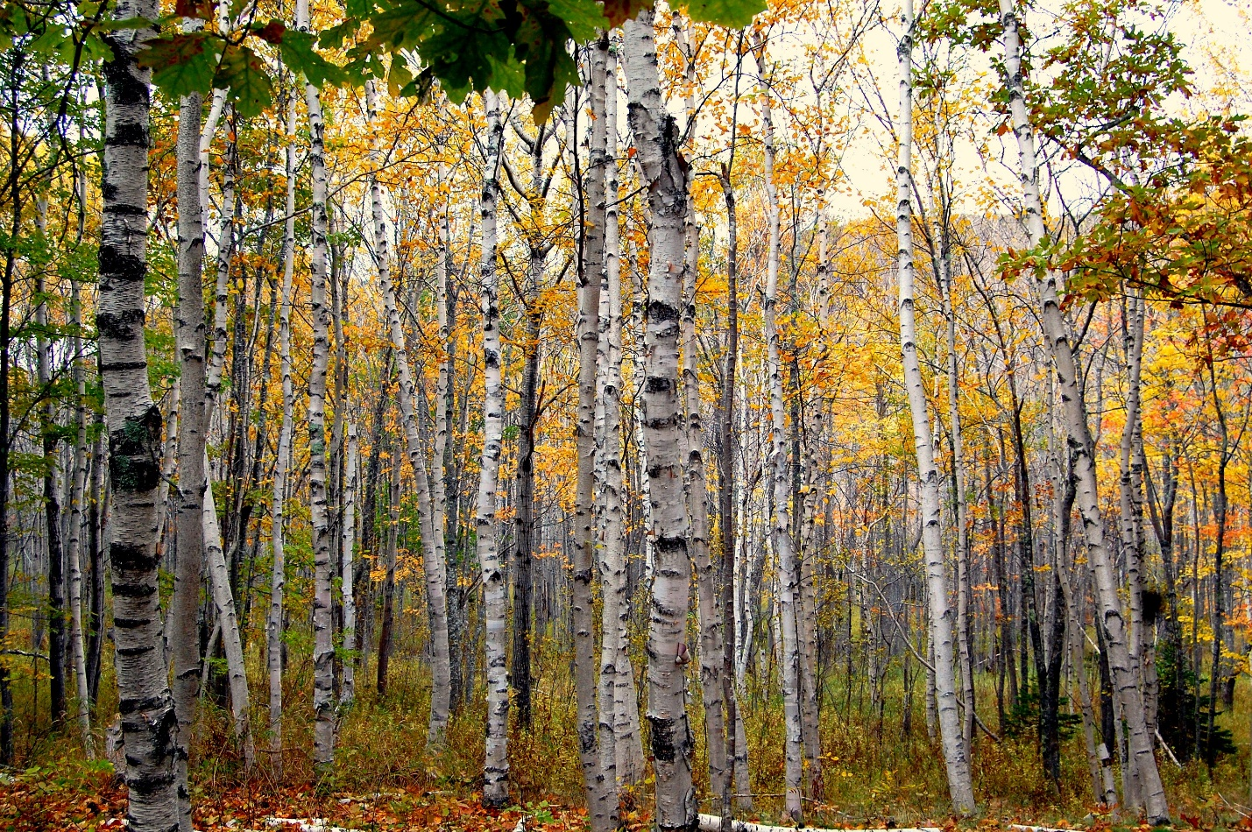
Aspen Forest Ecosystem
Distribution: Aspen ecosystems are found throughout North America in a variety of ecoregions. In Michigan, they are primarily found in the northern lower and upper peninsula regions.
Description:
Aspen forests provide more forage resources for animals than are found in coniferous forests, therefore they support a large number and diversity of species.
In addition to large and small mammals, birds found in aspen forests include a variety of warblers, indigo bunting, least flycatcher, yellow-bellied sap sucker, pileated woodpecker, and others including ground-dwelling birds, woodcock and ruffed grouse.
Food sources for these birds include berries, insects, and worms.
This activity is based on the interactions between these organisms in the aspen ecosystem.
Information on aspen forest ecology from:
U.S. Forest Service (https://www.fs.usda.gov/wildflowers/beauty/aspen/ecology.shtml)
Michigan DNR (https://www2.dnr.state.mi.us/publications/pdfs/huntingwildlifehabitat/landowners_guide/habitat_mgmt/forest/Aspen_And_Birch.htm#:~:text=to%20nine%20inches.-,Species%20that%20use%20this%20stage%20of%20the%20aspen%20forest%20as,%2C%20deer%2C%20and%20ruffed%20grouse) and
University of Colorado Boulder (https://www.colorado.edu/asmagazine/2021/03/02/understories-quaking-aspen-vary-dramatically-among-habitats)

Slide 2
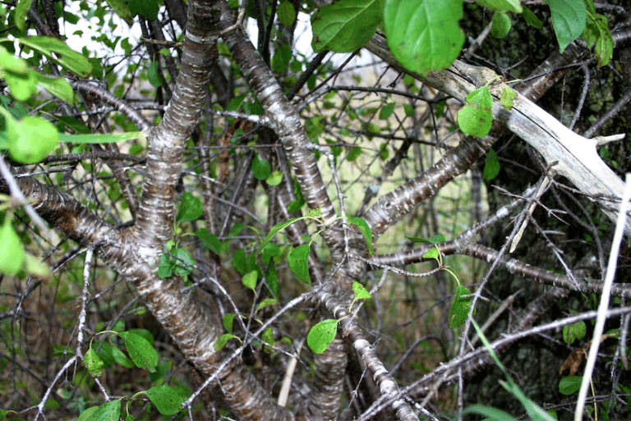
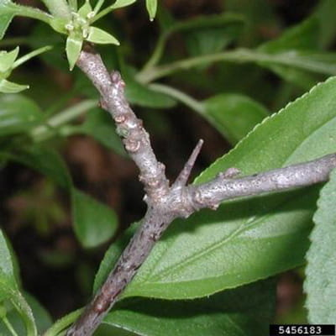
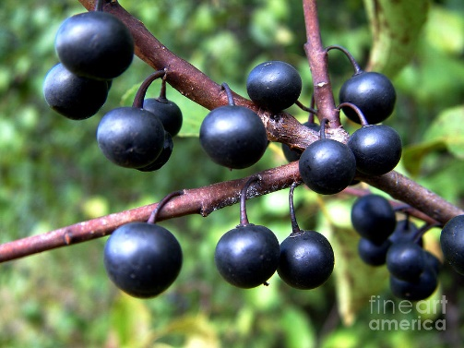
Buckthorn
Habitat: roadsides, pastures, old fields, and woodlots
U.S. Distribution: East Coast and Midwest, limited areas of California and Oregon.
Quick Facts: Buckthorn spreads quickly through seeds distributed by birds and wildlife; it crowds out native shrubs and understory plants. It is a host for certain viruses, fungi, and insects. It does not provide any nutritional value to birds that eat it.

Slide 3

Native vs Invasive Species
Native:
ALL naturally-existing organisms are native SOMEWHERE.
Within an ecosystem, organisms have a niche (role) regarding interactions with one another.
Q: What are some of these roles?
These roles develop through co-evolution with other organisms
Invasive:
An organism that is new to an area (often brought in by people but might also travel through animals, air, and water)
An organism that did not co-evolve with the other organisms within this area
Causes harm to: an ecosystem, other organisms (including people), or economies.
Q: Why might an organism that is not from the area be able to cause harm there?

Slide 4

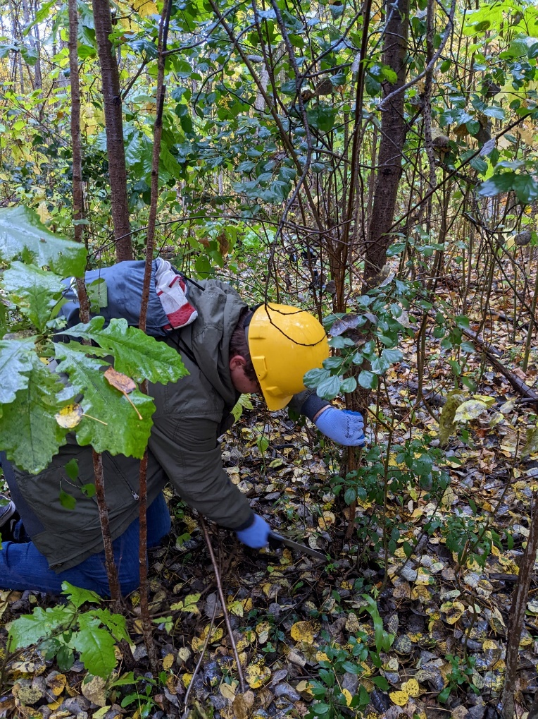
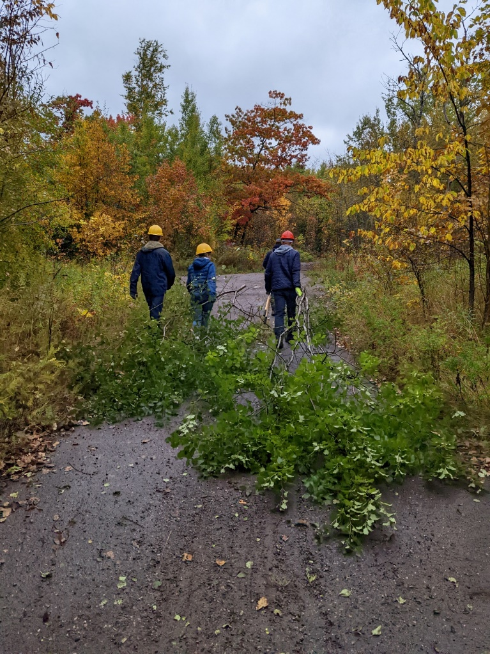
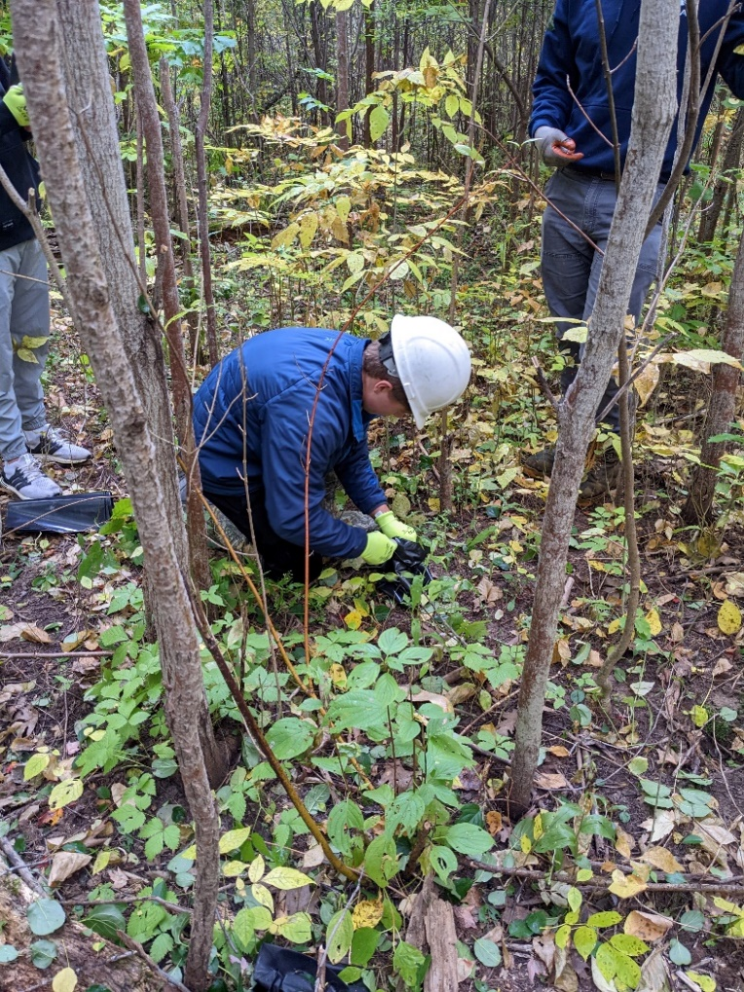
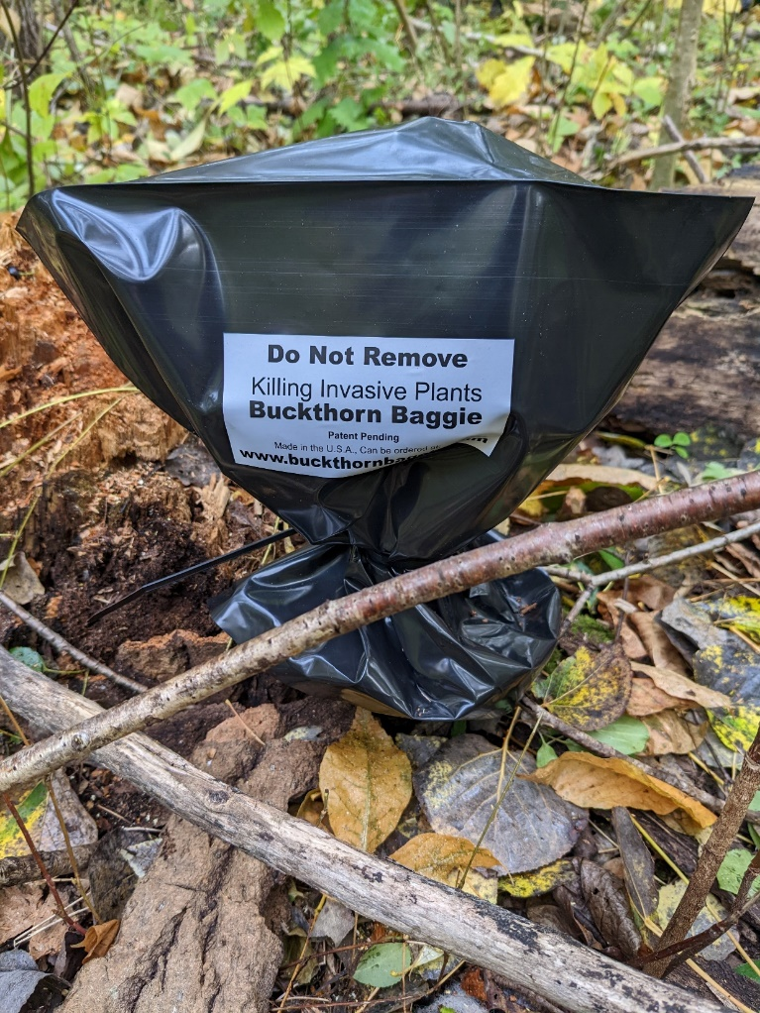
Stewardship – How can you help?
Notes:
Stephanie Hoyle, CISMA Coordinator

