Slide 1
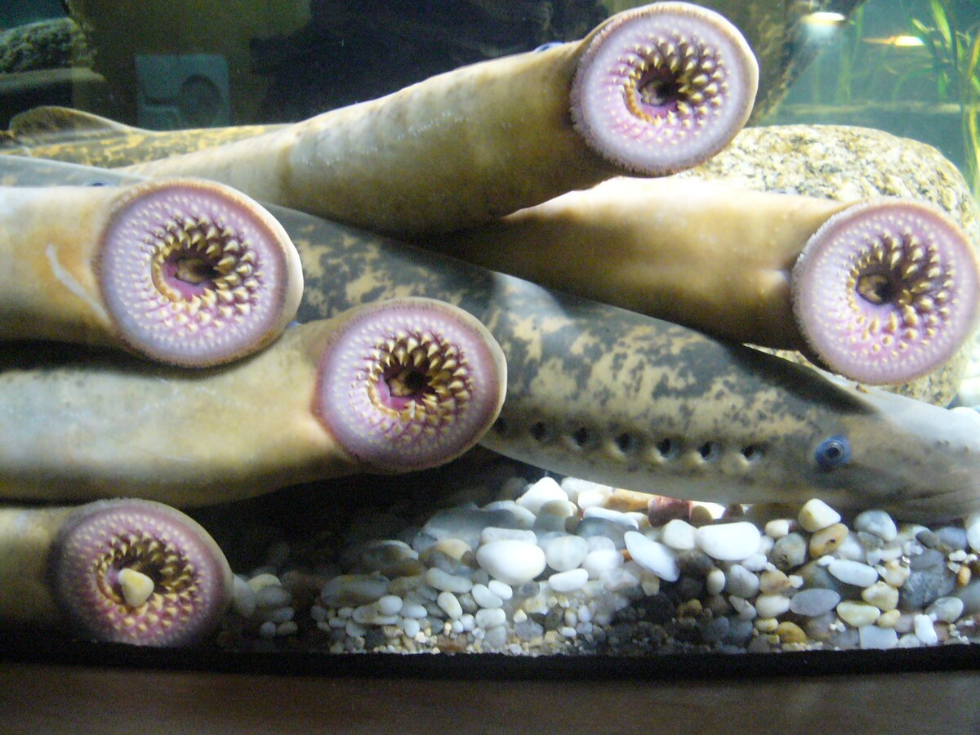
Sea Lamprey Sampler Student Project Overview
Goal:
Learn about sea lampreys and their impact on the Great Lakes environment and economies.
Objectives:
As a team, research and become experts on a sea lamprey characteristic and teach the rest of the class what you learned.
Increase understanding of what sea lampreys are, how they grow, and how they are being managed
Learn about sea lamprey and share your expertise:
anatomy and physiology; ecosystem niche/role; history in the Great Lakes; life cycle; impact on Great Lakes ecosystems; impact on Great Lakes economies; methods of control; and career pathways associated with their study and control
present your research findings to classmates

