Slide 1
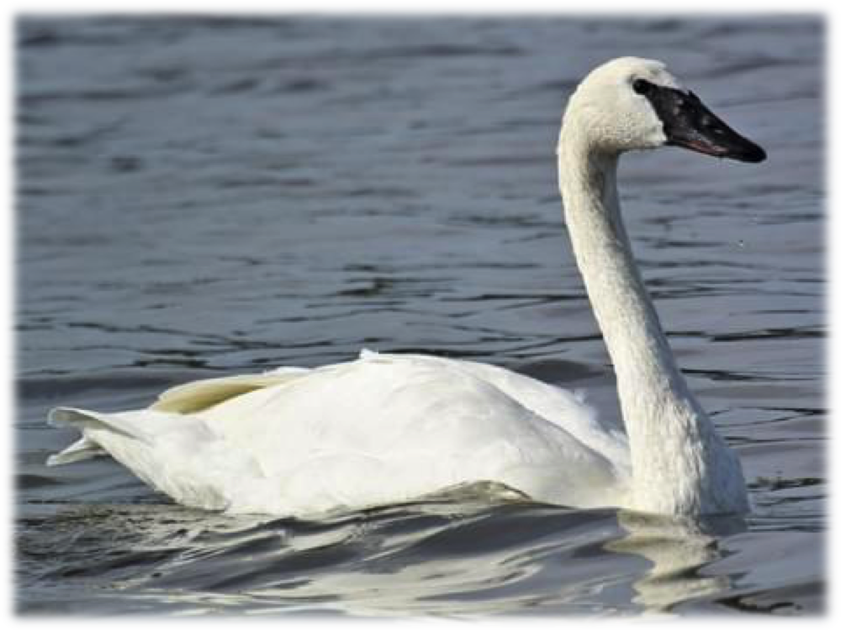
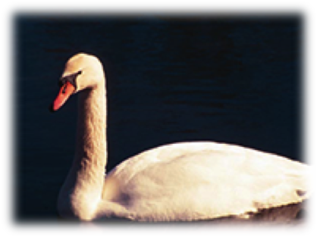
Activity Example:
Adapted from First Impressions (Project Wild, Association of Fish and Wildlife Agencies, Copyright 2018 p. 278-279)
Photos of native vs. non-native plants/animals
Given one clue
Choose which is invasive (left or right image)
Move to the “invasive” side of the screen
Mute Swan
(Cygnus olor)
Orange bill, black knob at forehead
Trumpeter Swan
(Cygnus buccinator)
Black bill comes to a peak/V-shape on forehead

Slide 2
Choose the Image (1 or 2) that matches the invasive plant
Brazilian Elodea
(Egeria densa)
American Waterweed
(Elodea canadensis)
Generally 4 leaves per whorl
Generally 3 leaves per whorl
Notes:
Brazilian Elodea Generally has 4 leaves per whorl
American Waterweed Generally has 3 leaves per whorl

Slide 3
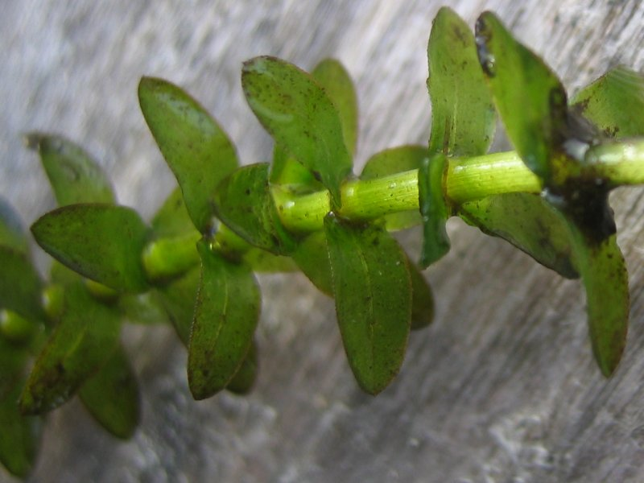
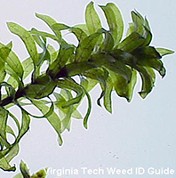
Choose the Image (1 or 2) that matches the invasive plant
1
2
Notes:
🍐 This is a Pear Deck Multiple Choice Slide. Your current options are: A: 1, B: 2,
🍐 To edit the type of question or choices, go back to the "Ask Students a Question" in the Pear Deck sidebar.
Brazilian Elodea Generally has 4 leaves per whorl
American Waterweed Generally has 3 leaves per whorl

Slide 4
Choose the Image (1 or 2) that matches the invasive plant
Eurasian Watermilfoil (Myriophyllum sibiricum)
Northern Watermilfoil (Myriophyllum spicatum)
Typically 14 or more leaflets on each leaf
Typically 5-10 leaflets on each leaf

Slide 5
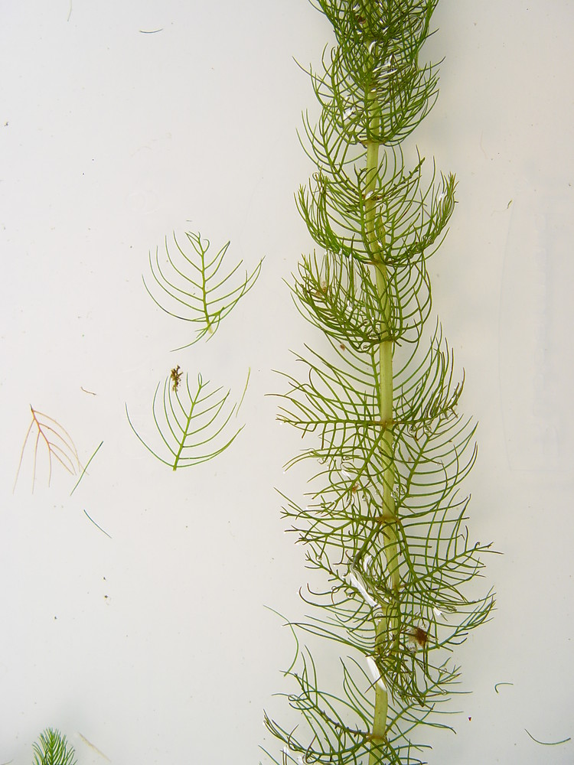
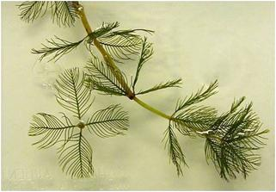
Choose the Image (1 or 2) that matches the invasive plant
1
2
Notes:
🍐 This is a Pear Deck Multiple Choice Slide. Your current options are: A: 1, B: 2,
🍐 To edit the type of question or choices, go back to the "Ask Students a Question" in the Pear Deck sidebar.

Slide 6
Choose the Image (1 or 2) that matches the invasive plant
Native Phragmites
(Phragmites australis americanus)
Non-native Phragmites (Phragmites australis
australis)
Stems at base are typically tan/green
Stems at base are typically red/chestnut

Slide 7
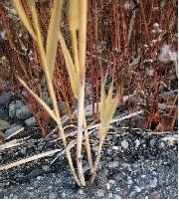
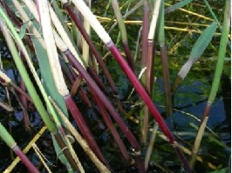
Choose the Image (1 or 2) that matches the invasive plant
2
1
Notes:
🍐 This is a Pear Deck Multiple Choice Slide. Your current options are: A: 1, B: 2,
🍐 To edit the type of question or choices, go back to the "Ask Students a Question" in the Pear Deck sidebar.

Slide 8
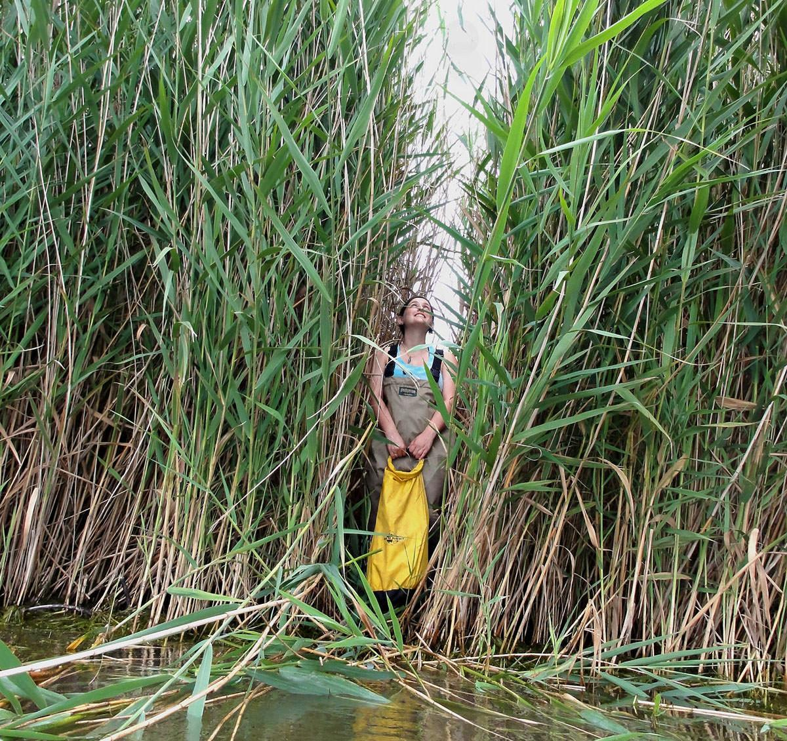
Non-native Phragmites (Phragmites australis australis)

Slide 9
Choose the Image (1 or 2) that matches the invasive fish
Sea Lamprey
(Petromyzon marinus)
Silver Lamprey
(Icthyomyzon unicuspis)
About 24 inches long with dark coloration
About 12 inches long with light grey coloration
2

Slide 10
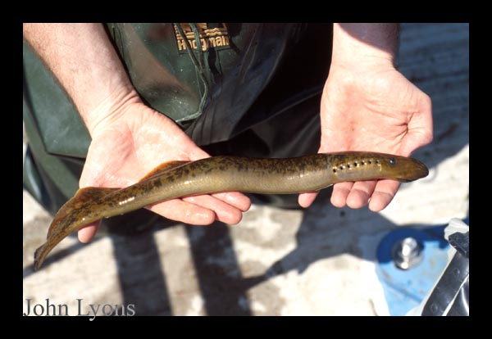
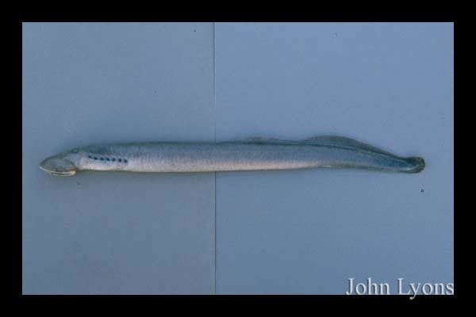
Choose the Image (1 or 2) that matches the invasive fish
1
2
1
Notes:
🍐 This is a Pear Deck Multiple Choice Slide. Your current options are: A: 1, B: 2,
🍐 To edit the type of question or choices, go back to the "Ask Students a Question" in the Pear Deck sidebar.

Slide 11
Choose the Image (1 or 2) that matches the invasive plant
Narrow-leaf Cattail
(Typha angustifolia)
Broad-leaf Cattail (Common cattail)
(Typha latifolia)
Narrow leaves
Separate male and female clusters
Broad leaves
Connected male and female cluster

Slide 12
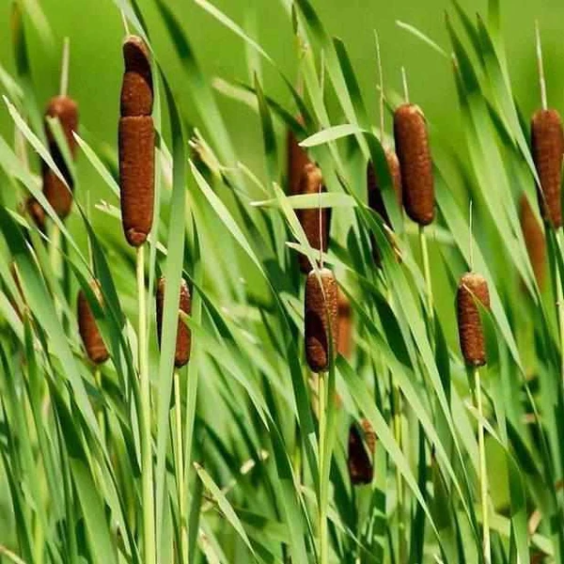
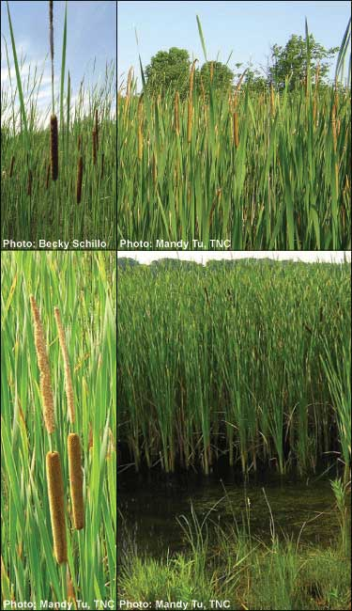
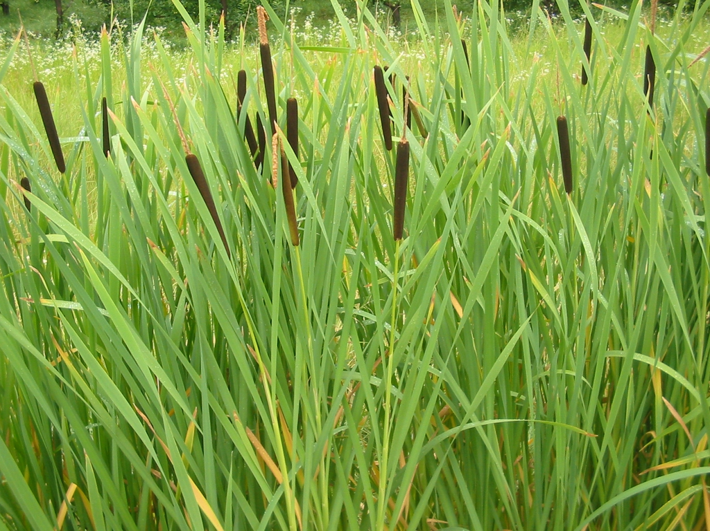
Choose the Image (1 or 2) that matches the invasive plant

Slide 13
Choose the Image (1 or 2) that matches the invasive crayfish
Rusty Crayfish
(Orconectes rusticus)
Clearwater Crayfish
(Orconectes propinquus)
Black tips on ends of pincers
Orange tips on ends of pincers

Slide 14
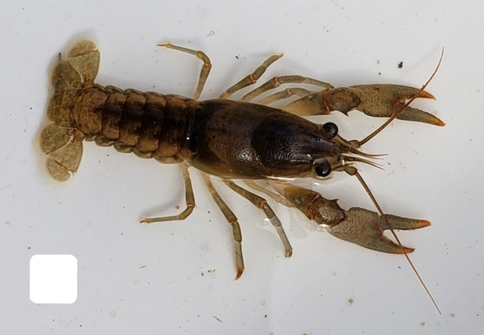
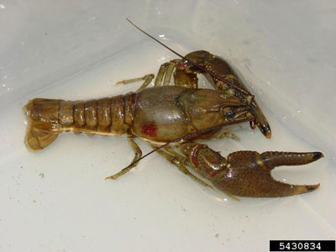
Choose the Image (1 or 2) that matches the invasive crayfish
1
2
Notes:
🍐 This is a Pear Deck Multiple Choice Slide. Your current options are: A: 1, B: 2,
🍐 To edit the type of question or choices, go back to the "Ask Students a Question" in the Pear Deck sidebar.

Slide 15
Choose the Image (1 or 2) that matches the invasive plant
Purple loosestrife
(Lythrum salicaria)
Fireweed
(Epilobium angustifolium)
Magenta flower spikes with 5-7 purple petals surrounding small, yellow centers.
Flowers have 4 broad petals and 4 narrower, darker sepals; 8 large pollen sacks and a 4-pronged stigma projecting from the center.

Slide 16
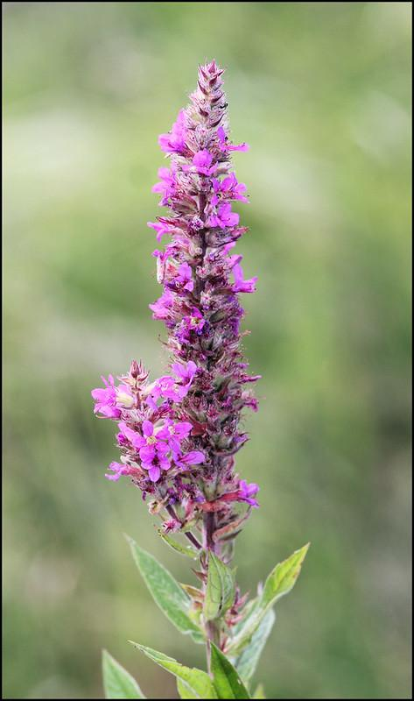
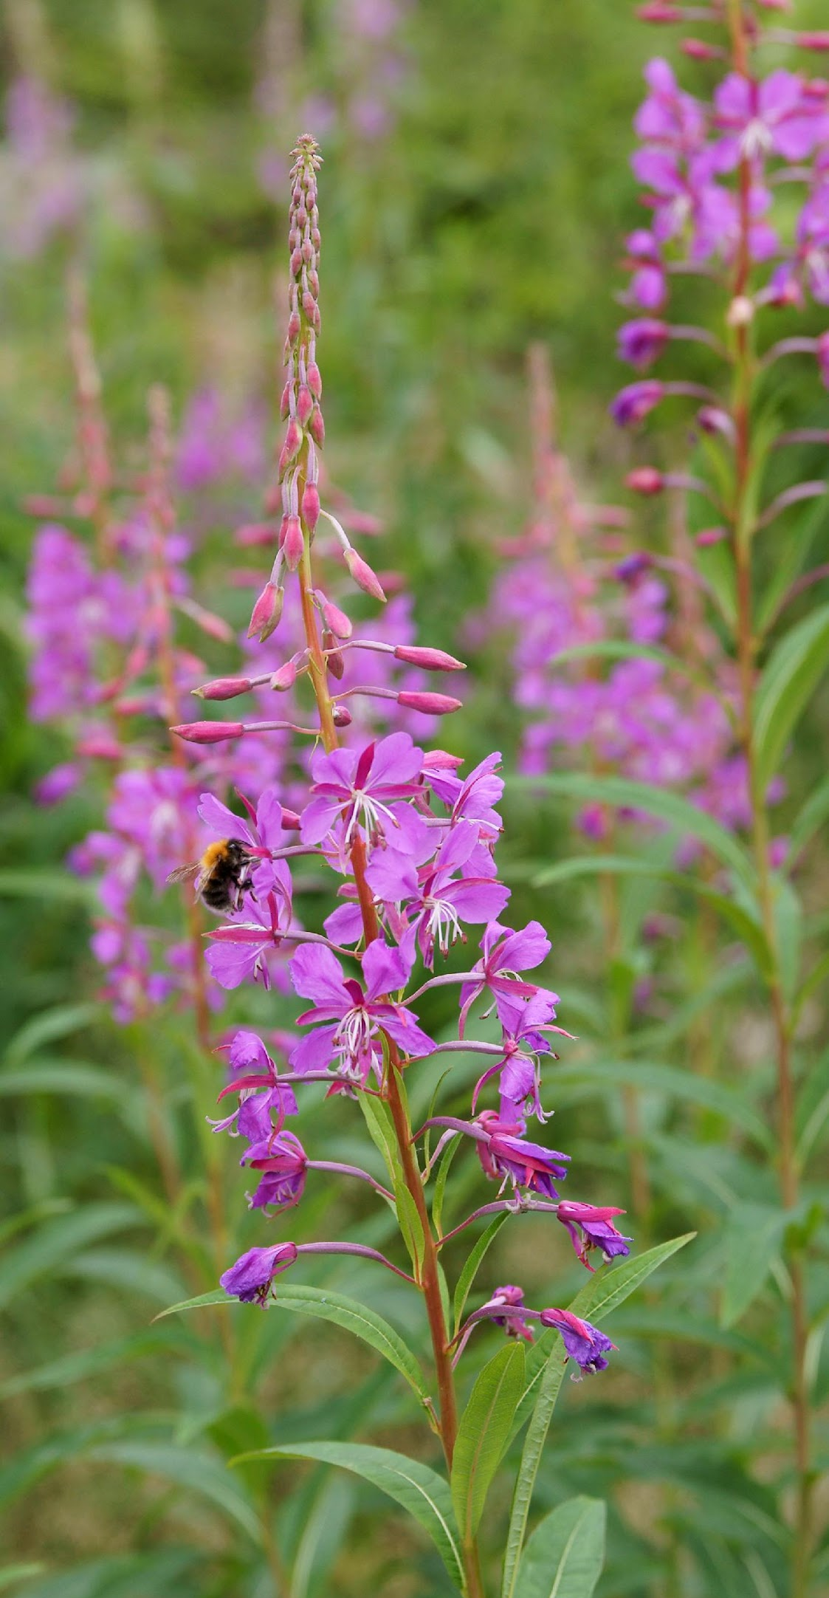
Choose the Image (1 or 2) that matches the invasive plant
Notes:
🍐 This is a Pear Deck Multiple Choice Slide. Your current options are: A: 1, B: 2,
🍐 To edit the type of question or choices, go back to the "Ask Students a Question" in the Pear Deck sidebar.

Slide 17
Choose the Image (1 or 2) that matches the invasive plant
European frog-bit
(Hydrocharis morsus-ranae)
American Waterlily
(Nymphaea odorata)
Leaves are small, 0.5-2.5 inches, round to heart-shaped.
Leaves are narrowly and deeply cut almost to the center, where the stem is attached

Slide 18
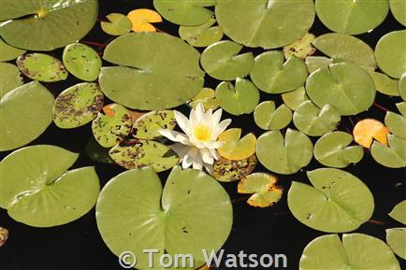
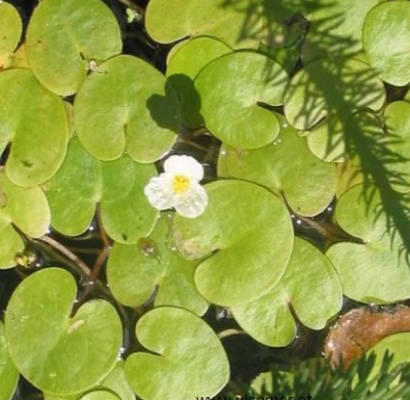
Choose the Image (1 or 2) that matches the invasive plant
Notes:
🍐 This is a Pear Deck Multiple Choice Slide. Your current options are: A: 1, B: 2,
🍐 To edit the type of question or choices, go back to the "Ask Students a Question" in the Pear Deck sidebar.

Slide 19
What does is all mean?
Introduced
Non-Native
INVASIVE
Alien
Exotic
Native
Endemic

Slide 20
What’s the Difference?
Native, endemic
Part of a balanced ecosystem (niche)
Co-evolution with other organisms

Slide 21
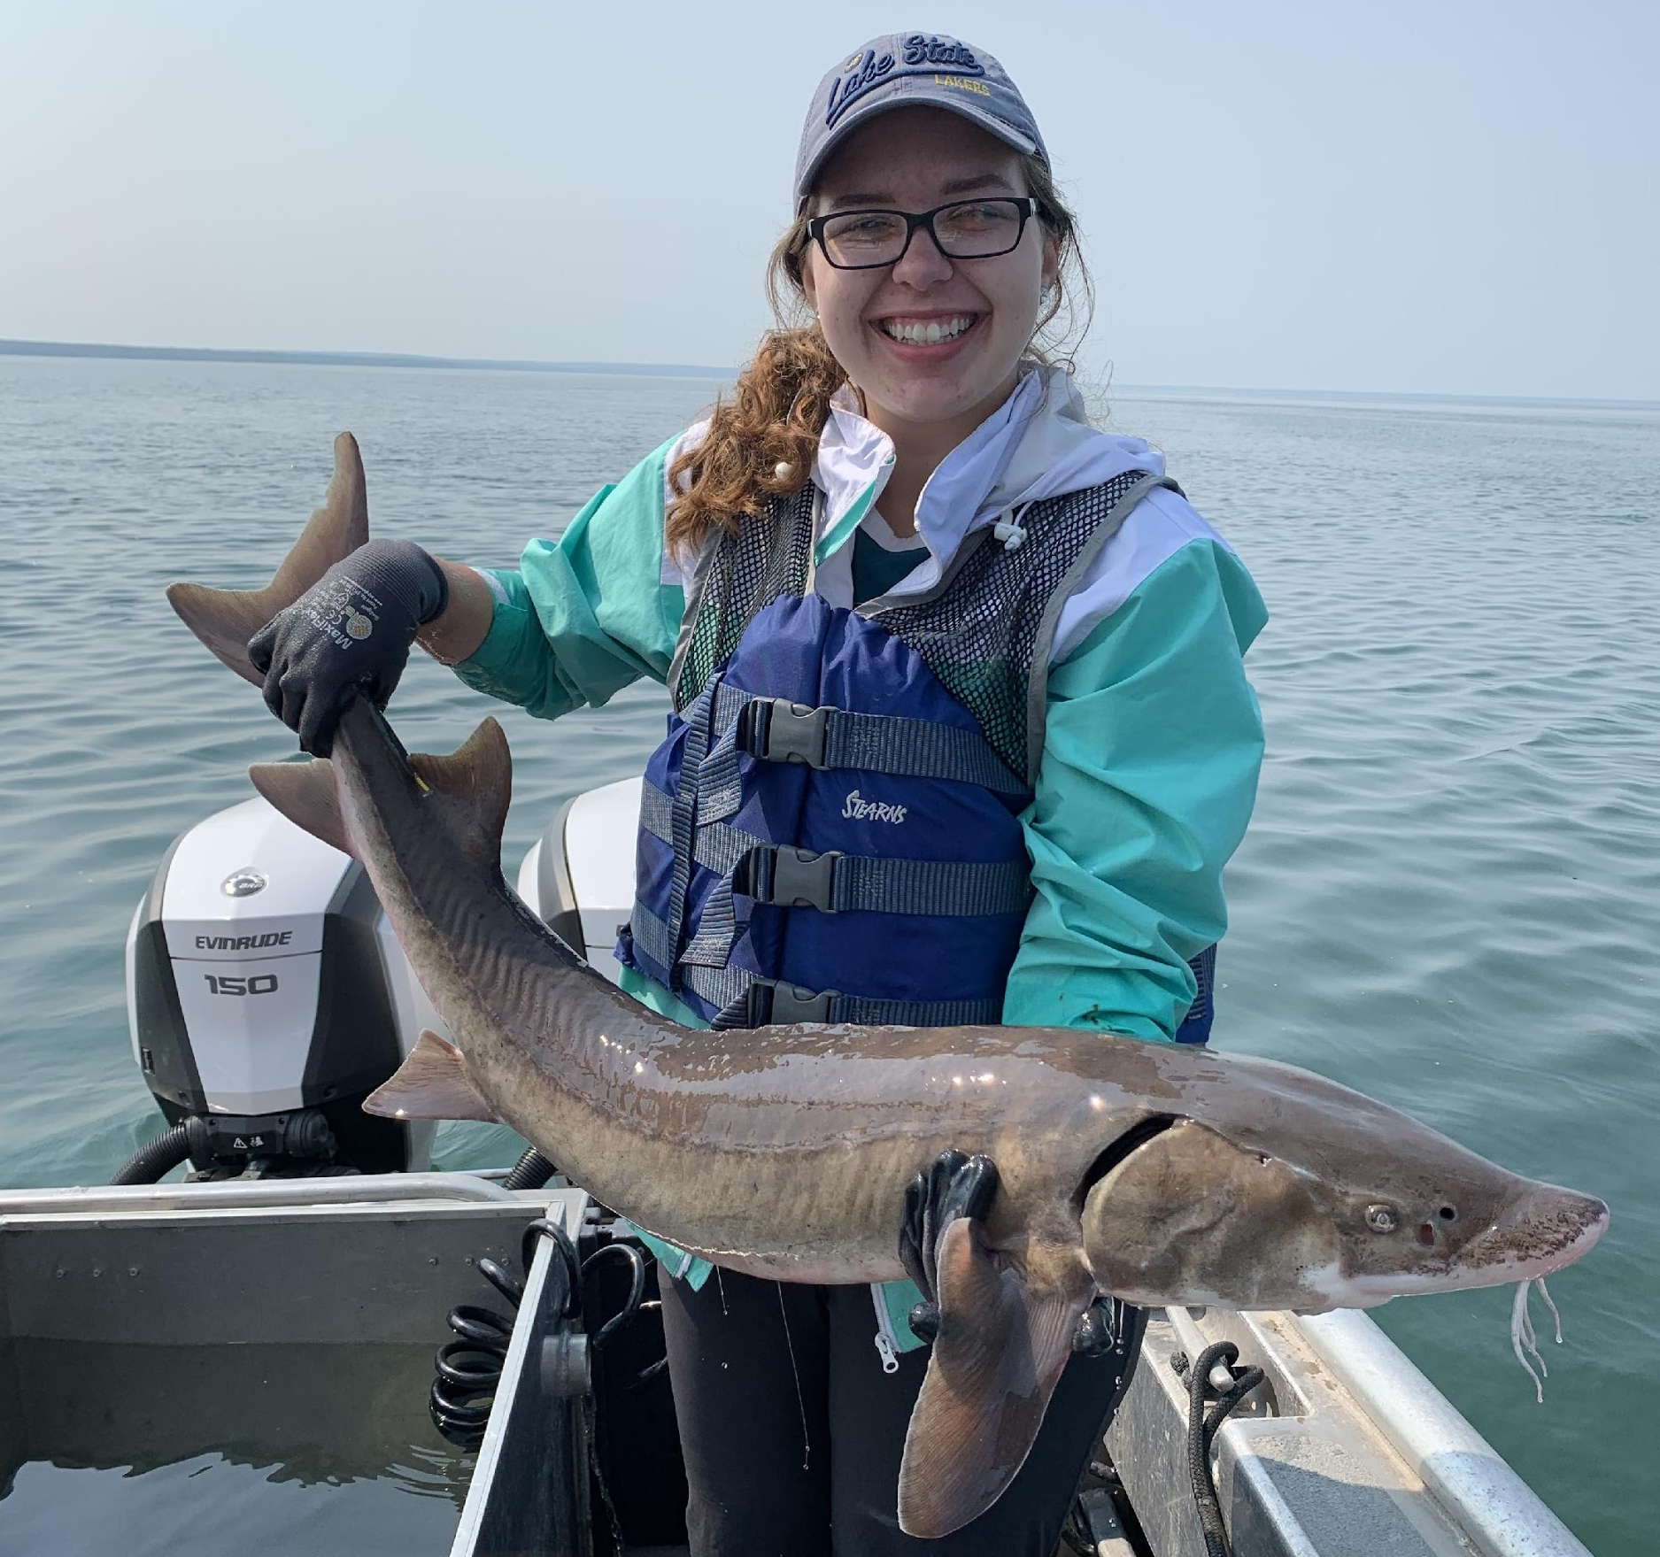
What’s the Difference?
Lake
Sturgeon

Slide 22
What’s the Difference?
Native, endemic
Part of a balanced ecosystem (niche)
Co-evolution with other organisms
Introduced, non-native, exotic
Usually human introduction (exceptions)
May not impact an ecosystem (held in check)

Slide 23
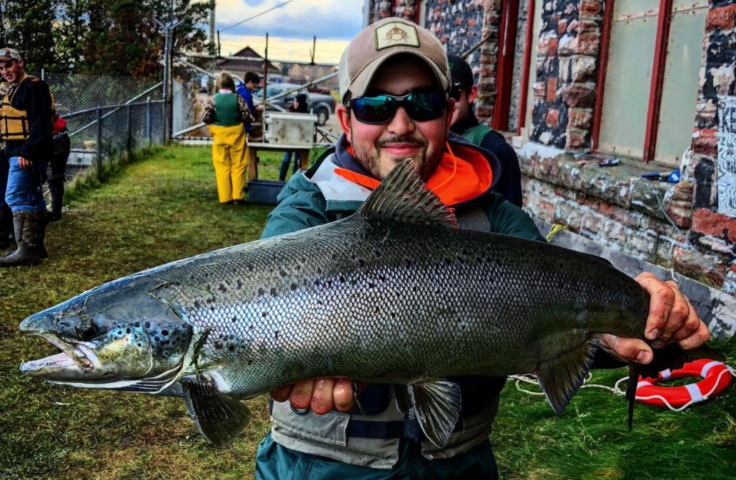
What’s the Difference?
Native, endemic
Part of a balanced ecosystem (niche)
Co-evolution with other organisms
Introduced, non-native, exotic
Usually human introduction (exceptions)
May not impact an ecosystem (held in check)
Atlantic salmon

Slide 24
What’s the Difference?
Native, endemic
Part of a balanced ecosystem (niche)
Co-evolution with other organisms
Introduced, non-native, exotic
Usually human introduction (exceptions)
May not impact an ecosystem (held in check)
Invasive: introduced and causes economic, ecological, or human, animal, or plant harm

Slide 25
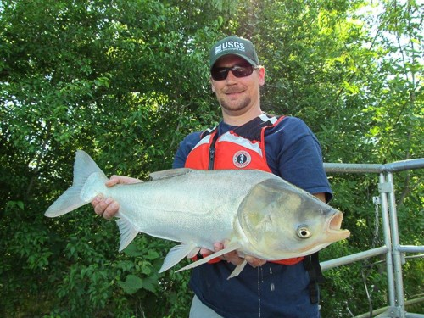
What’s the Difference?
Native, endemic
Part of a balanced ecosystem (niche)
Co-evolution with other organisms
Introduced, non-native, exotic
Usually human introduction (exceptions)
May not impact an ecosystem (held in check)
Invasive: introduced and causes economic, ecological, or human, animal, or plant harm
Silver Carp
(an Asian carp species)

Slide 26
Photo resources:
Trumpeter and mute swans (slide 1) from allaboutbirds.org
Brazilian Elodea (Egeria densa) (slide 3): VA Tech Weed ID Guide, VA Tech, Bugwood.org
American Waterweed (Elodea canadensis) (slide 3): Kristian Peters https://commons.wikimedia.org/wiki/File:Elodea_canadensis.jpeg
Northern Watermilfoil (Myriophyllum sibiricum) (slide 5): By Donald Cameron. Copyright © 2020 Donald Cameron.
Eurasian Watermilfoil (Myriophyllum spicatum) (slide 5): John Halpop - Montana State Univ. Extension
Phragmites (Phragmites australis australis and Phragmites australis americanus) (slide 7): Ontario Phragmites Working Group https://www.opwg.ca/phragmites/native-vs-invasive/
Phragmites (slide 8): Elizabeth Banda/NASA (https://www.nasa.gov/SpaceforUS/stories/greatlakes.html) and Great Lakes phragmites collaborative: https://www.greatlakesphragmites.net/blog/native-vs-invasive-phragmites/
Silver Lamprey (Ichthyomyzon unicuspis) and Sea lamprey (Petromyzon marinus) (Slide 10): John Lyons
Northern Clearwater Crayfish (Orconectes propinquus) (Slide 14): USGS https://nas.er.usgs.gov/queries/FactSheet.aspx?SpeciesID=2249
Rusty Crayfish ((Orconectes rusticus) (Slide 14): USGS https://www.michigan.gov/invasives/0,5664,7-324-68002_73847-368768--,00.html
photos from slides 12, 16, 18, 25 are available through the michigan.gov/invasives website
Other photos provided by Lake Superior State University Center for Freshwater Research and Education

Slide 27
Resources
RIPPLE: www.bit.ly/getmiripple
Habitatitude: https://www.habitattitude.net/
MN, WI, and MI Sea Grant
MISIN--MSU Extension (APP)
MIPN https://www.mipn.org/
Michigan.gov/invasives
MI Invasive Species Coalition: https://www.michiganinvasives.org/
Local CISMA office: https://www.michiganinvasives.org/managementareas/ (3 shores CISMA—EUP)
Michigan Conservation Districts: https://macd.org/local-districts/
Great Lakes Aquatic Nonindigenous Species Information System (GLANSIS): https://www.glerl.noaa.gov/glansis/

Slide 28
Additional Information
Nonindigenous Aquatic Nuisance Prevention and Control Act of 1990 (USFWS)
MI Natural Resources and Environmental Protection Act 451 of 1994
Michigan laws limit the import, sale and possession of prohibited and restricted species including plants, animals, fish, mollusks and crayfish.
Michigan laws regulate the possession and sale of certain plant species which are considered undesirable from agricultural as well as environmental viewpoints.
prohibited and restricted species: https://www.michigan.gov/invasives/0,5664,7-324-68002_74282---,00.html
It is illegal to import or move species listed as “injurious to wildlife” except with a federal permit (Lacey Act: https://www.animallaw.info/statute/us-lacey-act-chapter-53-control-illegally-taken-fish-and-wildlife).
Species injurious to wildlife: https://www.fws.gov/injuriouswildlife/pdf_files/Current_Listed_IW.pdf
Noxious weeds cannot be brought into the United States or moved from state to state.
Plant protection Act: https://www.law.cornell.edu/uscode/text/7/chapter-104
Federal law prohibits the interstate transportation, delivery, receipt or sales of alligator grass, water chestnut plants or water hyacinth plants or their seeds.

