Slide 1

Navigating Your Role
As A New Board Member
Virtual Professional Development Series 2025/2026
September 9, 2025
Presented by:
Angela L. Irwin, Owner
AirWin Educational Services, LLC

Slide 2

CONTENT
01
HISTORY
02
MISSION AND GOALS
03
STRUCTURE
04
CONTRACT
05
RELATIONSHIP(S)
06
PUTTING IT INTO PRACTICE

Slide 3

HISTORY
Origin and Purpose
Impact

Slide 4

MISSION AND GOALS
Knowing the Mission
Supporting the Mission
Understanding Goals

Slide 5
Governance Structure
Mi Legislature
Part 6A – Act 451 of 1976
Authorizer
State
Public School District
Jurisdictional
Intermediate School District
Jurisdictional
Community College
Jurisdictional
Public University
Statewide
Charter School Board
Authorizer/Contract
Provider of Educational Services
Board/Agreement
Public School Academies operate under a charter contract
They are governed by an independent Board of Directors
They are bound by Michigan’s Revised School Code
Issues contract and oversees Board’s compliance to it
Mission, vision, policy, strategic direction (including goals) and oversight
Alignment
Implements policy and manages operations – management agreement defines operational oversight
Notes:
Visual offers a helpful reminder of the broader system in which we operate. Every decision made as a Board, must consider not only YOUR internal priorities but also how you align with and are accountable to key external entities like your authorizer and the State. The structure highlights how governance, leadership and oversight interact.
# of schools operating in State: 363; # of students served: 150,000 – 155,000 – about 11% of Michigan’s public school enrollment

Slide 6
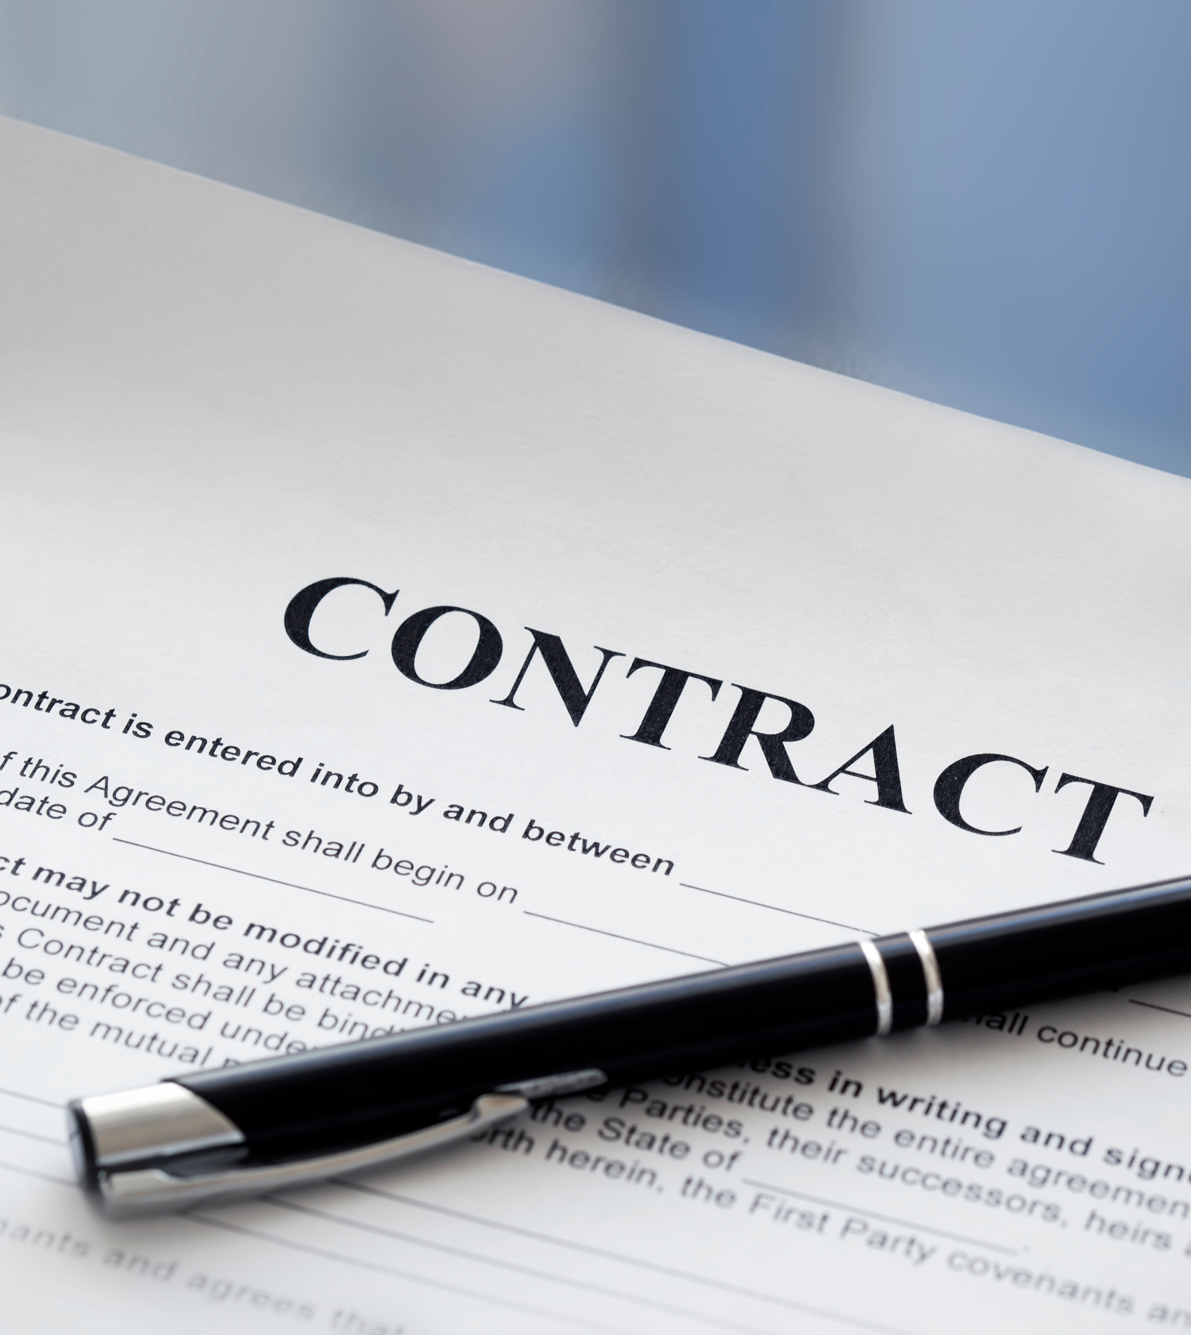
CONTRACTS
Uniquely Customized
Accountability Document
Performance Expectations
Authorized and Reauthorized

Slide 7

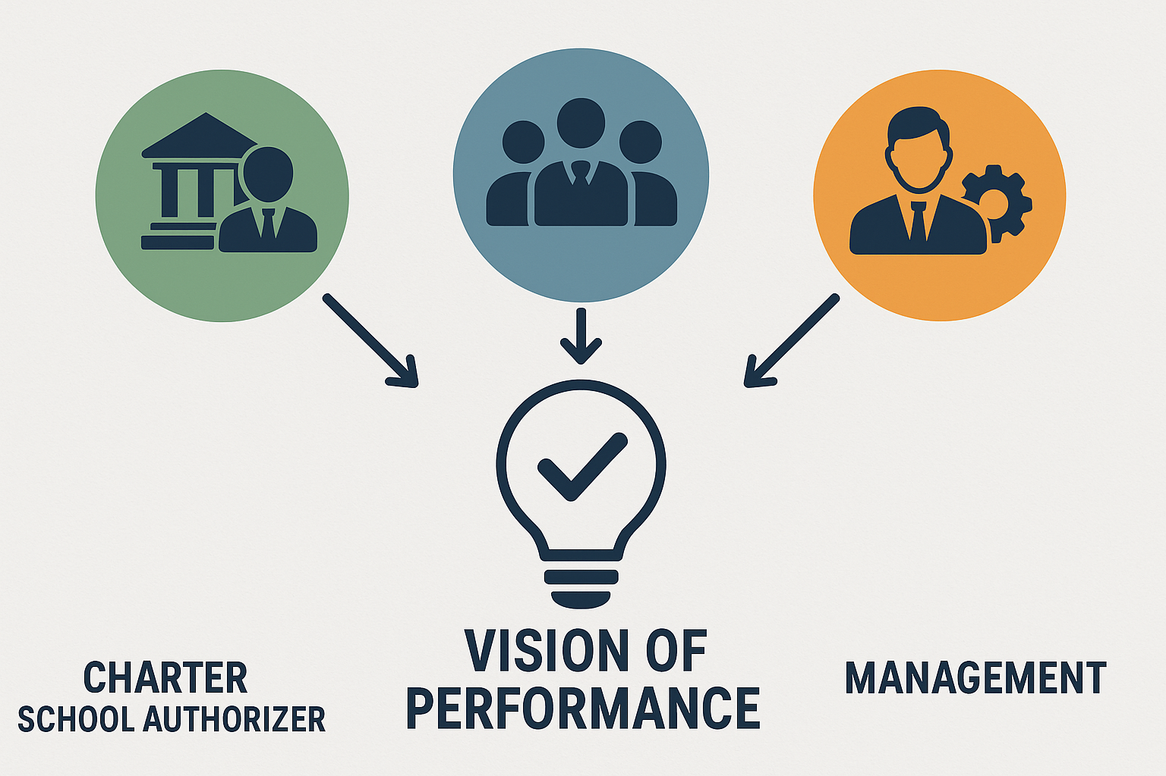
The Relationships
Three groups = One Vision
Alignment of structure, content and mission
Role clarity is essential for success

Slide 8
Putting It Into Practice
History: Share one story from the school’s origin with your community.
Mission and Goal: Use the mission statement as a filter: “Does this decision align with our mission?”
Structure: Clarify roles at your next board meeting (what is the board’s responsibility vs the management team’s responsibilities, for example?).
Contracts: Review one section of the charter contract together as a board each quarter.
Relationships: Schedule a touchpoint with your authorizer or school leader to strengthen communication.

Slide 9

THANK YOU!
4521 Henry Drive
Beaverton, MI 48612
989.239.7555
ANGELA@AIRWINLLC.COM

