Slide 1

Leading with Purpose:
Mission-Driven Decision-Making
2025/2026 Webinar Series
October 14, 2025
Presented by:
Angela L. Irwin, Owner
AirWin Educational Services, LLC

Slide 2
Session Overview
Why mission matters
Revisiting and realigning mission
Recognizing and addressing mission draft
Takeaways
Notes:
Visual offers a helpful reminder of the broader system in which we operate. Every decision made as a Board, must consider not only YOUR internal priorities but also how you align with and are accountable to key external entities like your authorizer and the State. The structure highlights how governance, leadership and oversight interact.
# of schools operating in State: 363; # of students served: 150,000 – 155,000 – about 11% of Michigan’s public school enrollment

Slide 3
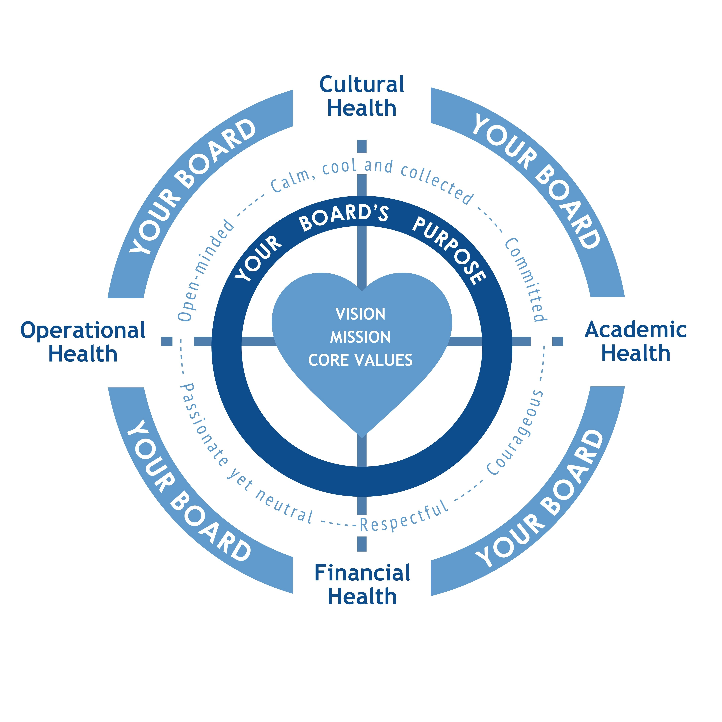
Why Mission Matters
Anchors board priorities and decisions
Builds stakeholder trust
Represents “your why”
Definitions:
Mission = Purpose and reason for being
Vision = Desired future state
Notes:
Charter contract: Standard legal documents: terms and conditions language, bylaws, articles of incorporation, oversight agreement, fiscal agent agreement, etc. Certain schedules that are specific to school: physical facility, governance structure, ed program, ed goals, days and hours of operation (schedule), etc.

Slide 4
Revisiting Mission and Vision
Revisit during annual retreat or strategic planning cycle
Keep vision and mission “front and center” during board meetings
Ensure entire school community knows and lives the mission (and vision)
For every proposed board decision, thought question: “How does this decision align with our mission?”
Signature School: Consistently ranked as the nation’s top charter high school by U.S. News and World Report!
The mission of the Signature School is to meet the needs of self-motivated learners in a progressive environment driven by global concerns. We emphasize rigor and excellence in academics, the arts, integrated technologies and community service.
Notes:
Review teacher’s first agreement . . .
Business, Finance, and Accounting and worksite employees

Slide 5
Aligning Governance with Mission
How to align governance and mission . . .
Embed mission in:
Policies
Budget decisions
Program approval/review
Board evaluations
Management evaluations
Thought Question: What tools do we use to ensure mission-alignment and mission-focused practices?
Notes:
Through which understood lens should you operate? GET EXAMPLES . . See handout – have handout available
.

Slide 6
Recognizing Mission Drift
Signs of mission drift:
Program choices inconsistent with mission
Budget not funding mission priorities
Partnerships are diluting mission focus
Thought Question: Where might drift appear in your board/school?
“Mission Drift is the natural course for organizations, and it takes focused attention to safeguard against it.”
Peter Greer and Chris Horst
Center for Congressional Health
Notes:
Through which understood lens should you operate? GET EXAMPLES . . See handout – have handout available
.

Slide 7

Course-Correction Strategies
Policy review for alignment
Board retreats solely focused on mission
Data-based reflection
Thought Question: Do our stakeholders know and understand our mission? Are we modeling mission-focused leadership?
Notes:
Through which understood lens should you operate? GET EXAMPLES . . See handout – have handout available
.

Slide 8
Applying Mission-Driven Strategies
Embed Mission Alignment in Every Decision Process
Integrate Mission Metrics into Board Dashboards and Evaluations
Use Annual Retreats for Mission Reflection and Renewal

Slide 9
Key Takeaways
Mission is the foundation of governance
Alignment ensures consistent, student-centered decisions
Drift can be addressed with intentional, transparent actions
Purpose is the reason you journey; passion is the fire that lights the way.

Slide 10
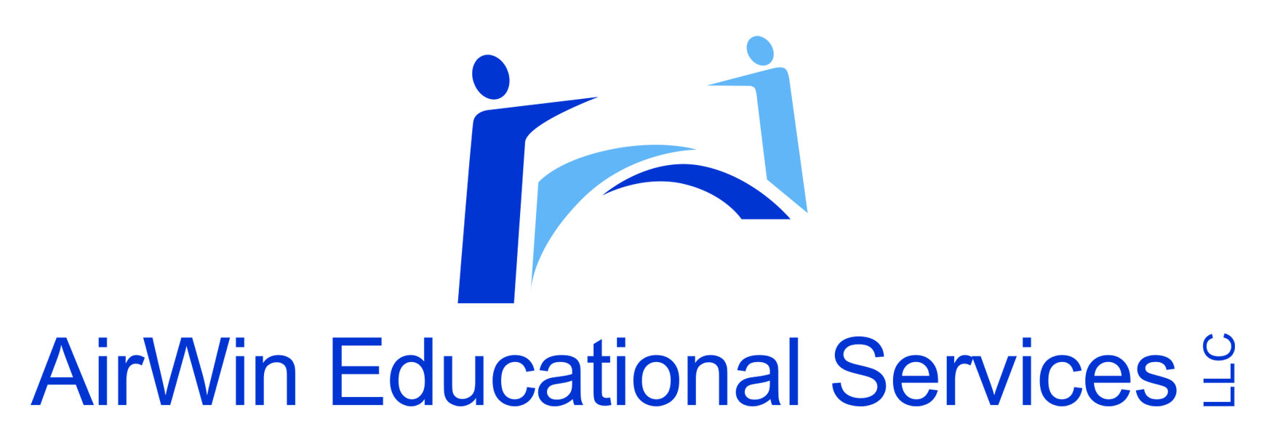
THANK YOU!
4521 Henry Drive
Beaverton, MI 48612
989.239.7555
ANGELA@AIRWINLLC.COM

