Slide 1

Strategic Oversight vs. Micromanagement
2025/2026 Webinar Series
November 11, 2025
Presented by:
Angela L. Irwin, Owner
AirWin Educational Services, LLC
Notes:
Good evening, everyone! Welcome to our session! I am Angie, the proud owner of AirWin Educational Services, LLC, and I am thrilled to be here with you this evening! In customary fashion, before we begin tonight’s presentation, I will share my traditional housekeeping notes: please participate with questions, comments, thoughts, etc., in a manner that works best for you, Jenny, my co-organizer, will be helping me monitor your input; this session is being recorded and the link will be shared with you either by me or your authorizer
This evening we will be exploring one of the most important – and sometimes tricky – aspects of board governance: understanding the difference between strageic oversight and micromanagement.

Slide 2

The board’s role is to see the forest, not count the trees!
Notes:
As we move through this evening’ session, I want you to focus on, what I liked to call, this mental backdrop slide – “the board’s role is to see the forest, not count the trees” – meaning, do not venture into the detail - keep this phrase in mind, as it captures the spirit of this evening’s conversation . . .

Slide 3
Definitions: Oversight vs. Strategic Oversight
Oversight: Ensures that what is supposed to happen, actually happens!
Strategic Oversight: The practice of governing through vision, accountability, and results – not control.
Strategic oversight = outcomes over activities; trends over details; and governance over management!
Notes:
What I want to make clear is strategic oversight is not suggesting an ABANDONMENT of your traditional oversight responsibilities but, rather, designed to enhance oversight by GOVERNING THROUGH VISION, ACCOUNTABILITY AND RESULTS – NOT CONTROL – in strategic oversight we align vision and results . . .

Slide 4
Our Purpose for this Evening’s Session:
Clarify the difference between strategic oversight and micromanagement
Strengthen board capacity to govern effectively and confidently
Protect the balance between accountability and autonomy
Notes:
3. And to protect the balance between accountability and autonomy – ensuring that your board leads with vision and trust – not control!

Slide 5
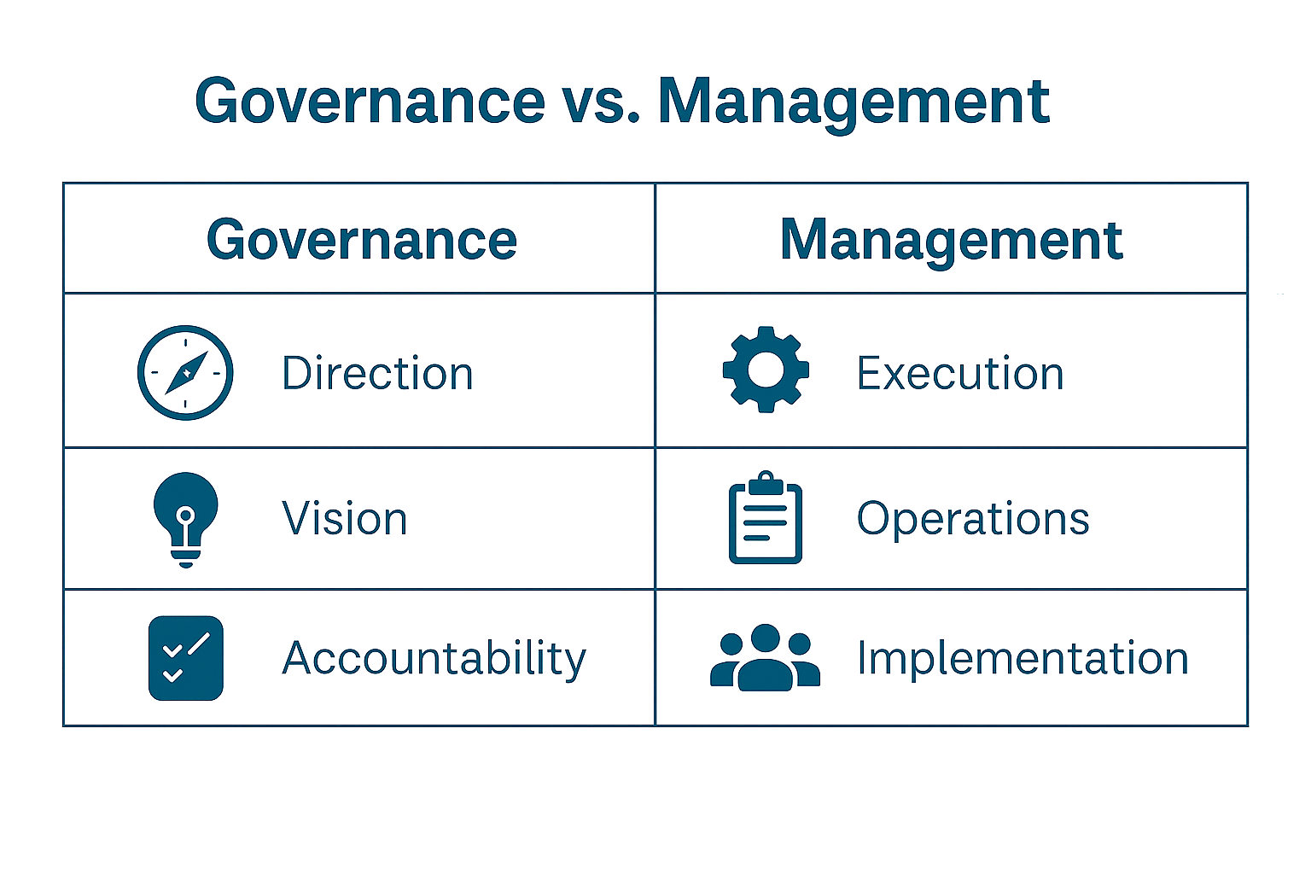
Defining the Roles
Notes:
Let’s start by defining our roles In a charter school setting, the board governs; the school leader or management, “manages.” The board’s responsibility is to define what success looks like – through goals, policies and oversight systems. The leader’s role is to determine how to achieve that success – through day-to-day operations, staff leadership, program implementation, etc. So, what does this look like . . .
EXECUTION: CARRYING OUT THE TASK (WITHIN THE PLAN)
IMPLEMENTATION: PUTTING A PLAN OR IDEA INTO PLACE (SETTING UP THE STRUCTURE, PROCESS OR SYSTEM)
The healthiest governance relationships happen when both sides stay in their lane but, yet, drive in the same direction!

Slide 6
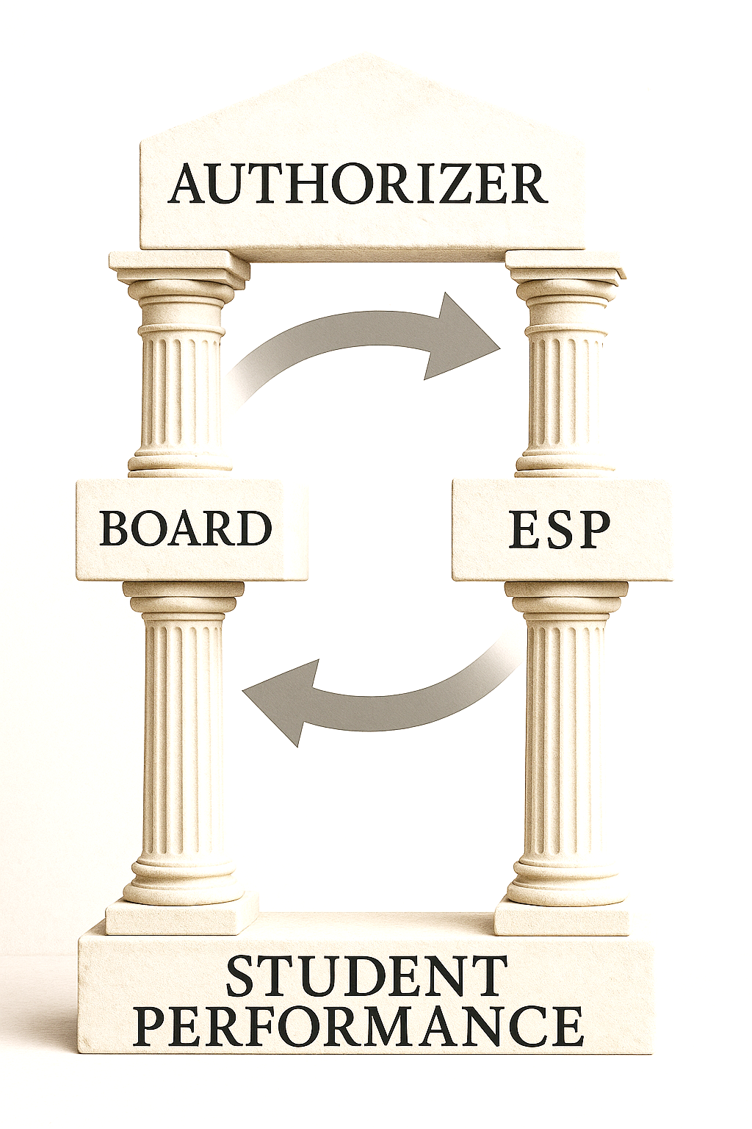
Charter School Context
The Accountability Relationship
Notes:
What is the Charter School Context of all of this?
In our charter school world, governance is a unique balancing act. Boards are both autonomous and accountable – you have the freedom to innovate but also the responsibility to deliver results. Your authorizer grants that autonomy but expects evidence that the school is fulfilling its mission and meeting performance targets. So the real question becomes: How do we provide strong oversight without crossing into management.
Think of the accountability relationship as a chain of trust. The authorizer holds the board accountable for the schools results. The board, in turn, holds the school leader/management accountable for performance and compliance. And the leader/management holds staff accountable for implementation. If that chain is disrupted – if the board starts managing or the leader/management stops reporting – governance breaks down student performance suffers and the authorizer may be forced to enforce its accountability role, unfavorably. This structure then collapses!

Slide 7
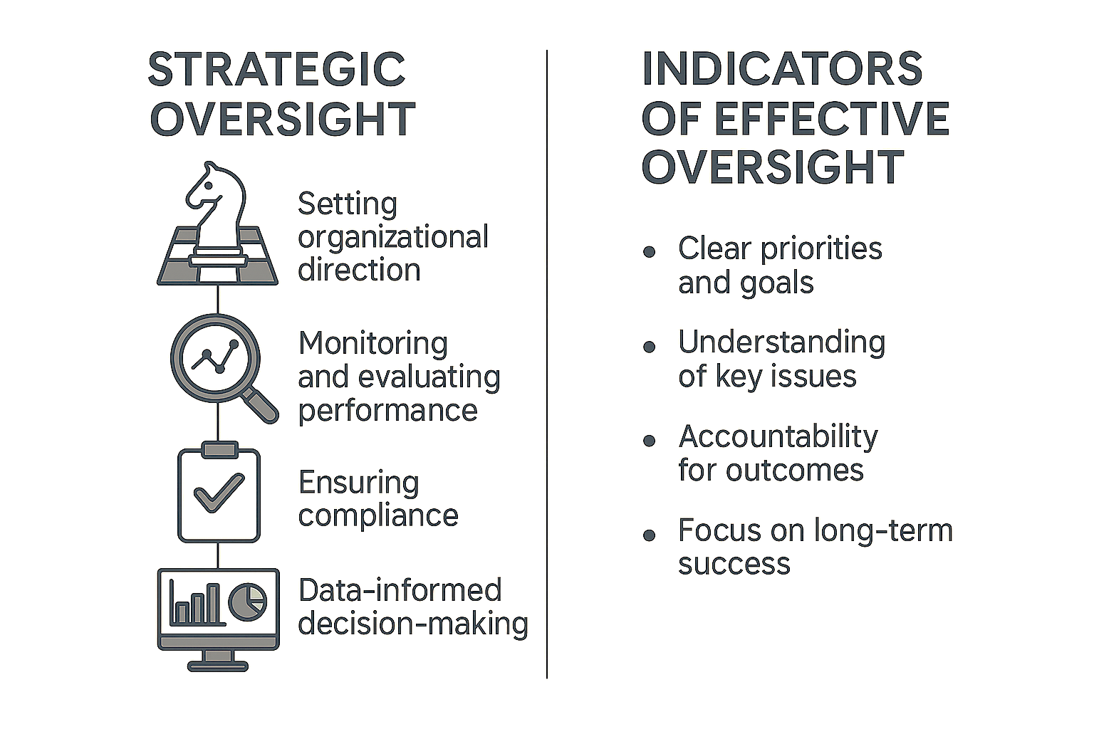
What Strategic Oversight Looks Like
Indicators of Effective Oversight:
Board agendas aligned to strategic priorities
Use of dashboards and annual reports
Governance questions framed as “how does this align with our mission and goals?”
Notes:
When boards operate with strategic oversight, they stay focused on the “big picture.” You are still performance standard oversight functions; however, in strategic oversight board agendas are aligned to strategic priorities and mission; the board has a firm understanding of key issues and is exercising its accountability role for outcomes, while focusing on long-term success; dashboards and annual reports are used to monitor progress and questions are framed around alignment – “how does this decision advance our mission and goals?”
Strong oversight is about staying informed, asking the right questions, and holding leadership accountable for results, not routines!

Slide 8
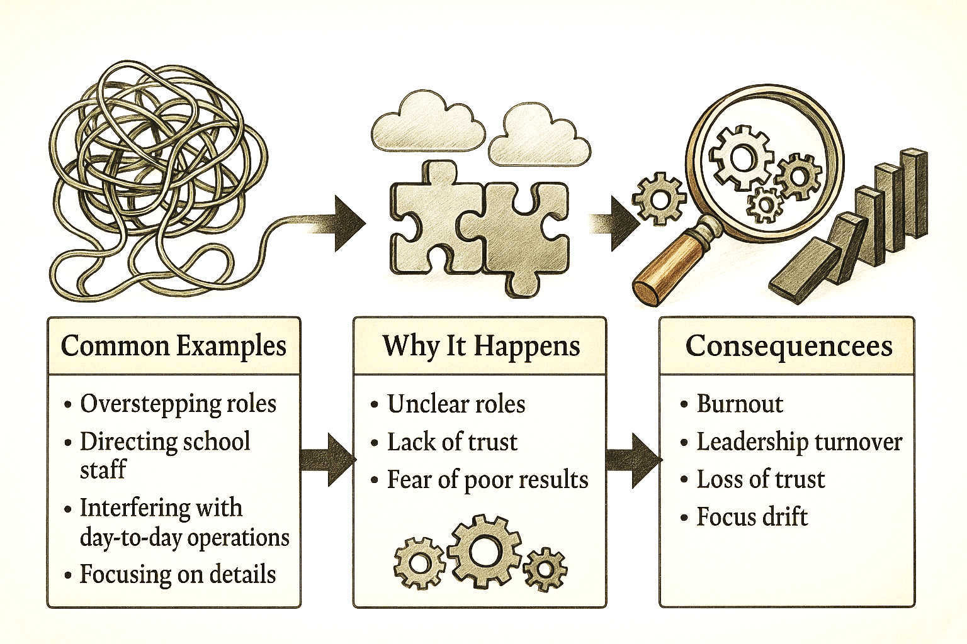
What Micromanagement Looks Like
Common Examples:
Directing staff instead of setting expectations for the school leader
Interfering with day-to-day operations (discipline, hiring, curriculum)
Overstepping roles during board meetings or site visits
Focusing on details rather than trends and outcomes
Notes:
Micromanagement, on the other hand, often comes from good intentions because boards, generally, want to help; to fix problems; to be supportive – but those interests and efforts can easily cross into interference.
Here are a few examples:
*Overstepping during meetings or site visits
*Directing staff instead of setting expectations for management/school leader
*Getting involved in operational details like discipline, hiring, or curriculum choices
*Focusing on details rather than trends and outcomes – counting the trees!
Why does this happen . . . And what are the consequences???
When micromanagement happens, it shifts responsibility away from leadership AND weakens accountability.

Slide 9
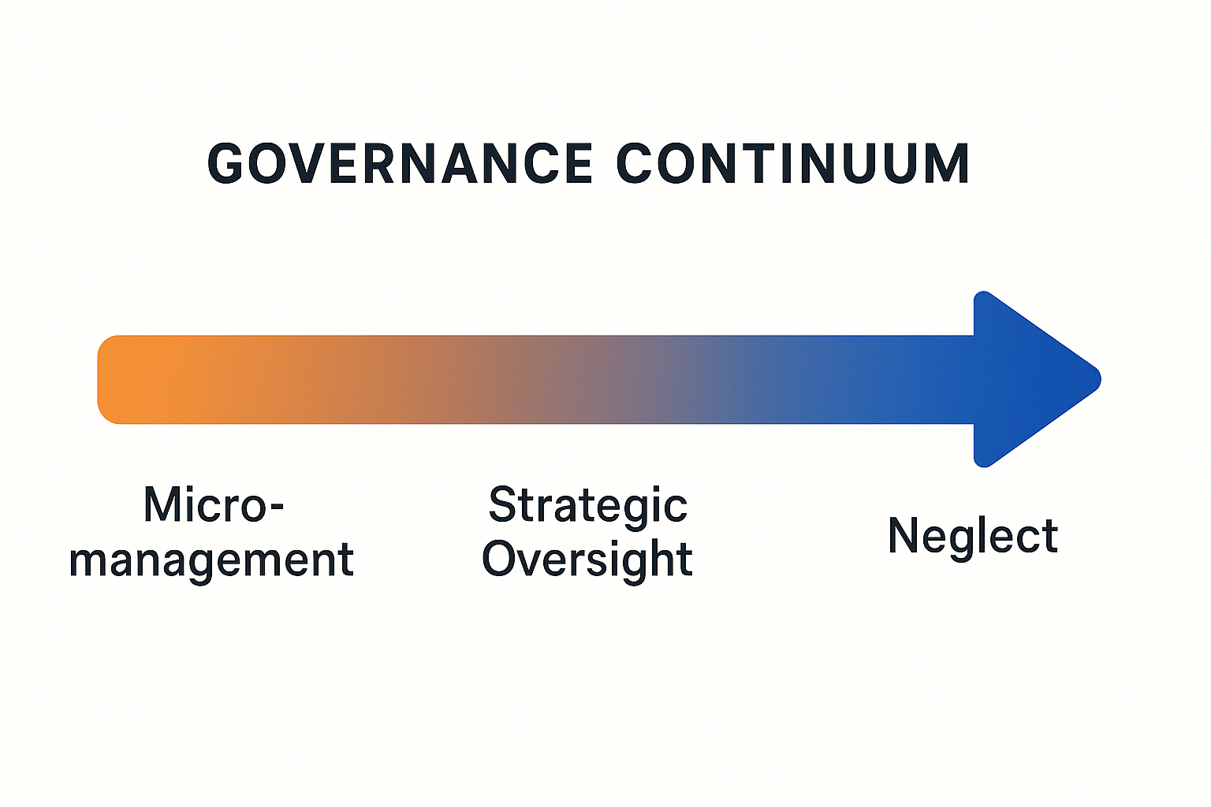
The Governance Continuum
Notes:
So, in all of this, we should think of governance as a continuum – from micromanagement on one end to neglect on the other.
MICROMANAGEMENT: DIVING TOO DEEPLY INTO OPERATIONS, DIRECTING INSTEAD OF OVERSEEING, FOCUSING ON DETAILS
STRATEGIC OVERSIGHT: SETTING DIRECTION AND OVERSEEING IN INTENTIONAL, NOT ROUTINE, WAYS
NEGLECT: STEPPPING TOO FAR BACK, FAILING TO FOLLOW-UP ON DATA, BECOMING PASSIVE
Our goal is to live in the center – where oversight is balanced, data-driven, and strategic. Too much control stifles leadership; too little oversight leads to risk. The sweet spot is strategic oversight – where boards use data, dashboards, and policy to guide decisions rather than dictate them!

Slide 10
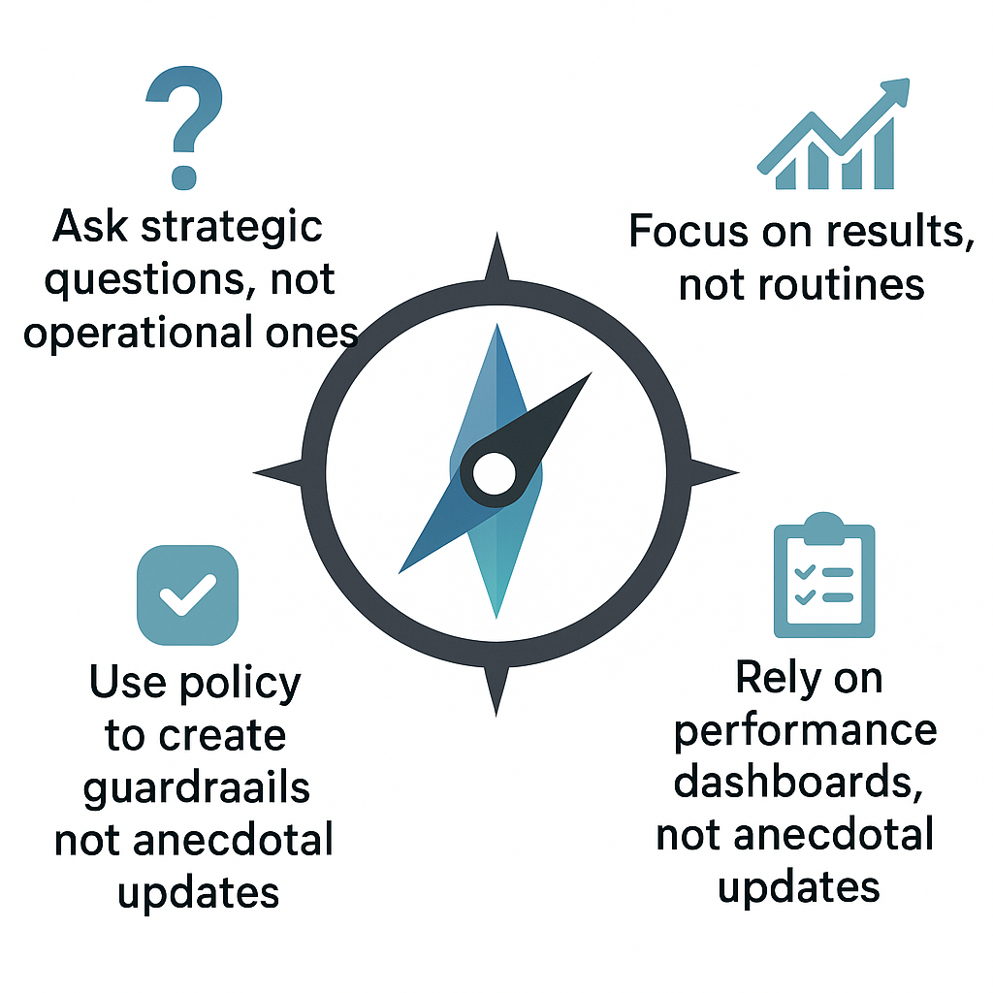
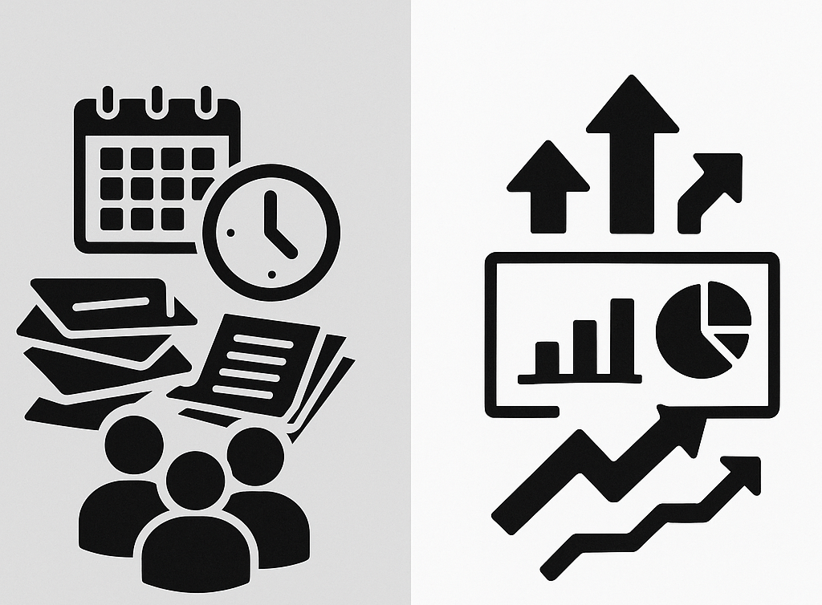
Shifting from Micromanagement to Strategic Oversight
BEFORE: MICROMANAGEMENT
AFTER:
STRATEGIC OVERSIGHT
Notes:
So how do we make the shift?? Here is how it happens in practice:
Before: Boards ask operational questions, like: “Who did you hire for that position?”
After: Boards ask strategic questions like, “How does our staffing structure support our academic goals?”
Before: Boards react to problems as they arise.
After: Boards use policies and performance measures as guardrais.
Before: Boards rely on anecdotal updates
After: Boards use dashboards and reports to monitor results.
.

Slide 11
Practical Tools
Strategic oversight checklist
Governance-management decision matrix
Mission-driven agenda template
Reflection Prompt: Where might our board, unintentionally, slip into micromanagement – and how can we shift toward strategic oversight?
Notes:
Strategic oversight checklist (pull it up): a quick self-assessment to keep your focus where it belongs
A governance-management decision matrix (pull it up): help you determine what’s a board decision versus a leadership responsibilitiy
Mission-drive agenda template (pull it up): to ensure every meeting reinforces the mission, not the minutae
Reflective Question: Review with them . . . This isn’t about blame; it’s about awareness. Every board – even strong ones – drafts at times. The goal is to catch it early and refocus on the mission.

Slide 12
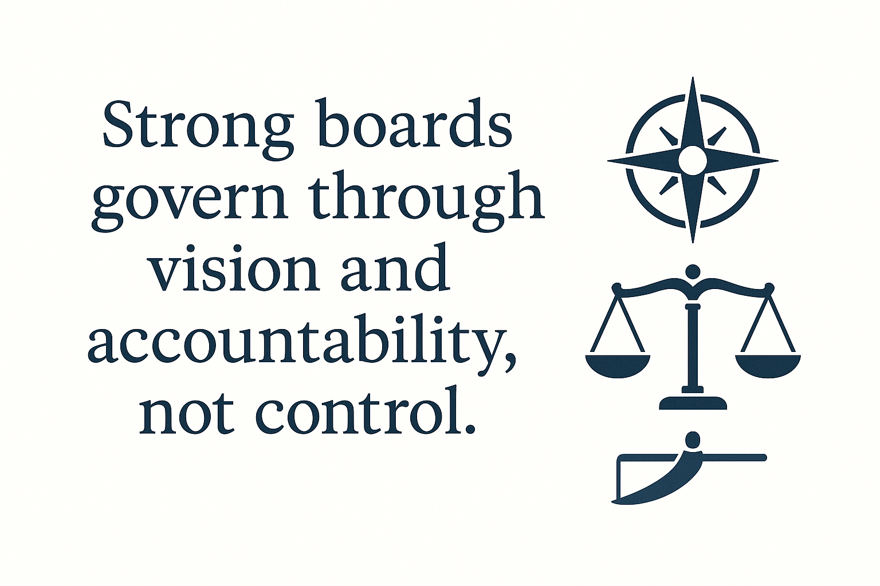

Slide 13

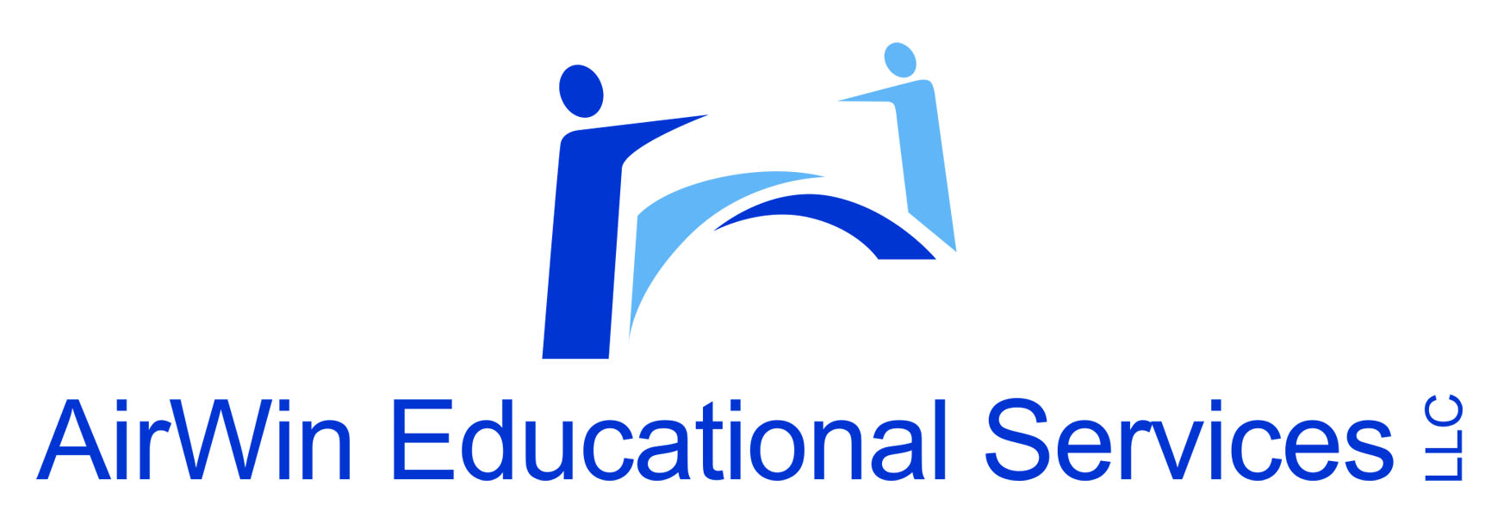
THANK YOU!
4521 Henry Drive
Beaverton, MI 48612
989.239.7555
ANGELA@AIRWINLLC.COM

