Slide 1

Data-Driven Governance for
Student Achievement
2025/2026 Professional Development Series
December 9, 2025
Presented by:
Angela L. Irwin, Owner
AirWin Educational Services, LLC
Notes:
Good evening, everyone, and welcome. I’m Angela Irwin, Owner of Airwin Educational Services. Thank you for taking time out of your very busy schedules (during this time of year) to join out Data-Driven Governance for Student Achievement Zoom session.
As a reminder, this session is part of our 25/26 governance series designed to help you strengthen oversight, sharpen decision-making, and ultimately improve outcomes for students.

Slide 2
Strong boards drive student success by using data to guide decisions . .
Notes:
Our focus tonight is quite simple: strong boards drive student success – and they do it by using data well.

Slide 3
DATA-DRIVEN GOVERNANCE . . .
Uses evidence to guide board discussions and decisions and monitor outcomes
Distinguishes between governance and management in a data context
Focuses on the vital few (avoiding data overload)
Notes:
Let’s start by grounding ourselves in what we mean by data-driven governance.
At its core, data-driven governance means using evidence to guide board discussions and decisions. It helps ensure you are not relying on anecdotes, assumptions, or incomplete information.
It also reinforces the difference between governance and management. Boards use data to set expectations, hold leadership accountable, and monitor outcomes – not to manage the day-to-day operations.
And, finally, data-driven boards focus on the vital few. You do not need 50 charts – you need the right handful of measures that tell the true story of student success!

Slide 4
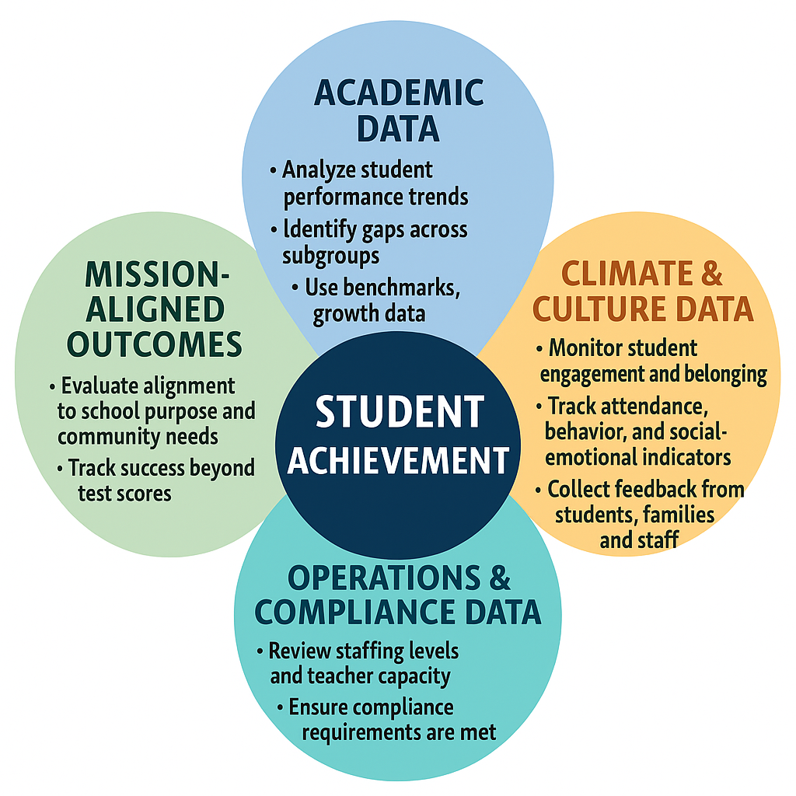
FOUR DOMAINS OF DATA-DRIVEN GOVERNANCE:
THE ECOSYSTEM
Notes:
One of the most important ideas in this entire series is that student achievement does not happen in isolation – it emerges from an ecosystem made up of four interconnected domains – when all four of the domains you see before you are working together! Let’s walk through them (ADDRESS SYSTEM)
All four create the conditions, supports and drivers that enable student achievement.
Discuss the role of financial data in the ecosystem . . .
Your task: think about/identify how each of these domains influence the other to, ultimately, influence student achievement . . .

Slide 5
ACADEMIC PERFORMANCE:
THE PRIMARY INDICATOR
Academic Data SHOULD Answer: (the BIG questions) | Boards Should Ask About: | Power Questions to Ask:
Are students learning? | Learning and progress | What do our data tell us about whether students are learning and progressing?
Are they progressing? | Instructional effectiveness | Are all student groups showing equitable progress?
Are instructional strategies effective? | Responsiveness and alignment | What evidence shows that curriculum is being implemented with fidelity?
Notes:
Academic performance is the primary indicator. It tell us whether students are learning the knowledge and skills we expect. But as we’ll see, academics alone do not provide a full explanation when results rise . . . Or whey they fall.
POWER QUESTIONS HANDOUT . . .

Slide 6
CLIMATE AND CULTURE:
THE CONDITIONS FOR LEARNING
Climate and Culture Data SHOULD Answer: (the BIG questions) | Boards Should Ask About: | Power Questions to Ask:
Are classrooms safe and supportive? | Physical environment/safety | Are classrooms consistently safe, orderly, and conducive to learning?
Is teaching retention strong? | Teacher attrition/mobility | What are our retention rates – and what influences retention?
Do students feel connected and engaged? | Academic environment (including social-emotional support) | What early warning indicators signal student disconnection?
When climate strengthens:
Attendance increases
Behavior improves
Instructional time grows
Teachers stay, improving instructional consistency
Every discussion, no matter the domain, comes back to evidence!
Notes:
Climate and culture are the conditions for learning. When climate strengthens, we see predictable improvements . . .
Boards should see these not as separate issues by as drivers of academic success.

Slide 7
OPERATIONS AND COMPLIANCE:
THE INFRASTRUCTURE OF ACHIEVEMENT
Operational and Compliance Data SHOULD Determine: (the BIG questions) | Boards Should Ask About: | Power Questions to Ask:
Are teachers fully staffed and supported? | Teacher capacity and support | What evidence demonstrates that teachers feel supported and are able to deliver high-quality instruction, daily?
Are resources (curriculum, technology, interventions) available? | Teacher effectiveness (relative to resources or lack, thereof) | Do teachers have all curriculum, materials and technology necessary to teach most effectively?
Are compliance requirements met so leadership is not pulled away from instruction? | School leadership effectiveness (relative to time spent on instructional leadership) | To what extent are compliance tasks pulling leaders from instructional leadership?
Strong operations more time, stability, and resources devoted to learning
Notes:
Next is the operational and compliance domain – the infrastructure of achievement.
When operations are strong, leadership has:
*more time to focus on teaching and learning; fewer crisis to manage; and better stability and resource allocation. If operations are strained, academic performance almost always reflects it.

Slide 8
MISSION-ALIGNED OUTCOMES:
THE COMPASS
Mission Outcomes SHOULD Determine: (the BIG questions) | Boards Should Ask About: | Power Questions to Ask:
Are we preparing students in accordance with the vision and mission? | Mission-driven competencies | What evidence shows students are developing mission-driven competencies?
Are we remaining focused on programs and priorities? | Funding key programs | In our budget preparation, are we ensuring our “mission” is being funded through financially supporting our key programs and priorities?
Are we, as a board, evaluating success beyond test scores? | Impactful programs | Which mission-specific programs show impact?
The mission must guide decisions, priorities, and resource allocation
Every discussion, no matter the domain, comes back to evidence!
Notes:
And, finally, mission-aligned outcomes – your compass.
Every board decision, every resource allocation, every priority should reinforce the mission. This domain helps you answer: Are we preparing students in the way our mission intended/intends? Are we staying true to our purpose?

Slide 9
DATA STANDARDS
Boards Typically See: | Boards Need to Ask For:
State and NWEA test scores Finance reports Enrollment and attendance data Behavior data Compliance updates | Trends across domains (not isolated metrics) Growth and proficiency Leading indicators Root-cause hypotheses Mission-aligned measures
Notes:
Leading indicator ask example: “What early signs – such as weekly formative assessment trends, attendance patterns or student engagement data – signal whether we are on-track to meet our quarterly academic goals?”
Mission-aligned measures question example: “What is the percentage of students competing community-based projects that demonstrate real-world application of learning, as defined in the school’s mission?”

Slide 10
THE BOARD’S JOB:
LOOK FOR PATTERNS ACROSS THE FOUR DOMAINS
Academic Data ⇆ Climate and Culture ⇆ Operations and Compliance ⇆ Mission-Aligned Outcomes
Data→ Patterns → Root Causes → Board Action →Improved Student Achievement
Notes:
Here’s where the work of the Board becomes powerful: your role, then, is to look for patterns across these domains; and if done right, this is what you will experience!

Slide 11
TAKEAWAY STATEMENT:
Boards do not need more dashboards to be data-driven; typically, they need better questions rooted in evidence!
Notes:
Please let me leave you with this statement before we enter into our reflective questions . . .

Slide 12
APPLYING THE ECOSYSTEM TO YOUR BOARD WORK
Reflect on your own board work over the last 6-12 months and answer the following questions:
Where have we made decisions without sufficient data?
Which domain has dominated most of our board conversations?
Which domain received the least attention?
Are there warning signs in any domain that deserves deeper monitoring?
Where could your board add the most value in the next 90 days?

Slide 13


THANK YOU!
4521 Henry Drive
Beaverton, MI 48612
989.239.7555
ANGELA@AIRWINLLC.COM
Notes:
Thank you, again, for being here this evening. Your commitment to governance is a direct investment in your students’ futures. Happy holidays to all of you!

