Slide 1

Ensuring Effective
Financial Oversight
Virtual Professional Development Series 2025/2026
January 13, 2026
Presented by:
Angela L. Irwin, Owner
AirWin Educational Services, LLC
and
Brian McMillan, Regional Director
EdOps
Notes:
Angie – Welcome – Happy New Year – Happy Board Appreciation Month (give thanks)
Three reasons I am exceptionally excited for this presentation:
Always thrilled to gather with you!
2. Co-presenter – Brian McMillan – Regional Director – EdOps – Brian joins me as a trusted colleague and expert in the area of charter school finances – not here to market his services but,, rather, to assist in ensuring an effective and helpful presentation
Critical topic designed to support board members in fulfilling their fiduciary responsibilities with clarity and confidence; it is not about turning board members into accountants but, rather, about strong governance – asking the right questions and proteching both financial health and mission alignment
Session being recorded - link to be shared with authorizer; however, if you want it sooner, just email me
Survey link will be shared with all of you, likely tomorrow
Format of presentation with handouts

Slide 2
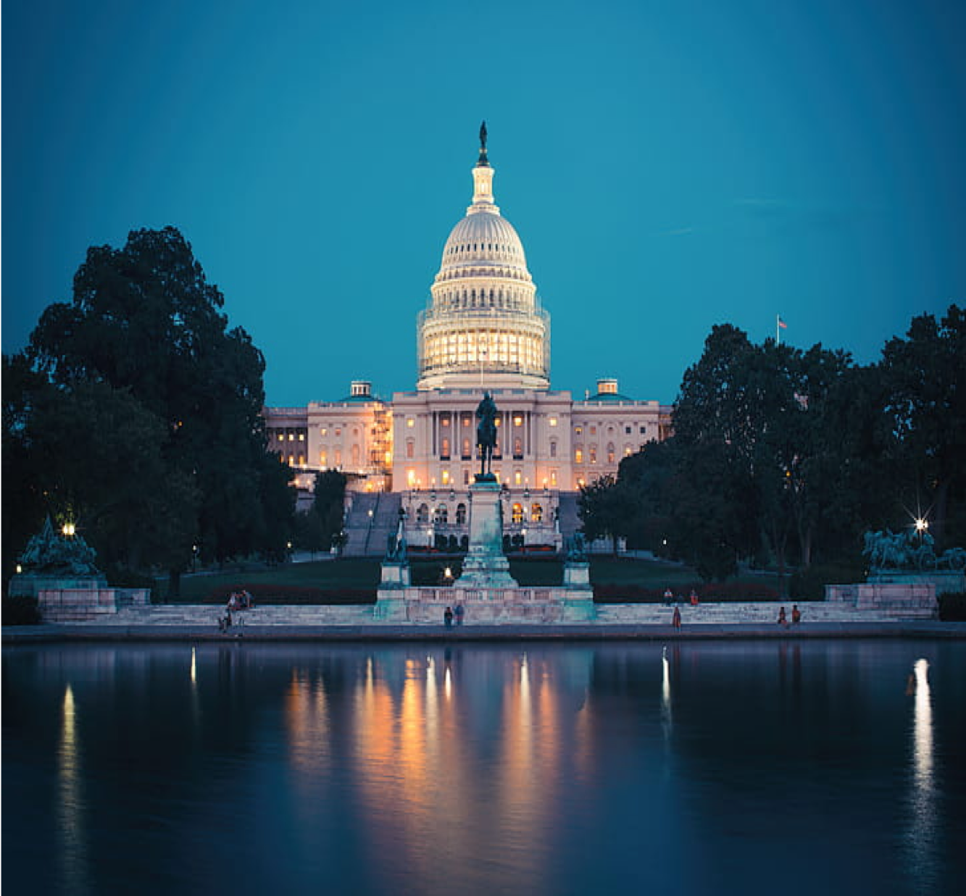
Financial Oversight: Defined
To ensure the school is financially sound, compliant, and aligned to its mission—by:
SETTING EXPECTATIONS
APPROVING KEY FINANCIAL DECISIONS
MONITORING PERFORMANCE THROUGH CLEAR REPORTS
AND HOLDING LEADERSHIP ACCOUNTABLE FOR RESULTS.
Notes:
Angie Slide
Financial oversight is a governance responsibility – not a management function
Review Definition – explain the presentation has been constructed around each of the all caps definition elements
Oversight is about direction and accountability – not ontrol!

Slide 3
IT ALL BEGINS WITH THE BUDGET
A school’s budget should serve as a strategic document that aligns with the school’s strategy for generating student outcomes. It should tell a clear story about how the school will invest to achieve these goals.
February
Strategic Direction Set
Assumptions (Enrollment, State Aid)
March
Staffing Plan Finalized
April-June
Vendor-level Detail
Review by Finance Committee (May)
Federal Grant Assumptions
Board Approval & Submission to MDE (June)
A school’s budget should be built from the “bottom up” with staff and vendor-level detail that aggregates to form a total budget AND SHOULD ALWAYS “FUND” YOUR MISSION . . .
Notes:
Brian Slide
The budget is the foundation of effective financial oversight . . . Take it away, Brian . . .

Slide 4
SETTING EXPECTATIONS
What is the Board Responsible For? | What Do/Should Expectations “Look” Like?
Adopting clear financial priorities | Budget reflects board-approved priorities Resources support student achievement and staffing stability Spending aligns to mission-critical goals
Establishing funding guardrails | Required reserves are maintained Staffing and debt stay within board-approved limits Financial risk is managed proactively
Defining expectations | Financial reports are timely and accurate Variances and risk are clearly explained Tradeoffs are presented transparently
Ensuring financial alignment with desired outcomes | Investments link to student and school outcomes Spending supports improvement goals Impact is periodically reviewed
Communicating expectations clearly | Priorities and limits are formally adopted Expectations are shared with leadership and partners Board decisions reinforce financial direction
Notes:
Angie Slide
Budgets are intentional, not default; priorities must be visible in all allocations, not just statements
Guardrails project against crisis management; boards define “how far is too far,” financially
Expectations apply to information quality, not daily execution; transparency in non-negotiable
Money is a means, not an end; financial discussions must connect to results
Silence creates misalignment; clear expectations reduce tension with management companies

Slide 5
APPROVING DECISIONS
Where Board Authority Is Required – 5 Key Areas:
APPROVAL IS NOT RUBBER-STAMPING – IT IS INFORMED STRATEGIC DECISION-MAKING
1. Adoption of the budget and any amended budgets
2. Approval of major contracts, leases and long-term financial commitments
3. Authorization of debt, loans and/or use of reserves
4. Approval of material changes that impact financial sustainability
5. Acceptance of annual audits and corrective action plans
Notes:
Angie
Responsible for approving key financial decisions that carry long-term impact for risk
Read and explain the “approval is not rubber stamping statement . . . And add, it is a governance act that ensures alignment, understanding and stewardship
Budget: Discuss CAO Uniform Budget and Accounting Act requirement – Board must appoint, formally, by resolution a CAO that is legally responsible for: preparing and administering the annual budget, maintaining the accounting system, and ensuring compliance with state budgeting and reporting requirements (Brian, anything you would like to add here) . . .
Refer back to “guardrails” discussion . . .

Slide 6
MONITORING PERFORMANCE
What Effective Oversight Looks Like
Monitoring is about patterns, trends, and trajectory – not line-item management
Receiving regular, standardized financial reports tied to the approved budget
Monitoring cash flow, fund balance, and budget variances
Using Key Performance Indicators (KPIs) to focus discussion
Looking ahead — not just year-to-date — to identify emerging risks
Asking questions that connect finances to student outcomes
Notes:
Brian Slide: Angie, as appropriate, add a comment on line-item management . . .
Angie can speak to KPIs given to boards over time . . .

Slide 7
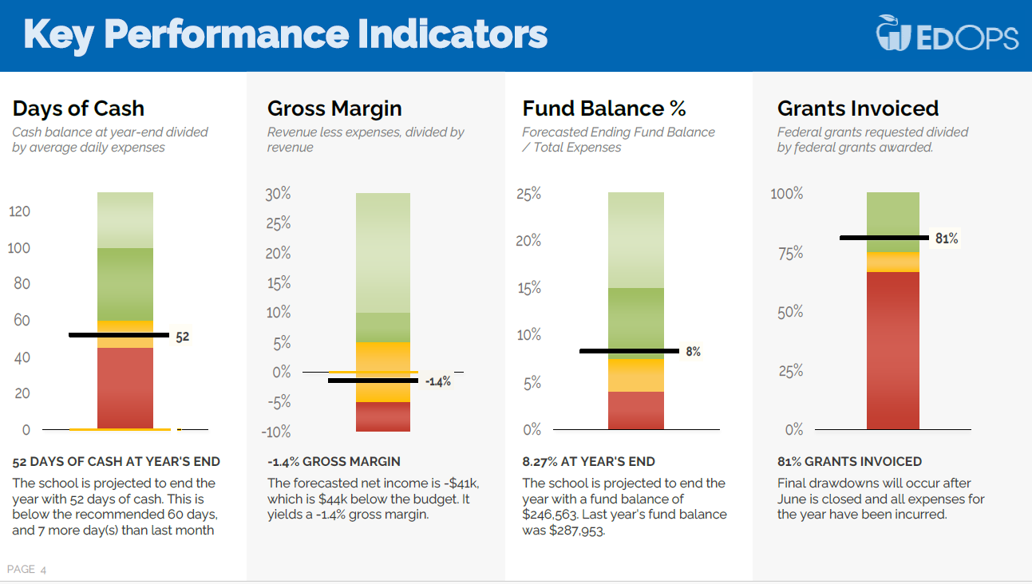
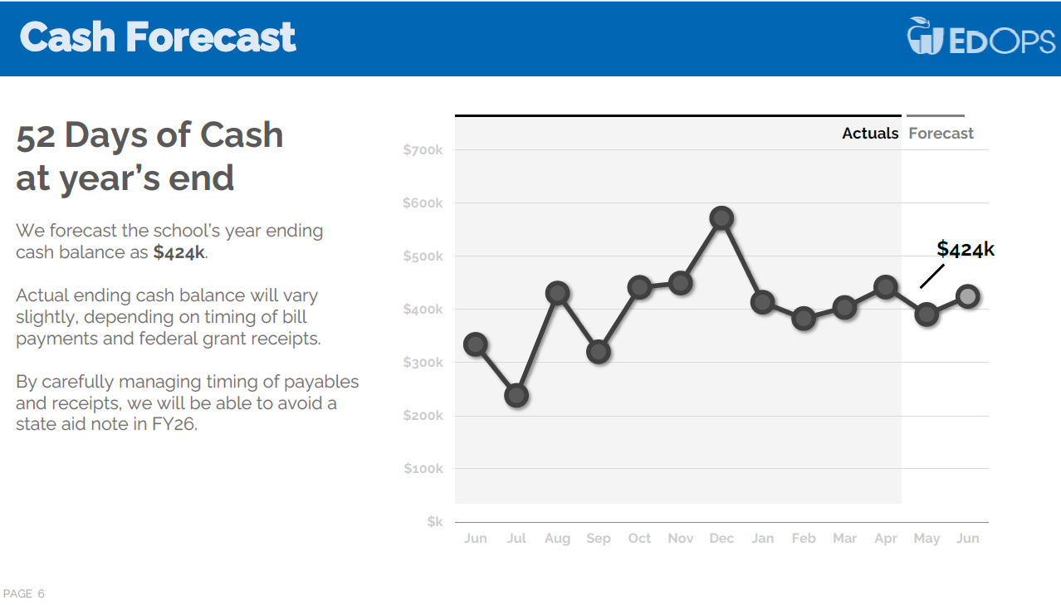
MONITORING PERFORMANCE (Continued)
Key Performance Indicators that form a foundation for discussion
Be Forward-Looking
Distill 2-3 key takeaways most relevant for financial oversight (if everything is highlighted, nothing is prioritized)

Slide 8
HOLDING LEADERSHIP ACCOUNTABLE
Closing the Oversight Loop
Accountability is about outcomes
and stewardship – not control.
Require follow-through on corrective actions when concerns are identified
Use financial data as part of the leader evaluation process
Evaluate financial decisions with board-approved priorities
Reinforce accountability without micromanaging day-t0-day operations
Ensure compliance issues are addressed promptly
Notes:
Angie Slide:
Accountability closes the oversight loop . . .
Boards hold leadership accountable by connecting expectations to results, following up on concerns, and ensuring correctin actions
Accountability is about outcomes and stewardship – not control!

Slide 9






COMMON FINANCIAL MISSTEPS
Running Out of Cash
1% + Budget Variance
Budget Not Strategic
Only Looking Year-to-Date
Not Investing Excess Cash
Not Asking Wise Questions
Notes:
Brian Slide

Slide 10
PUTTING IT INTO PRACTICE
Effective Financial Oversight Means the Board:
Sets clear expectations
Approves key decisions thoughtfully
Monitors performance through meaningful reports
Holds leadership accountable for results
Keeps the focus on sustainability and mission impact
Strong financial oversight protects the school today – and positions it for the future.
Notes:
Angie/Brian together

Slide 11


THANK YOU!
4521 Henry Drive
Beaverton, MI 48612
989.239.7555
ANGELA@AIRWINLLC.COM

