Slide 1
Evaluating Contracts: Tools for Accountability
Strengthening Oversight, Protecting Mission, and Ensuring Value
Virtual Professional Development Series 2025/2026
March 10, 2026
Presented by:
Angela L. Irwin, Owner
AirWin Educational Services, LLC
Notes:
Welcome, Introduction(s) and Housekeeping
Tonight, we are going to focus on Evaluating Contracts: Tools for Accountability
Contracts may seem like a routine administrative task, but, in reality, they are important governance tools! Every contract a board approves reflects a decision about resources, priorities, and ultimately, the experience students will have in the school.
So our goal tonight is to shift the mindset slightly – from viewing contracts as paperwork to understanding them as strategic instruments of oversight and accountability.
By the end of our time together, you will “leave” with:
*a clearer understanding of the board’s role in contract oversight
*a simple framework for evaluating contracts
*a practical review protocol you can use wth boards
*and some common red flags to watch for BEFORE APPROVAL
This session is intentionally practical. My hope is that you will walk away with tools you can use IMMEDIATELY at your next board meeting.

Slide 2

PURPOSE OF SESSION
Contracts are governance tools – not just legal documents
Strong contracts protect mission, finances, and students
Boards have a fiduciary duty to understand and monitor contracts
A signed contract is not the END of oversight – it is the BEGINNING of accountability
Notes:
Let’s start with a simply bit important concept – CONTRACTS ARE GOVERNANCE TOOLS- NOT JUST LEGAL DOCUMENTS
They shape how services are delivered, how money is spent, and how responsibilities are assigned. When done well, strong contracts protect:
*the school’s mission
*the school’s finances, and
*most importantly, the students the school serves
Boards also have a fiduciary duty to undertand and monitor the contracts they approve.
And here is a key point I often emphasize with boards: SIGNING THE CONTRACT IS NOT THE END OF OVERSIGHT – IT IS THE BEGINNING OF ACCOUNTABILITY.
Once a contract is approved, the board should continue monitoring:
*performance, compliance, financial impact, and alignment with the school’s strategic priorities
So tonight our focus is how you can approach contracts thoughtfully and responsibly!

Slide 3
GOVERNANCE ROLE IN CONTRACT OVERSIGHT
Board | Management
Approves major contracts | Manages day-to-day vendor relationships
Ensures alignment with mission and strategic goals | If own contract, implements the services
Monitors performance and compliance | Provides performance data to the board
Fiduciary Lens:
Duty of Care = informed decisions
Duty of Loyalty = avoiding conflicts
Duty of Good Faith = mission-aligned agreements
Notes:
To understand contract oversight, it is helpful to distinguish between the roles of board and management (in contract oversight)
Management typically oversees day-to-day vendor relationships; implements services, if own contract and provides data on contract service performance
The board’s role, then is to approve major contracts, ensure alignment with mission and strategy and monitor performance and compliance over time
Understanding this distinction, then, board should ALWAYS review contract through its fiduciary lens’ responsibility:
DUTY OF CARE: This means making informed decisions. Board members should understand the purpose, the cost, and potential impact of a contract BEFORE approving it
DUTY OF LOYALTY: This involves avoiding conflicts of interest and ensuring decisions are made in the best interest of the school
DUTY OF GOOD FAITH: This means ensuring contracts align with the mission and values of the school.
When boards apply these lenses, contract review becomes more thoughtful and intentional.

Slide 4
TYPES OF CONTRACTS BOARDS SHOULD MONITOR
Vendor Contracts:
ESP Agreements
Transportation
Food service
Technology
Facilities/leases
Professional services
Charter Contract:
Performance framework
Compliance expectations
Reporting requirements
Term and renewal conditions
Notes:
Not all contracts require the same depth of review, but boards should maintain awareness of the major agreements that affect the school.
These typically fall into two broad categories: Vendor contracts, which may include (read list) . . . These contracts often involve significant financial commitments or operational implications.
Second is the Charter Contract itself – this is THE MOST IMPORTANT AGREEMENT the school has. It defines: Performance framework, compliance expectations, reporting requirements, and the conditions for renewal
While management works closely with authorizers, boards should remain aware of the charter contract because it defines the school’s accountability structure.
Again, not every contract requires the same level of scrutiny, but all require awareness and oversight!

Slide 5
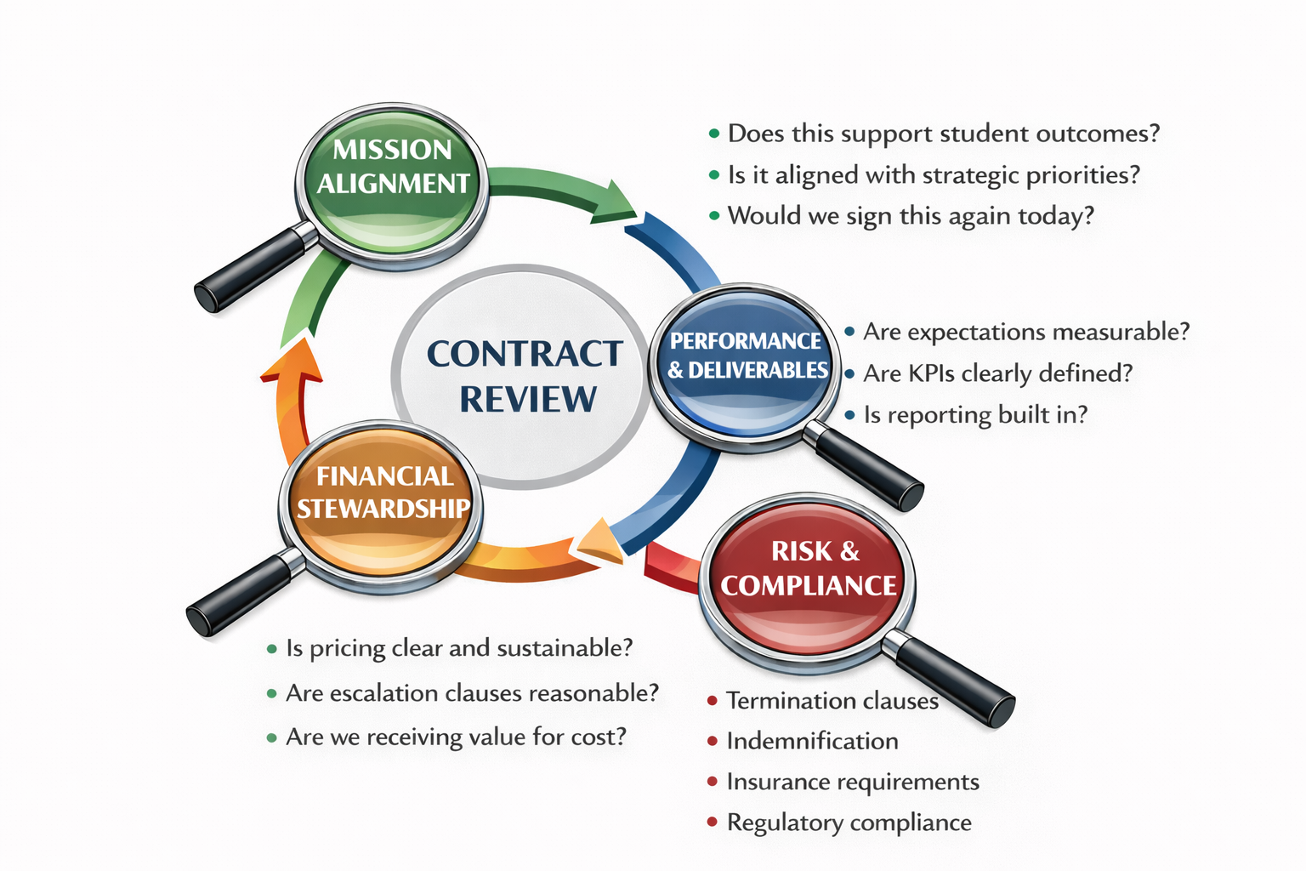
CONTRACT REVIEW:
FOUR-LENS FRAMEWORK
Notes:
One tool that can help boards review contracts effectively is a four-lens framework.
This approach encourages boards to consider contracts from several perspectives before approval and upon renewal or renewal discussions . . .
The first lens is FINANCIAL STEWARDSHIP: Is the cost sustainable? What is the short and long-term financial impact? If any increases or cost escalation clauses, are they reasonable?
The second lens is MISSION ALIGNMENT: Does the contract support the mission and educational priorities of the school?
The third lens is PERFORMANCE AND DELIVERABLES – the “accountability” lens – Are expectations clear? Are deliverables measureable?
And the fourth lens is RISK AND COMPLIANCE: Does the contract expose the school to legal, operational, or reputational risk?
Using these lenes helps boards ask better questions and avoid decisions based purely on convenience or habit!

Slide 6
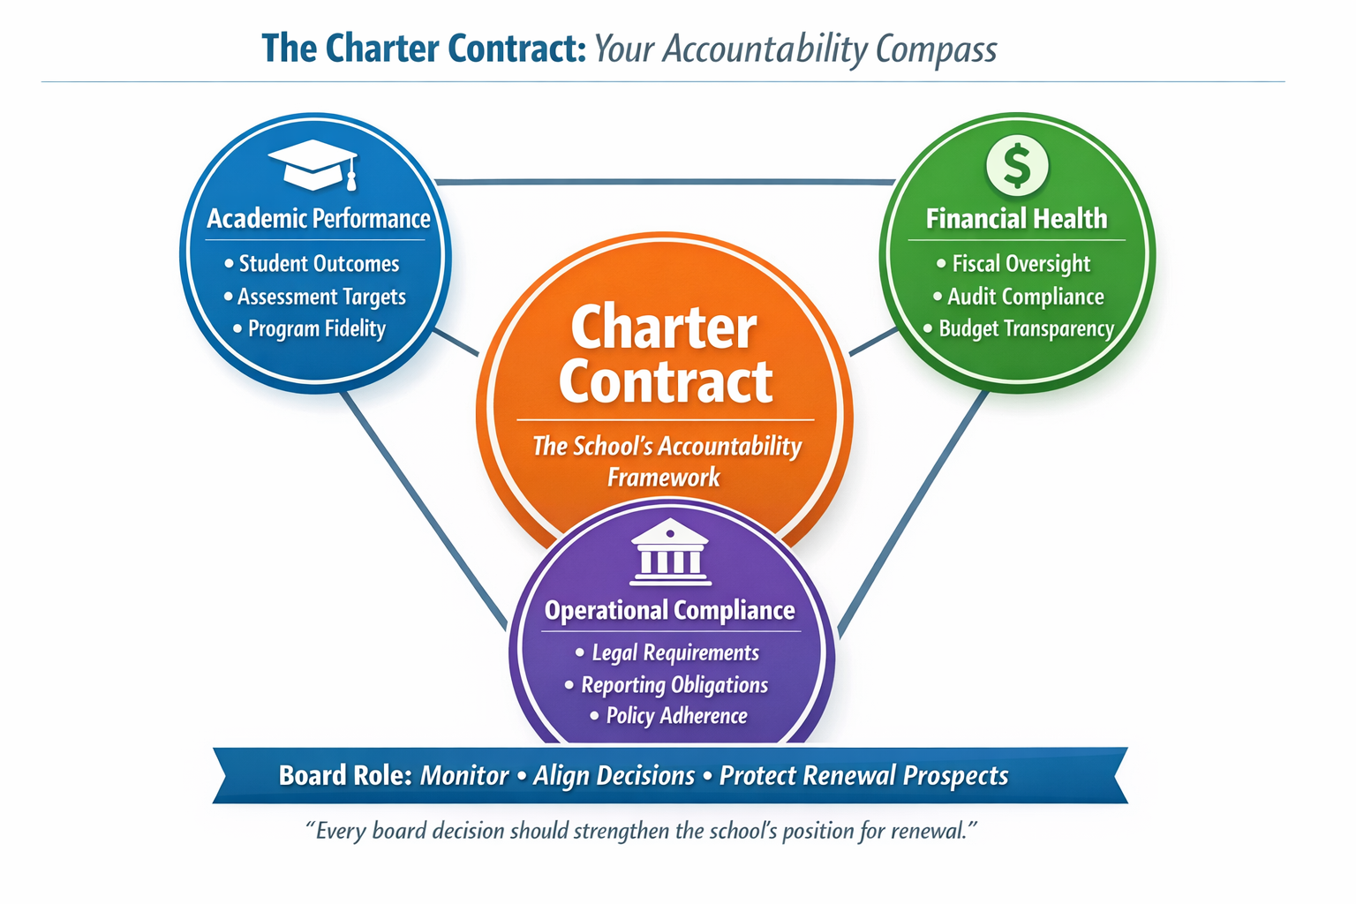
UNDERSTANDING THE CHARTER CONTRACT
Notes:
It is worth pausing, briefly, to talk about the charter contract, itself.
The charter contract is the agreement between the school (board) and the authorizer. It outlines: Performance expectations, compliance obligations, reporting requirements, and the renewal process.
Boards should periodically revisit this agreement to ensure the school remains aligned with its commitments.
In many ways, the charter contract serves as THEE ACCOUNTABILITY FRAMEWORK for the school.
Understanding its expectations helps boards ensure that other contracts and operational decisions remain aligned with those broader obligations.

Slide 7
PRACTICAL REVIEW PROTOCOL
Management Summary
Memo
Purpose vendor, cost, risks, due diligence
Legal Review
Triggered for complex, high-value, or long-term contracts
Finance Committee Preview
Recommended for high-cost, high-impact contracts
Board Discussion
Formal Approval
Board Focus: Clarity of purpose and transparency
Good processes protect both the school and the board
Board Focus: Assurance that review occurred
Board Focus: Fiscal impact and sustainability
Mission fit, financial impact, risk, accountability, exit plan
Board Focus: Governance-level questions
Vote recorded in minutes
Board Focus: Accountability and transparency
Notes:
To support thoughtful oversight, boards can adopt a simple review profocol.
A typical process might include several steps.
First, management prepares a summary memo that explains: the purpose of the contract, cost and financial impact, potential risks and due diligence that has been conducted.
Second, when appropriate, legal review may be triggered – particularly for complex or long-term agreements.
Third, the finance committee may preview the contract if the financial implications are significant.
Finally, the contract comes to the full board for discussion and approval.
During this stage, the board should focus on governance-level questions, such as: Does this align with our mission? Is the financial commitment sustainable? Are expectations and accountability clear?
When boards use consistent processes like this, they protect both the school and themselves as fiduciaries.

Slide 8
RED FLAGS AND COMMON CONTRACT PITFALLS
COMMON PITFALLS | RED FLAGS
Auto-renewals without review | Rushed approvals
Vague deliverables | Pressure to sign quickly
Long terms with limited exit options | Lack of competitive bids (when and as appropriate)
Vendor-friendly termination clauses | Unclear scope of work
Signing without legal review | Multi-year commitments without clear benefit
“We’ve always done it this way” decisions
Notes:
Even with good processes, certain contract issues should raise caution.
Some common pitfalls include: auto-renewal clauses that allow contracts to continue without review; vague deliverables that make performance difficult to measure; long contract terms with limited exit options; vendor-friendly termination clauses.
There are also warning signs during the approval process.
Theses include: rushed approvals, pressure to sign quickly, lack of competitive bids when appropriate and unclear scope of work
And one of the most common challenges I see is the mindset of “we’ve always done it this way.”
Strong governance requires periodically revisiting contracts to ensure they still serve the school’s needs!

Slide 9
REFLECTION AND DISCUSSION
Have we ever approved a contract we later regretted?
What would better due diligence have looked like?
How do we ensure consistent review practices?
Notes:
Reflective questions such as these help boards strengthen governance over time!

Slide 10
CRITICAL TAKEAWAYS
Ask thoughtful questions
Focus on alignment and risk
Trust management but verify process
Protect both mission and resources
Good contracts don’t just protect the school – they protect the students you serve!
Notes:
Let me leave you with a few key reminders . . .
Strong contract oversight begins with asking thoughtful questions
Boards should focus on alignment, risk and sustainability
It’s also important to trust management, but verify that appropriate processes have been followed.
Ultimately, good contracts protect: the mission of the school, the responsible use of resources, and the students the school exists to serve

Slide 11

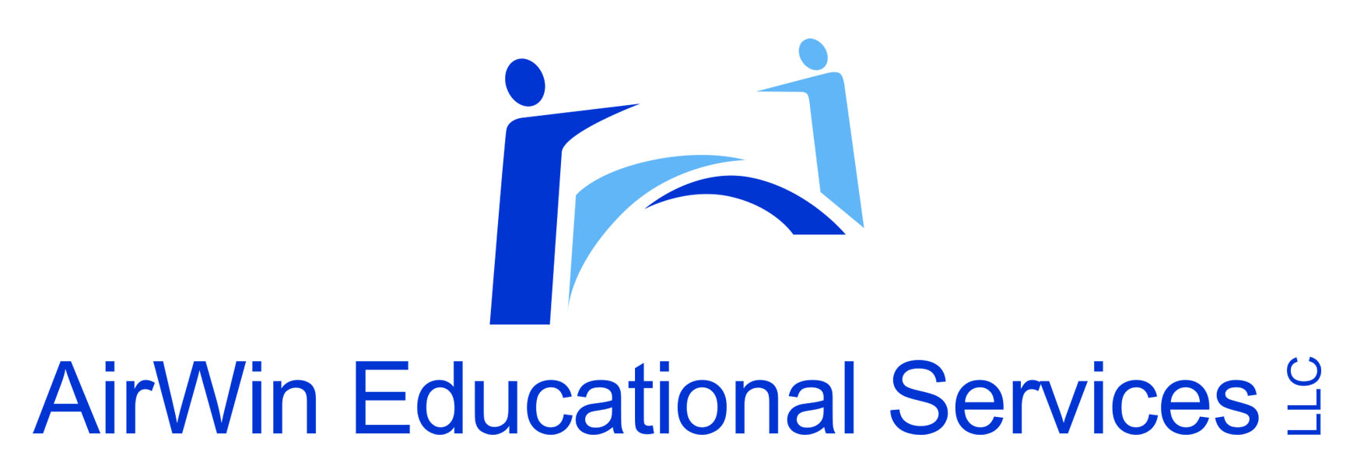
THANK YOU!
4521 Henry Drive
Beaverton, MI 48612
989.239.7555
ANGELA@AIRWINLLC.COM
Notes:
Thank you, again, for your leadership and for the work you do to support strong schools and strong governance.
Please join me for our next session scheduled for April 14th where we will discussion governance and management/school leader partnerships!

