Slide 1

Strengthening Governance and
Authorizer Partnerships
MCCSA Webinar Series
May 2026
Presented by:
Angela L. Irwin, Owner
AirWin Educational Services, LLC
Notes:
Good evening, everyone and thank you for joining me tonight for our last session of our 25/26 webinar series. As a reminder, our theme for this series was “Governance Growth: Strengthening Boards, Empowering Schools.” I hope, together, we made progress in operationalizing this theme!
In our last session, we spent time on the board/management partnership – how those roles align, internally, within your school.
Tonight, we are shifting the lens outward; we’re going to focus on the board/authorizer partnership – and, more specifically, how that relationship when it is strong, becomes a driver of school success . . . Not just a compliance requirement.
As we move through this conversation, I want you to keep one idea in mind: Strong partnerships do not happen by accident – they are built through clarity, consistency and shared purpose.

Slide 2
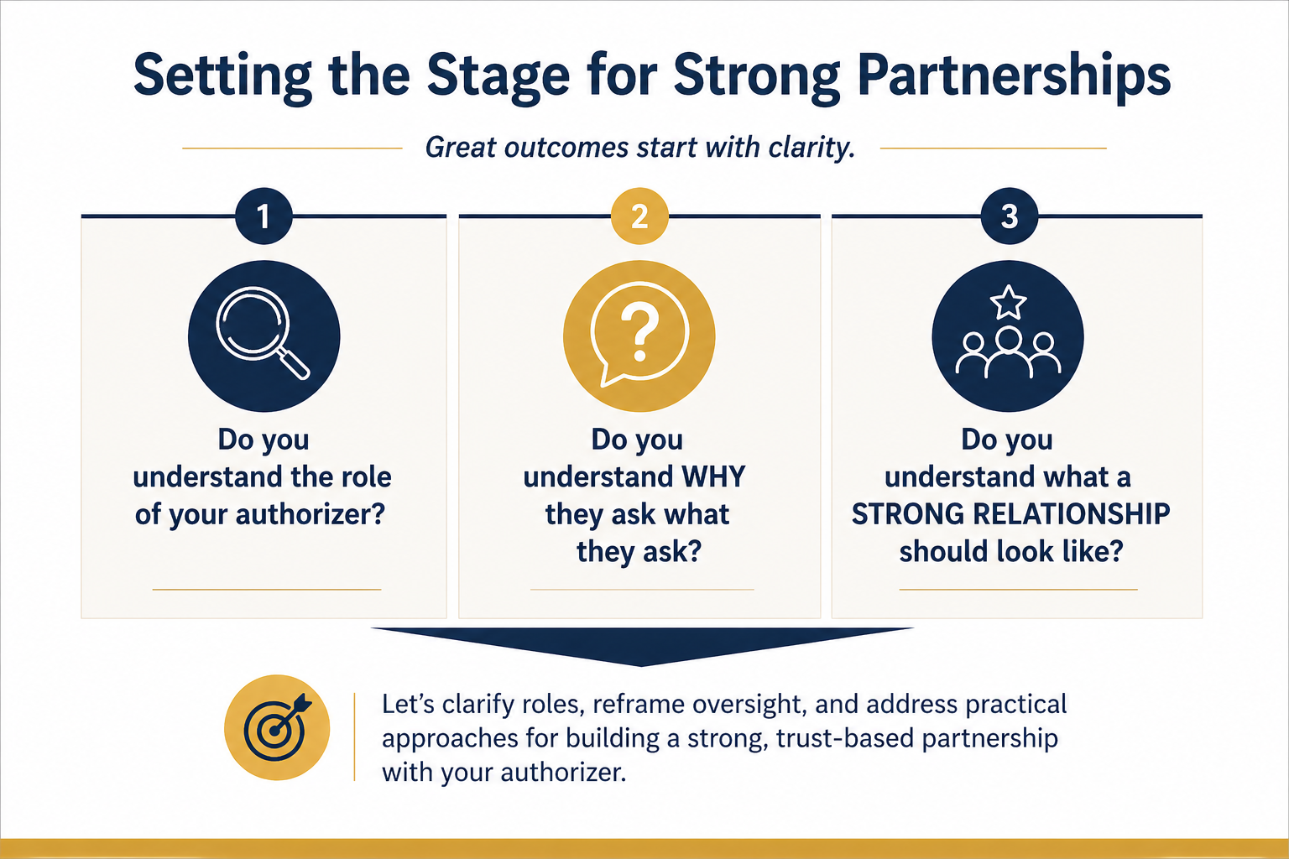
Setting the Stage for Strong Partnerships
Notes:
Let’s start by setting the stage. I want to ground us in three simple – but very important – questions:
Do you understand the role of your authorizer?
Do you understand WHY they ask what they ask?
And do you understand what a strong relationship should actually look like?
Because here is what I have seen over and over again . . . Tension between boards and authorizers is rarely about disagreement.
It’s usually about MISUNDERSATNDING . . . Misunderstanding of roles; misunderstanding of expectations; and often, misunderstanding of intent.
So tonight, our goal is to bring clarity to all three of these areas – so that oversight feels less like pressure and more like partnership.

Slide 3
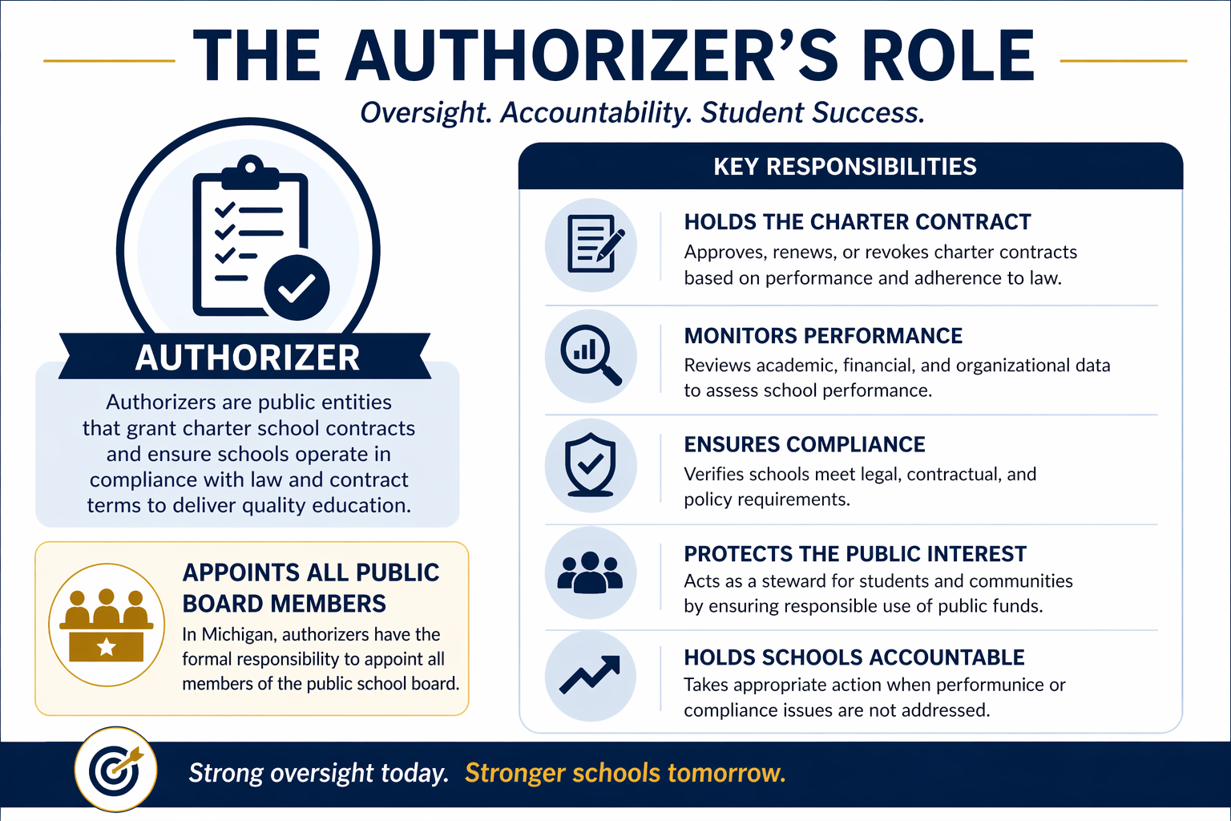
The Authorizer Role
Notes:
Let’s begin with the role of the authorizer.
At its core, the authorizer exists to do three things:
Ensure the school is meeting its contractual obligations; monitor performance and compliance; and, ultimately, protect student and public interest. The enabling legislation states “the oversight must be sufficient to ensure that the board of directors is in compliance with the terms of the contract and with applicable law.” (Act 451 of 1976 – Revised School Code – Part 6A; Section 380.57(d)
Now, that can sometimes feel like scrutiny.

Slide 4
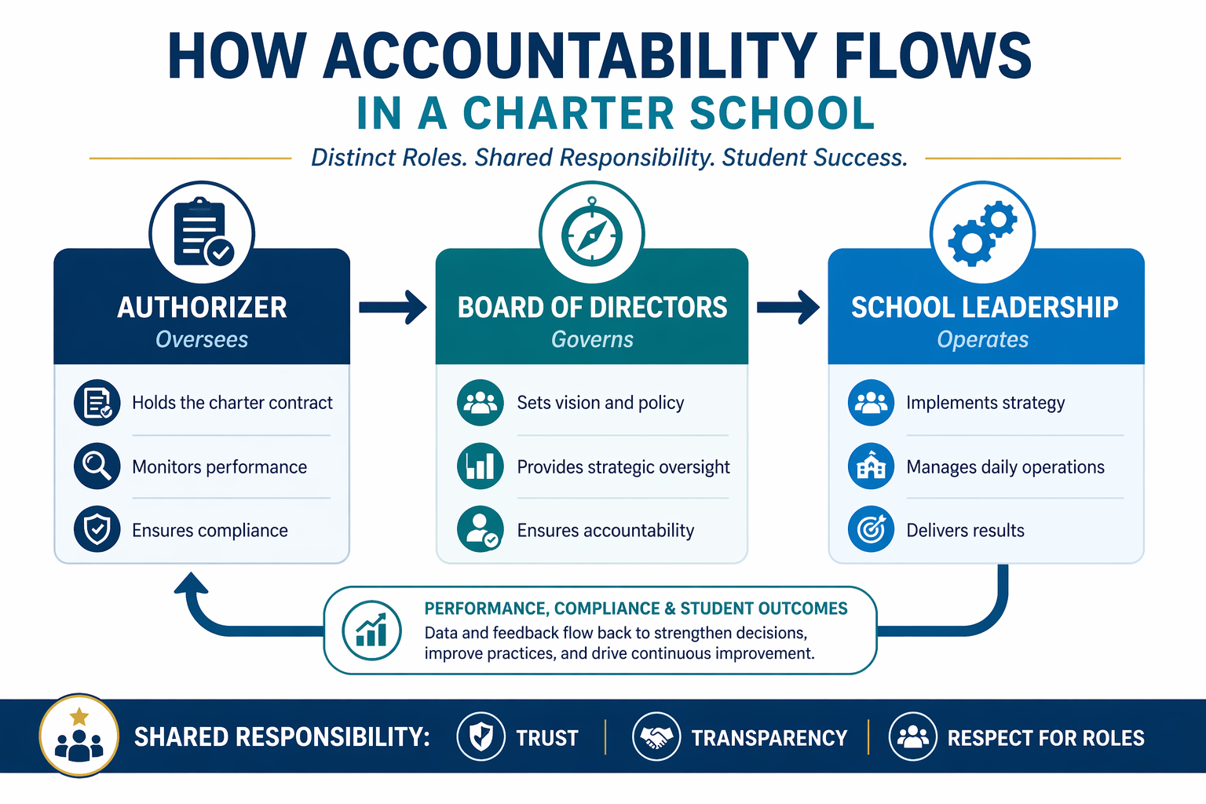
ACCOUNTABILITY
Notes:
Let me walk you through this model, because it captures something critically important in charter school governance – how accountability actually flows across the system.
At the highest level, this diagram shows three distinct roles: The authorizer, the board and the school leadership or operator; each has a different function, but they are all connected through a shared accountability loop.
On the left, we begin with the authorizer, whose role is to OVERSEE – the authorizer holds the charter contract, monitors performance and ensures compliance – so, the authorizer is not running the school – it is ensuring that the promises made in the charter are actually being fulfilled.
Next, accountability flows to the board of directors, which governs. The board sets the vision and policy, provides strategic oversight and ensures accountability for results. This is a critical BRIDGE role. The board translates the expectations of the authorizer into a clear direction for the school – and then holds leadership accountable for delivering on that direction.
From there, accountability flows to school leadership, which operates the school day-to-day.
Leadership implements strategy, manages daily operations and delivers results. This is where execution happens. But importantly – leadership is not operating in isolation. They are accountable to the board for performance.
Now, this is where the model becomes especially important – at the bottom, you will see a feedback loop: performance, compliance and student outcomes flow back through the system. That data informs board decisions, drives leadership adjustments and, ultimately, feeds back to the authorizer.
This creates a continuous improvement cycle, not a one-way chain of command.
And across the entire system there is a shared responsibility – this is key.
That responsibility is built on trust, transparency and a respect for roles. Without those three elements, this flow breaks down: boards may overstep into operations, authorizers may become overly directive; and leadership may lose clarity on accountability. But when those elements are strong, the system works exactly as designed.
So the takeway is this: This is not just a structure – it is a discipline of roles and relationships. The authorizer holds the board accountable; the board holds leadership accountable; leadership delivers results; and outcomes drive better decisions at every level – all with one shared goal: student success.

Slide 5
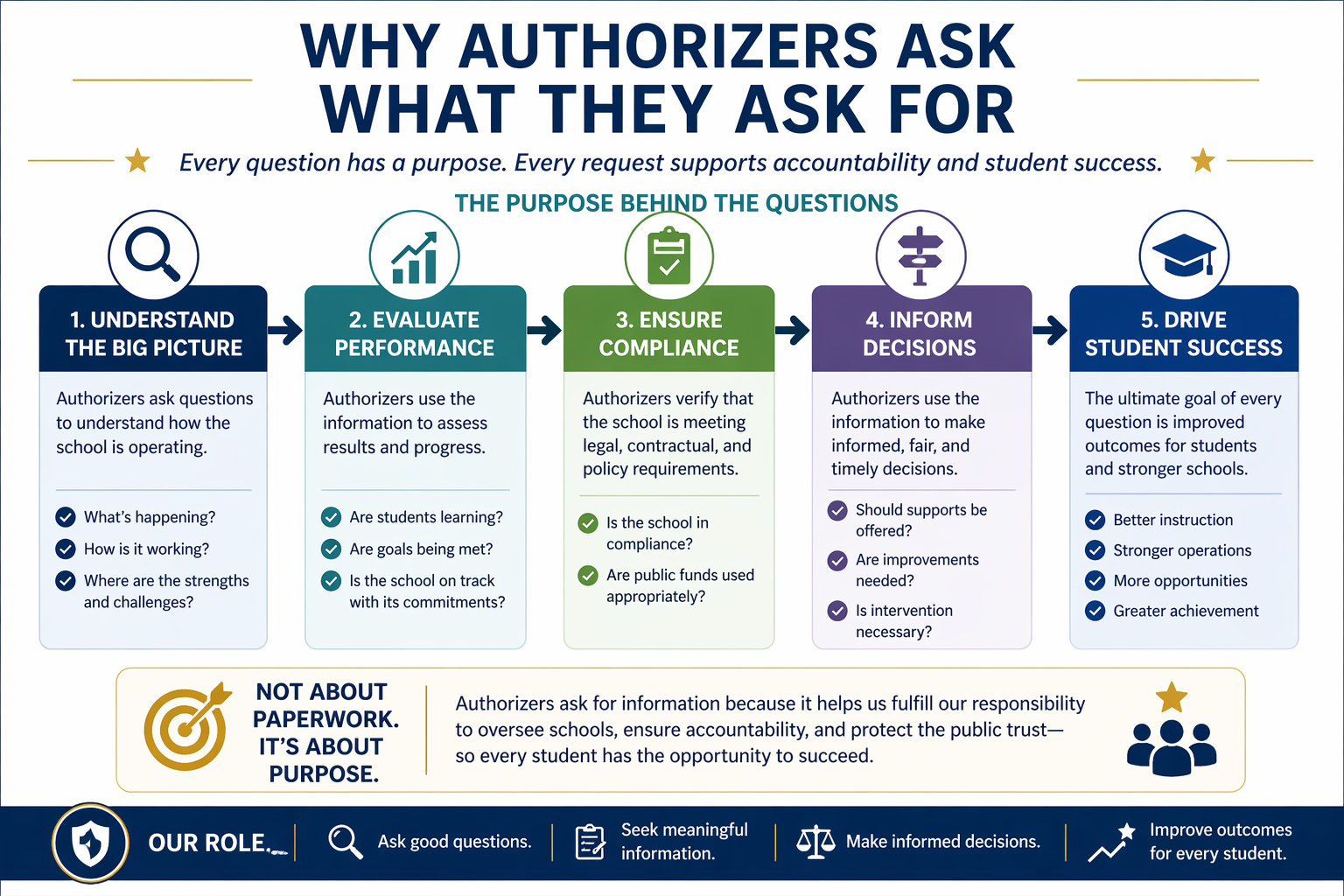
UNDERSTANDING THE WHY
Notes:
This is one of the most important shifts we can make. When authorizers ask for information – academic data, financials, compliance reports – it can sometimes feel repetitive . . . Or even excessive.
But those requests are not random. They are tied directly to four core responsibilities: monitoring performance, ensuring financial stability, confirming legal and contractual compliance; and assessing organizational capacity. And, ultimately, all of that connects to one thing: protecting students and ensuring school success. So when boards begin to understand the why behind the ask, the dynamic shifts FROM: why are they asking for this again TO: How does this help us demonstrate our effectiveness?

Slide 6
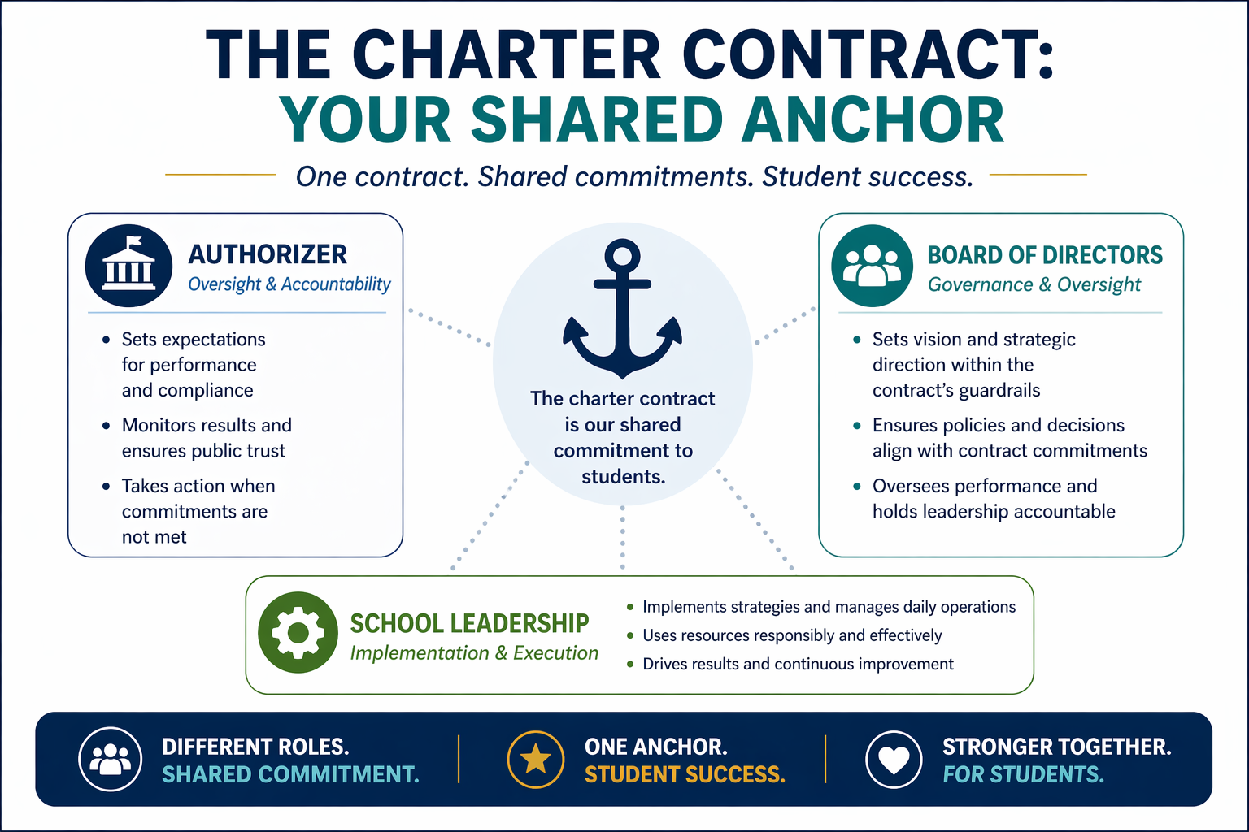
THE CHARTER CONTRACT
Your Shared Anchor
Notes:
This is where your charter contract becomes essential. The contract is not just a document you signed at authorization. It is your SHARED ANCHOR with your authorizer. It defines: expectations, performance standards; and accountability measures.
So when questions arise – or when requests are made – the contract is the reference point. It grounds the relationship in clarity. And it helps ensure that both the board and the authorizer are aligned around the same expectations.

Slide 7
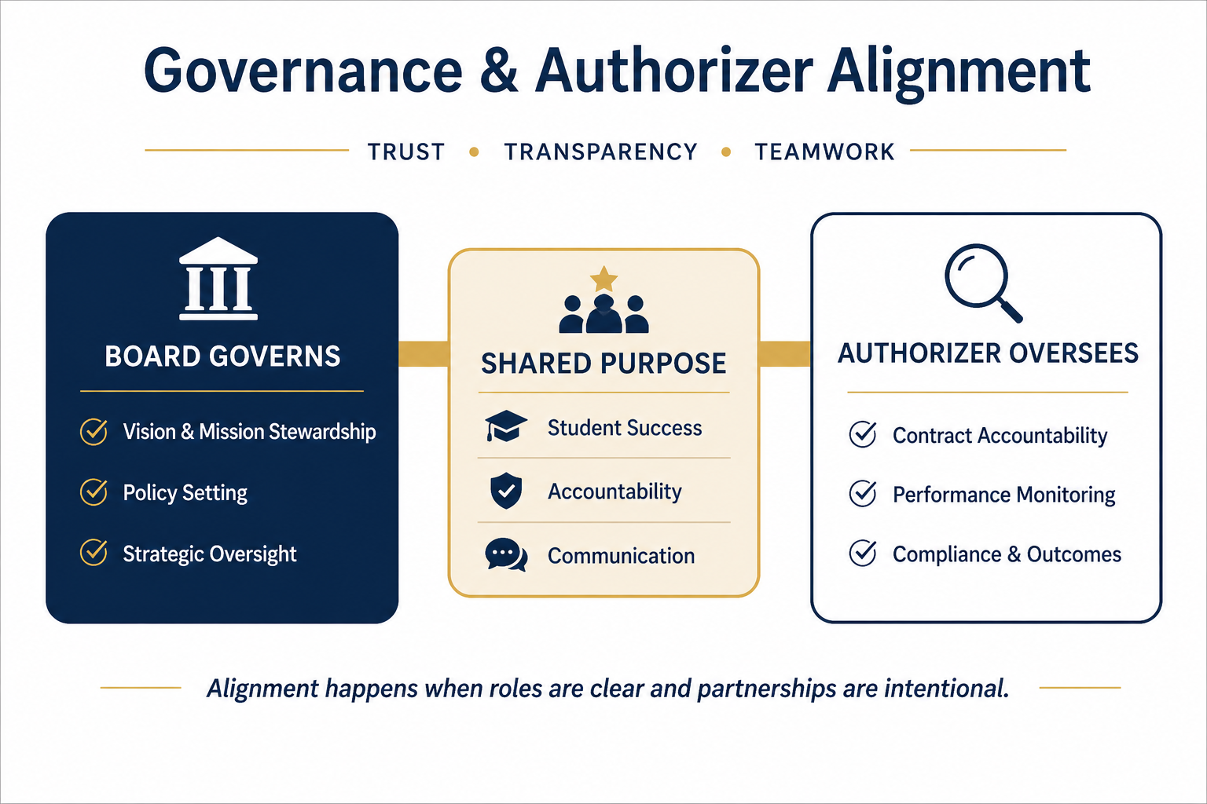
GOVERNANCE AND AUTHORIZER ALIGNMENT
Notes:
So what does strong board-authorizer partnership actually look like? It looks like alignment – not tension. It looks like clear communication, early transparency – especially when challenges arise and mutual respect for roles.
Trust is not built in big moments; it is built in consistent ones.
And the strongest relationships feel less like compliance . . . And more like shared accountability for results.
That’s the shift – that’s the goal.

Slide 8

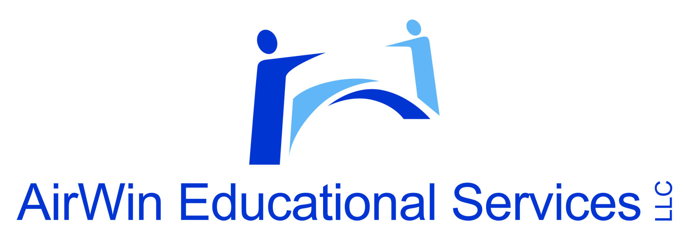
THANK YOU!
4521 Henry Drive
Beaverton, MI 48612
989.239.7555
ANGELA@AIRWINLLC.COM
Notes:
As you leave tonight, I encourage you to reflect on those three questions we started with:
Do we truly understand our authorizer’s role?
Do we understand the WHY behind their expectations?
And are we intentionally building a strong, aligned relationship?
Because when that relationship is strong, everything else becomes more effective.

